Slide 1
Beyond Recycling How we want to move Wales to a circular economy
Consultation Document Guide 2019-2020
This is a chance to give Welsh Government your views
Mae’r ddogfen yma hefyd ar gael yn Gymraeg.
This document is also available in Welsh.
Notes:
This short presentation and accompanying notes are designed to help you respond to the consultation and may be useful for use in discussion by groups, in schools and in communities. The full consultation document and other helpful resources can be found online. We are keen to improve these and if you have any feedback, please email us at: beyondrecycling@gov.wales
The text below is intended to help people using the presentation by giving information about each slide. The consultation closes on 3 April 2020.
Slide 1 – Cover slide
The Welsh Government has produced a consultation called Beyond Recycling and are asking citizens and stakeholders what they think.
This presentation explains the background to the strategy and what it will achieve. This is a draft strategy and your views will help shape what is the final version and the actions to achieve it. This is a chance to give the Welsh Government your views and suggest ideas and activities.
There are a number of ways to respond, both individually or as a group. This can be via the online questions, by email or post to the questions in this presentation.
There is also an easy read version of the strategy document available.

Slide 2
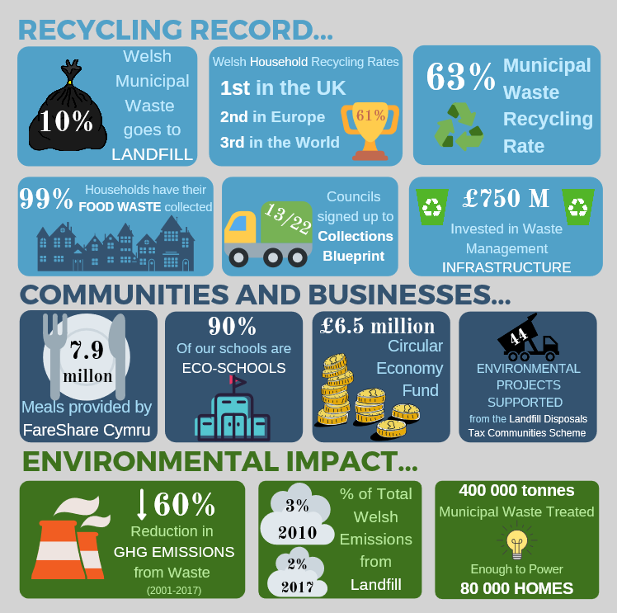
Wales is leading the World when it comes to waste
Notes:
27/03/2020
2
Slide 2 - Wales is leading the World when it comes to waste
Wales has improved recycling in a number of ways and is now a global leader.
Since devolution there has been a significant change in the recycling of household waste. In 1999 Wales recycled 5% of this, in 2018 we recycled 60% of our public waste. This success has been down to the people of Wales all doing our bit, for example, by recycling at home.
Other recycling records in Wales from the last 20 years are shown in the infographic.
Recycling has become part of our culture. It’s what we do.
This strategy aims to continue and to build on these successes. In particular, we need to look ‘beyond recycling’ and take steps towards less waste, more recycling and more local use and re-use of materials.

Slide 3
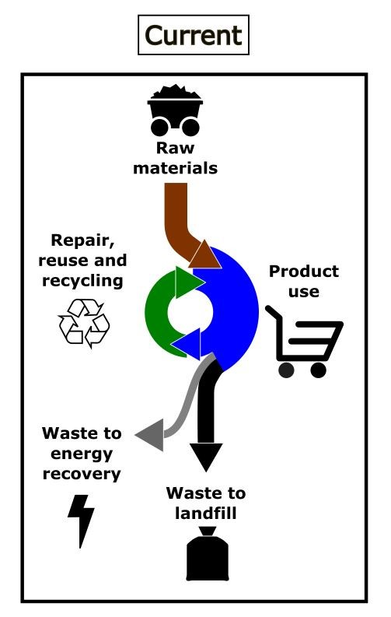
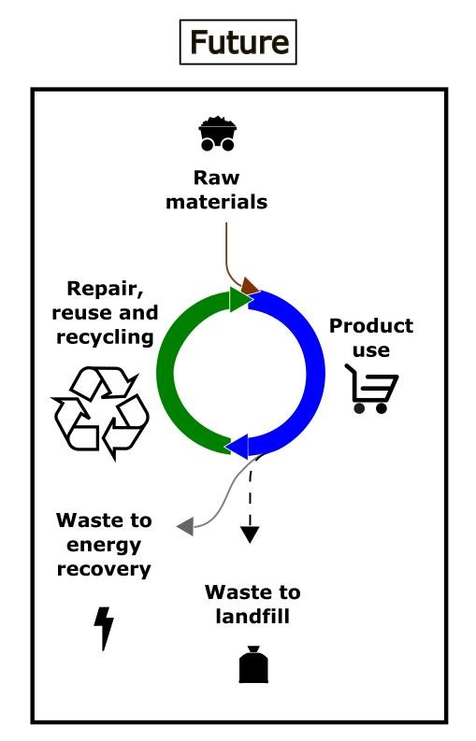
The next stage – where we want to be
Our aim is to move to a circular economy in Wales. Where waste is avoided and the things we use are kept in use as long as possible.
This is an important part of the action needed on climate change. It also brings many new economic opportunities as part of the move to a low carbon economy.
Notes:
27/03/2020
3
Slide 3 - The next stage – where we want to be
The consultation document is about Wales moving towards a more circular economy. The term circular economy in this document has a simple meaning. It means keeping materials in use as long as possible and avoiding waste.
As a country we need to reduce the overall amount of materials that we use (such as wood, glass, plastic, and metal).
The first infographic shows the way we currently use materials. The thickness of the lines relates to how much we use. There isn’t an endless supply of materials; we’re using too much too quickly and this isn’t sustainable. It puts the Welsh economy at risk if the materials we use become rarer and cost more. It also causes negative environmental effects. We are extracting too many raw materials, sending too much waste to landfill and this also produces too high a level of carbon emissions. Materials from outside Wales may also have a large environmental and human cost.
We want to move to a more sustainable, more circular economy where we are using less materials and creating a lot less waste. The second infographic shows how this would look. This involves encouraging repair, re-use and recycling. The material we re-use becomes the new products so we need to send very little to landfill and use much less raw materials.
Changing to repairing more, re-using more and recycling more will mean there are more jobs doing these activities. This is an example of it can positively benefit the economy while using less resources and producing less waste.

Slide 4
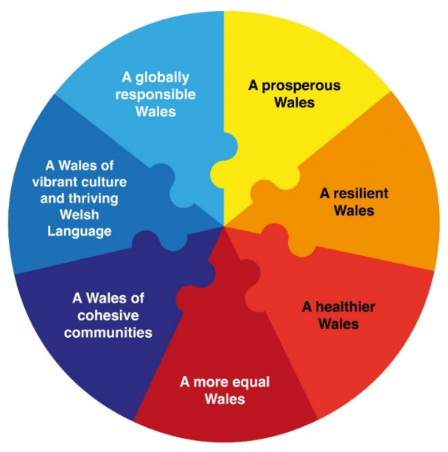
Connecting this strategy with other plans
Notes:
27/03/2020
4
Slide 4 - Connecting this strategy with other plans
Earlier this year the Welsh Government declared a Climate Emergency. Everyone has to act now to stop damaging changes to our climate, including the Welsh Government and its strategies.
Making products (such as clothes and food) that we use every day creates almost half of total global carbon emissions. Man made carbon emissions are causing the climate emergency.
Inaction is not an option. We need to take action and address this challenge directly, which is the key reason why the Welsh Government is producing this strategy.
For the Strategy to have impact, it needs to complement with other important work. This includes the Low Carbon Delivery Plan which is looking at how we respond directly to the climate emergency.
The Welsh Government’s Economic Action Plan aims to improve resource efficiency, improve economic opportunities across Wales and reduce carbon emissions. The plan includes important opportunities that can come from changing the way we use materials.
The strategy also delivers against the aims of the Well-being of Future Generations Act – and that the aims are integrated into the strategy with the goals shown in the circular diagram on the slide.
In this way, the Beyond Recycling strategy is designed to help make Wales more prosperous and low carbon emissions support more sustainable use of our natural resources.

Slide 5
The priorities that will guide our work
Fairness
Using only our fair share of resources by 2050
Greener
Meeting our low carbon aims and reducing our impact on nature
Prosperity
The aim to be a zero waste, circular economy nation by 2050
Notes:
27/03/2020
5
Slide 5 – The priorities that will guide our work
The Welsh Government wants to create a fairer, greener and more prosperous Wales and the strategy has this aim at its core.
For the Beyond Recycling strategy, the “Fairer” means only using a sustainable, fair share of resources and ensuring that waste management services reach a minimum standard no matter where they are in Wales. Everyone should be able to access options that allow them to repair, re-use and recycle more of their items.
“Greener” means taking the important steps to reduce carbon emissions and to minimise other negative environmental impacts. This includes attempting to minimise the transport of products and waste, and not moving our waste problems to other countries.
“More prosperous” means making the most of the economic opportunities that can come from a more circular economy. It means ensuring businesses are supported to change where needed and that potential job opportunities are made the most of in Wales.

Slide 6
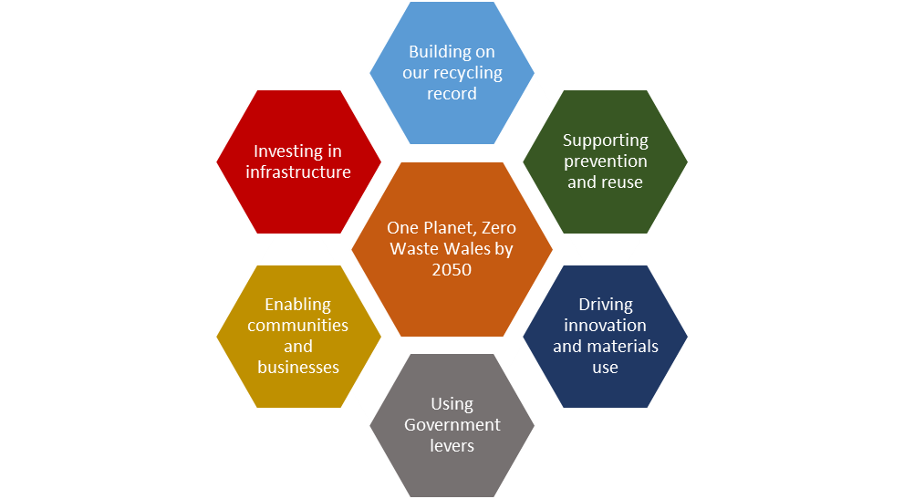
How we will get there: The Six Core Themes
Notes:
27/03/2020
6
Slide 6 – How we will get there: The Six Core Themes
To achieve the aims mentioned in this presentation and the strategy, the Welsh Government has developed six core, evidence based themes.
The Welsh Government would now like your feedback on these themes.
The themes are shown in the diagram. More detail on the themes can be found in the strategy consultation document.
The themes are;
Improving our recycling record
Supporting prevention and re-use
Driving innovation and material use
Using Government Levers
Supporting communities and businesses
Investing in infrastructure
Do you think these are these the right themes to focus on to achieve the aims of the strategy? Why? If not, what else would you propose to help achieve the strategy aims?

Slide 7
How we will get there: Eight Headline Actions
Become the world leader in recycling
Phase out single use plastic
Invest in clean technology for materials collection
Make efficient use of our food
Prioritise the purchasing of wood, remanufactured and recycled content
Enable communities to take collective action
Create the conditions for business to seize the opportunities
Take full responsibility for our waste
Notes:
Slide 7 – How we will get there: Eight Headline Actions
Each theme has key further actions which the Welsh Government proposes. The actions are designed to effect change and be focused on achieving the strategy aims of less waste, more recycling and re-use and a greener, fairer and more prosperous Wales.
Are these the right actions needed to achieve the aims of the strategy? Why? If not, what other actions would you propose? What can Welsh Government do most effectively?

Slide 8
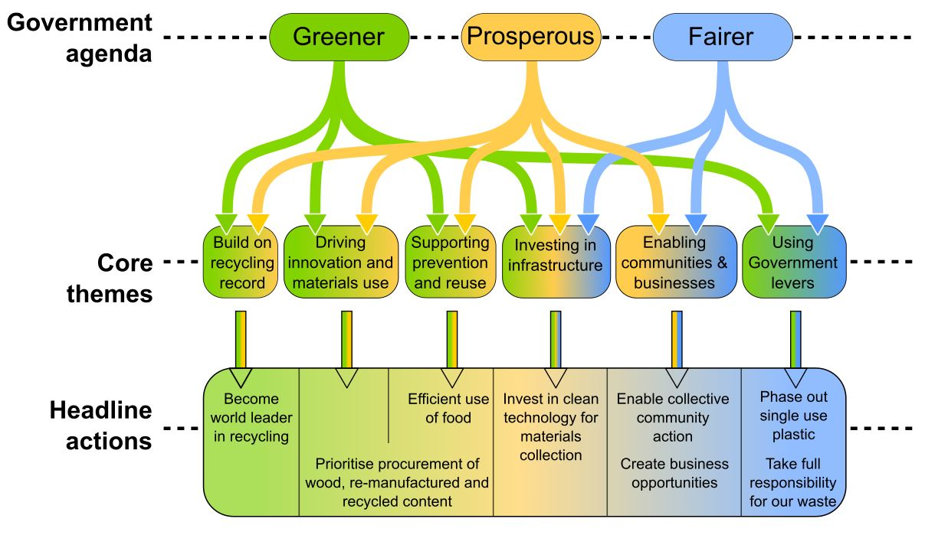
How it all fits together
Notes:
27/03/2020
8
Slide 8 - How it all fits together
The agenda, themes and actions are designed to all fit together to achieve maximum impact.
The strategy is based on the overall Welsh Government agenda to create a Greener, Fairer and more Prosperous Wales. The themes follow on to actions that can achieve the overall goals. This diagram shows how they each draw on different sections.
This a short presentation on the overall background, aims and proposed actions of the strategy. More specific detail can be found in the ‘Beyond recycling’ consultation document.

Slide 9
Welsh Government want to hear your views
Your views will shape the actions taken over the next decade and will continue the trajectory towards zero waste in Wales.
There are a number of questions in the consultation, and they can be responded to online or by email / post.
Broadly we want to know;
Are we looking at the right themes and actions?
How would you suggest we achieve the strategy aims, taking full responsibility for our waste, encouraging businesses to make reusable items and considering the effects on the natural world?
Notes:
27/03/2020
9
Slide 9 – Welsh Government want to hear your views
The Welsh Government wants to hear your views. Your input will shape the actions they decide to take.
There are specific questions within the consultation document. These are the same as in the online response form.
In general, the Welsh Government want to hear your feedback on the following questions in particular:
Are the six themes and eight actions the right areas to focus on?
Is there anything missing from the strategy?
What opportunities are there for the Welsh Government to work with you?

Slide 10
How to Respond
Consultation period: 19th December 2019- 24th April 2020
Please respond using:
The online questionnaire: https://gov.wales/circular-economy-strategy
Email here: BeyondRecycling@gov.wales
Address : Resource Efficiency and Circular Economy Division,
Welsh Government,
Cathays Park,
Cardiff.
CF10 3NQ
The link to the full document can be found here:
https://gov.wales/circular-economy-strategy
Notes:
27/03/2020
10
Slide 10 – How to respond and send comments to Welsh Government.
If you want to get involved and give your feedback, you can submit your responses to the questions using the online questionnaire.
You can also reply with your question responses or comments, by post or by email to the Welsh Government’s dedicated consultation mailbox.
If you feel there are no changes you would suggest, still please respond to the consultation. For example, to improve the strategy it is important to know what people support within it.
There will be lots of opportunities to engage though the consultation period to get your views across. For example through webinars, online tools, and social media as well.
Your responses will make a difference, so please get involved.

