Slide 1
Tertiary Education Reform in Wales

Slide 2
Background
‘Hazelkorn Review’ (2016)
“Post-compulsory institutions have played an important role in Wales’ history but a step-change is required”
“Absence of an overall vision for the post-compulsory system aligned to the social, cultural and economic needs of Wales, regionally and nationally, now and in the future”
Government response (2017)
“The various sectors and providers are regulated and funded in different ways...”
“Unhelpful competition between education and training providers, duplication or gaps in provision and confusion for learners…”
“Boundaries between higher education and further education, which once were clear, are now breaking down…”
Notes:
The Welsh Government commissioned Professor Ellen Hazelkorn to undertake a review of the governance, regulation and oversight of post-compulsory education in Wales. The report, ‘Towards 2030: A framework for building a world-class post-compulsory education system for Wales’ was published in 2016 and contained two primary recommendations:
To develop an overarching vision for the PCET sector
To establish a new arm’s-length body responsible for the oversight, strategic direction and leadership of the sector.
The recommendations were accepted by the Welsh Government in January 2017

Slide 3
The journey so far
Technical consultation
2018
Legislation development
2019
Draft Bill consultation
Elections and govt returned
May 2021
Pandemic
Bill in Senedd
Nov 2021
Hazelkorn Review
2016
2020
Royal Assent
Sept 2022
CTER operational
August 2024
Initial consultation
2017
Notes:
This slide details the various stages that have taken us to where we are now.
Following the Hazelkorn review, a White Paper was issued in 2017: Public Good and a Prosperous Wales.
This was followed by a technical consultation, Public Good and a Prosperous Wales: the next steps, which closed on 17 July 2018.
On the 14 July 2020, The Welsh Government published the Tertiary Education and Research (Wales) Bill in draft for consultation. The consultation closed on 4 December 2020 and summary of responses were published on 25 February 2021.
The Act was given Royal Assent in September 2022 and the first Commencement Order in respect of the Act was made in December 2022, the first of a series of Commencements that will implement the Act and establish the Commission.

Slide 4
What the Act does:
The Tertiary Education and Research (Wales) Act will:
Establish the Commission for Tertiary Education and Research (CTER), a new Welsh Government sponsored body.
Dissolve the Higher Education Funding Council for Wales (HEFCW).
CTER will be responsible for strategy, funding, and oversight of:
Further education, including colleges and school sixth-forms.
Higher education, including research and innovation.
Adult education and adult community learning.
Apprenticeships and training.
The Welsh tertiary sector
Notes:
The Tertiary Education and Research (Wales) Act 2022 sets out a new vision for the future of post-16 education and creates a new national steward for post-16 education to expand lifelong learning, focus on learner welfare, and supports our colleges and universities.
The Act provides for the establishment of a new Commission for Tertiary Education and Research which will be the regulatory body responsible for the funding, oversight and regulation of tertiary education and research in Wales and dissolves Higher Education Funding Council for Wales (HEFCW).
The establishment of the Commission brings together responsibility for overseeing Wales’s higher and further education, school sixth forms, apprenticeships, and research and innovation in one place.
Wales will be only UK nation to have its tertiary education sector managed as a single system.

Slide 5
Meeting the Challenges of the Future
A changing UK and global context
Rebuild from COVID-19 with a greener economy
Ageing population
Integrate digital technology into educational delivery
Challenges of an unequal economy
Notes:
A changing UK and global context requires new thinking and a re-invigorated approach to our PCET sector’s place within the UK and the wider-world. We will continue to support our PCET sector to build resilience and preparedness throughout the EU transition period and beyond. Strengthening and deepening international education links, with and beyond the EU, will benefit individuals, providers, communities and industry. As well as looking outward, we must also look to our PCET sector’s connections with their local communities.
To rebuild from COVID-19 with a greener economy, our PCET sector will be integral to preparing people for new jobs utilising innovative new technologies and deliver research and innovation in health, clean energy, digital transformation, social sciences and the humanities.
Ageing population - As the economy and labour market continue to change, and the population of Wales is set to grow older, lifelong learning has never been more important. Our PCET system must enable people of all ages to enter and re-enter learning at all skill levels. It is essential that people are equipped with the transferable skills and knowledge to thrive in a changing labour market throughout their lives.
We need to seamlessly integrate digital technology into educational delivery and to innovate to find inclusive, accessible and bilingual approaches to enhance learners’ experiences through technology. Education and training providers need to equip learners and staff with the higher level digital skills, capabilities and confidence they will need to succeed in everyday life and in work in a digital world.
Wales continues to face the challenges of an unequal economy, a need for better economic opportunities outside of growing urban areas, and a lack of skills in communities hurt by deindustrialisation. . A more equal PCET sector is essential to breaking down the inequalities we see in society in particular inequalities of class, geography, race, gender and disability.

Slide 6
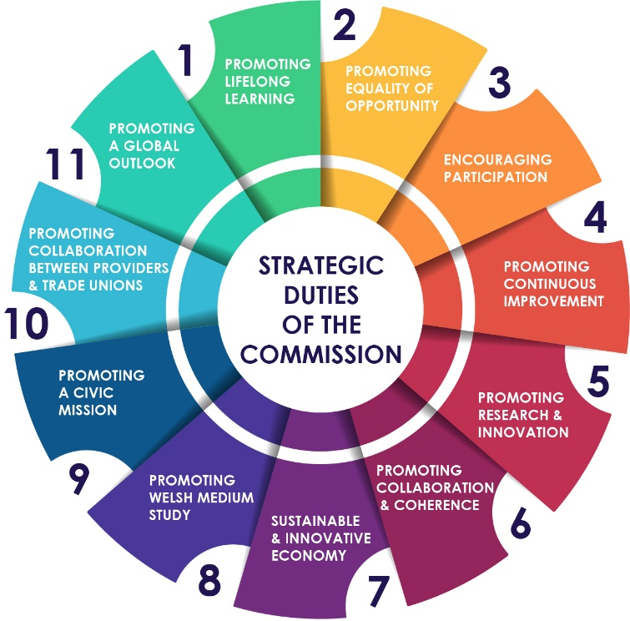
The Strategic Duties of the Commission
The Act sets out eleven strategic duties under which the Commission is required to exercise its functions. These legal duties are the long-term strategic purposes for the system, and reflect the Government’s vision.
Notes:
The Strategic Duties, in conjunction with the Welsh Ministers’ statement of priorities, will outline the core matters the Commission must consider and take in account when exercising its functions.
The statement of priorities is intended to set the long-term overarching policy direction for tertiary education and research and innovation in Wales.
Following the publication of the statement of priorities, the Commission will produce a strategic plan, following consultation with stakeholders, which will set out how it will deliver on these priorities and discharge its strategic duties. The Commission must take all reasonable steps to implement the strategic plan.

Slide 7
What will success look like?
Expand lifelong learning opportunities across a wide range of modes, levels, and types of tertiary education.
Improve equality of opportunity in tertiary education, ensuring greater access, continuation, and success for learners from under-represented and disadvantaged groups.
Grow overall participation in tertiary education, reducing gaps in qualification levels between Wales and elsewhere in the UK.
Improve the quality of tertiary education and learner experience in the sector so that learners have the knowledge, experiences and skills needed to thrive as engaged, employable and educated citizens.
Ensure greater collaboration between tertiary education providers, allowing different types of providers to focus on their diverse strengths and to collaborate for the benefit of learners and wider society.
Align tertiary education, research, and skills development with the economic, social, and cultural needs of local communities and Wales a whole.
Grow tertiary education provision through the medium of Welsh.
Notes:
These are some of Welsh Government’s longer-term policy objectives resulting from passage of the Act – also to:
Promote global opportunities and partnerships which benefit learners, academics, providers, communities and the nation as a whole.
Increase the undertaking of research in Wales, including through the medium of Welsh, and further develop a competitive and collaborative research sector.
Support providers as civically engaged actors who promote community and national economic, social, environmental or cultural well-being.
The overriding message here is that we want to build on the excellence that already exists and make it more available and accessible to a wider range of learners.

Slide 8
Top 6 innovations
Bringing post-16 education together - Wales will be only UK nation to have sixth-forms, colleges, universities, apprenticeships, and adult education managed as a single system.
A clear purpose for post-16 education - Sets out in law our values and ambitions for post-16 education in Wales.
A commitment to lifelong learning - The Act creates a new duty to fund proper facilities for further education for adults.
More Welsh medium education - The Act creates new duties to promote bilingual and Welsh-medium tertiary education provision.
Making sure learners and students are heard - Registration and funding conditions on providers to ensure students’ interests are represented and their wellbeing promoted and protected.
Welsh apprenticeships - New powers will enable Welsh apprenticeships to be aligned with the future needs of the Welsh economy.

Slide 9
Principles for change linked to the Well-being
of Future Generations (Wales) Act 2015
A RESILIENT AND GLOBALLY RESPONSIBLE WALES
Tertiary education and research (TER) providers which maximise public value and are economically and environmentally sustainable.
A WALES OF COHESIVE COMMUNITIES AND A HEALTHIER WALES
TER providers which are diverse and cohesive communities of learning, valued by the communities they serve.
A MORE EQUAL WALES
A system that provides lifelong learning and development for all, supports people to make informed choices about their future, and is accessible to all.
A PROSPEROUS WALES
A system that strengthens Wales’ economic well-being, collaborates with businesses, provides the skills employers and workers need, and grows our research and innovation base.
A WALES OF VIBRANT CULTURE AND WELSH LANGUAGE
An accessible and effective TER system that supports learning, assessment and progression through the medium of Welsh and is central to Welsh cultural life.
Notes:
In its Well-Being of Future Generations Act, the Welsh government has identified its seven wellbeing goals. This is about ensuring that future generations have at least the same quality of life as we do now.
The Act makes it clear that public bodies in Wales are under a duty to monitor, manage and report their performance to deliver the well-being goals.
Our vision, informed by the Well-being of Future Generations goals, is set out in this statement as a new, clear direction for the TER sector, and successful delivery of this vision will only be possible via genuine partnership and collaboration across the sector.
The Ways of Working
Public bodies listed in the Act must also demonstrate in their decision making that they are taking into account the impact that they could have on people living their lives in Wales in the future as well as in the present.
The five ways of working are:
Thinking for the long-term
Prevention
Integration
Collaboration
Involvement

Slide 10
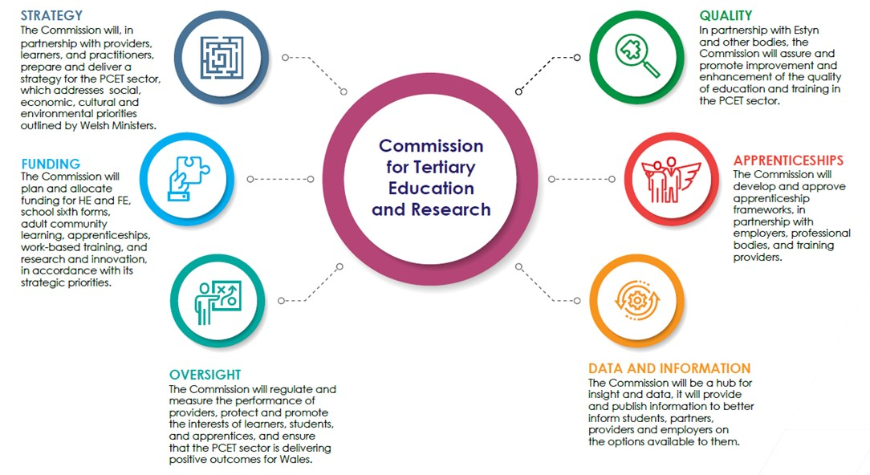
Responsibilities of the Commission
Notes:
This slide captures the responsibilities that the Commission will have.
These include strategy, funding, oversight, apprenticeships, data and information, as well as quality.
The picture is an attempt to show succinctly the scope of the Commission’s responsibilities.

Slide 11
The ambition for students, learners and apprentices
A joined-up national focus on the challenges facing students, learners and apprentices across the whole post- compulsory education sector.
More information provided on options and qualifications available whether in school, further education, apprenticeships, or higher education.
More opportunities to have your voice heard in the running of your university or college.
Better protections for student rights, including a new right to a complaints scheme in further education.

Slide 12
The ambition for further education colleges and schools with sixth-forms
A new approach to funding, with one organisation responsible for planning and funding post-16 education in schools and colleges.
A more coherent approach to improving quality, with a single quality framework overseen by the Commission and improved coordination between Estyn and QAA.
Improved collaboration and partnership between providers, working together in the interests of learners.
Longer-term strategic oversight and alignment with local, regional and national education and training needs.

Slide 13
The ambition for universities and other higher education providers
Clearer and more coherent regulation of providers which can adjust to the changing size and shape of the sector and the changing needs of Wales.
A more level playing field in regulation between ‘established’ full-time undergraduate providers and part-time, distance and postgraduate providers.
A more strategic approach to widening access and opportunity, with a longer-term focus on securing positive outcomes.
More opportunities for collaborating with external bodies in research and innovation funded by the Commission.
Grow the scale, breadth and depth of our research and innovation base, through increased engagement between our universities, colleges and the private, public, and third sectors.

Slide 14
The ambition for employers, training providers and adult learning providers
A new duty to fund adult education and a renewed strategic focus on lifelong learning and adult skills.
A new, clear definition of a Welsh apprenticeship, establishing a gold standard for Welsh apprenticeships as sought-after and valued pathways from education into employment.
More flexibility to develop new apprenticeship frameworks and to keep existing apprenticeships up-to-date to meet changing skills needs.
Close collaboration between the Commission, providers, and Regional Skills Partnerships to inform planning, funding and strategic planning.
A single organisation responsible to ensuring the Welsh economy has the skills it needs for businesses and communities to thrive.

Slide 15
Chair of the Board for CTER
Professor Dame Julie Lydon appointed in December 2022
Role involves:
Working with the CEO and Welsh Government Programme Board to ensure CTER is delivered on time and is fit for purpose for day one of operation
Leading the CTER board in setting the strategic direction for CTER and evaluate the development and delivery of the organisation’s business strategy, plans and performance objectives
Engaging in and supporting CTER’s stakeholder engagement activity, building relationships with sector leaders
Chairing the CTER Board, putting in place effective governance arrangements
Notes:
The Commission will have a Board and an Executive and will consist of a maximum of 17 members comprising a Chair, Deputy Chair, (who will be Chair of the Research and Innovation Committee (details on next slide)), the Chief Executive and up to 14 ‘ordinary’ members.
The Welsh Ministers will be responsible for appointing the Chair, Deputy Chair, and ordinary Board members and the first appointment of the Chief Executive. Subsequent appointments to the Chief Executive role will be made by the Commission, with the approval of the Welsh Ministers.
The Board will include a number of associate members, who will be non-voting members of the Commission, these members will include:
• at least two tertiary education workforce representatives, one to represent the academic workforce, and one to represent the non-academic workforce, both of whom will be appointed by Welsh Ministers;
• one Commission staff member; and
• at least one person appointed by Welsh Ministers to represent learners in tertiary education.

Slide 16
Chair of the Research and Innovation Committee (RIC) and Deputy Chair for the CTER Board
Professor David Sweeney appointed in December 2022
Role involves:
Chairing and facilitating RIC Committee meetings, putting in place effective governance arrangements
Leading the Committee in setting the strategic direction for the Commission’s Research & Innovation functions
Deputising for the Chair in facilitating CTER Board meetings
Supporting the Chair in leading the CTER board in setting the strategic direction for CTER
Engaging in and supporting RIC and CTER’s stakeholder engagement activity, building relationships with sector leaders
Notes:
The Commission will include three statutory committees: Research and Innovation Committee; the Quality Committee; and the Staff Member Appointment Committee.
The Research and Innovation Committee will oversee the Commission’s functions in respect of research and innovation and is intended to help ensure the Commission acts as a champion for Welsh research at the UK and global level.
The creation of the committee is intended to help ensure that the research and innovation system remains competitive and is sufficiently strategic and agile to deliver national capability that drives discovery and growth.
The Chair of the committee is also the Deputy Chair of the Commission. The remaining size and membership of the committee will be determined by the Commission.

Slide 17
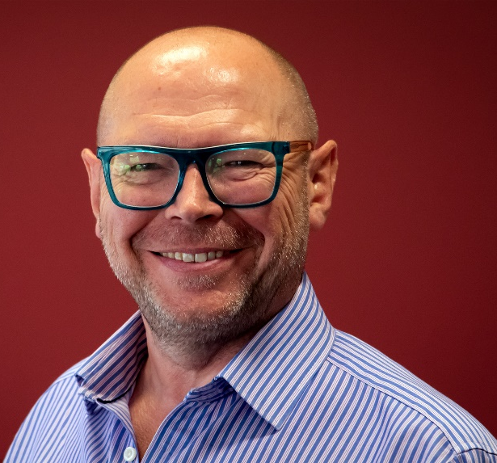
Chief Executive Officer
Simon Pirotte was formally appointed in June 2023 and took up post in September 2023
Role involves:
Providing strong and inspirational leadership, vision, and strategic direction to staff
Shaping the new organisation’s structure, operating systems, and its ways of working
Ensuring the new organisation performs its functions effectively
Principal adviser to the CTER Board, working with them to uphold CTER’s independence in considering the effectiveness of funding, delivery and monitoring methods.
Leading the sector to deliver world class innovative solutions to future challenges, placing learners at the heart of the system
Building on the strengths of our current education system to better meet the challenges and opportunities ahead.
Notes:
Simon was previously Principal and Chief Executive of Bridgend College and has worked in the education sector for over thirty years. This includes work in the Higher Education, Further Education and 11-18 Schools sectors in Wales, England and the USA.

Slide 18
Establishment Phase
The phase between the Commission’s establishment and its operational date will be pivotal for the Commission to start building its:
Capacity,
Culture and
Working relationships with a range of significant bodies across the sector

