Slide 1
Talk With Me
Speech, Language and Communication (SLC) training
for the Health Visitor Skill Mix workforce
Version 2 - 2024
Notes:
Estimate timings: 2 mins
Trainer to check IT equipment and clarity of white text prior to delivery.
Learners will need:
Pen
Red, blue and green coloured pen/pencil
4 x pages of paper
Trainer will need:
Doll
Brush
Teddy
Sponge/ Flannel
Case Scenarios (Slide 59)
Trainers: Please familiarise yourself with the HCWP Quality Assurance Framework: Healthy Child Wales (gov.wales) (WG, 2022) which is referred to throughout.
Time/ content: Feedback from HV and SLT indicates suggest that the session will take up to a day to deliver – certainly more than half a day. Once it has been piloted and refined we’ll add more info on logistics in terms of delivery.
There was a difference of opinion about whether additional videos would add to the content – again, we will pilot as it is and refine according to feedback.
Who should deliver the training: there was a consensus from HV colleagues that, at least initially, both expertise and capacity would mean that SLTs should either deliver or co-deliver the content. We are recommending a ‘best practice’ model of SLT services leading on the delivery and inviting HV colleagues to co-deliver the context. Capacity in both services is under pressure across Wales, and we are exploring alternative options such as embedding this content in pre-registration SCPHN training. Meanwhile, we will be seeking feedback from all those delivering (and receiving) the training on what works well and less well.

Slide 2
Timetable
Timetable for the day:
09:00am
10:30am ish
12:30pm ish
16:30pm ish
Notes:
EST: 10-15 mins depending on number of participants and length of pre-survey
Welcome:
Welcome the group
Introductions – name, role, location, best hopes for the day (record on a flip chart to review at the end of the day)
Housekeeping - fire alarms/escapes/facilities- toilets/ phones
Start and finish times/ break times (Format to be agreed locally i.e. Full day if face to face, 2x1/2 days if virtual)
Ask the participants to complete the pre-course evaluation (format of evaluation to be agreed locally i.e. paper/ smart survey/ ms forms)

Slide 3
Virtual
Delivery
**Hide if face to face
KEEP YOUR MIC ON MUTE
USE THE ‘HANDS UP’ FACILITY
USE THE CHAT BOX TO ASK QUESTIONS.
CAMERA ON
Notes:
EST: 1 min
Slide only needed if course is delivered virtually (if face to face, hide slide)
To facilitate the smooth running of the session, can all attendees please:
Keep your camera on
Keep your mic on mute unless you are speaking
Use the ‘hands up’ facility when you want to ask a question and turn it off afterwards
Or use the chat box to ask questions, and we will answer your questions during the session.
If we cannot answer your question, we will get back to you with a response post session

Slide 4
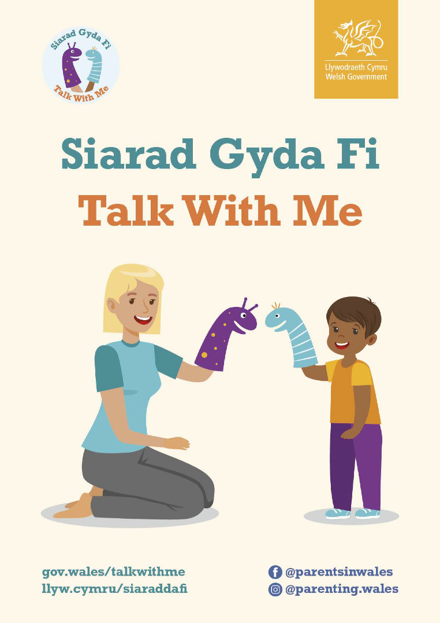
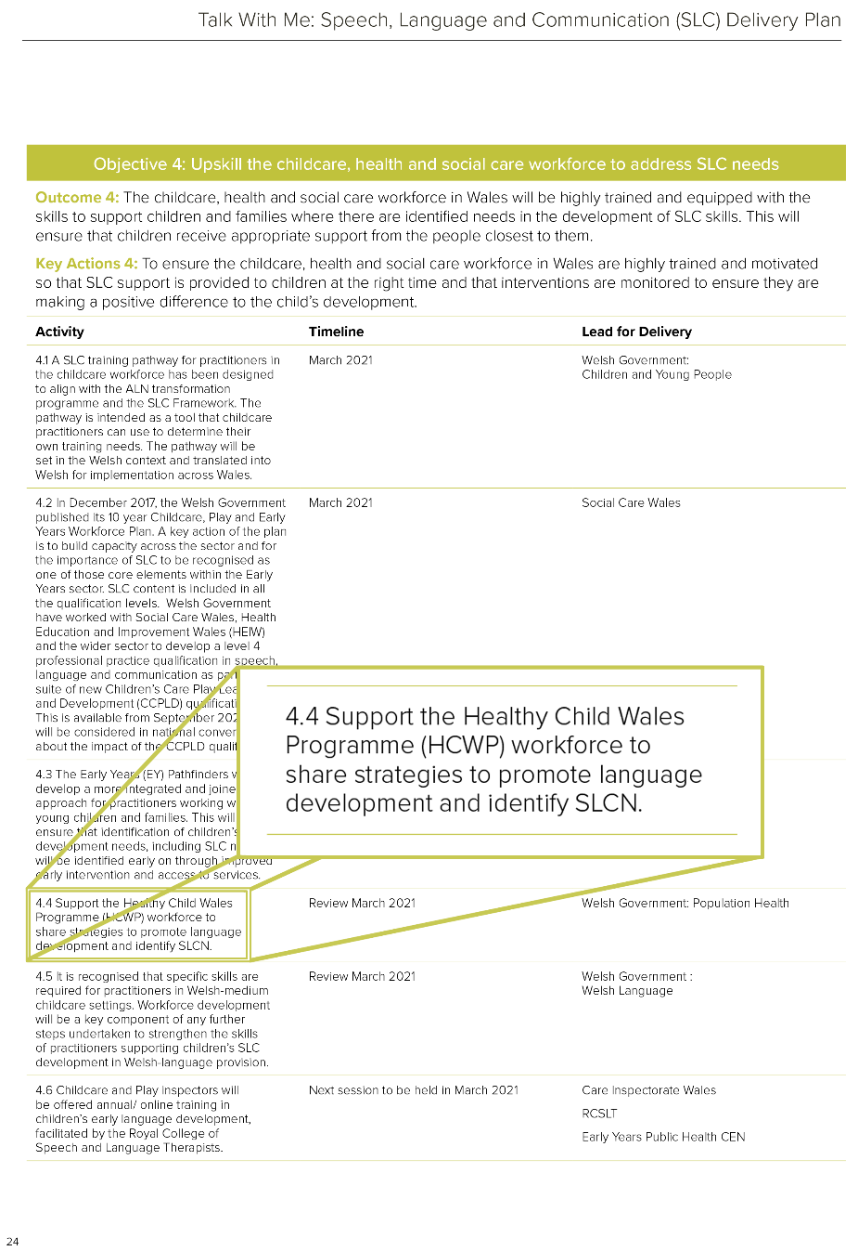
Talk With Me
Delivery Plan
Delivery Plan, Page 24
Notes:
EST: 5 mins
Talk with Me: Welsh Government’s SLC delivery plan, launched in November 2020. 5 objectives all with a focus on evidence-based SLC provision at universal, population and targeted levels
Objective 4 has a focus on Upskilling the childcare, health and social care workforce to address SLC needs with a specific action to support the Healthy Child Wales Programme workforce to promote language development and identify SLCN
This is SLC training for the Specialist Community Public Health Nursing (SCPHN) and skill mix team to support identification and early intervention as part of a progressive universal approach
In a national survey in England 96% of Health Visitors told PHE and institute for Health Visiting that HVs would like more training on SLC, Specifically HVs wanted more on the evidence to support their role and approaches to work effectively with families to promote early language acquisition.
NB HV workforce survey was not repeated in Wales as HV leads network felt the need for similar training in Wales was evident

Slide 5
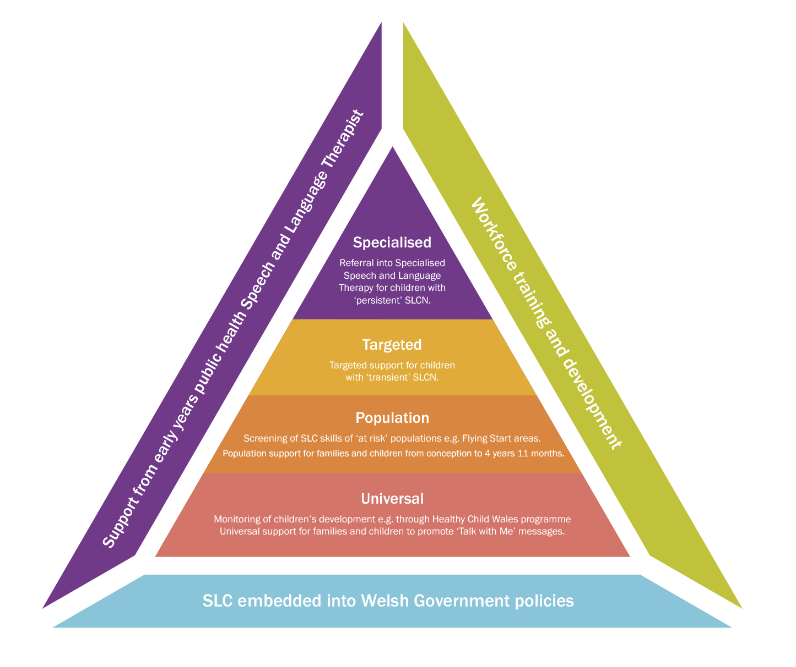
Talk With Me
Delivery Plan
Notes:
EST: 5 mins
Explain each level with local example (eg targeted – language group/ population – screening/ universal – TWM messages)
NB Text may not be readable when delivering virtually so go through each level in detail if online

Slide 6
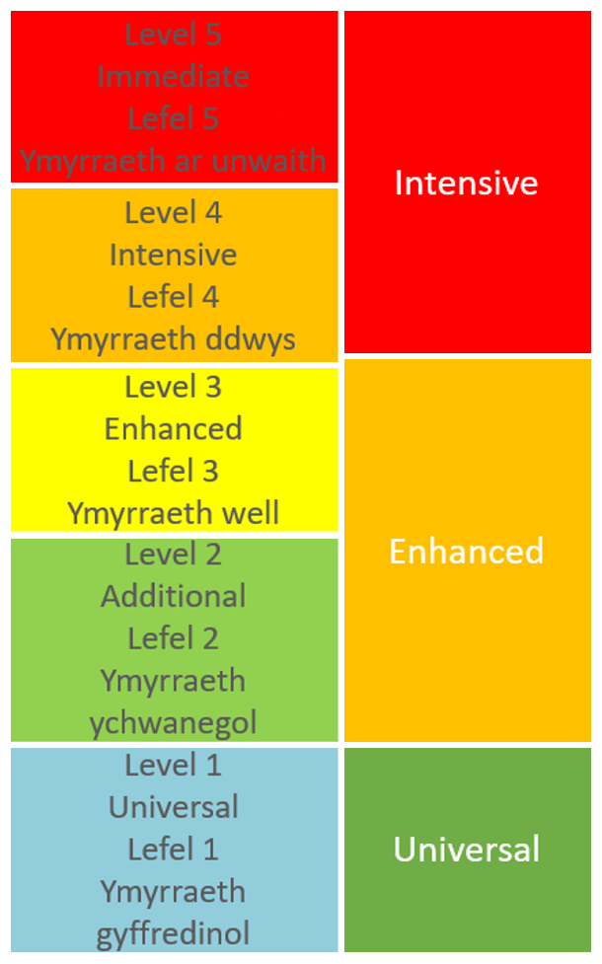
Welsh Levels of Care
Healthy Child
Wales
Programme
Intensive- referral to specialist services, intensive structured home visiting programmes Progressive universal approach to SLC support – provide intervention and assess response prior to referral to specialised SLT service
Enhanced- child development, speech and language, Parenting support programmes, including assessment and promotion of parent-baby interaction Targeted SLC support from EY workforce provided to families with a child at risk of Speech, Language and Communication Needs (SLCN)
Universal- health and development, promotion of sensitive parenting, secure infant attachment and bonding, involvement of fathers. All families could benefit from universal promotion of SLC messages
Notes:
EST: 2 mins
Make explicit the links between the terminology used in Healthy Child Wales Programme/ Welsh levels of care and the universal/ population/ targeted/ specialist terminology from the triangle

Slide 7
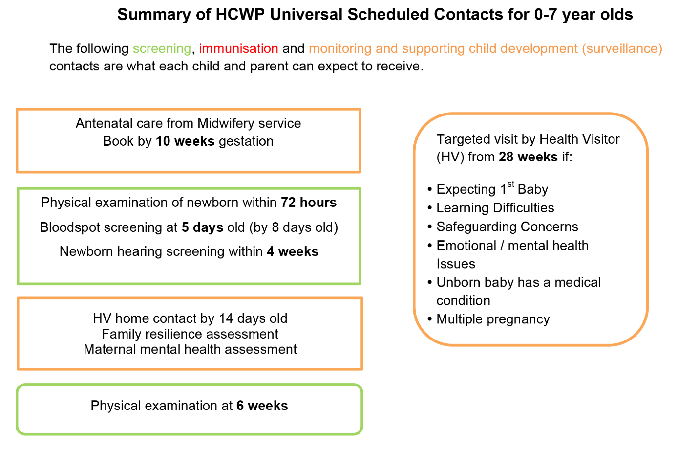
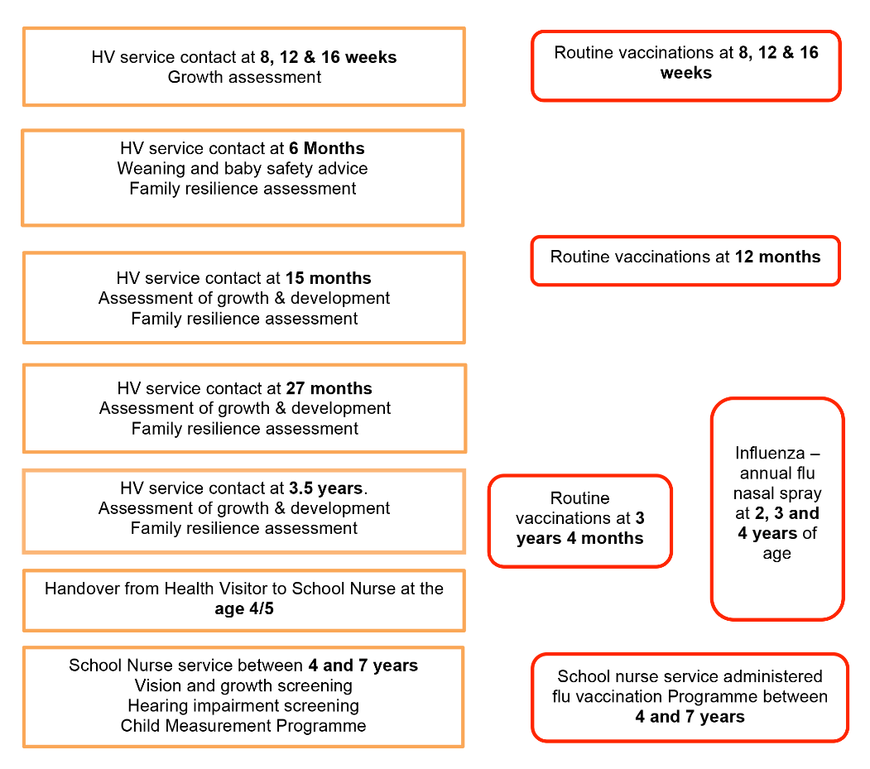
Welsh Levels of Care
Healthy Child
Wales
Programme
‘Assess and promote the development of the child’s speech and language skills (HCWP QA framework, 2022)’
Notes:
Continued…
SLC as thread throughout HCWP contacts: 15 month HV Service Contact has a specific focus on the development of speech and language skills but its important to note that SLC should be considered with every child at every contact. The QA framework states at the 15 months visit: ‘Assess and promote the development of the child’s speech and language skills’

Slide 8
Aim of the Training
To equip Health Visitors, skill mix teams and partner agencies with additional skills and knowledge to support families in promoting speech, language and communication (SLC) in the home learning environment, to support improved health and wellbeing outcomes.
‘Effective interventions and prevention in the early critical years of a child’s life are vital to ensure a best start in life and reduce long term health and social issues’
(HCWP QA framework, 2022)
Notes:
EST: 1 min
The aim of the training will be to support families to promote SLC at a universal population and targeted level within the home environment rather than focussing on escalation to specialised services.
The training focuses on ensuring families get the right support from the right person in the right place at the right time.

Slide 9
Learning Outcomes
‘Introduce […]early language and play development in baby groups and at home’​
(HCWP QA framework, 2022)
Understand typical Speech, Language and Communication (SLC) development
Identify risk and protective factors for speech, language and communication needs (SLCN) through your observations and discussions
Consider the impact of SLCN on the child
Promote evidence-based strategies to support families to support their children to learn to talk
Know when to seek extra support/ signpost appropriately to universal, population, targeted and specialist services as required (NB right person/ place/ time)
Notes:
EST: 1 min
Recognise knowledge and experience within everyone’s roles.
This training is an opportunity to reflect on how we currently support SLC, and raise awareness of latest research/resources.

Slide 10
Why Health Visiting?
The Health Visiting Service Workforce have expertise and opportunities to promote speech, language and communication development with all families
The Talk with Me Delivery Plan focuses on SLC as the ‘golden thread’ over time: consider right person/ place/ time
Health visiting teams can offer timely interventions through established relationships with families
Health Visiting teams work within the home and can promote this as the most important learning environment
Notes:
EST: 1 min
The Health Visiting workforce are key to working with families
Health visiting workforce can share messages to support language development, identify those with SLCN as part of holistic assessment and support families with interventions proportionate to need
HVs have a role in supporting all children to achieve their potential, not just those with an identified need

Slide 11
Activity: Identification
of SLCN
Consider:
How do you currently identify SLCN?
Which contact points are most crucial for this? How do you ensure that SLC is considered at every contact?
What do you listen out for from the parent?
From the child?
How do you currently decide what to do next?
‘Discuss with parents/carers their views and any concerns they may have regarding their child’s speech, language and communication’
(HCWP QA framework, 2022)
Notes:
EST: 15 mins
Ask the group to spend a 10 minutes on their tables to consider the questions on the slide and nominate 1 person to feed back to the group – explain that we’ll come back to identification of SLCN later in the session

Slide 12
Activity- Barrier Game
1. You will need the following equipment: blank paper, 3 different colours of pen / pencil / crayon.
2. Sit to your partner or place a barrier between you. If online, turn off your cameras.
3. Decide who will be the ‘instructor’ first. The other person will be the ‘listener’. You will be given 5 minutes in each role.
The instructor will start to draw a simple image, and describe what she is doing as an instruction as she draws.
e.g. ‘draw a large circle in the middle of your page’.
5. The listener follows the instructions and without looking at the instructor’s picture, draws according to her instructions.
Continue to do this until the picture is finished.
The ‘listener’ is not allowed to ask questions and the instructor is not allowed to give clues e.g. with gestures.
👀
7. Compare pictures – how similar are they?
⇄
8. Swap roles and repeat the process.
9. Discuss how this activity felt.
Notes:
EST: 15 mins
Learners will need: Red, blue and green coloured pen/pencil for each person ; 1 page of paper each
Present the instructions on the slide and time 5 mins per turn
In discussion, draw out importance of face to face, non verbal communication, and using visual supports. Link to child with SLCN experiencing frequent communication breakdowns

Slide 13
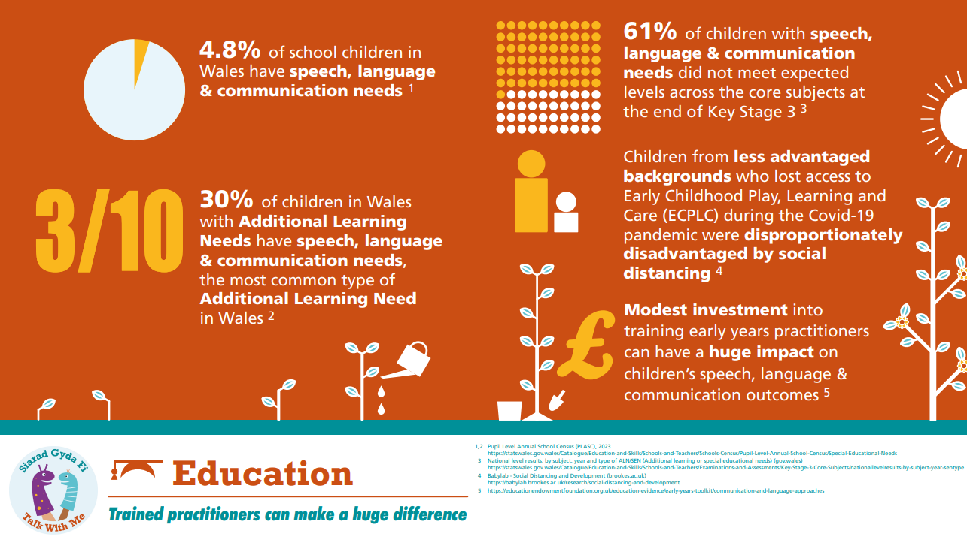
Why does SLC matter?
Notes:
Total for slides 13-15 Est: 3-4 mins
The next few slides summarise the research about why SLC skills are important, both in the short and long term.
It is essential we intervene early as SLC is a public health issue and a cost to the nation (Early Intervention Foundation, 2017)

Slide 14
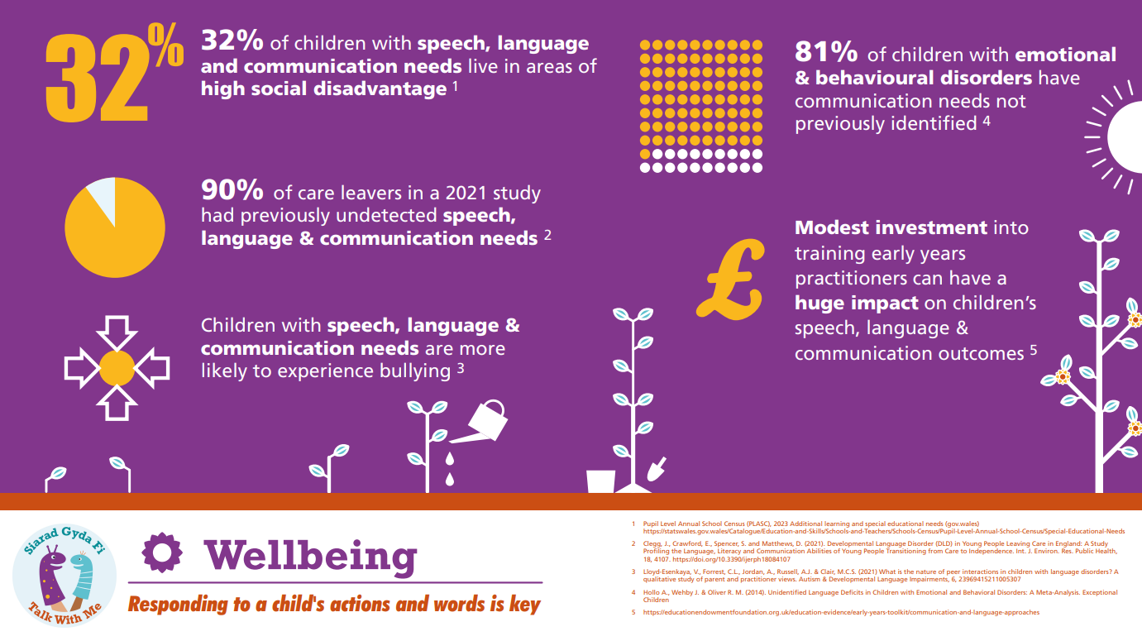
Why does SLC matter?

Slide 15
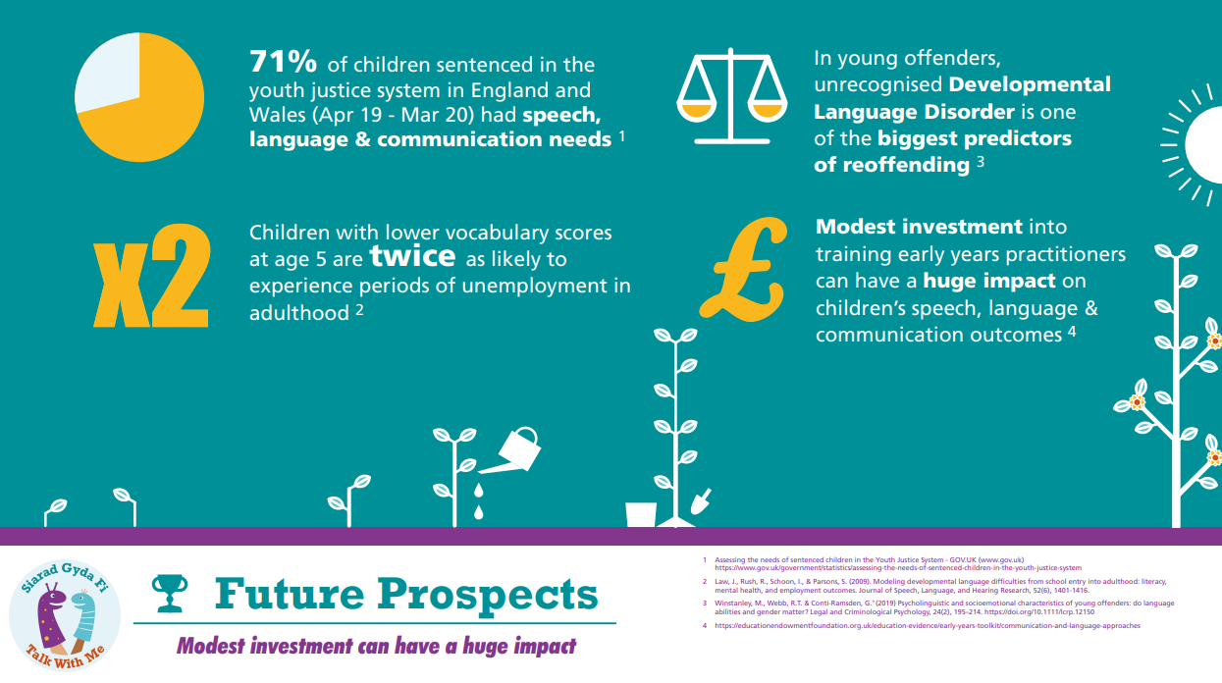
Why does SLC matter?

Slide 16
Policy Context in Wales
Notes:
EST: 1-2 mins
This training is in one of the objectives in the Welsh Government’s Talk With Me delivery plan which draws together a range of strategic policies and documents from Wales and across the UK– all of these aim to develop services which provide the best possible outcomes for children
Draw out Early Intervention Foundation (EIF) ‘language as a child wellbeing indicator’ and contrast with focus on school readiness still prevalent in some services.

Slide 17
Break
See you in 15 minutes
Notes:
EST: 10-15 mins depending on number of participants and length of pre-survey

Slide 18
SLC is Everyone’s Business
‘Work with multi-agency
team with a plan of care to deliver
intensive support for speech, language
and communication needs’ (HCWP QA framework, 2022, Intensive level)
‘Discuss with parents/carers appropriate stimulation to enable their children to reach their full potential with their social, play and language development, both in and outside the home’ (HCWP QA framework, 2022)
Notes:
EST: 2-3 mins
The aim is to make SLC ‘everyone’s business’ - it’s the people in the child’s environment who make the difference. We can all play a role in supporting children’s SLC skills both personally and professionally. From midwives, HV teams and early childhood education and care teams; to family and friends - With the right information, we can Make Every Contact Count

Slide 19
Importance of the Home Learning Environment
“The child’s communication environment was a more important predictor of language development at two, and school entry ‘baseline’ scores at 4 than socio-economic background”
(Roulstone et al., 2011)
Notes:
EST: 1 min
It's not who you are but what you do...

Slide 20
Importance of the Home Learning Environment
 | Mon | Tue | Wed | Thurs | Fri | Sat | Sun
07:00 | Home | Home | Home | Home | Home | Home | Home
08:00 | Home | Home | Home | Home | Home | Home | Home
09:00 | Nursery | Nursery | Nursery | Nursery | Nursery | Home | Home
10:00 | Nursery | Nursery | Nursery | Nursery | Nursery | Home | Home
11:00 | Nursery | Nursery | Nursery | Nursery | Nursery | Home | Home
12:00 | Nursery | Nursery | Nursery | Nursery | Nursery | Home | Home
13:00 | Home | Home | Home | Professional Visit | Home | Home | Home
14:00 | Home | Home | Home | Home | Home | Home | Home
15:00 | Home | Home | Home | Home | Home | Home | Home
16:00 | Home | Home | Home | Home | Home | Home | Home
17:00 | Home | Home | Home | Home | Home | Home | Home
18:00 | Home | Home | Home | Home | Home | Home | Home
19:00 | Home | Home | Home | Home | Home | Home | Home
20:00 | Home | Home | Home | Home | Home | Home | Home
Notes:
EST: 1 min
Families may look to the professionals as ‘experts’ and rely on their appointments to change the child. However, we know from research that its actually families who are the experts in their child and they are the ones that can make the biggest difference- particularly because they are with the child the majority of the time

Slide 21
SLC Definitions
S - Speech
L - Language
C - Communication
Notes:
EST: 5 mins
Learners will need: 3 x pieces of paper, pen. Tutors will need: statements (from notes below)
Instructions:
Everyone to take 3 pieces of paper and write ‘S’ , ‘L’, ‘C’, one on each piece
Trainer reads out the statements (below) and asks everyone to hold up the letter they think the statement relates to
Explain that the terms are often confused and it helps to be clear about which we are talking about. Definitions to follow on next slides
Statements:
Child doesn’t understand when you say ‘find your shoes’
Child says ‘tar’ instead of ‘car’
Child struggles to take turns
Child makes eye contact when spoken to
Child says ‘mouses’ instead of ‘mice’
Child says ‘boo’ instead of ‘blue’

Slide 22
SLC
Speech, language and communication are essential life skills. They are linked with social and emotional development, learning, behaviour, and mental health.
SLC is therefore a fundamental indicator of child wellbeing.
Speech
Language
Communication
How we say sounds and how these sounds go together to form words
The words and sentences that we understand and use
How we use language to interact with people
Notes:
EST: 2 mins
We often talk about speech, language and communication but are we sure what each of these terms actually mean?
Speech- is about how we say sounds and how these sounds go together to form words
Language- is about the words and sentences that we understand and use
Communication- is about how we use language to interact with people

Slide 23
SLC
SLC
Speech
The individual sounds you use
e.g. “k” “s” “b”.
Sounds together make a word
e.g. c + a + t = cat
Use of Language / Talking
Using spoken words and sentences, even if the sounds aren’t right e.g. ‘bubu’ instead of bubbles
S
Social Interaction
Skills we need when communicating with people e.g. turn taking, eye contact and showing interest in others.
Understanding of Spoken Language
Understanding what words and sentences mean
Attention and Listening
Play
Focusing on language or play activities and listening to spoken words
Exploring toys and the
world around them
Notes:
EST: 4 mins
Explain it is important to consider the building blocks of SLC
Stress that this is not completely linear and the areas overlap
Explain language development is complex and this is a small snap shot of some of the areas of development
Discuss the importance of nurturing environment to support development.
Children’s brains are wired to learn language but there is evidence that the rate at which children develop language is sensitive to the amount of input they receive from the adults around them. The quality of input that children receive is likely to be more important than the quantity, (LuCid and EIF) The number of conversational turns between adult and child are as important as the number of words the child hears
Although children often have different patterns of interaction as they start to speak (some use lots of words, others combine words very early on in their development), typically children need to be using between 50 and 100 words before they start putting words together into short phrases.

Slide 24
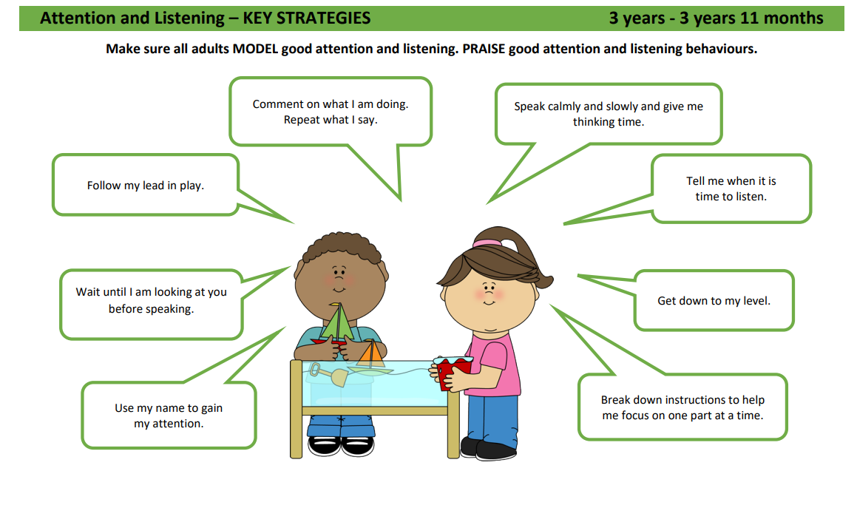
Attention and Listening
Attention and listening skills are the foundation
of speech, language and communication.
Children need to develop these essential skills to:
Understand the world around them
Develop social skills
Understand routines
Learn new words
Develop speech sounds.
www.gov.wales/speech-language-and-communication-guidance
Notes:
EST: 2 mins
Attention and listening: Develops from fleeting (think of babies) to single channelled (child has to focus on one thing and exclude everything else) to fully integrated attention where the child is able to attend to 2 things at once.
NB- pick out 1 or 2 key strategies from the image and encourage staff to read the rest after the session
Images taken from Talk with Me SLC guidance – available here www.gov.wales/speech-language-and-communication-guidance Age 3 poster selected as this contains the most strategies but other posters available for younger ages

Slide 25
Play
‘Inform parents/carers
about the importance of play, reading and stimulation with regard to their baby’s continued brain and social development’ (HCWP QA framework, 2022)
Play is how children make sense of the world and it is crucial to support brain development in the early years. Through play, children develop and learn to use their SLC skills. Play is the essential context for learning about social skills.
Notes:
EST: 4 mins
Play: Children learn language through play. HVs can support families to build play into daily routines as well as dedicating time to play with their little ones. Play is a precursor to language as it supports symbolic development (as words are abstract in nature). Children learn about objects through play and symbolic play (pretend play) is an important part of this as it helps children to understand that things can be used to represent other things e.g. you can pretend that a banana is a phone.
NB- pick out 1 or 2 key strategies from the image and encourage staff to read the rest after the session
NB these posters have been developed for settings so some strategies may not be so appropriate for you to introduce in your roles s e.g. now and next boards

Slide 26
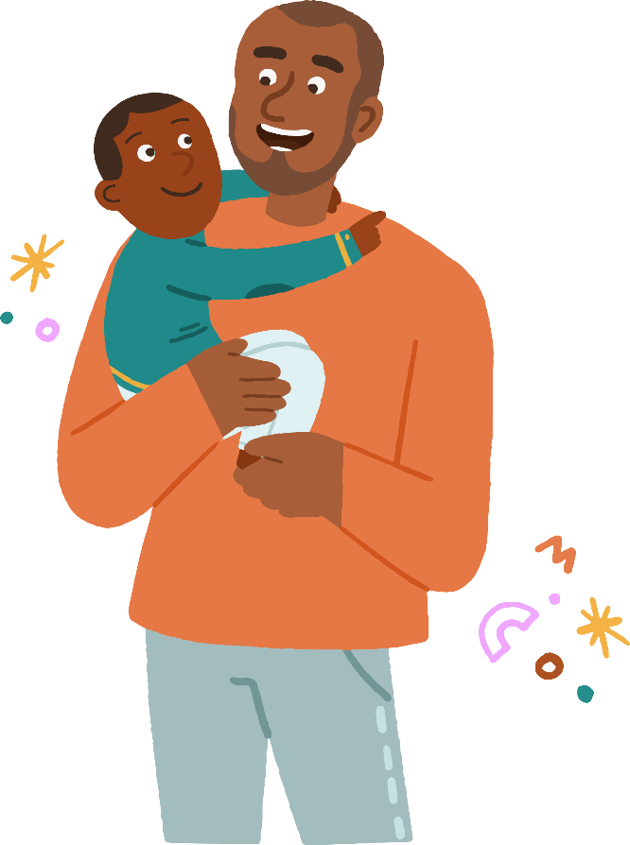
Gesture
Gesture
Slide content provided by Professor Anna Theakston, LuCiD Centre, University of Manchester
Notes:
EST: 3 mins
Babies whose caregivers engage in longer back-and-forth interactions in response to ‘show’ gestures use more pointing gestures later on than those who experience shorter interactions...

Slide 27
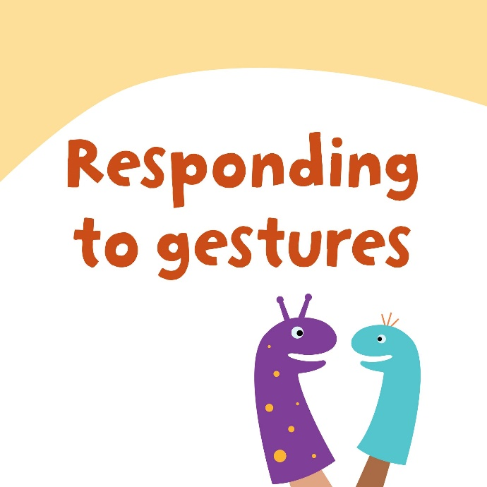
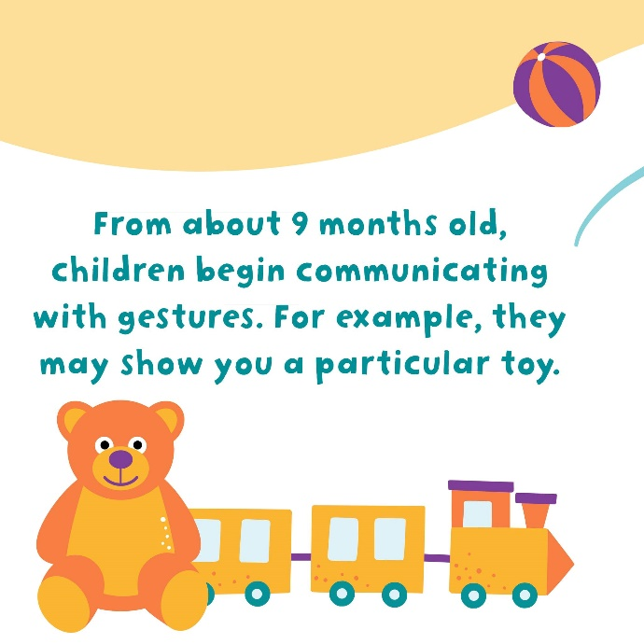
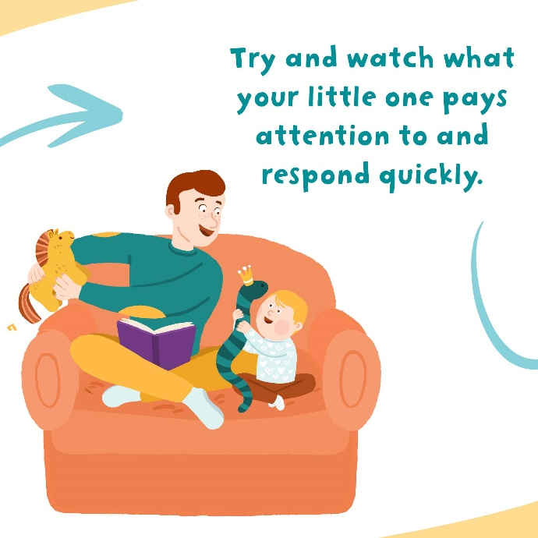
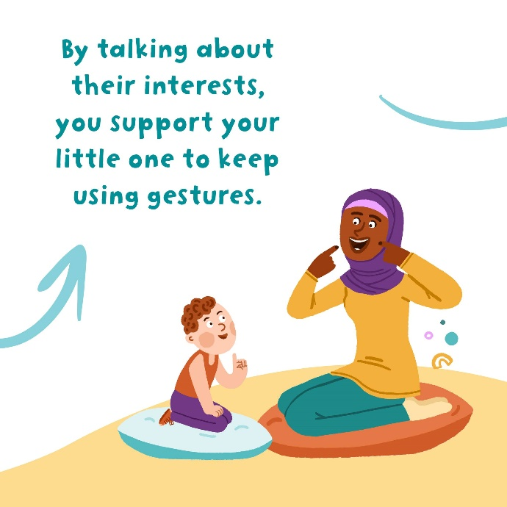
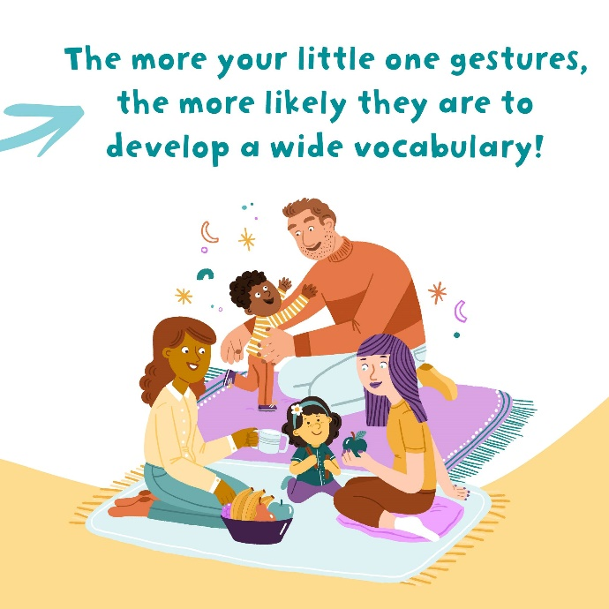
Gesture
Notes:
EST: 2 mins
Babies gesture more if caregivers respond to their early attempts
Caregivers can help their baby’s language development by responding immediately (within 2 seconds) and appropriately (by talking about the baby’s interests).
Longer two-way ‘conversations’ are best.

Slide 28
Understanding
Understanding language is essential for children to make sense of the world. It includes understanding of:
Words
Sentences
Non-verbal communication
Most children learn to develop an understanding of words and sentences in stages:
One word → a number of individual words → short sentences → longer more complex sentences.
Notes:
EST: 5 mins
Understanding of spoken language:
Understanding is crucial to language development and typically precedes expression
Situational understanding- Parents often report that their children will understand everything they say, this is because the child will pick up the non-verbal cues from the situation, rather than what the parent is saying e.g. parent pointing at the child’s shoes while saying ‘put your shoes on’. This is an important first step in learning language.
True Understanding- As understanding develops, children will become less reliant on cues to follow instructions e.g. they will be able to find a picture of shoes in a book when you say ‘where are the shoes?’.
When discussing levels of understanding with parents, it is important to explore how reliant the child is on non-verbal cues.
NB- pick out 1 or 2 key strategies from the image and encourage staff to read the rest after the session

Slide 29
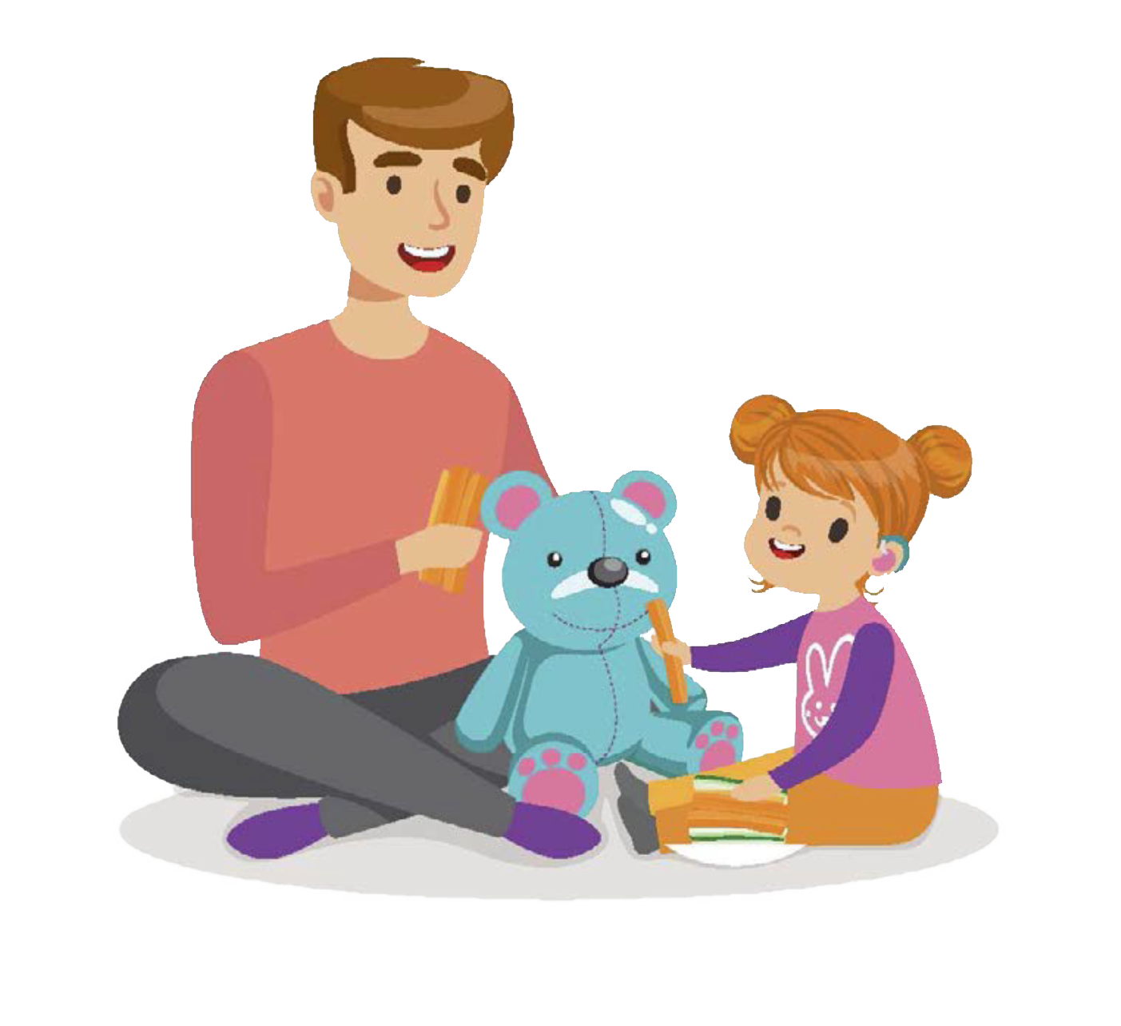
Understanding
Activity
Notes:
EST: 5 mins
DEMONSTRATE – Information Carrying Word activity – brushing the dolls hair
Trainer has a doll and brush and gives the instruction ‘brush the dolls hair’- how many words does the child have to understand? (ANSWER= none as this is a situational understanding instruction)
Trainer has a doll, teddy and brush and gives the instruction ‘brush the dolls hair’- how many words does the child have to understand? (ANSWER= one - doll vs teddy)
Trainer has a doll, teddy, brush and sponge and gives the instruction ‘brush the dolls hair’- how many words does the child have to understand? (ANSWER= two- doll vs teddy and brush vs wash)
NB in SOGs assessment this claims to assess understanding of language but is a situational understanding instruction so results must be interpreted with caution (trainer to familiarise themselves with the relevant SOGs qs)
SOGS question on page 39 labelled item 101 says; “Leave the cup, spoon, doll and brush in front of the child. Ask the child to ‘give doll a drink’ or ‘brush dolls hair’” so this is not testing 2 part understanding as there is only one character choice.

Slide 30
Use of language
Using spoken language (expressive language) is the ability to recall words and information and use language, body language and gestures appropriately in given situations e.g. to:
Label/name objects
Describe actions and events
Ask and answer questions
Retell a story.
A good vocabulary is essential for children to express their thoughts, needs and wants.
Notes:
EST: 2 mins
NB- SLT can briefly discuss Gestalt Language Processing if they feel confident to.
There is increasing discussion around two ways of processing and learning language -
Analytic Language Processing – the majority of children learn language like this
Gestalt Language Processing- where children learn language in chunks or 'gestalts'. Children may repeat phrases from previous experiences/ dialog from TV. Therapy works to shape these into more varied, self generated language.
Can signpost to www.meaningfulspeech.com
NB- pick out 1 or 2 key strategies from the image and encourage staff to read the rest after the session

Slide 31
Speech
Speech
Speech refers to being able to say speech sounds to make yourself understood.
When we are listening to a child talk, we can think about how clear their words are. Speech is not the same as talking.
Talk with Me Phonological Awareness Factsheet – English Version (gov.wales)
Notes:
EST: 3 mins
Speech sounds develop gradually and some children may make some speech sound errors while they are learning to talk e.g. tat instead of cat.
Show the Phonological Awareness fact sheet and highlight it as a resource for parents
NB- pick out 1 or 2 key strategies from the image and encourage staff to read the rest after the session

Slide 32
Speech
A recent study (Hustad, Mahr, Natke and Rathouz 2021) into typical intelligibility suggests that children between:
2 years 10 months and 3 years 10 months | are understood 50% of the time by unfamiliar adults
3 years 10 months and 5 years 1 month | are understood 75% of the time by unfamiliar adults
5 years 2 months and 7 years 3 months | are understood 90% of the time by unfamiliar adults
Notes:
Continued…
Speech sounds develop gradually and some children may make some speech sound errors while they are learning to talk e.g. tat instead of cat.

Slide 33
Notes:
EST: 2 mins
From Speech acquisition - Multilingual Children's Speech (csu.edu.au)
Note that this relates to speech sound development in English. We do not have equivalent information on Welsh speech sound development.

Slide 34
Activity
I saw four cows, five sheep and a cat at the farm.
(change the ‘f’ sounds to ‘b’ and ‘c/k’ sounds to ‘t’)
The lady was scared of the little spider.
(miss off the ‘s’ sounds and change the ‘l’ sounds to a ‘w’)
I put two cuddly teddies and a toy car in the cupboard.
(change the ‘t’ sounds to ‘d’ and the ‘c/k’ sounds to ‘g’)
I like to read my book in bed.
(leave 'd' and 'k' off the end of the words)
Notes:
EST: 8 mins – OPTIONAL SLIDE
Choose one sentence to do as a demonstration
Face to face option – In pairs take turns to say one of the sentences, the listener has to guess what they are saying
Online option- put themselves on mute, practise all of the sentences (3 minutes) then feedback
Discuss
How did you find it?
How did you feel?
Could you keep this up?
If you had to do this all the time, what do you think would help?
How do you think it would make children feel?
This just goes to show that when we are asking young children to change their speech, it is hard and remember you had an extra visual to what the child would have, as the sentence you were saying was written down.
They’re not being lazy or stubborn if they’re not changing their sounds, it will take time for them to build this new habit into their day to day speech.
(Credit- this slide content is shared from the All-Wales Sounds So Simple Parent workshop)

Slide 35
Social interaction
Interaction includes the ability to play
cooperatively with peers and take turns.
Through play and interaction, children learn to understand
and regulate their emotions and develop their social skills.
Provide opportunities for turn taking
My social interaction is enhanced by adults who…
Get down to the same level and face to face with me
Follow my lead in play
Wait for me to communicate
Avoid questions and use more comments
Use short, simple sentences
Notes:
EST: 4 mins
Some children find it difficult to interact with other people- this could be children or adults. Lots of parents and professionals may jump to conclusions about Autism- its important to remember that many features associated with Autism are also typical stages of development e.g. lining toys up in a row/ doing the same thing again and again.
Anecdotal evidence suggests that there has been an increase in the number of referrals mentioning social communication difficulties received by specialist services post- lockdown.
If you have concerns about a child’s social communication, remember to consider environmental factors and how this may be contributing to their development.

Slide 36
The ages and stages of language development
‘Discuss with parents/carers their baby’s vocalisation and speech and language progress in accordance with their age and stage’
(HCWP QA framework, 2022)
For all stages please refer to ages and stages chart on
www.gov.wales/talk-with-me
https://gov.wales/learning-talk-stages-speech-and-language-development
Every child develops at their own pace so these norms should not be used in isolation, and not as ‘red flags’.
Consider how they are communicating functionally and what the impact is on the child e.g. are they getting frustrated as they are not able to communicate their message with a familiar adult
Notes:
EST: 4 mins
Won’t spend time going through norms as you are all familiar with child development – please refer to the link on the slide for the professional and parents norms charts
Make it clear that this is only an indicative guide for the development in young children and development is not always linear, and that this shouldn’t be used as a checklist with parents
Trainer: follow links to show charts

Slide 37
Lunch
See you in 30 minutes ☺

Slide 38
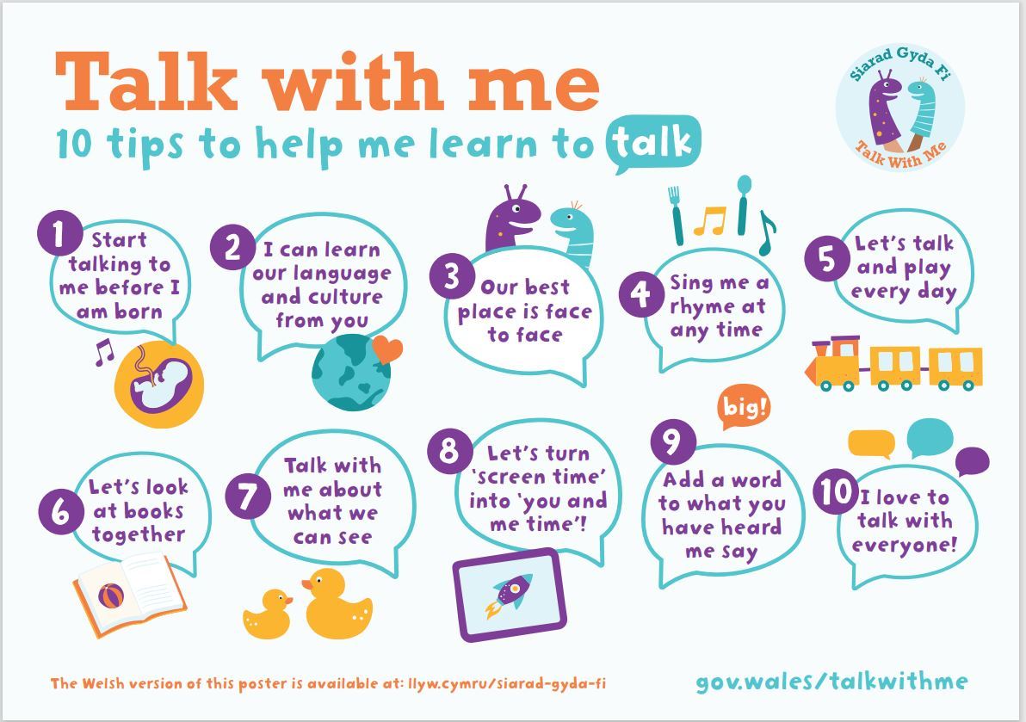
TWM
Key Messages
Notes:
EST: 1 min
Introduce TWM key messages: based on latest evidence about what helps with early SLC – parent facing resources on campaign page
We will go through each of these key messages in turn and present the evidence supporting each one

Slide 39
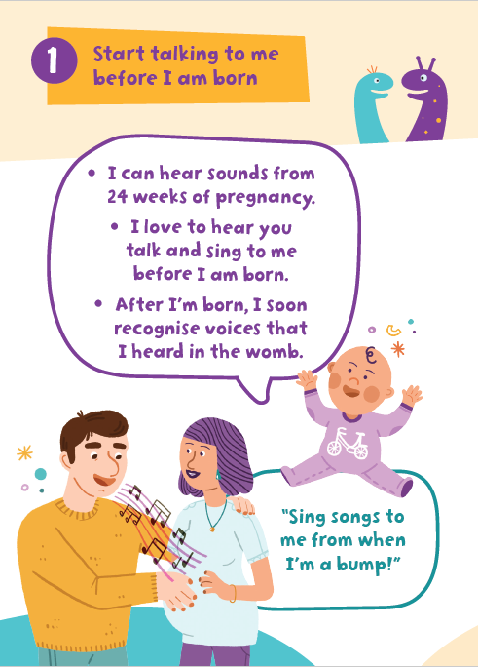
Start talking to me before I am born
Top Tip #1
https://youtu.be/vIhUEvEXDOI
Dancing babies?!
Music stimulates increased heart rate and movement in the baby both before and after birth (Bhamani, 2020)
Notes:
EST: 3 mins
Show first animation and judge response and timing when deciding how many of the others to show

Slide 40
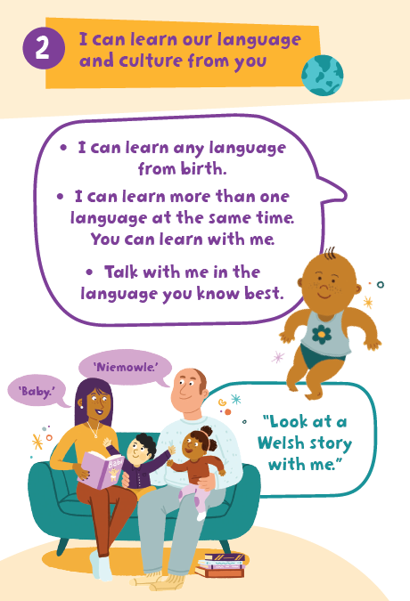
I can learn our language and culture from you
Encourage families/carers to speak to children in whichever language they are most comfortable speaking themselves
Top Tip #2
https://youtu.be/-zqU4GFBhsA
Sharing books in the home language promotes wellbeing as well as language development, because of the adult-child interaction during book sharing along with the content of the books (He, 2019)
Notes:
EST: 4 mins
Explain that in order to learn a second language (in this case, English or Welsh), it is imperative that the child’s first language is both maintained and developed. Parents should be encouraged to use their home language with their child. This is because the home language will be rich in terms of vocabulary, concepts and grammatical structures. If a parent, whose first language is not English or Welsh, speaks to their child only in English or Welsh the child will not be hearing a full and rich model from which to develop their own language skills. Evidence shows that children with SLCN need to be supported in their home language first

Slide 41
English or Welsh as an additional language
Bilingualism and multilingualism are assets
Children learning a new language often go through a silent phase of 2-3 months in the environment in which they are exposed to the new language. This is a normal part of development.
It can take up to 2 years after the child is exposed to the language for them to develop conversational English or Welsh
There is NO evidence to suggest that learning English or Welsh as an additional language will cause SLCN
10% of ALL children will have long-term SLCN, children with English or Welsh as an additional language are as likely to have these needs as those with English or Welsh as the first language.
Although the child may have a limited number of words in each language they are learning, when all are added together they usually have the expected number of words for their developmental stage
Notes:
EST: 4 mins
There is no evidence that English or Welsh as an additional language will cause SLCN, however, it can take up to 2 years to develop conversational language (e.g. understanding requests such as ‘Go and get your coat’ and using short phrases such as ‘Can I have a drink?’). It can take between 5 and 7 years to develop the language needed for academic success e.g. being able to use language to predict, hypothesise, plan etc
In the past, children learning English or Welsh as an additional language have been over-represented in referrals to SLT
EXAMPLE
Think of the developing language as a coat hook. The coat hook (or home language) will be firmly fixed to the wall if it is learnt from a native speaker of the language. This firm foundation enables any number of other languages to be hung on the hook
If the language is learnt from a non-native speaker it will not contain the rich vocabulary and grammar of a first language – the coat hook will be wobbly and the addition of other coats/languages will be compromised
Therefore encourage parents to talk with their baby in the language they feel most comfortable speaking

Slide 42
Bilingualism
Welsh language develops differently to English, with individual speech sounds, word order and grammar all varying from English. We do not yet have good evidence of expected Welsh language norms.
‘Code switching’, or using words from more than one language in the same phrase or sentence, is a normal part of bilingual language development.
Encourage parents to talk with their child in the language they feel most comfortable speaking
Notes:
EST: 3 mins

Slide 43
Bilingualism:
how to support more than one language
Supporting children acquiring more than one language is the same as supporting any child learning to talk: keep it simple, repeat, use visual props and, above all, be responsive.
A good way to support families with English or Welsh as an additional language is to encourage parents to share stories using either books in their preferred language or a non-word picture book. This allows them to use their preferred language to create rich stories in their own words.
Where a child has suspected or identified SLCN, assessment and intervention should be in the preferred language, using an interpreter.
Remember to accept and praise communication in whatever language the child chooses to use.
Bilingualism factsheets
Notes:
Continued…

Slide 44
Activity
Get into pairs and have a conversation about something interesting when:
P1 sits on a chair, P2 stands behind them
P1 sits on a chair, P2 stands in front of them
You both stand/sit facing each other
Discuss – how did this feel for each? What are the implications for children and adults?
Notes:
EST: 8 mins
Virtual Activity option:
Camera off
Camera on standing up
Camera on face to face
Draw out people’s thoughts and feelings in each condition, and conclude that ‘our best place is face to face’…

Slide 45
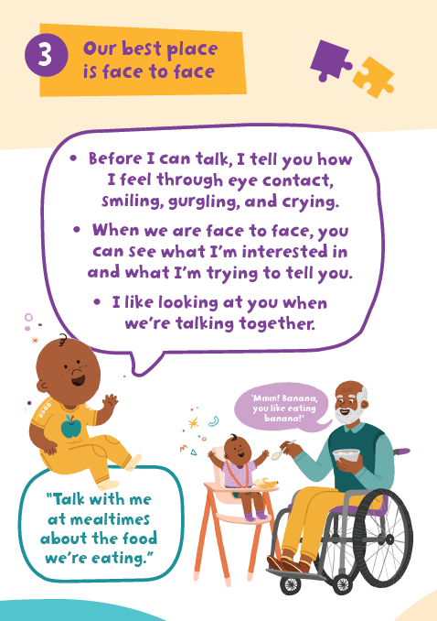
Our best place is face to face
Top Tip #3
https://youtu.be/k9mzKK1zjlE
‘Our turn taking skills rely heavily on gesture and facial expression – if we can’t see and process the other person’s movements, we can’t respond effectively’ (Holler et al., 2018)
Notes:
EST: 3 mins

Slide 46
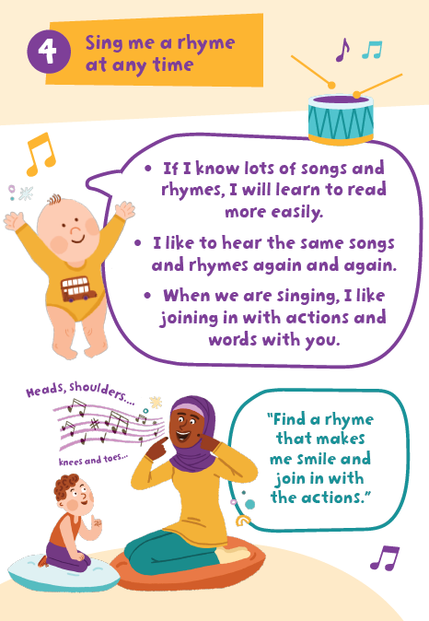
Sing me a rhyme at any time
Top Tip #4
https://youtu.be/jBR0bMcCVSY
‘The structure of music and rhyme helps us to segment words (i.e. knowing where one word ends and another begins). This is crucial in language learning’ (Schön et al., 2008)
Notes:
EST: 3 mins

Slide 47
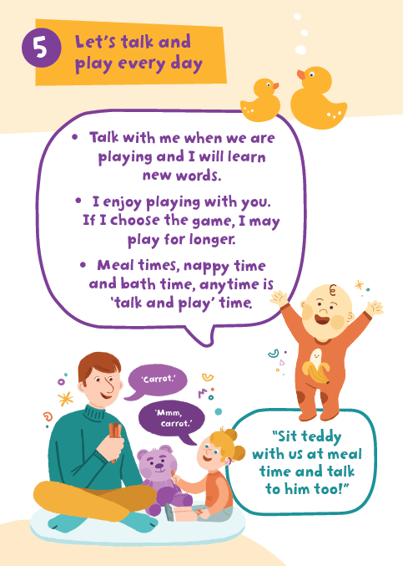
Let’s talk and play every day
Top Tip #5
https://youtu.be/PVaZolMYa2Y
‘When adults play with children, they use different language than when in other interactions, so the child hears new words and ideas’ (Tamis-LeMonda & Schatz, 2019)
Notes:
EST: 3 mins

Slide 48
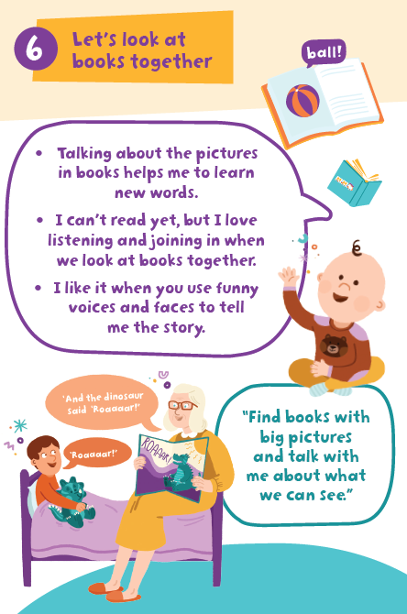
Let’s look at books together
Top Tip #6
https://youtu.be/YuRGHWwi-MU
‘Reading storybooks to children maximizes the kinds of experiences that predict language learning and may even exceed the power of oral conversations at times’ (Dickinson et al 2012).
Notes:
EST: 5 mins

Slide 49
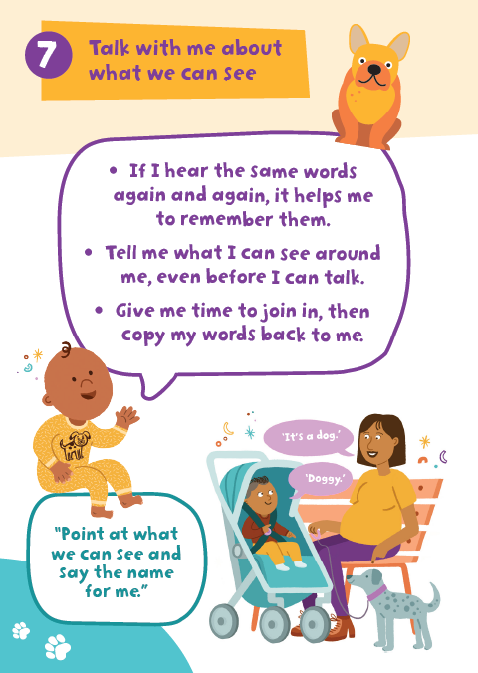
Talk with me about what we can see
Top Tip #7
https://youtu.be/6qVRjPuaa58
‘‘Contingent talk’, or talking about what the child is focused on, supports vocabulary development. Interventions can be effective in increasing contingent talk in parents across the socio-economic spectrum’ (McGillion et al, 2017)
Notes:
EST: 3 mins

Slide 50
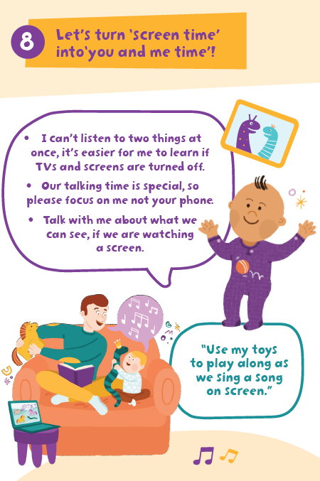
Let’s turn screen time into ‘you and me time’!
Top Tip #8
https://youtu.be/H9cEu0NmWew
‘Parents monitoring of, and participation in, their children’s screen time, has an important effect on whether screen time has a positive or negative impact on SLC development’ (Karani et al, 2022)
Notes:
EST: 3 mins
Allow for conversation time as this tends to be a topic that people feel strongly about!
Trainer needs to know:
Evidence about children under 2 needing to be in an interaction to learn language
Guidance on no screen time for under 2s (American Paediatric Association)
Difference in research depending on what kind of screen time it is (eg type of programme, whether child is alone or interacting)

Slide 51
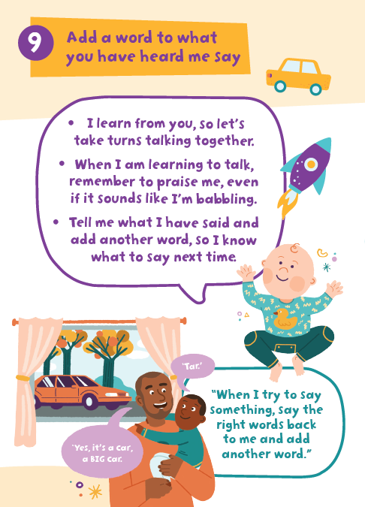
Add a word to what you have heard me say
Top Tip #9
https://youtu.be/U0mX60HnkHA
‘Higher rates of maternal expansions at 24 months predicted improvement in language between 24 and 36 months’ (Levickis et al 2014)
Notes:
EST: 3 mins
“The study supported an independent contribution of maternal expansions, which predicted improvement in language scores between 24 and 36 months. None of the other behaviours were predictive of change in language scores”.
Conversation around colours and numbers: parents with teaching style rather than conversational/ responsive stye tend to have children with poorer SLC outcomes- Typically children learn nouns first, then verbs, then concepts such as colours/shapes/location words

Slide 52
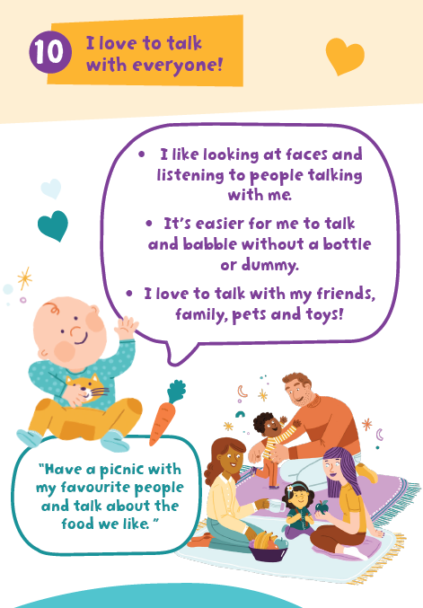
I love to talk with everyone
Top Tip #10
https://youtu.be/nWyM8NBAWok
‘There is a significant association between increased atypical errors and greater frequency of daytime dummy use - Each additional hour of daily dummy use correlated to an approximate 7–15% increase in atypical errors, and an approximate 3–9% decrease in typical errors’ (Strutt et al 2021)
Notes:
EST: 3 mins
NB dummy message removed from Learning to Talk messages due to inconclusive evidence. Some emerging evidence about blocking articulators changing how children perceive speech sounds (oral motor blocker paper ref) and the study quoted on the slide found ‘qualitative analysis of the atypical processes used by the children who had used a dummy, backing (producing speech sounds that should be made at the front of the mouth at the back of the mouth instead) was the most common’ and ‘A dummy user makes approximately 35% more backing errors than a nondummy user, on average’ give example of backing eg t>k
Mention impact on dentition/ ear infections

Slide 53
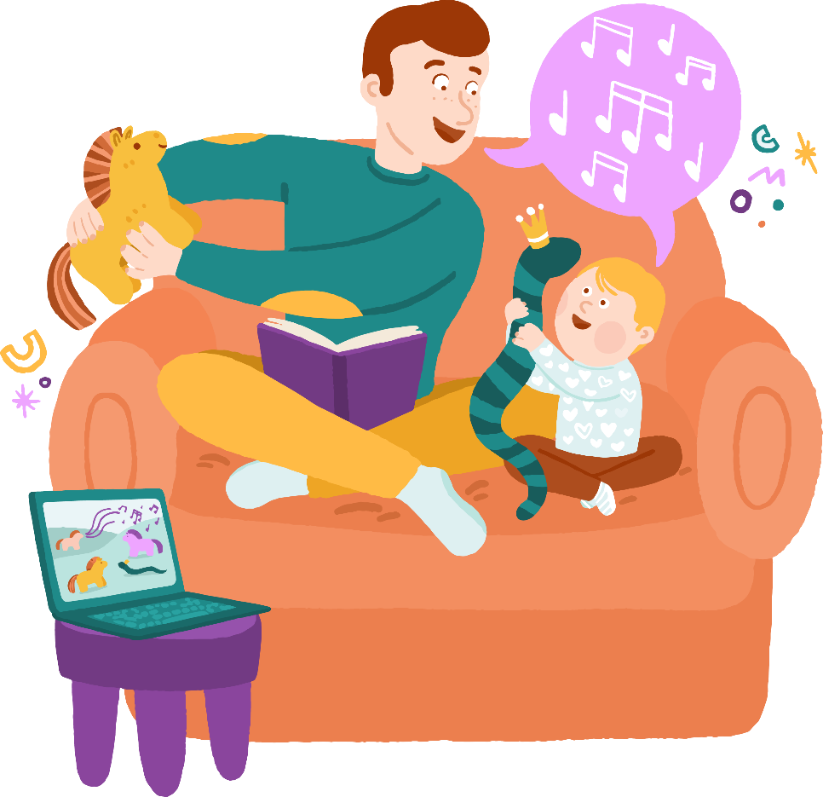
Parent/Child Relationship
In a nutshell, all the key messages have a focus on enhancing responsive interactions
between adult and child, in order to support SLC development which improves wellbeing
and long term outcomes.
Notes:
EST: 2 mins
“Caregivers who hold longer back-and-forth interactions and respond contingently to their babies’ early attempts to communicate have babies who: gesture more, continue to initiate interactions with their caregivers creating opportunities for learning, and go on to have larger vocabularies (McGillion et al (2013) and Cameron-Faulkner et al (2015))

Slide 54
PaRRiS
PaRRiS Question
Please rate the observed parent‐child dyad based on the ratings of parental responsiveness below (circle one only):
Very low Low Moderate High Very high 1 2 3 4 5
1 = very low: Parent rarely responds in a developmentally appropriate way either verbally or non‐ verbally to any of Child’s gestures or verbalisations AND Parent attempts to redirect Child’s behaviour, rather than following Child’s interest
5 = very high: Parent frequently responds in a developmentally appropriate way either verbally or non‐ verbally to Child’s gestures or verbalisations AND Parent rarely attempts to redirect Child’s focus from the current activity, but follows Child’s interest
www.gov.wales/speech-language-and-communication-outcomes-guidance
Notes:
EST: 5 mins
NB this slide is for information only for the majority of those attending (may be some local variation)
Summary paragraph from PaRRiS guidance
www.gov.wales/speech-language-and-communication-outcomes-guidance:
Adult responsiveness is the primary target of most, if not all, evidence based universal and targeted SLC interventions in the early years. Please see the Wales Intervention Review (WiRE) report for a summary of evidence based universal, population and targeted level SLC interventions for under 5s.
Responsiveness can be measured using the PaRRiS rating scale or an alternative measure of adult-child interaction behaviours. The PaRRiS consists of a single question and does not require training (see PaRRiS manual, annexe 2). If your service uses an existing measure of adult responsiveness, it is not essential that you adopt the PaRRiS scale, although you may choose to do so due to both its growing evidence base and its ease of use. Please note that it is not essential that a formal or published tool is used. If you have a locally developed measure in use, you may continue to use it and report on that.
Positive change is defined as an increase of at least 1 point on 1 or more items on the scale used. For example, on the PaRRiS scale, which has a maximum total score of 5, an improvement of 1 point (e.g., from 3 to 4) post intervention would be defined as a positive change. On a scale consisting of 5 items, each scored 0-10 (totalling 50 points), an improvement of 1 point (e.g., from 7 to 8) on one of the items scored would be defined as a positive change.
Consideration should be given to inter[2] and intra-rater[3] reliability, whichever scale is used. Good practice would be to implement supervision sessions for all practitioners using the tool to ensure that its use remains consistent and reliable.
[2] Inter-rater reliability is consistency of ratings between different observers (‘raters’) and can be checked by doing joint exercises to rate the same interaction eg using videos of parents and children)
[3] Intra-rater reliability is internal consistency – i.e., the same rater using the same process each time to produce similar ratings for similar interactions.
https://www.gov.wales/speech-language-and-communication-outcomes-guidance

Slide 55
The importance of responsive interactions
30) Molly Wright: How every child can thrive by five | TED - YouTube
Notes:
EST: 2 mins
“Caregivers who hold longer back-and-forth interactions and respond contingently to their babies’ early attempts to communicate have babies who: gesture more, continue to initiate interactions with their caregivers creating opportunities for learning, and go on to have larger vocabularies (McGillion et al (2013) and Cameron-Faulkner et al (2015))

Slide 56
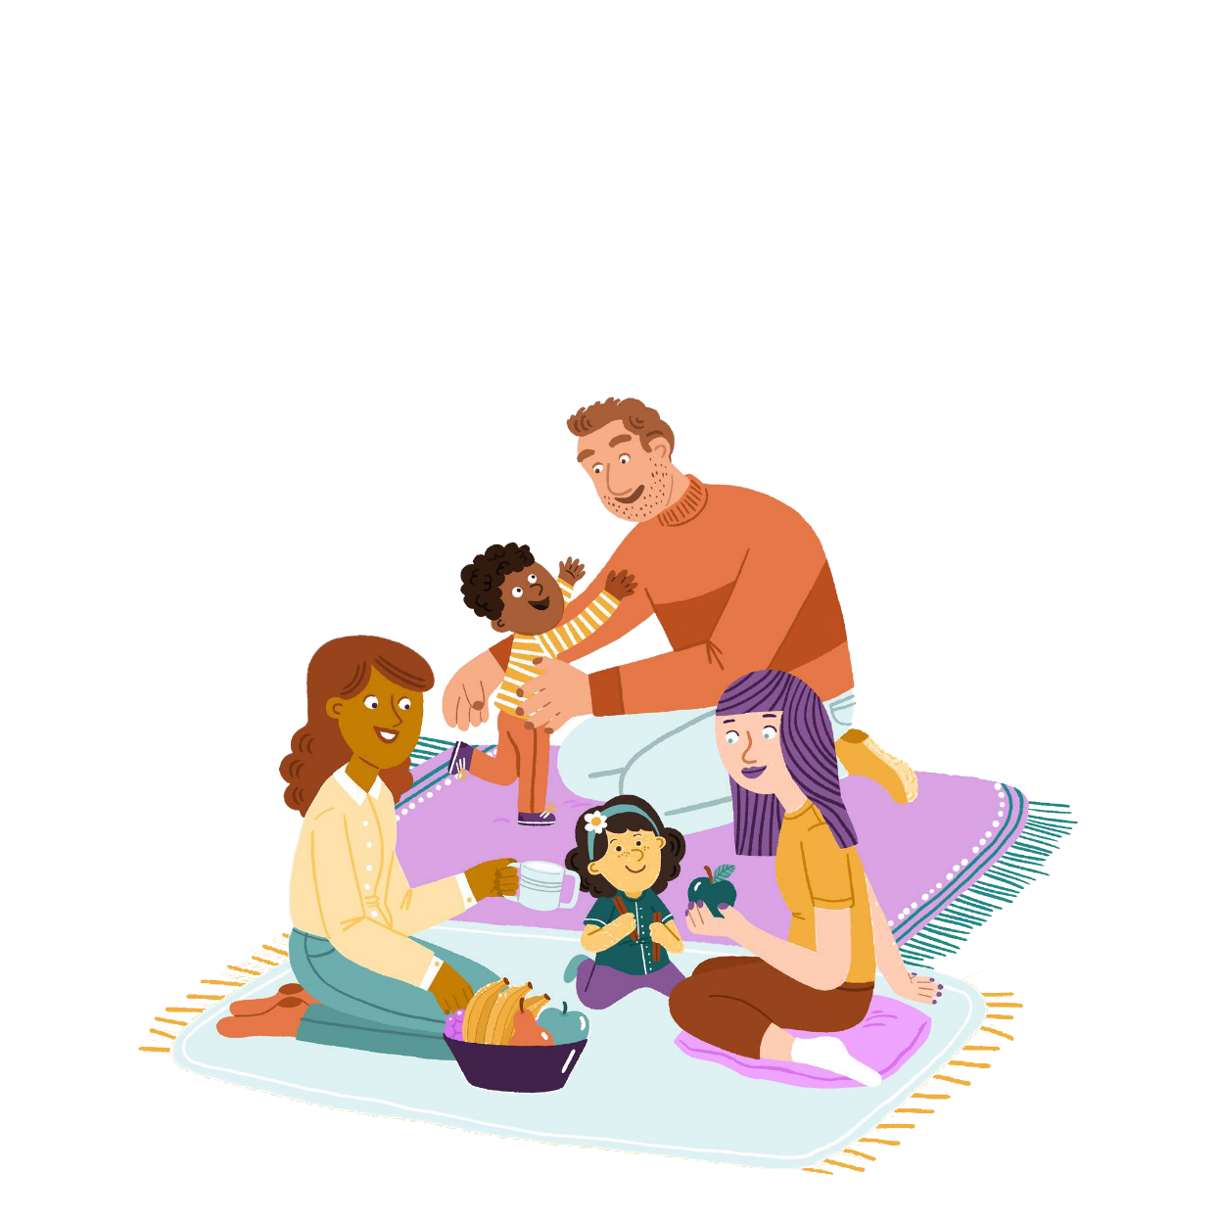
Applying the key messages to change behaviour
Capability
Limited understanding of how to support SLC development,
including milestones and activities
Opportunity
Limited time together
Other developmental
needs prioritised
Behaviour:
Talking together
Motivation
Parents tend to seek advice
on SLC from friends and family
rather than professionals
Notes:
EST: 12 mins
The Behavioural Insights Team (BIT) supported the development of the TWM campaign materials and approach to delivering the key messages
COM-B comes from a behavioural change approach which links with the ‘what matters’ approach. It is a model to support our thinking when working with families.
For a behavioural change to take place the family need the capability, opportunity and motivation.
It is important to consider that the capability, opportunity and motivation will be different in each family and this is what we can try and support by working with parents and creating opportunities.
Give a clear example and check understanding of the model before moving on. Give examples not about language e.g. person wants a dog but doesn’t feel they will walk it enough. This might be related to:
Capability (the dog is too strong, they don’t know what lead to buy, don’t know where to take it)
Opportunity (no time due to long work hours, nowhere local to go to)
Motivation (don’t see the benefit, don’t enjoy working the dog)
Ask the group to think of something they want to achieve in their own life (work or personal). E.g. drinking more water/travelling more/seeing family/going to the gym/clocking off on time etc and think about the COM factors that could mean this is happening or not going well.
If they are managing it, what gives them the COM they need? If they aren’t, what part/s is/are holding them back?

Slide 57
Applying the key messages to change behaviour
How to deliver Key Messages - make it ‘EAST’:
Easy (remove barriers)
Attractive (get my attention/ what’s the reward?)
Social (others do this…)
Timely (make it relevant to me right now)
Reference: BIT-Publication-EAST_FA_WEB.pdf
Notes:
EST: 12 mins
OPTIONAL SLIDE- can summarise if running out of time- BUT link to document at bottom of slide
Go through EAST with examples. For example when suggesting families sing to their child:
Easy: provide the message rather than the generic TWM link. Suggest a specific song to the family. Simplify the message. The BIT work has found it’s especially effective to show how a bigger goal e.g. ‘sing more’ can be broken down into smaller goals like ‘sing twinkle twinkle when he’s in the bath this evening’..
Attractive: use the TWM branded resources which are designed in an attractive/colourful way. Make them personal by including names. Research suggests we are more likely to be attracted to something if we think resources are limited so advising TWM is Wales only.
Social: note that it’s a typical behaviour for example ‘lots of parents sing to their children, do you have an interest in that?’, utilise groups where available so parents are accessing a network, encourage parents to commit to someone else and reflect this back ‘you agreed’ rather than ‘thank you for agreeing’.
Timely: talk about immediate benefits, ask them to write down their plan. Help parents identify a barrier and then a plan to overcome it. For example ‘I forget to read a book at bedtime’ the plan might be ‘i’ll add some books to the PJ drawer’.

Slide 58
Activity: Supporting SLC development
Choose 1 of the 10 Talk with Me key messages
Consider ways you could share the message if you were visiting the family this week – make it topical!
Consider how the COM-B model is relevant: What might parents say? What could the barriers be? What do they need in order to try using the message?
Notes:
EST: 10 mins
What do we think the barriers could be for families
How can these barriers be overcome?
If time available - Make the message EAST

Slide 59
Break
See you in 15 minutes

Slide 60
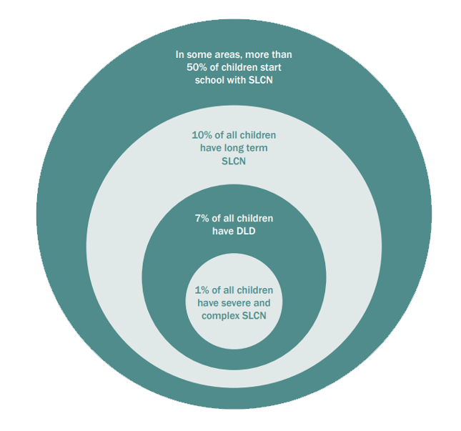
Speech, Language and Communication Needs (SLCN)
SLCN is the most under-identified Additional Learning Need, but the most common
DLD = Developmental Language Disorder
10% of children have long term SLCN that needs support. Robust, early identification is essential.
The prevalence of speech, language and communication needs in Children.
Notes:
EST: 5 mins
Children are diagnosed with Developmental Language Disorder by SLT (not every child with SLCN has DLD) if:
Their communication needs present a barrier to learning to everyday life
Their needs are long term and persistent i.e. beyond the age of 5. Many children with environmental delays will catch up given the right support- these children will not and need referral
Their difficulties are solely with SLC and not associated with another difficulty e.g. of learning, brain injury, chromosome disorder or ASD
Children with DLD are the most under identified and under supported children with ALN within schools
4.8% of school children in Wales have SLCN (WG, 2022 )
SLCN is the most common type of ALN in Wales. 30% of children with ALN have SLCN (WG, 2022 )
Children from less privileged backgrounds who lost access to Early Childhood Play, Learning and Care (ECPLC) were disproportionately disadvantaged by social distancing
Children from poorer backgrounds suffered more from the effects of lockdowns in terms of their SLC development
So how do we identify SLCN that might resolve compared to SLCN that might be persistent? We are going to talk more about this now

Slide 61
Plan for SLC Package for Wales
The report into the review of early language screening suitable for children in Wales aged 0-5 years contains a set of 14 recommendations: see executive summary
Welsh Government have procured a 4 year project from 2023 to develop an SLC package, incorporating:
- an identification tool or tools
- evidence based intervention(s) according to level of need
- evaluation of the tool and intervention(s)
Notes:
EST: 10 mins
The specification for the SLC package was co-produced with an operational and a strategic steering group, including Health Visitor leads from service and Welsh Government. The package itself will also be co-produced with practitioners and families across Wales. It will be piloted, refined and evaluated over the 3 years from 2022 to 2025, with full scale implementation from 2025 onwards.
Meanwhile, the recommendations from the review, and in particular the consideration of risk factors alongside presenting skills, should be used to support clinical decision making.

Slide 62
Risk and Protective factors associated with SLCN
The report into the review of early language screening suitable for children in Wales aged 0-5 years included a summary of risk and protective factors for SLC development. These factors should be considered, together with the child’s presenting skills, each time a practitioner assesses a child’s SLC and their risk of developing SLCN.
Physiological Factors | Risk Factors | Protective Factors
Antenatal Factors | Premature Birth | Being born full term
Biological Sex | Male | Female
Hearing | Sensorineural hearing loss | No hearing loss
Temperament | Shy children/low sociability. Reactive temperament | Sociable, more persistent temperament
Notes:
EST: 5 mins
Trainer to have WELS-R report (Review of Early Language Screening Suitable for Children in Wales from Birth to 5 Years (gov.wales))open to refer to if questions arise - refer back to identification of SLCN activity eg WellComm doesn’t consider risk and protective factors

Slide 63
Family factors associated with risk and protective factors for SLC
Risk and Protective factors associated with SLCN
Family and Environmental Factors | Risk Factors | Protective Factors
Maternal age | Mother aged under 30 years old at birth of first child | Mothers aged over 30 years old at birth of first child
Family history of SLCN | History of an immediate family member with Developmental Language Disorder | n/a
Socio-economic status | Low socio-economic status | n/a
Parents level of education | Low level of parental education | High level of parental education. Knowledge of child development
Quality of interaction | Limited child-directed speech. Limited exposure to varied vocabulary | High levels of child-directed speech, exposure to wide vocabulary
Book sharing | Limited exposure to books or book-sharing activities | Frequent book sharing activities and access to books
Childcare | n/a | Exposure to childcare settings and other language role models
Notes:
EST: 5 mins

Slide 64
Risk and Protective Factors in relation to SLC skills
Developmental Feature | Risk Factors | Protective Factors
Babble | Absent or limited babble | Using babble at appropriate developmental level
Gesture | Absent pointing and limited use of gestures | Use of pointing and gestures
Severity of difficulty | Receptive and expressive language difficulties. Large gap between expected level of language and level child is functioning at | Reaching developmental language milestones
Vocabulary | Limited expressive vocabulary | Wide vocabulary use
Grammatical markers | Lack of grammatical markers e.g. auxiliary verbs ‘is/are’ past tense ‘-ed’ and plurals | Using grammatical structures at an age appropriate level
Notes:
EST: 5 mins

Slide 65
Things to
Look Out for
In the first year | 1-2 years | 2-3 years
No babbling or other sounds by 6 months No simple gestures (e.g. shakes head) by 12 months | Not responding to speech and/or sounds No pointing by 15 months Minimal or no attempts to communicate or interact | Minimal interaction Does not display intention to communicate Minimal reaction to spoken language Regression or no progression
At any age Infant not engaging with parent/carers or with the environment Parents/carers not responding to child’s attempts to communicate
Adapted from Ebbels et al (2019) and CATALISE, (2016)
Notes:
EST: 5 mins
These are signs that would need further review and assessment
Assessment should be made against the normal developmental milestones
They represent signs that identify a child who may be at risk of persistent/ longer term SLCN
If you are concerned about any of these areas, it is important to work with the family; following local pathways for signposting to relevant services and/ or referral for assessment by a Speech and Language Therapist
If you identify these signs alongside the risk factors on the previous slide the need for early intervention is increased
How would you raise/ discuss these with families? NB balance between unnecessarily creating anxiety and raising awareness of what we would expect to see.
P75 of WELS-R: While the relationship between pointing and language development was evident from age 12 months, the strongest evidence was from when children were aged 15 to 20 months. Therefore, screening whether children are pointing at this age can be used as a potential clinical marker for language difficulties.

Slide 66
What’s the Impact?
IMPACT
who is ‘bothered’?!
e.g. child can make needs known. HV feels the child is behind,
parents feel he will catch up
SLC skills
e.g. child can’t say anything apart from ‘mama’ and ‘dada’
Risk factors
e.g. child is a boy, and has sibling with SLCN and lives in low SES area
Protective factors
e.g. parents are responsive and share books with him
Notes:
EST: 10 mins
Why might SLCN matter to children and their families? What is the impact on them?
Consider functional communication: can they make themselves understood well enough to get their needs met? Do they become frustrated when unable to make themselves understood? Are they content because the rest of the family intuitively know what they need, and fulfil these needs without the child needing to communicate?
How does this link to the COM-B model?

Slide 67
Your Local Provision
** TRAINER
TO EDIT
Trainer: Personalise with your own local resources for children at a universal, population and targeted level
Consider SLT, Early years and Children Centres, Voluntary Sector Providers all of whom can offer support and activities for families
Notes:
EST: 10 mins
In this slide add in your local pathways

Slide 68
Activity:
Case Scenarios
Think about risk and protective factors
Questions to consider:
1. Are you concerned? Why? / Why not?
2. What questions would you like to ask? Why?
3. Which one Talk with Me message would you focus on with this family?
How would you raise this?
What are the benefits and drawbacks of demonstrating this with the child yourself?
How else could you manage this?
4. What would your next steps be? Why?
Notes:
NB trainer to consider role of skill mix in decision making – ensure that for ‘next steps’ they are going back to HV
EST: 30 mins – 2 mins to introduce activity/ 15 mins to discuss/ 2 mins per group to feed back. Prompt groups to move on through the questions as they go.
Face to face: split into 5 groups, each is given 1 scenario and asked to nominate a scribe and a spokesperson and then all have 2 mins to feed back at the end.
Virtual: 5 breakout rooms, scenarios in chat, one person to share screen with risk/ protective factors and group asked to nominate a scribe and a spokesperson. All groups have 2 mins to feed back at the end.
NB trainer to provide 1. laminated scenarios and 2. risk/ protective factor tables (slides 59-62) individually for face to face training. If virtual, trainer to put scenarios in chat and allocate 1 scenario per breakout room
You visit a home for a 27-month contact. When you arrive, the TV is on in the living room with the child, J, watching whilst she has her morning bottle. There is also a younger child who is sat holding a doll. You ask Mum to introduce the children and she explains that J is worrying her at the moment, she is having tantrums and not sleeping well at night. She has a limited diet. She has recently started talking more. Mum says the 1-year-old is ‘no trouble at all’ and easy to look after. You notice the little ones sit quietly or get toys from the toy box themselves. Mum brings them a bottle and some toast whilst you are there.
You visit a family to see a 3.5-year-old boy, E, whose name you recognise from working with an older sibling a few years ago. It’s a big family and the child you have been asked to see is the youngest of 6. The house is very busy and chaotic. One of the older children is diagnosed with ASD and Mum is very busy. When you chat with Mum she says that E is saying a couple of words sometimes but she isn’t worried at all. Mum didn’t speak until she was 4 and feels confident that E just needs time to catch up.
You visit a family after a parent has called because she is very concerned about her child’s talking. When you arrive, Mum tells you her child, C, aged 20 months, is making mistakes when she talks and isn’t always clear. Mum is very concerned and has done some online research which tells her that C needs speech therapy straight away. Mum has started using flashcards and getting C to repeat her but wants more help.
You visit a home for 27 month old twins, one boy and one girl. They attend Flying Start childcare 5 mornings a week. Dad explains that the girl, P, is very confident and talks for her quieter twin, S. Generally S doesn’t really need to communicate for much at home because of this. Dad says that they both like watching cartoons on their tablet and they like splashing water outside but he doesn’t like this much as it's messy. They have started carrying their dinosaurs around and making them roar. Dad says they can count to 10 and know some colours. He shows you this by getting some blocks out and telling the twins to come and build. He asks ‘what’s this?’, ‘what colour is it?’, ‘how many?’ but the twins are distracted by holding their teddy out to you and smiling. Dad explains that they also have a 9-month-old baby who is napping upstairs.
You visit the home of a family with a 3-year-old boy, M. He has an older sister aged 10. M does not attend childcare, and Mum is home with him full time. Both parents have Urdu as their first language and that is the only language spoken at home. Dad has just enough English to explain that his son isn’t talking yet. He isn’t worried and describes M as a ‘baby’. When you get down on the floor to play with him, he looks at you and smiles, and points to show his favourite teddy. He doesn’t follow any of your instructions eg ‘give teddy to Daddy.’ He doesn’t say any words but gets excited after a few repetitions of ‘ready, steady, go!’ as you play with a car on a track.

Slide 69
Activity: Identification
of SLCN
Revisit: has anything changed?
How do you currently identify SLCN?
Which contact points are most crucial for this? How do you ensure that SLC is considered at every contact?
What do you listen out for from the parent?
From the child?
How do you currently decide what to do next?
Notes:
EST: 15 mins
Revisit questions from earlier and ask each participant to pledge 1 change as a result of today’s training

Slide 70
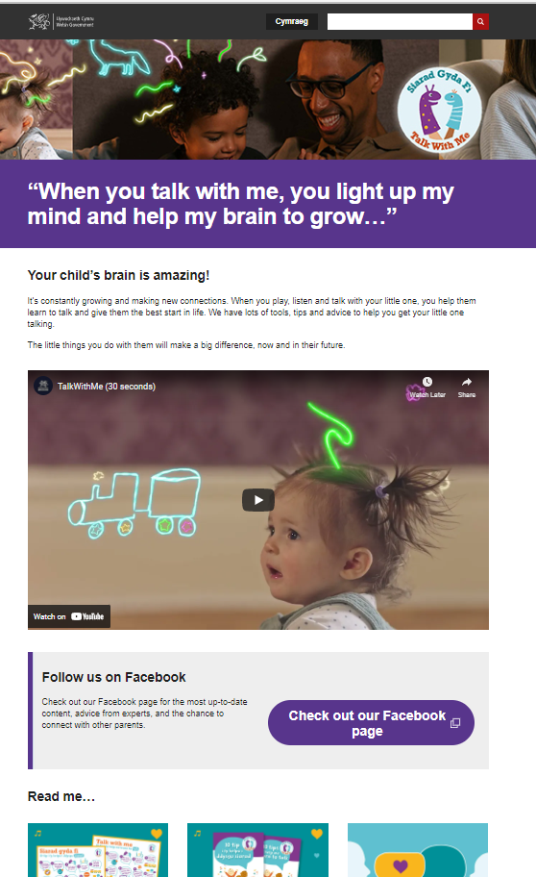
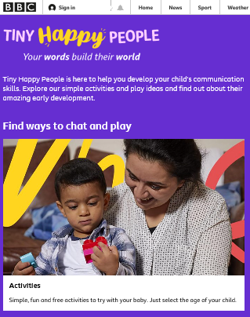
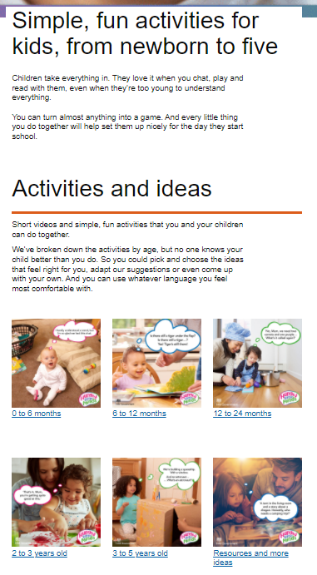
Resources for Families
Talk with Me
Tiny Happy People
Start for Life
Speech and Language UK
Talk with Me Speech, Language and Communication Training
Notes:
EST: 5 mins

Slide 71
Links and Resources for Practitioners
Talk with Me campaign page
Talk with Me practitioner page
ExChange Community of Practice
ExChange training content
Elklan short course An Introduction to Speech, Language and Communication (elklan.co.uk)
Factsheets: fluency (stammering); phonological awareness; Deafness; bilingualism; tongue tie
Talk with Me Speech, Language and Communication Training
Notes:
EST: 3 mins

Slide 72
Questions & Feedback
**insert own organisation’s survey link and QR code onto this slide**
Notes:
EST: 15 mins
All to complete post evaluation (insert own organisation’s survey link and QR code onto this slide)

Slide 73
References
Bhamani, S (2020). Educating Before Birth via Talking to the Baby in the Womb: Prenatal Innovations. Journal of Education and Educational Development, 4(2). Retrieved from http://jmsnew.iobmresearch.com/index.php/joeed/article/view/181
Boundy, L., Cameron-Faulkner, T., & Theakston, A. (2016). Exploring early communicative behaviours: A fine-grained analysis of infant shows and gives. Infant Behavior and Development, 44, 86-97. DOI: 10.1016/j.infbeh.2016.06.005
Clegg, J., Crawford, E., Spencer, S. and Matthews, D. (2021). Developmental Language Disorder (DLD) in Young People Leaving Care in England: A Study Profiling the Language, Literacy and Communication Abilities of Young People Transitioning from Care to Independence. Int. J. Environ. Res. Public Health, 18, 4107. https://doi.org/10.3390/ijerph18084107
Dickinson, D.K. et al. (2012) “How reading books fosters language development around the world,” Child Development Research, 2012, pp. 1–15. Available at: https://doi.org/10.1155/2012/602807.
Hart, B. and Risley, T.R., 2003. The early catastrophe. Education review, 17(1).
He, S. (2019) Home Environment, Bilingual Preschooler’s Receptive Mother Tongue Language Outcomes, and Social-Emotional and Behavioral Skills: One Stone for Two Birds? Frontiers in Psychology. 10
Holler, J., Kendrick, K.H. & Levinson, S.C. Processing language in face-to-face conversation: Questions with gestures get faster responses. Psychon Bull Rev 25, 1900–1908 (2018)
Hustad KC, Mahr TJ, Natzke P, Rathouz PJ. Speech Development Between 30 and 119 Months in Typical Children I: Intelligibility Growth Curves for Single-Word and Multiword Productions. J Speech Lang Hear Res. 2021 Oct 4;64(10):3707-3719
Karani, NF., Sher, J. & Mophosho M. (2022) The influence of screen time on children’s language development: A scoping review South African Journal of Communication Disorders. 69:a825
Levickis, P. et al. (2014) “Maternal behaviors promoting language acquisition in slow-to-talk toddlers,” Journal of Developmental & Behavioral Pediatrics, 35(4), pp. 274–281. Available at: https://doi.org/10.1097/dbp.0000000000000056.
McGillion, M., Pine, JM., Herbert, JS. & Matthews D. (2017) A randomised controlled trial to test the effect of promoting caregiver contingent talk on language development in infants from diverse socioeconomic status backgrounds. Journal of Child Psychology and Psychiatry 58:10
Roulstone, S; Law, J; Rush, R; Clegg, J and Peters, T, Department for Education (DFE). (2011) Investigating the role of language in children's early educational outcomes
Schön, D., Boyer, M., Moreno, S., Besson, M., Peretz, I., Kolinsky R. (2008) Songs as an aid for language acquisition. Cognition, 106:2,, Pg 975-983
Strutt, C., Khattab, G. and Willoughby, J. (2021) “Does the duration and frequency of dummy (pacifier) use affect the development of speech?,” International Journal of Language & Communication Disorders, 56(3), pp. 512–527. Available at: https://doi.org/10.1111/1460-6984.12605.
Tamis-LeMonda, CS. & Schatz J. (2019) Learning Language in the Context of Play. International Handbook of Language Acquisition p20
Welsh Government (2022) Healthy Child Wales Quality Assurance Framework
Talk with Me Speech, Language and Communication Training

