Slide 1
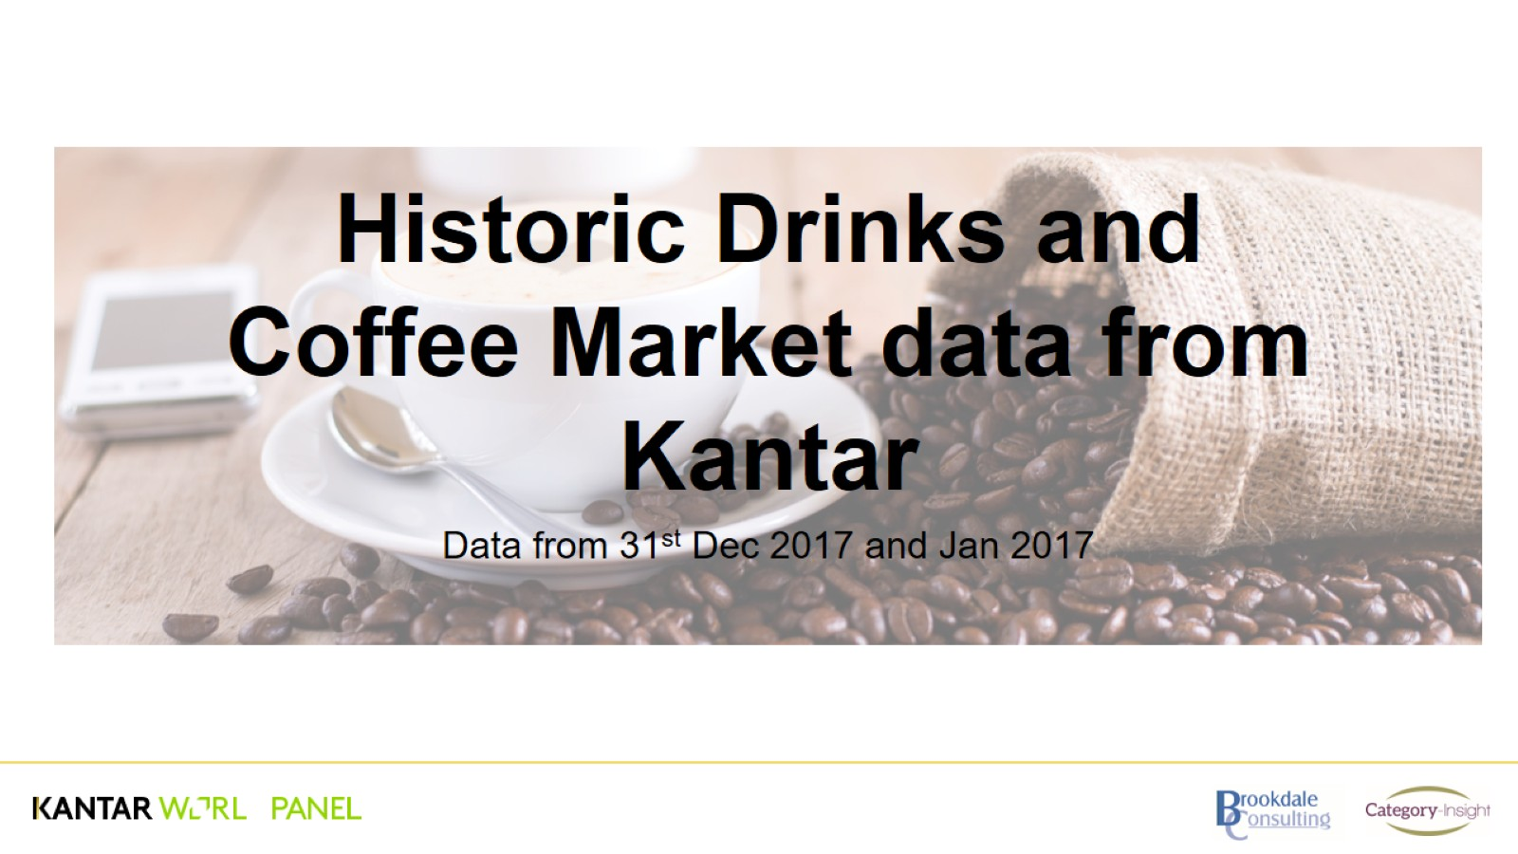
Historic Drinks and Coffee Market data from Kantar

Slide 2
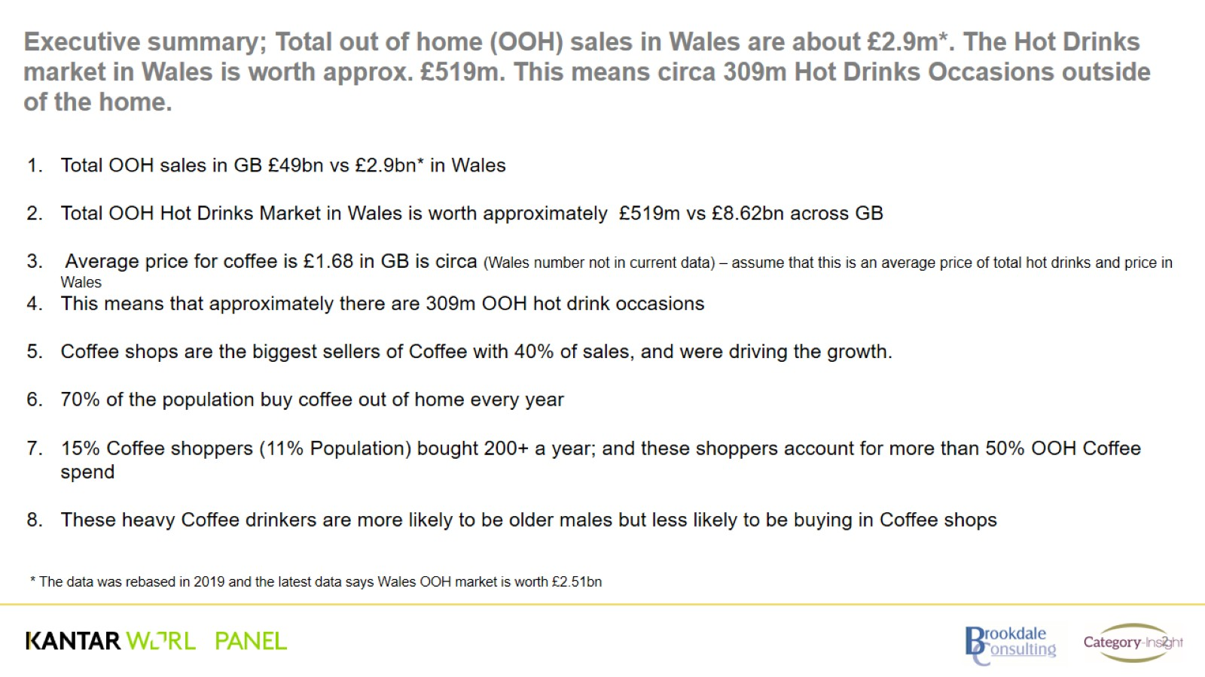

Slide 3
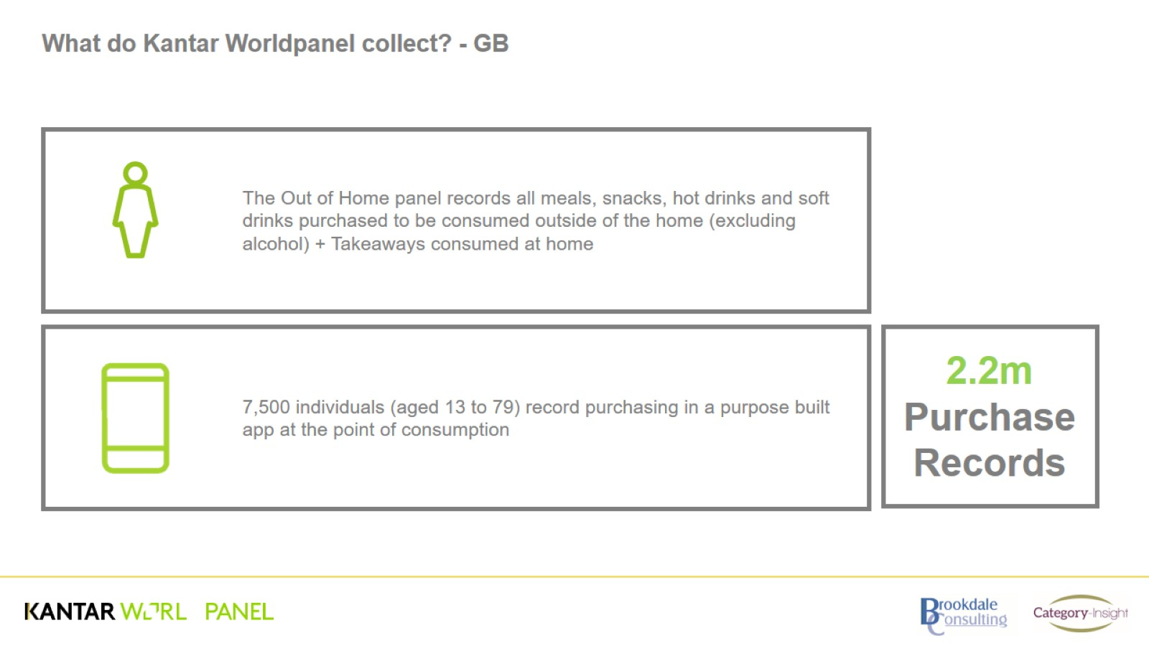
What do Kantar Worldpanel collect? - GB

Slide 4
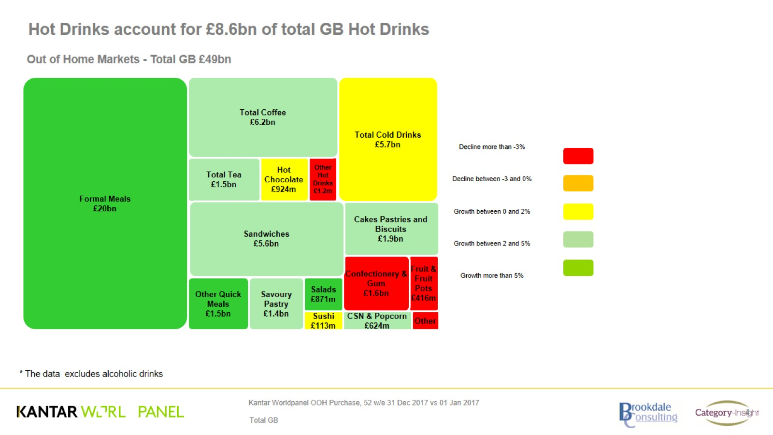
Hot Drinks account for £8.6bn of total GB Hot Drinks

Slide 5
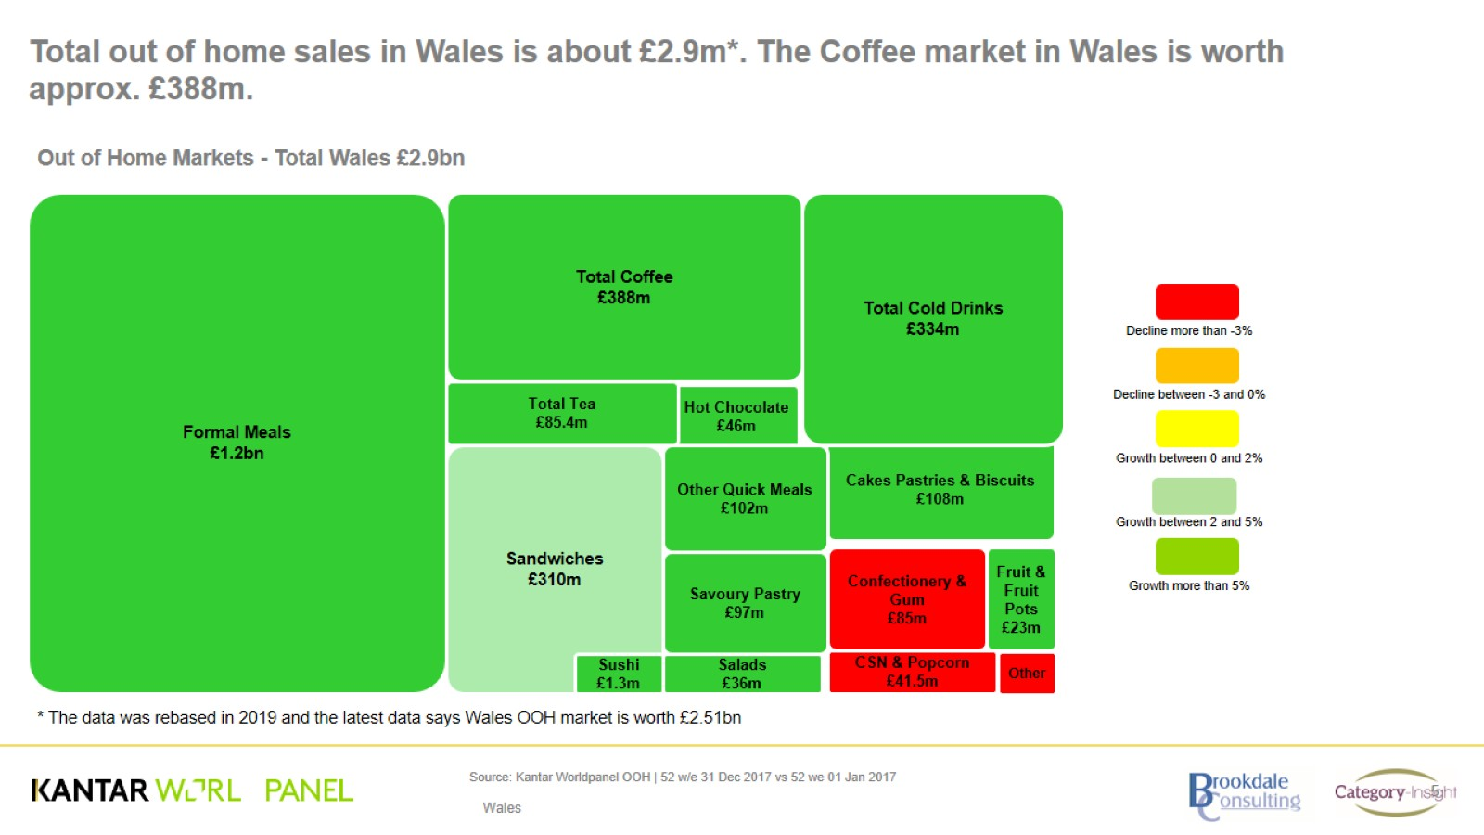

Slide 6
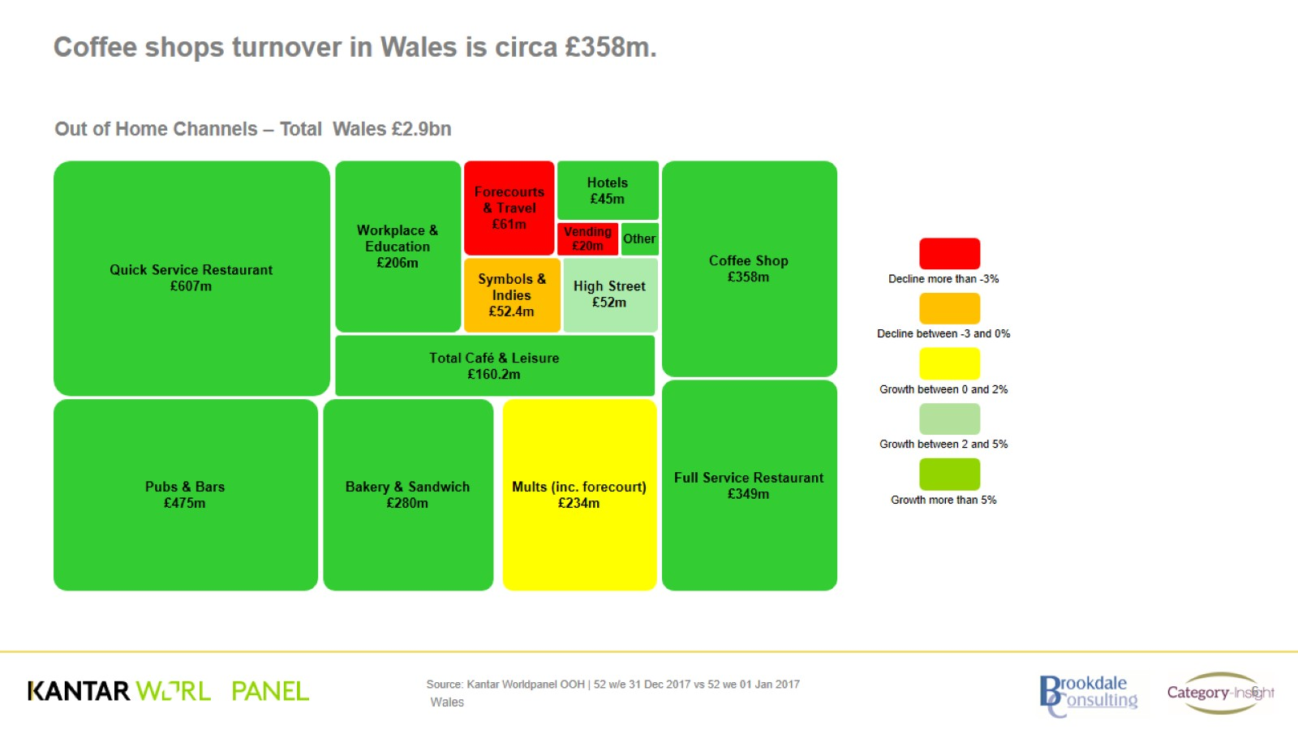

Slide 7
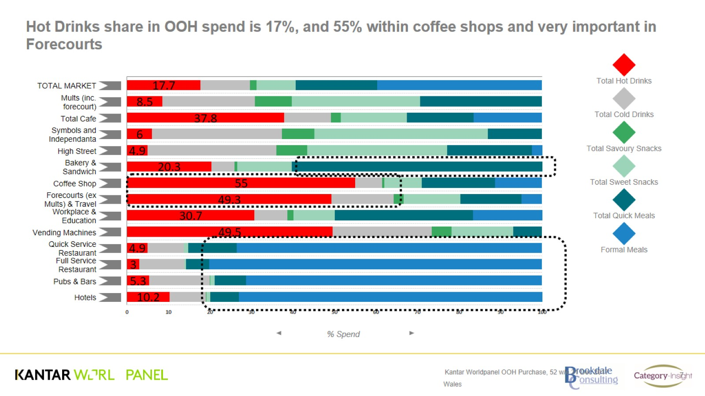

Slide 8
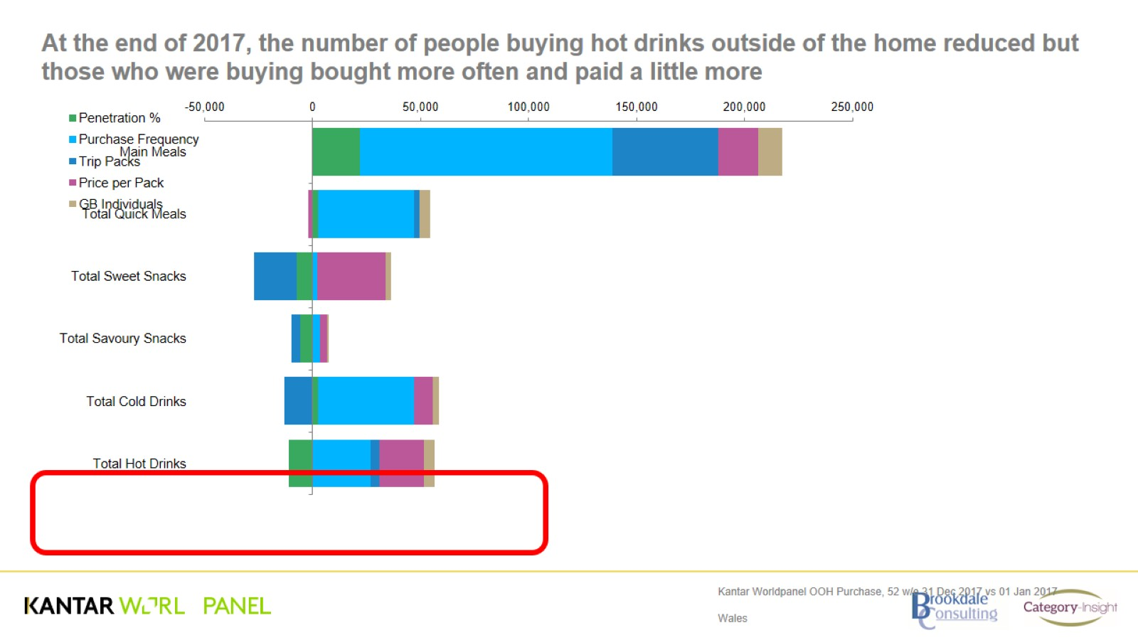
At the end of 2017, the number of people buying hot drinks outside of the home reduced but those who were buying bought more often and paid a little more

Slide 9
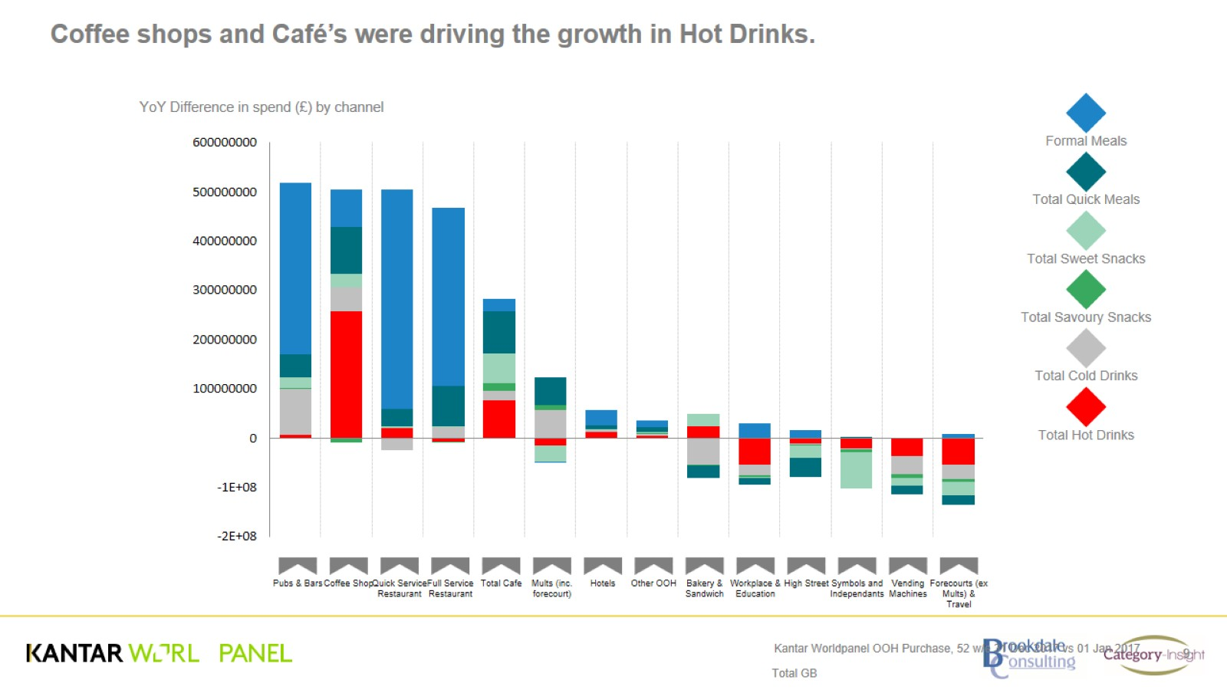

Slide 10
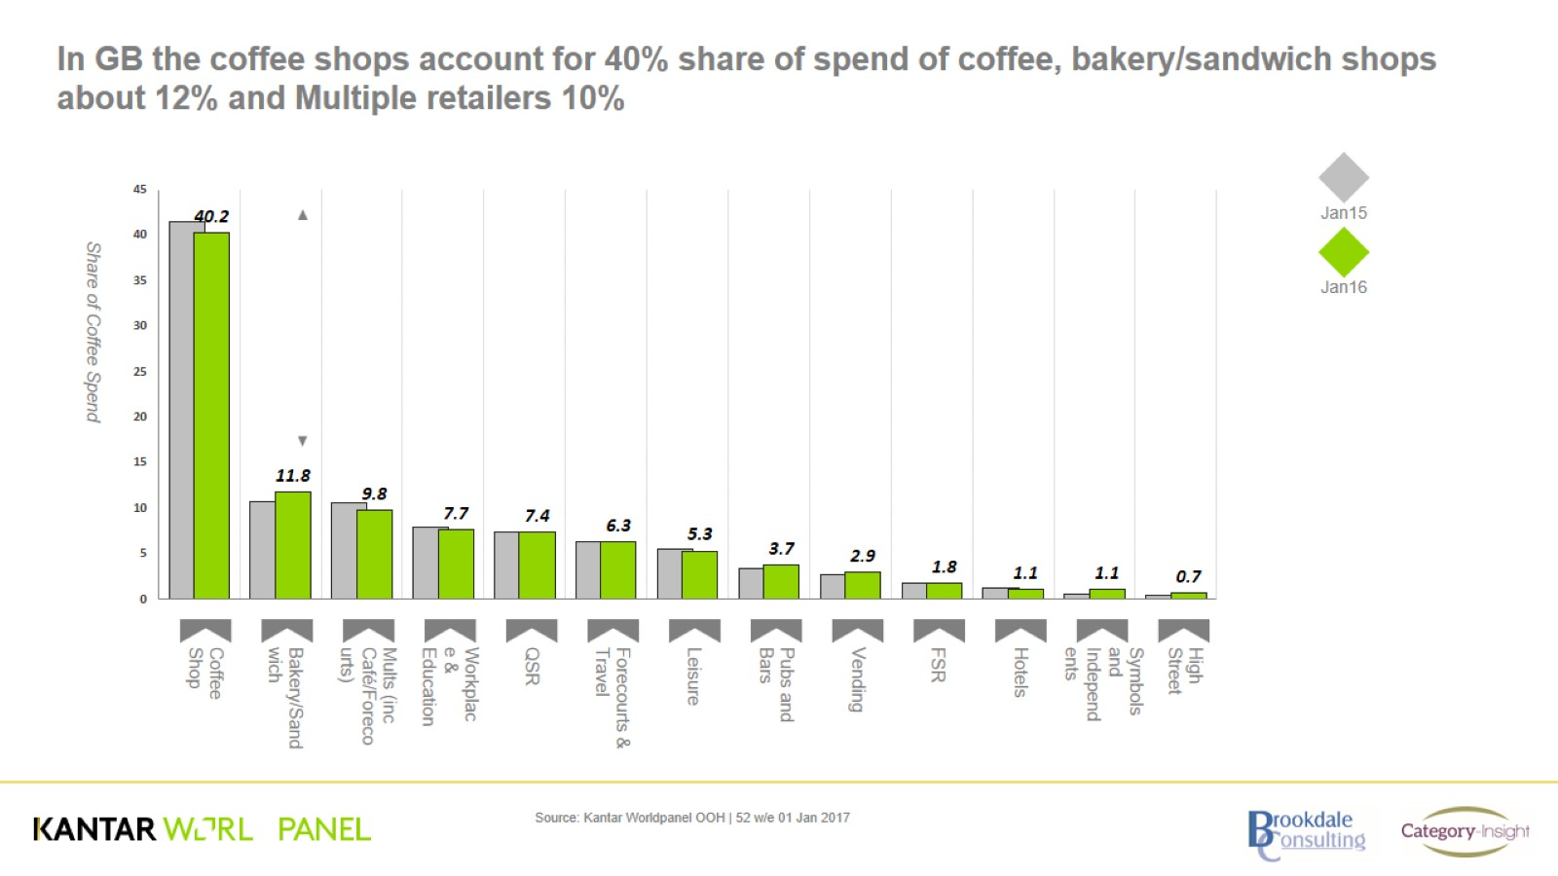
In GB the coffee shops account for 40% share of spend of coffee, bakery/sandwich shops about 12% and Multiple retailers 10%

Slide 11
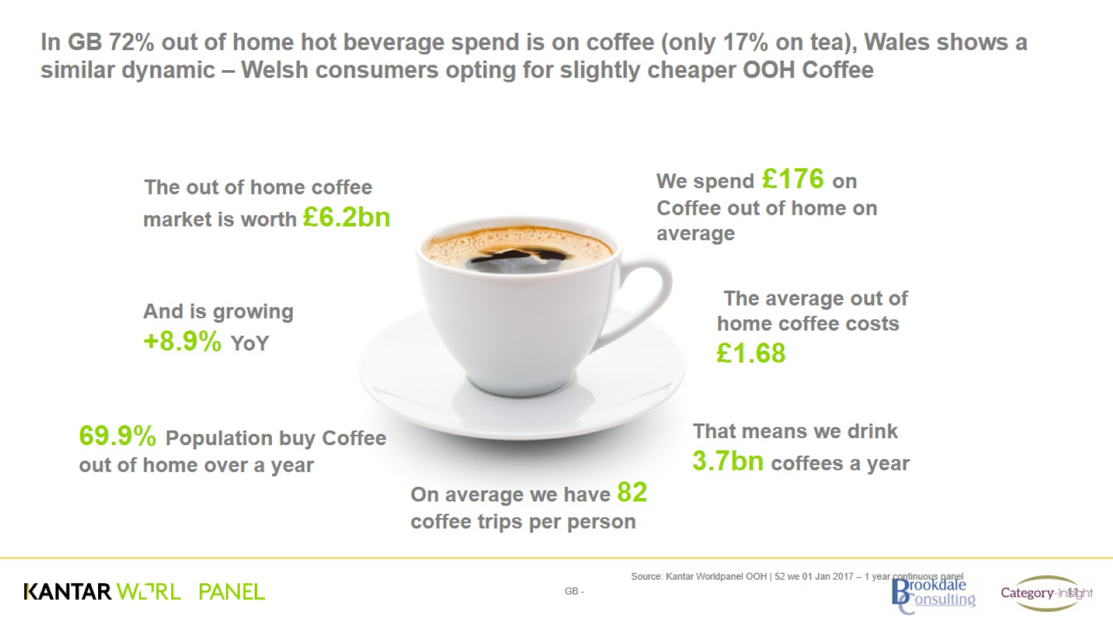
In GB 72% out of home hot beverage spend is on coffee (only 17% on tea), Wales shows a similar dynamic – Welsh consumers opting for slightly cheaper OOH Coffee

Slide 12
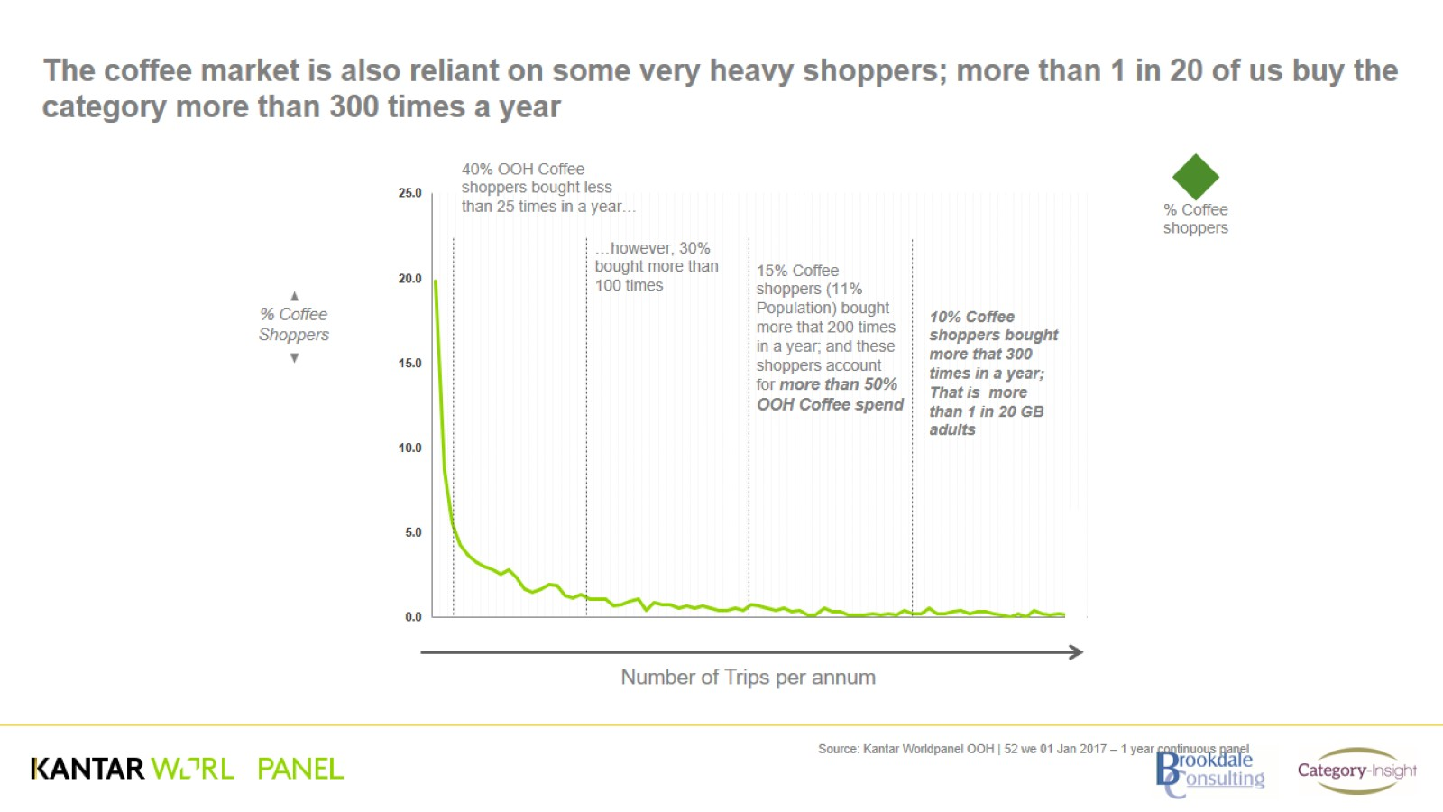
The coffee market is also reliant on some very heavy shoppers; more than 1 in 20 of us buy the category more than 300 times a year

Slide 13
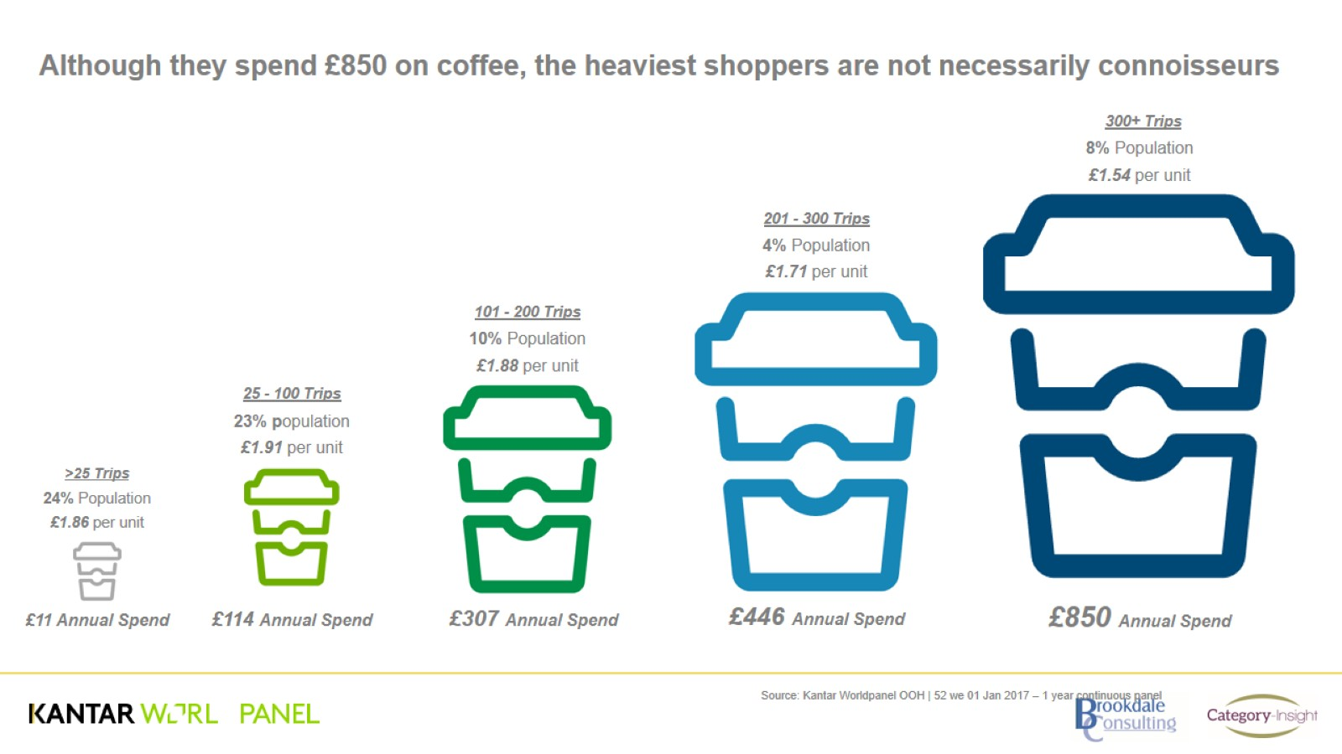
Although they spend £850 on coffee, the heaviest shoppers are not necessarily connoisseurs

Slide 14
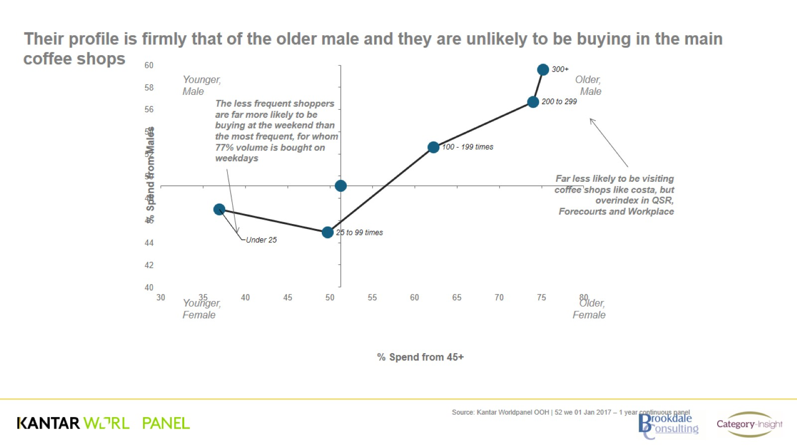
Their profile is firmly that of the older male and they are unlikely to be buying in the main coffee shops

Slide 15
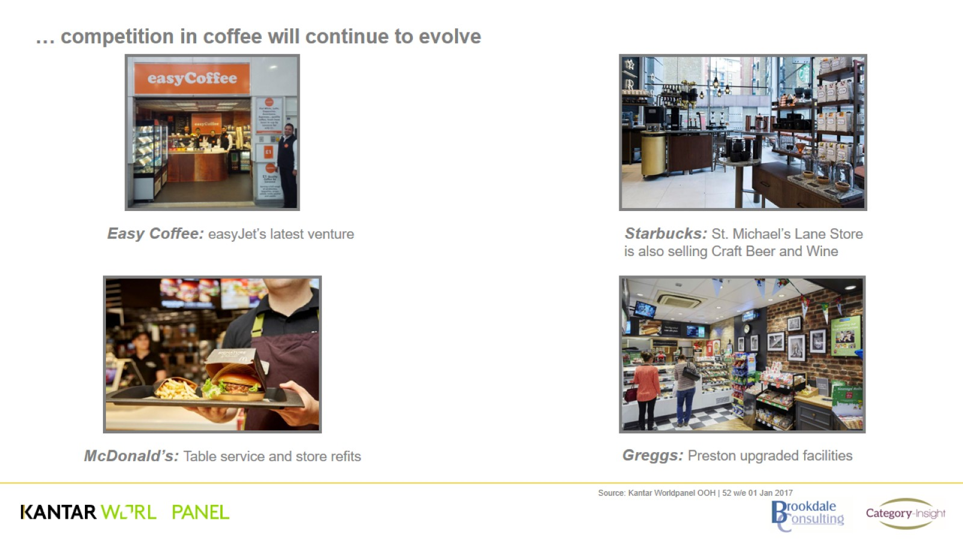
… competition in coffee will continue to evolve

Slide 16
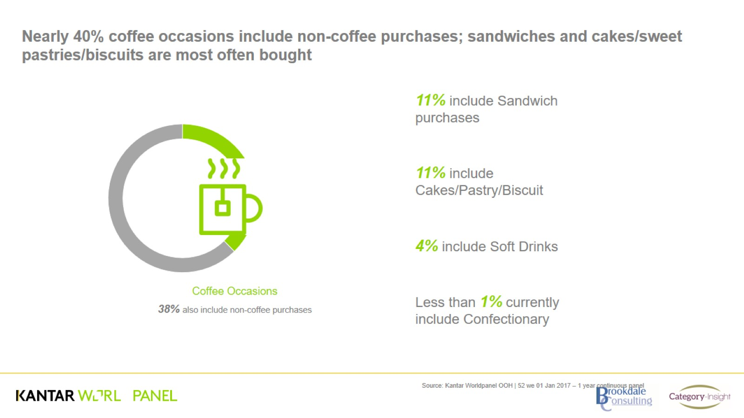
Nearly 40% coffee occasions include non-coffee purchases; sandwiches and cakes/sweet pastries/biscuits are most often bought

Slide 17
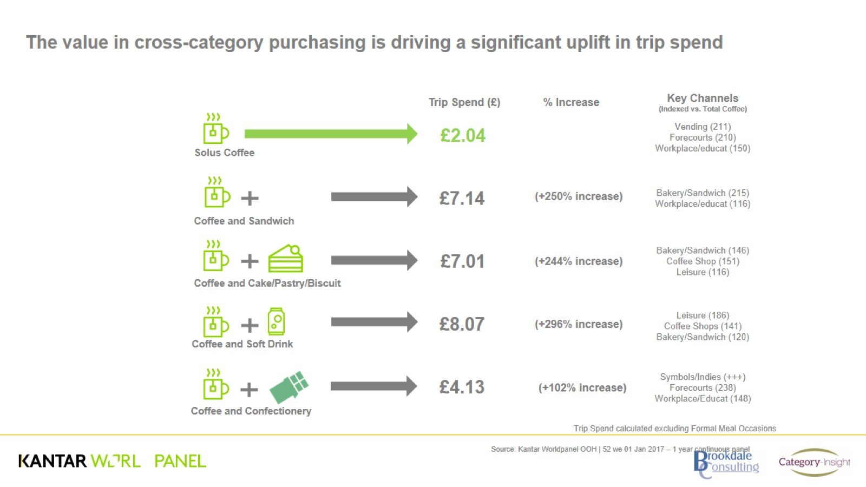
The value in cross-category purchasing is driving a significant uplift in trip spend

