Slide 1


Visit Wales Market Demand Study –
Ireland (2025)
Social Research Number: 79/2025 Publication date: 18/07/25
Digital ISBN: 978-1-80633-077-5
© Crown Copyright
Mae’r ddogfen yma hefyd ar gael yn Gymraeg.
This document is also available in Welsh.

Slide 2


Full Research Report: Visit Wales Market Demand Study – Ireland (2025)
Cardiff: Welsh Government, GSR report number 79/2025
Available at: https://www.gov.wales/tourism-market-demand-reports-march-2025
Views expressed in this report are those of the researcher and not necessarily those of the Welsh Government.
For further information please contact:
Research and Insights Team
Visit Wales,
Economy, Energy and Transport
Cathays Park
Cardiff
CF10 3NQ
Email: tourismresearch@gov.wales

Slide 3
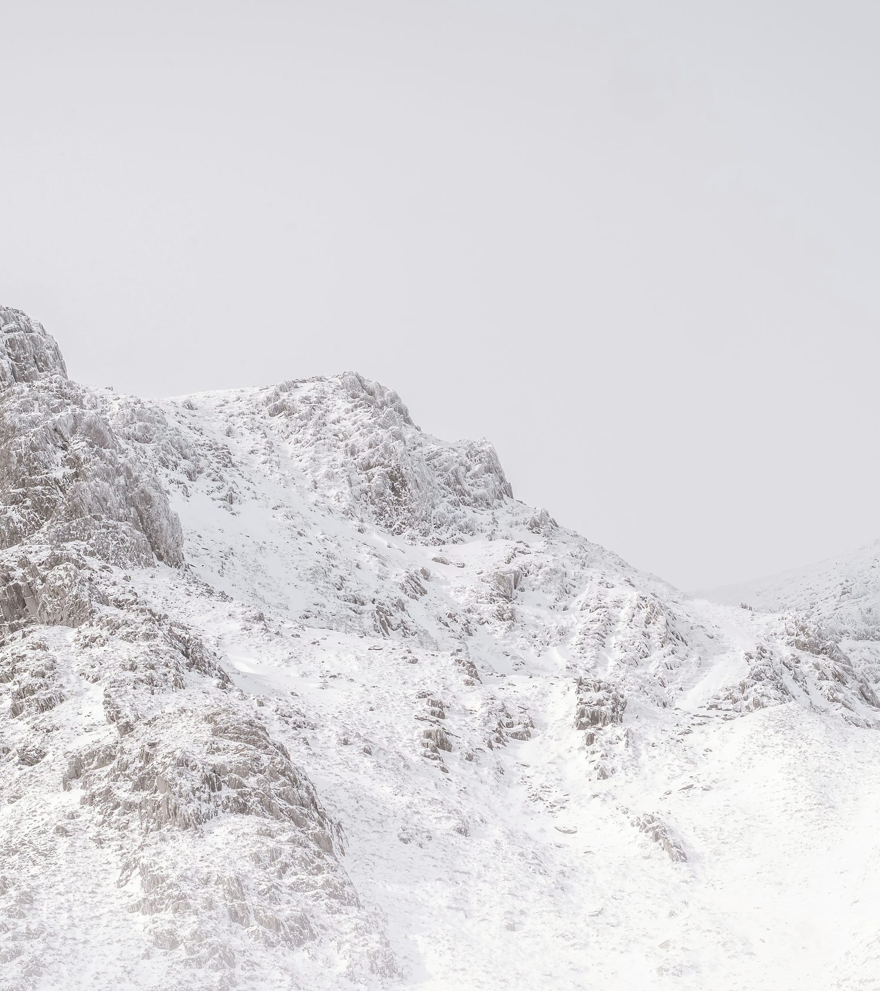
Contents
01 | Background & methodology
02 | Key findings
03 | Profile of Irish holiday market
04 | Wales visitation 2024
05 | Intention to take a trip in Wales in 2025
06 | Visit Wales marketing impact
07 | Accessibility & luxury focus
08 | Reasons for not visiting Wales in 2024
09 | Reasons for not planning to visit Wales in 2025

Slide 4



BACKGROUND
& METHODOLOGY

Slide 5
Background
As the Welsh Government’s tourism team, Visit Wales is responsible for deploying tourism campaigns in the UK and internationally to promote Wales as a holiday destination.
As part of this, each year Visit Wales conducts research amongst its priority markets. The research featured within this report covers the Irish market and broadly looks at:
  Profile of Irish holiday market
  Factors influencing UK short breaks and holidays
  Short breaks and holidays taken in Wales in 2024
  Short breaks and holidays planned in Wales in 2025
  Visit Wales marketing impact
  Luxury and accessibility focus
  Reasons for not visiting Wales

Slide 6






Methodology
Online Survey | 18 minutes length of interview | 26 February – 13 March | Ireland
Respondents were contacted through an online panel and could complete the survey via desktop or mobile device. A total of 750 respondents completed the survey, representing a national sample of the Irish holiday-taking population. To qualify for the survey, participants had to belong to the Irish holiday market, which is defined as:
  Lives in the Republic of Ireland.
  Aged 16+
  Making most overnight trip decisions themselves or with someone else.
  Be very/fairly likely to take a short break or holiday in the UK in the next few years.
Key data considerations included non-response bias, where individuals uninterested in tourism or unfamiliar with Wales might have dropped out or completed the survey hastily. To address this, completion times and data quality flags were monitored. Additionally, seasonal bias could have influenced perceptions, as Wales might have seemed more appealing in summer than in winter. To mitigate this, fieldwork is conducted during a consistent period each year.
Incidence Rate
39.4%

Slide 7
Definitions used in this report
This report uses several terms to define the survey respondents.
Irish holiday market: The total survey population. Residents of the Republic of Ireland who are very/fairly likely to take a short break or holiday in the UK in the next few years.
Wales 2024 trip takers: Residents of the Republic of Ireland who stated they took a short break or holiday in Wales in 2024. Trip behaviour for this audience relates to the whole year.
Non-Wales trip takers 2024: Residents of the Republic of Ireland who stated they did not take a short break or holiday in Wales in 2024.
Wales trip intenders 2025: Residents of the Republic of Ireland who are definitely or probably intending to take a short break or holiday in Wales in 2025. Trip behaviour for this audience relates to their next trip planned in Wales so will be naturally biased to earlier in the year. With this in mind, trips planned for 2025 should not be compared to trips taken in 2024.
Life stages are preferable to ‘age’ as they better describe someone’s life situation. For the purpose of this report, the following is used:
Younger independents: Aged 16-34 without children in household.
Families: Aged 16-64 with children in household.
Older independents: Aged 35-64 with no children in household.
Retirement age: Aged 65+.
Social grade:
AB: Higher and intermediate managerial, administrative and professional occupations.
C1: Supervisory, clerical and junior managerial, administrative and professional occupations.
C2: Skilled manual occupations.
DE: Semi-skilled and unskilled manual and lowest grade occupations.
DEFINITIONS

Slide 8
KEY FINDINGS

Slide 9
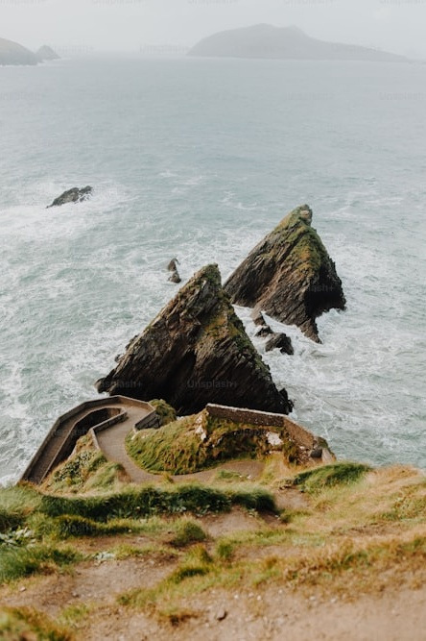


KEY FINDINGS
Wales visitation
In 2024, 15% of people visited Wales, closely matching the 16% from last year. Again, families were the most likely to have taken a short break or holiday.
Overnight visits to Wales by domestic tourists are highest in the summer, with slightly more visiting in winter and fewer in spring.
In 2024, 49% of visitors chose Wales as their first destination, a decrease from 66% in 2023. North Wales was the top spot for Irish holidaymakers, but most stayed in Cardiff for short visits, with few staying more than a week. The majority of Irish visitors travelled with at least one other person, with 61% travelling with a partner and only a small minority traveling alone.
Approximately 43% plan to visit Wales in 2025, an increase from 36% last year. Southeast Wales is the top destination for 2025 trip planners, with Cardiff being the most popular location (35%).
Know about Wales?
A greater percentage of people have become aware of Wales as a destination for 2025 compared to 2022 and 2023, although it remains similar to last year. TV advertising is the main source of information about Wales, followed closely by word of mouth.
The family campaigns had slightly more recall with 32% stating they have seen it for the Hwyl campaign and 26% for the Wales by tails campaign. Perceptions of these advertisements were positive, with a significant majority agreeing that they portray Wales in a favourable light and make it an appealing destination.
35% of people engaged with Visit Wales' digital marketing channels in the past year, marking a 3% increase from the previous year, with the website and TikTok being the most popular platforms.
Reasons for not visiting
The main reasons for not visiting Wales in 2024 were opting for an overseas holiday or not knowing enough about the activities available. Over half chose other destinations in the British Isles or Ireland, particularly the Republic of Ireland and London.
Other reasons included not taking a holiday at all.
For 2025, the primary reason for not planning to visit Wales is again choosing an overseas holiday, with 29% never considering Wales as a holiday destination and 24% unsure about available activities.
London (38%) and the Republic of Ireland (36%) are the top alternative destinations for those not planning to visit Wales.

Slide 10
PROFILE OF IRISH HOLIDAY MARKET

Slide 11





The sample is similar to last year, with families compromising the largest lifestage.
Life stage | 2024 | 2025 (this report)
Younger independents | 18% | 17%
Families | 34% | 38%
Older independents | 31% | 27%
Retirement age | 17% | 18%
Age | 2024 | 2025 (this report)
16-34 | 28% | 28%
35-54 | 39% | 39%
55-64 | 16% | 14%
65+ | 17% | 18%
Gender
Social class | 2024 | 2025 (this report)
AB | 26% | 23%
C1 | 31% | 36%
C2 | 18% | 20%
DE | 20% | 21%
SAMPLE
50%
50%
S1. How do you describe your gender?
X2. Please type in your age.
X2b. Do you have any children aged 15 or under in your household that you are responsible for (parent, legal guardian etc.)?
X3a.Which of these best describe you? X4a. Which one of these best describes the occupation of the main income
earner in your household? X4b. You say that the main income earner in the household is now retired. Which one of the
following best describes their occupation before they retired?
Total base size, n=750.

Slide 12
Region of origin
The sample reflects the national representation of the Irish population, similar to last year.
S3. And where in the Republic of Ireland do you live? Total base size, n=1000 (2024), n=750 (2025).

Slide 13
Relationship with each destination
England is the top destination for the Irish when it comes to taking a short break or holiday.
%Take
occasional
short breaks
/ holidays
16%
17%
32%
40%
C1. Which of the following statements best applies to you when it comes to visiting these destinations? Total base size, n=750.

Slide 14
Previous visits to each destination
Of those who had visited Wales, 13% did so in 2024, while 5% visited in the past two months. The majority, however, visited England.
C2. When did you last visit these places for a short break or holiday? All who have visited or not sure, n=421 Wales, n=459 Scotland, n=568 Northern Ireland, n=648 England.

Slide 15

Destination influences
Value for money is the most influential factor when selecting a domestic holiday, followed by convenience. ‘Great value for money’ is important across all social grades, but it is particularly important for those in the DE grade (61%) compared to the AB grade (46%).
AB | 46%
C1 | 56%
C2 | 57%
DE | 61%
Great value for money
54%
B2. Below is a list of influences people have given for choosing their short break and holiday destinations. Which, if any, are most influential when you think about choosing short breaks or holidays in the UK? Total base size, n=750.

Slide 16
WALES VISITATION 2024

Slide 17
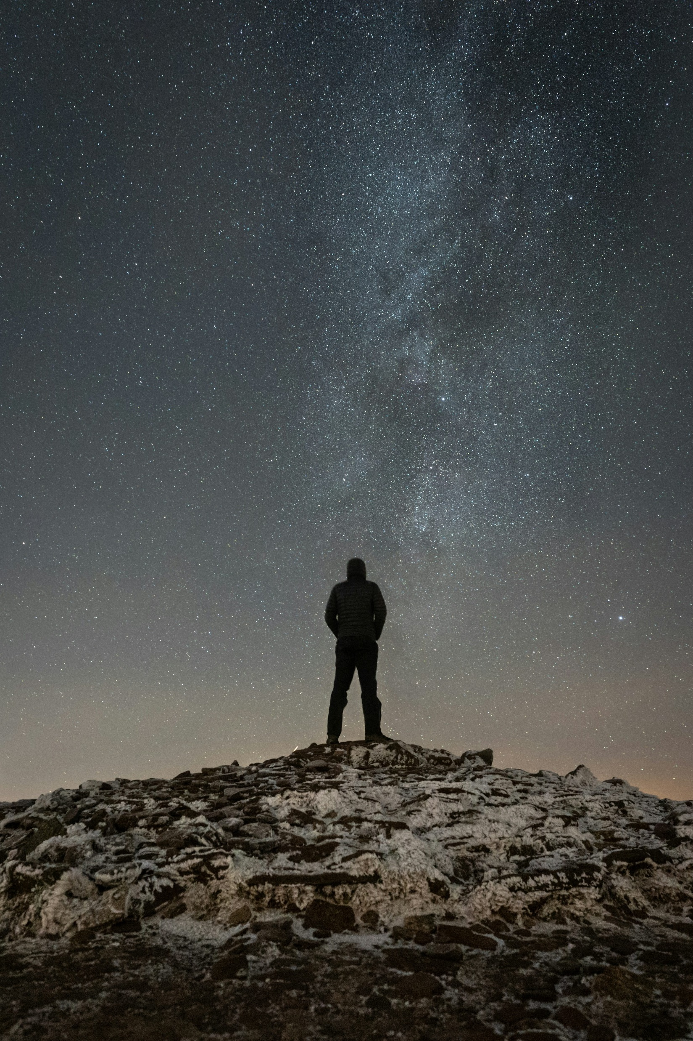
Took a short break or holiday in Wales in 2024
In 2024, 15% of people visited Wales, closely matching the 16% from last year. Again, families were the most likely to have taken a short break or holiday.
How many short breaks or holidays (average in 2024)
2.06 short breaks (1-3 nights)
2.17 holidays (4+ nights)
D1. Did you take a short break or holiday in Wales in 2024? Total base size, n=750.
D2. How many short breaks or holidays did you take in Wales in 2024? Wales 2024 trip takers, n=109.

Slide 18

Month trip taken in Wales in 2023 or 2024
Overnight visits to Wales by domestic tourists are highest during the summer months. Compared to 2023, a slightly higher number took a holiday in the winter, while slightly fewer visited in the spring.
D3. And in which months of the year did you visit for a short break or holiday in 2024?
Wales trip takers, n=162 (taken a trip in 2023), n=109 (taken a trip in 2024).

Slide 19

Wales as a first-choice destination
Of the 2024 visitors, 49% indicated that Wales was their first choice, showing a decrease compared to visitors in 2023 (66%).
D4. Which, if any, of these statements best apply to your trip in Wales in 2024?
Wales trip takers, n=162 (taken a trip in 2023), n=109 (taken a trip in 2024).

Slide 20

Where in Wales and number of nights stayed
In 2024, North Wales emerged as the top destination for Irish holidaymakers visiting Wales. However, the majority of them stayed in Cardiff, with most opting for short stays, and only a few choosing to stay for more than a week.
48%
North Wales (1)
23%
Mid Wales (2)
28%
South West Wales (3)
38%
South East Wales (4)
0% can’t recall
D6. Where in Wales did you stay overnight on this trip in 2024?
D8. On this trip in Wales in 2024, how many nights did you stay away for? Wales 2024 trip takers, n=109.

Slide 21

Company
The overwhelming majority of Ireland visitors to Wales in 2024 travelled with at least one other person. 61% travelled with their partner, and only a small minority took the trip alone.
Your partner
61%
D9. With whom did you spend your short break or holiday in Wales in 2024?
Wales 2024 trip takers, n=109.

Slide 22
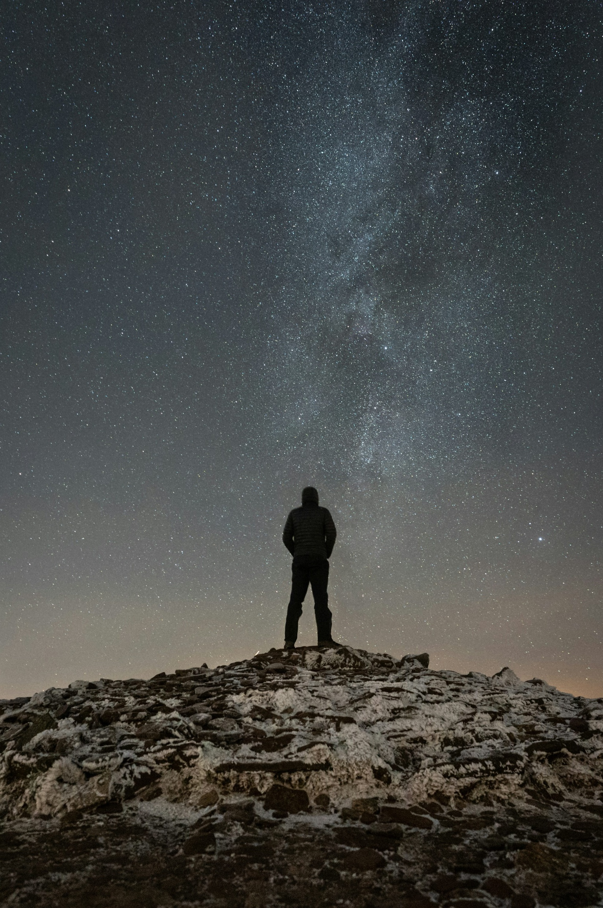

Understand the characteristics of trips taken in 2024
Wales visitation
In 2024, 15% of people visited Wales, similar to the previous year, with families being the most common group for short breaks.
Trip characteristics
Summer saw the highest number of domestic overnight stays. Compared to 2023, winter had slightly more visitors than spring. North Wales was popular, though most stayed in Cardiff.
Additionally, 61% of Irish visitors travelled with a partner, with only a small percentage traveling alone.
Almost half had Wales as their first choice destination
49% of visitors in 2024 chose Wales as their first choice destination, a decrease from 66% in 2023.

Slide 23
LIKELY TO VISIT WALES IN 2025

Slide 24



Intending to visit Wales in 2025
Approximately 43% plan to visit Wales in 2025, an increase from 36% last year.
Annual Average
1.54 intended 2025 short breaks on average
1.39 intended 2025 holidays per year on average
F1. Are you intending to take a short break or holiday in Wales in 2025? Total base size, n=1000 (2024), n=750 (2025).
F2. Roughly how many short breaks or holidays do you plan on taking in Wales in 2025? Wales trip intenders 2025, n=320.

Slide 25
Intending to visit Wales in 2025, by lifestage
Families are more likely to visit, while older independents and those of retirement age are more likely to be unsure or undecided.
% Yes
43%
38%
54%
35%
35%
F1. Do you intend to visit Wales for a short break or holiday in 2025? Total base size, n=750 (younger independents n=125, families n=285, older independents n=203, retirement age n=137).

Slide 26
Intending to visit Wales in 2025, by lifestage
... among those aware of the Visit Wales campaign(s), the likelihood of visiting Wales in 2025 is notably higher, demonstrating the effectiveness of the marketing efforts.
% probably/definitely will visit or already booked
F1. Do you intend to visit Wales for a short break or holiday in 2025? Total base size, n=261 (younger independents n=35*, families n=128, older independents n=53, retirement age n=45*).

Slide 27
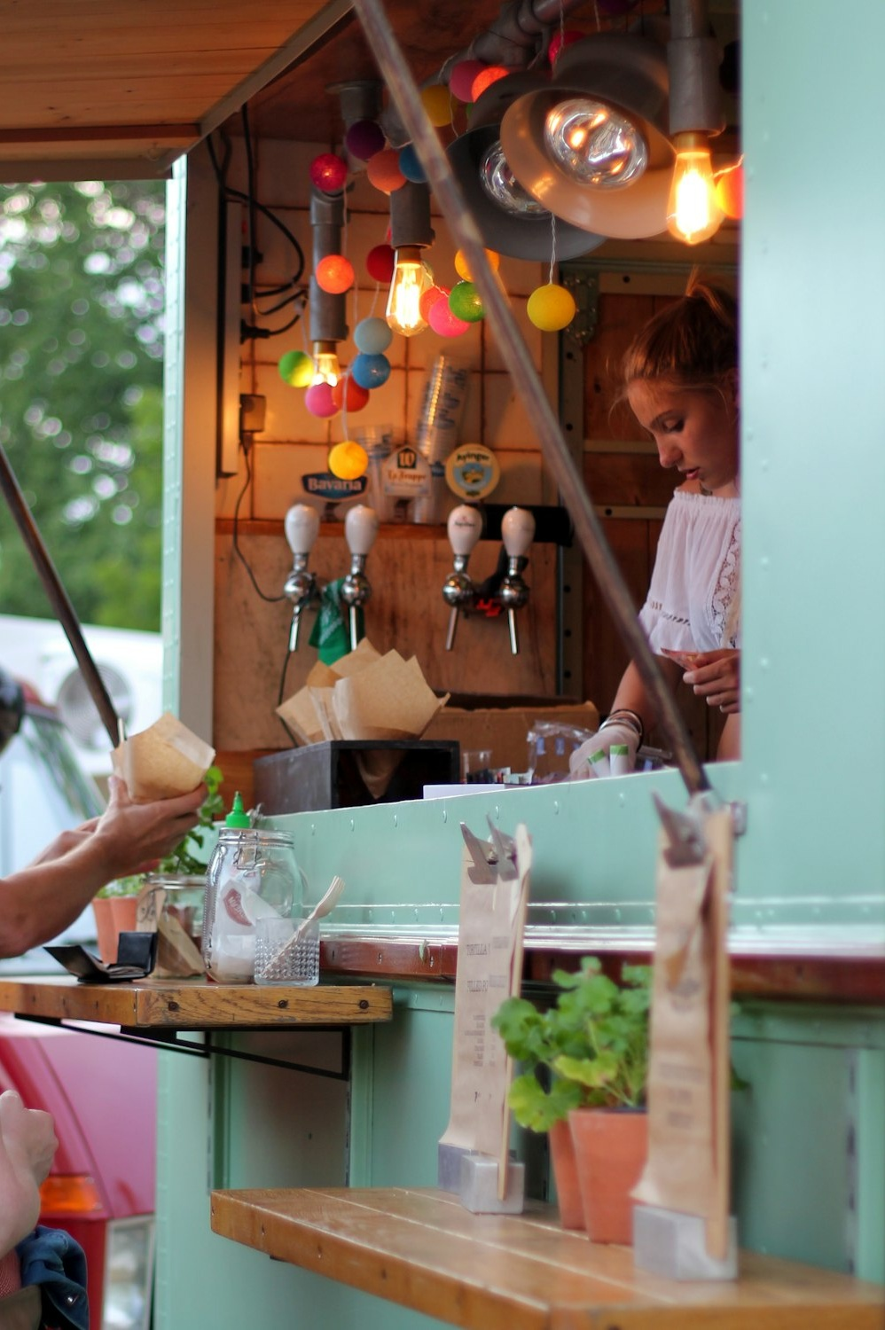
Events
There is a strong interest in attending a 'food and drink festival’ for those planning to visit in 2025, although there is a wide range of events and activities that appeal to those planning trips in 2025.
% very interested
(I will look into attending/I will definitely attend)
F10. How, if at all, interested would you be in attending the below types of festivals or events in Wales in 2025?
Wales trip intenders 2025, n=320.

Slide 28
Where are they planning to go in 2025 in Wales?
Southeast Wales is the top destination for 2025 trip planners, with Cardiff being the most popular location.
37%
North Wales (1)
25%
Mid Wales (2)
28%
Southwest Wales (3)
46%
Southeast Wales (4)
3% don’t know
F7. Which of these areas do you plan on staying overnight on your next short break or holiday in Wales in 2025?
Wales trip intenders 2025, n=320.

Slide 29

Sources of information
Those planning a trip to Wales in 2025 use a range of sources to plan their 2025 trip. The most commonly used methods include 'conversations with friends or family who have visited' and 'search engines.' Additionally, 26% have already used or plan to use the Visit Wales social media page.
F11. Which, if any, of these information sources are you likely to or have you already used to plan your trip/s in Wales in 2025? Wales trip intenders 2025, n=320.

Slide 30

UK and Ireland considerations for 2025
39% of those planning trips in 2025 are also considering an overnight stay in London. The Republic of Ireland, Scotland and Northern Ireland are also among the top domestic destinations being considered.
F12. Where else, if anywhere, in the UK and Ireland are you seriously considering visiting for a holiday or short break in the next 12 months? Wales trip intenders 2025, n=320.

Slide 31


Understanding intentions to take trips to Wales in 2025
High interest continues for Welsh tourism in 2025
Around 43% of people plan to visit Wales in 2025, up from 36% last year.
Families are more likely to visit, while older independents and retirees tend to be more unsure or undecided.
Among those aware of the Visit Wales campaign(s), the likelihood of visiting in 2025 is notably higher, highlighting the success of these marketing efforts.
Where do they go to and what will they do?
There is strong interest in food and drink festivals, along with various other events, among those planning trips to Wales in 2025.
Southeast Wales, with Cardiff being the top destination (35%), remains the most popular choice for travellers in 2025, similar to 2024.
Travellers typically rely on conversations with friends or family and search engines for planning their visit, with 26% also using the Visit Wales social media page.
Other places
39% of those planning trips to Wales in 2025 are also considering an overnight stay in London.
The Republic of Ireland, Scotland, and Northern Ireland are also among the top domestic destinations being considered.

Slide 32
VISIT WALES MARKETING IMPACT

Slide 33
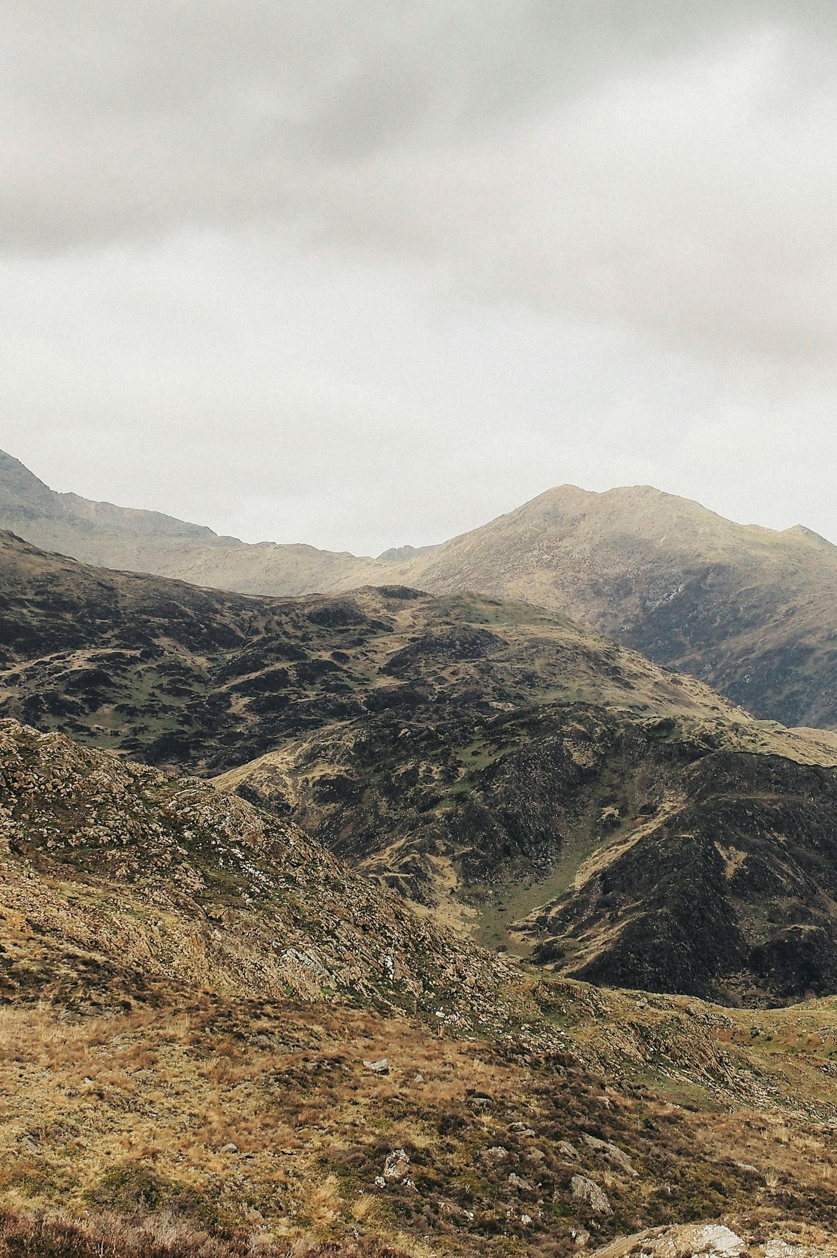
Heard Wales talked about as a place to visit
A larger percentage has heard more about Wales as a destination to visit in 2025, either ‘a little’ or ‘a lot more’, compared to 2022 and 2023, though it's similar to last year.
% A little/
lot more
10%
10%
22%
23%
H1. Compared to normal, how much have you heard Wales talked about as a place to visit over the last 3 months? Total base size, n=750 (2025).

Slide 34
65% have seen or heard about Wales via at least one information source in the last few months.
TV advertising is the primary source, closely followed by ‘word of mouth’. However, younger independents are less likely to have heard about it through TV ads and more likely through content creators, influencers, and social media.
Seen or heard about holidays in Wales
H2. Which, if any, of the following have you seen or heard about holidays in Wales in the last few months?
Total base size, n=750.

Slide 35
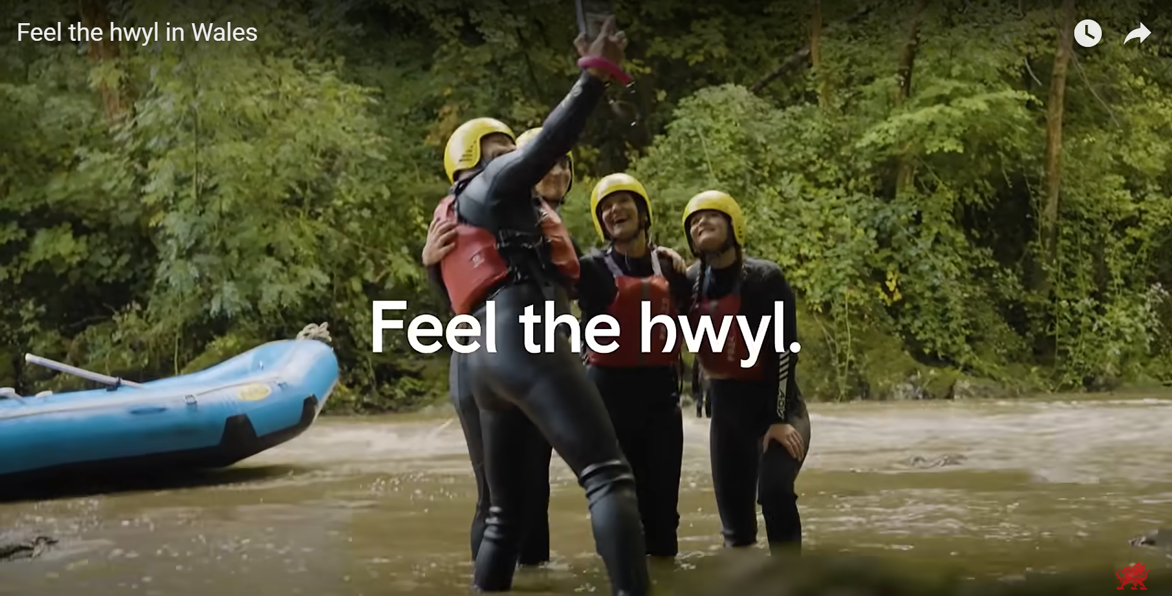
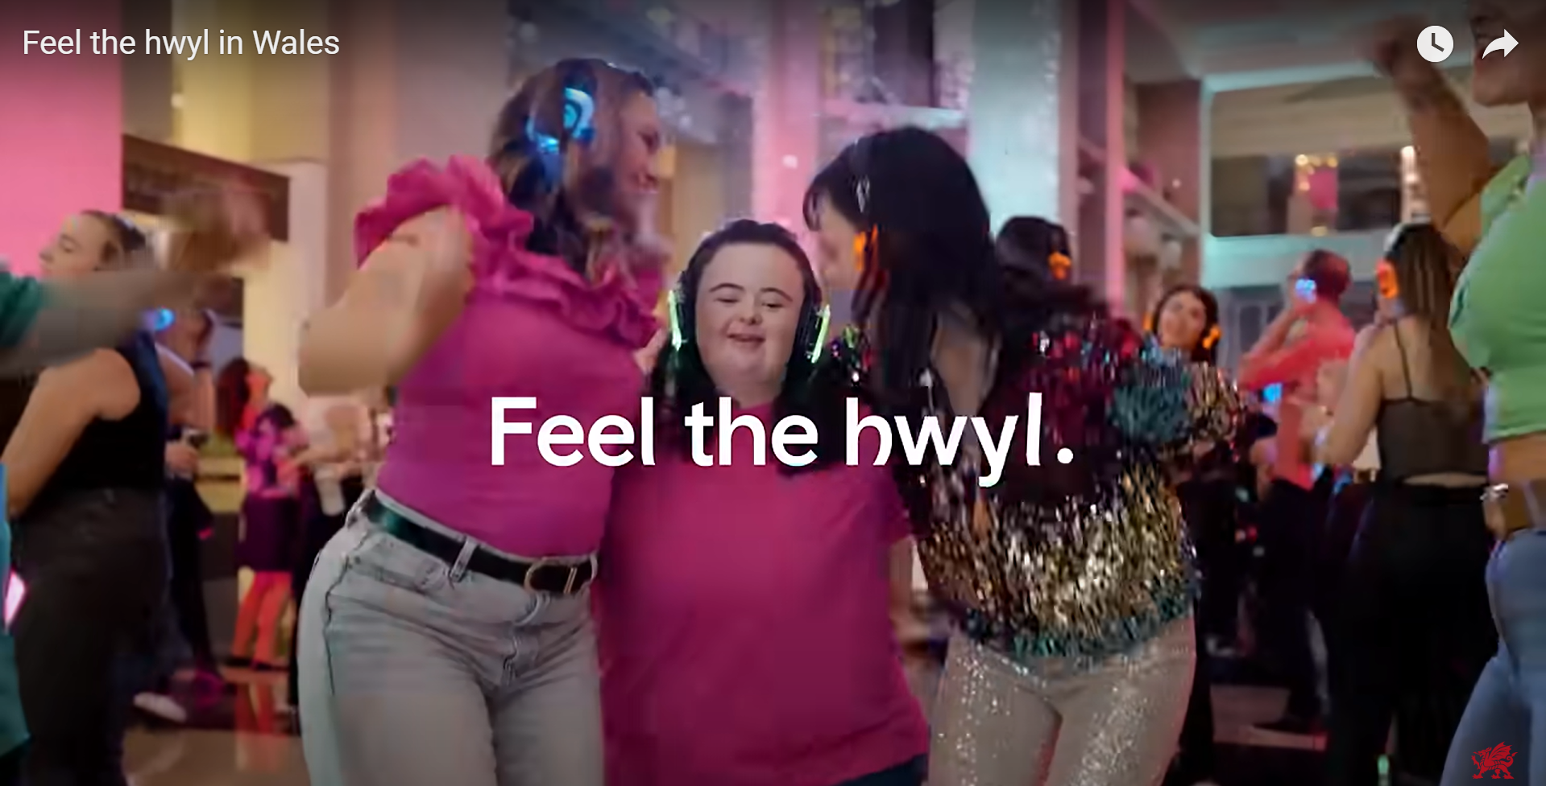
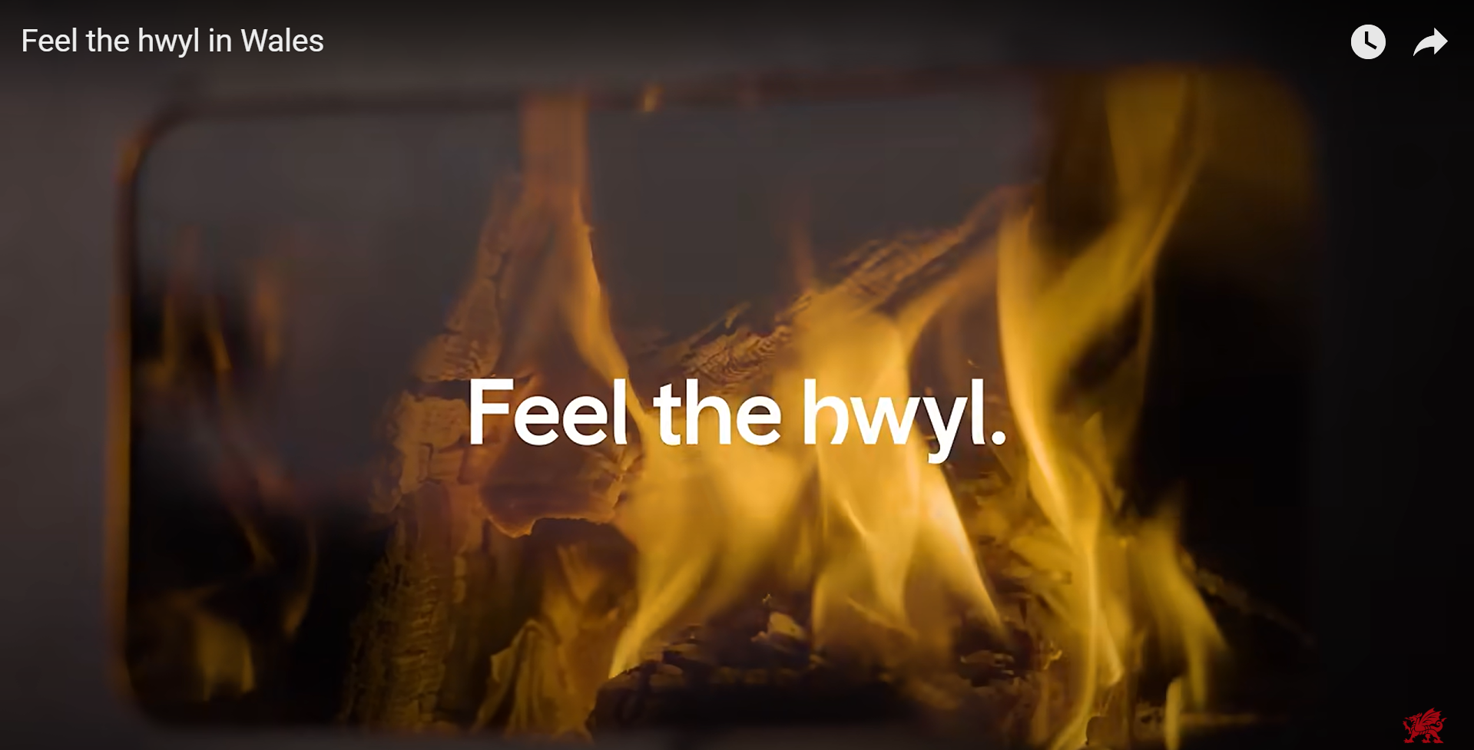
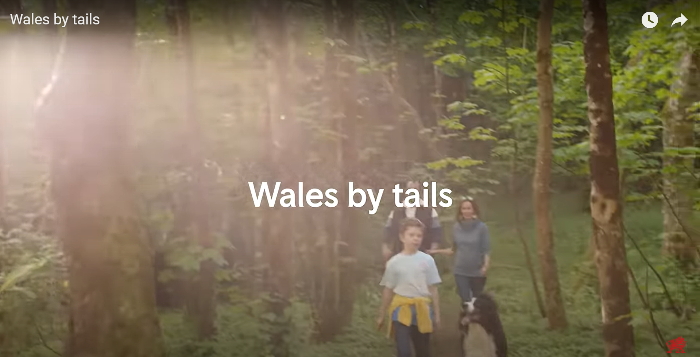

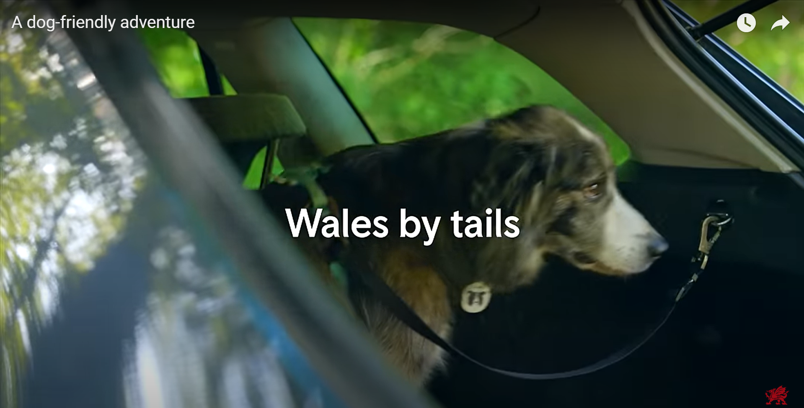

The family campaigns had slightly more recall with 32% stating they have seen it for the Hwyl campaign and 26% for the Wales by tails campaign.
Recall campaigns
Family 32%
Culture buffs 27%
Luxury seekers 26%
Hwyl
Family 26%
Couple 25%
Wales by tails
H4. Do you recall seeing this film or something very similar in the last few months? Total base size, n=750.
Notes:
Hwyl campaign:
Families: Feel the hwyl in Wales
Luxury seekers: Feel the hwyl in Wales
Culture buffs: Feel the hwyl in Wales
Dogs campaign:
Couple: A dog-friendly adventure
Family: Wales by tails
Couple: Wales by tails (vertical display)
Family: A family getaway (vertical display)

Slide 36
Statements campaigns
Perceptions of the advertisements were positive, with a notable majority agreeing that they paint Wales in a positive light and that they makes Wales look very appealing for a trip.
% Agree
81%
77%
71%
70%
68%
H5. Now thinking of the films we have just shown you as one whole marketing campaign, how much do you agree or disagree with the following statements? Total base size, n=750.

Slide 37
Perceptions campaigns
70% agree that the campaign Wales increased their interest in visiting Wales, and makes them eager to explore areas of the country they haven't visited yet.
% Agree
70%
69%
66%
63%
59%
H7. Now thinking about the impact the campaign has had on you personally, how do these films and adverts impact your perceptions of Wales as a short break or holiday destination?
Total base size, n=750.

Slide 38
Perceptions campaigns, of those aware
… and among those aware of (any) of the campaigns, this impact increases for all statement.
H7. Now thinking about the impact the campaign has had on you personally, how do these films and adverts impact your perceptions of Wales as a short break or holiday destination?
Total base size, n=261.

Slide 39
Descriptive statements campaigns
The advertisements scored highly for communicating incredible scenery and landscapes in Wales and for having lots of activities and things to do.
Incredible scenery and landscapes
42%
H6. Which, if any, of these descriptive statements about Wales would you say come across clearly from the adverts you have seen? Total base size, n=750.

Slide 40

Visit Wales contact
35% reported engaging with one of the Visit Wales digital marketing channels in the last 12 months (3% more compared to last year), with the website and TikTok being the leading points of contact.
H8. More generally, which of the following apply to you and Visit Wales in the last 12 months?
Total base size, n=1000 (2024), n=750 (2025).

Slide 41
Saw marketing in relation to Welsh tourism?
Of those who are either unlikely to visit or undecided about visiting Wales in 2025, 12% reported having seen marketing or advertising about Welsh tourism. Within this group, most agreed that the advertisement made Wales appear more exciting.
% Agree
70%
64%
64%
F12a/b. Have you seen any marketing or advertising in relation to Welsh tourism? How much do you agree or disagree with the following statements about the advertising that you saw in relation to Welsh Tourism...Unlikely or undecided about visiting Wales in 2025, n=430 (and have seen advertising for Welsh tourism n=50*). *Caution low base size.

Slide 42

Visit Wales marketing impact
Effective marketing impact
A larger percentage of people have heard more about Wales as a destination for 2025, either ‘a little’ or ‘a lot more,’ compared to 2022 and 2023, though it's similar to last year.
TV is the main information source
TV advertisements are the main source through which people have heard about Wales, followed by word of mouth.
However, younger travellers are more likely to discover Wales through influencers and social media.
35% of respondents engaged with Visit Wales' digital channels in the past year, a 3% increase from the previous year, with the website and TikTok being the most popular.
Campaigns
The family campaigns had slightly more recall with 32% stating they have seen it for the Hwyl campaign and 26% for the Wales by tails campaign.
They have been well-received, with 70% stating they’ve increased interest in visiting Wales, particularly for its scenery, landscapes, and activities.
Among those undecided or unlikely to visit Wales in 2025, 12% saw the campaigns and found Wales more exciting.

Slide 43
LUXURY & ACCESSIBILITY FOCUS

Slide 44
Perception of Wales
When people think of Wales, common associations include rugby, friendly locals, and its stunning scenery, such as mountains, valleys and countryside.
“Friendly people and welcoming place.”
“Friendly people and lovely scenery and places to go.”
“The rugby stadium in Cardiff.”
“Snowdonia, Rugby, friendly people.”
Friendly people
Rugby
“Nice friendly country with great scenery.”
Rugby no 1 in Cardiff, love going to matches there, a great weekend is had by doing this.”
“Castles and scenery.”
“Beautiful scenery, Rugby, Genuine people and of course food and drink.”
“The scenery and the cultural attractions.”
Scenery
G1. When you think of Wales, what aspects come to mind? Total base size, n=750.

Slide 45
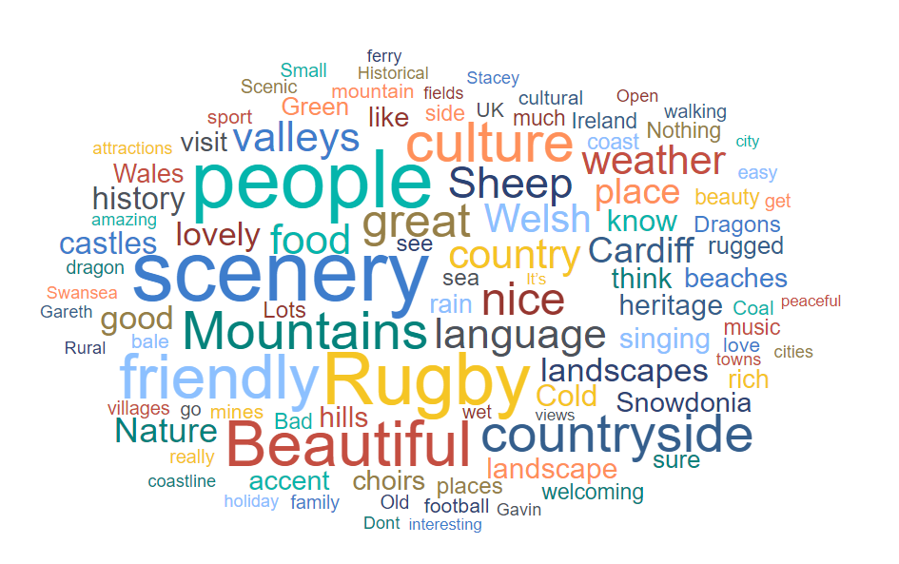
Perception of Wales
G1. When you think of Wales, what aspects come to mind? Total base size, n=750.

Slide 46
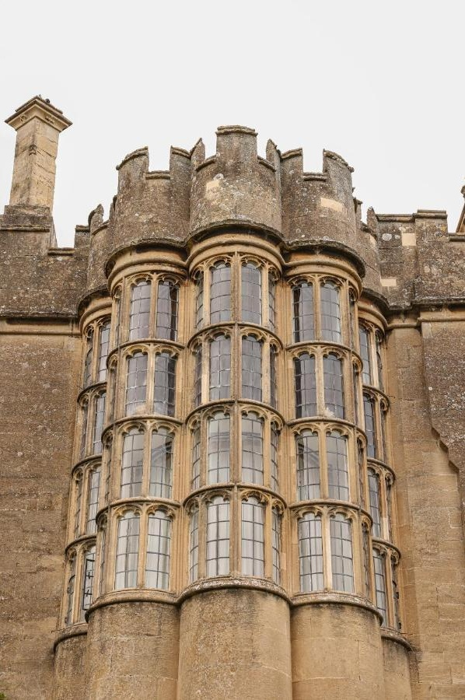
Luxury importance
31% said they consider luxury to be very or extremely important.
Extremely important
31%
Very important
Moderately important
Slightly important
Not important at all
G2. How important is luxury when choosing a travel destination? Total base size, n=750.

Slide 47
Luxury importance, by lifestage
Families generally place more importance on luxury compared to other life stages.
% very or
extremely important
31%
33%
39%
23%
26%
Extremely important
Very important
Moderately important
Slightly important
Not important at all
G2. How important is luxury when choosing a travel destination? Total base size, n=750 (younger independents n=125, families n=285, older independents n=203, retirement age n=137).

Slide 48
Luxury
35% would consider Wales for a luxury holiday.
58% consider scenic locations/views to be important luxury features when booking accommodation, while 42% prioritise fine dining options.
Moreover, 44% are willing to spend more on luxury holidays
G3. Would you consider Wales for a luxury holiday? Total base size, n=750.
G4. What luxury features are important to you when booking accommodation? Those who think luxury is important, n=527.
G5. How do you feel about spending more money for a luxury experience? Total base size, n=750.

Slide 49
Accessibility importance
Accessible transport and the availability of information are frequently mentioned as important accessibility features when booking accommodation.
% very/extremely important
G6. What accessibility features are important to you when booking accommodation? Total base size, n=750.
G7. How important is this feature to your decision when booking accommodation? Base size, n=233.

Slide 50
Accessibility accommodation & attractions
Wales' performance is relatively strong in these key areas.
% good/excellent: Accommodation
% good/excellent: Attractions
G9. How do you rate the accessibility of accommodation when you have visited Wales in the past?
G8. How do you rate the accessibility of attractions when you have visited Wales in the past? Base size, n=107

Slide 51
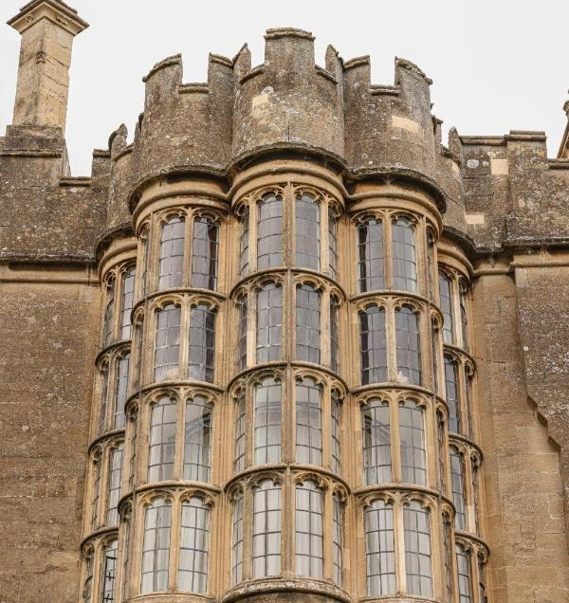

Luxury & accessibility focus
Luxury
When people think of Wales, common associations include rugby, friendly locals, and stunning scenery, such as mountains, valleys and countryside.
31% consider luxury very or extremely important, with families placing more emphasis on it than other groups.
35% would consider Wales for a luxury holiday. 58% value scenic locations/views when booking accommodation, while 42% prioritise fine dining. Additionally, 44% are willing to spend more on luxury holidays.
Accessibility
Information availability and accessible transport are commonly cited as key accessibility features, and they also rank highly in terms of importance, with Wales performing relatively well in these areas.

Slide 52
REASONS FOR NOT VISITING WALES IN 2024

Slide 53

Reasons for not visiting Wales in 2024
The primary reasons for not visiting Wales in 2024 are that people took an overseas holiday instead or they feel they don’t know enough about the available activities. Other reasons included not taking a holiday at all.
NON-WALES TRIP TAKERS 2024
E4. What are the reasons that you didn't take a short break or holiday in Wales in 2024?
Non-Wales trip takers 2024, n=641.

Slide 54
Wales visiting intentions by non-trip takers to Wales
Of non-Wales trip takers, 75% did not consider an overnight trip in Wales in 2024. Just over half decided to go elsewhere in British Isles or Ireland, with the republic of Ireland and London being the most popular destinations.
NON-WALES TRIP TAKERS 2024
25% of non-Wales trip takers were considering an overnight trip in Wales in 2024
E1. You indicated that you did not take a short break or holiday in Wales in 2024. Were you considering a trip in Wales in 2024 at any stage?
E2. Did you go somewhere else for a short break or holiday in 2024 or did you not take one at all? Non-Wales trip takers 2024, n=641.
E3. To which of the following areas of the British Isles or Ireland did you go on your short break or holiday in 2024? Went to British Isles or Ireland, n=330.

Slide 55
REASONS FOR NOT PLANNING TO VISIT WALES IN 2025

Slide 56

Reasons for not planning to visit Wales in 2025
Similar to the reasons for not visiting Wales in 2024, the main reason for not planning to visit in 2025 are opting for an overseas holiday. Additionally, 29% never thought of Wales as a holiday destination and 24% are unsure about what activities are available in Wales.
NON-WALES TRIP INTENDERS 2025
F13. What are the reasons that you are not planning to visit Wales for a short break or holiday in 2025?
Non-Wales trip intenders 2025, n=255.

Slide 57

UK and Ireland locations considered for visiting in 2025
Among those who are not planning to visit Wales in 2025, London (38%) is the most popular destination, closely followed by Republic of Ireland (36%)
NON-WALES TRIP INTENDERS 2025
F14. Where, if anywhere, in the UK and Ireland are you seriously considering visiting for a short break or holiday in 2025? Non-Wales trip intenders 2025, n=255.

Slide 58

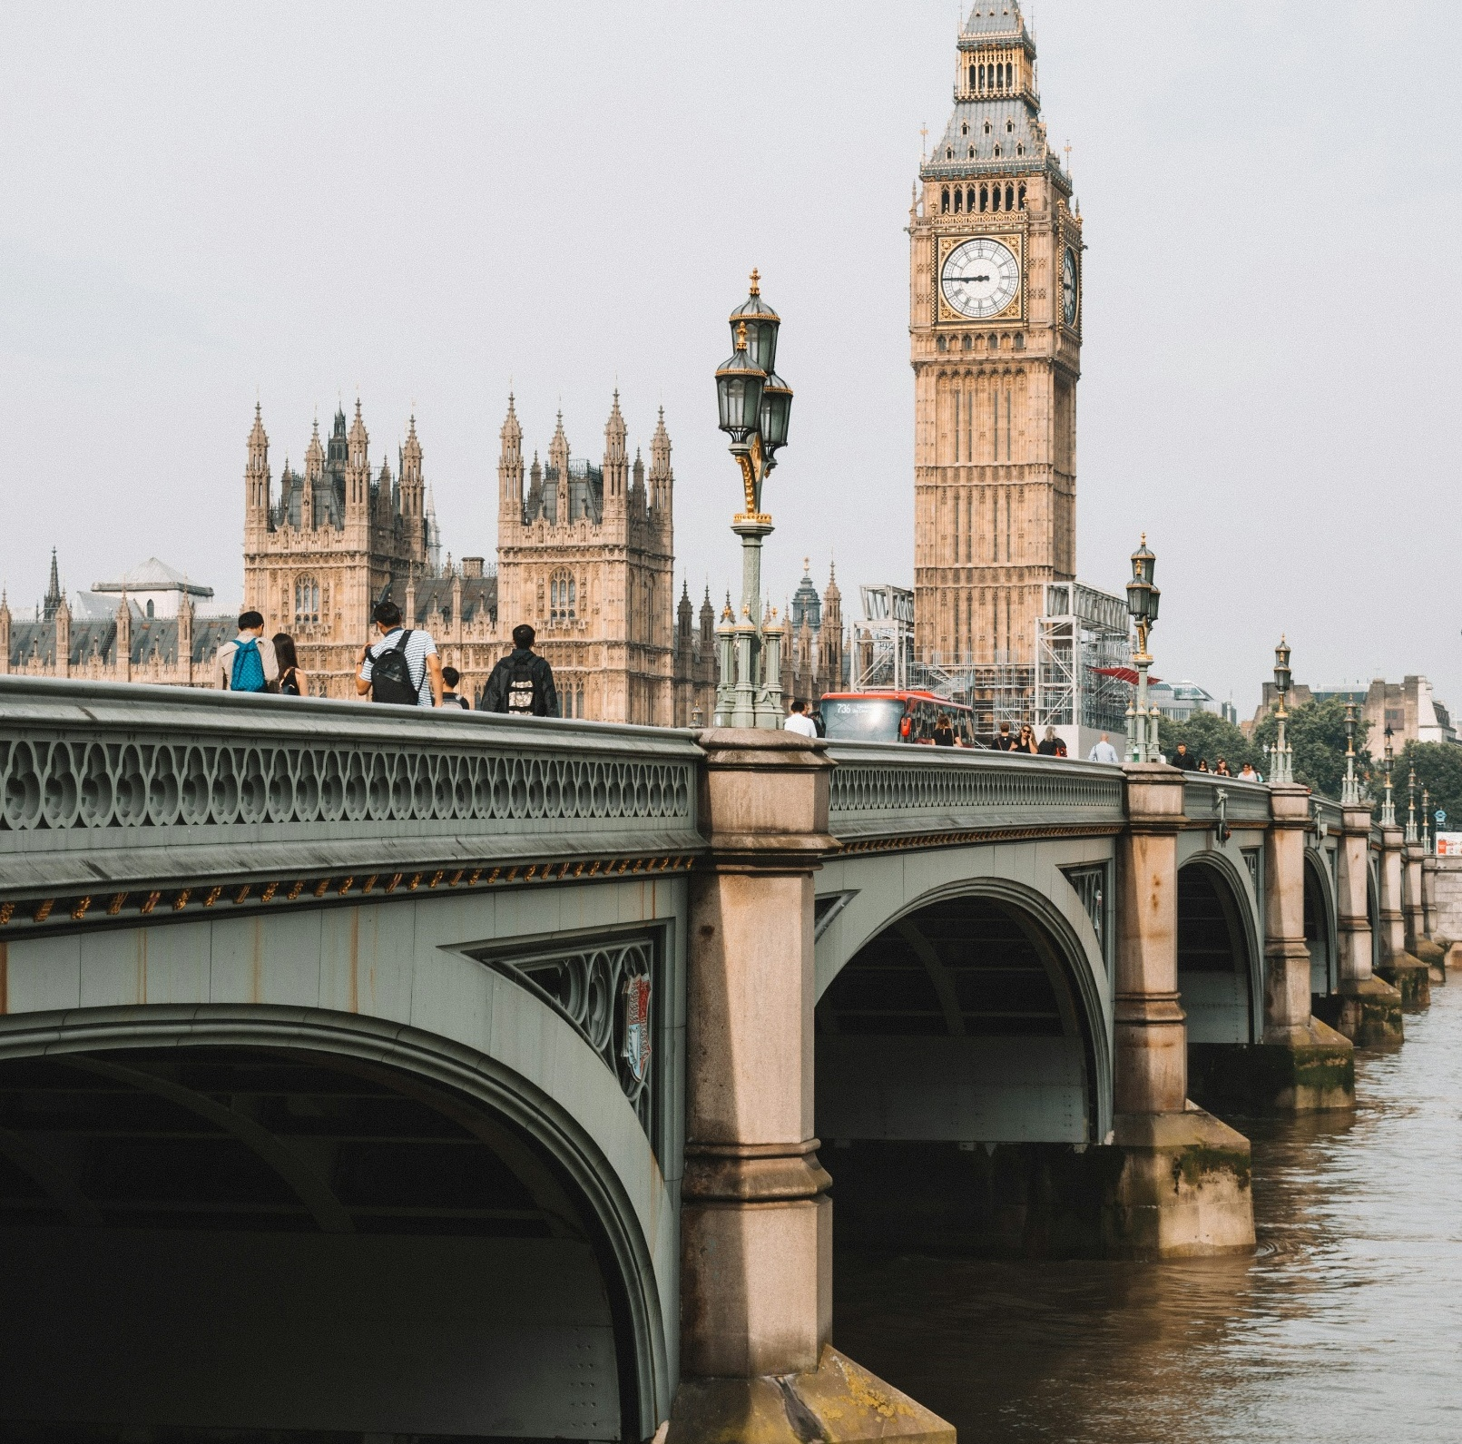
Reasons for not visiting Wales in 2024 or planning to visit in 2025
Reason for not visiting
The main reasons for not visiting Wales in 2024 are that people opted for an overseas holiday or feel they lack knowledge about the available activities.
Similarly, the primary reason for not planning to visit Wales in 2025 is also choosing an overseas holiday. Additionally, 29% haven't considered Wales as a holiday destination, and 24% are unsure about the activities available there.
Top destination
For those not planning to visit Wales in 2025, London (38%) is the top destination, followed by the Republic of Ireland (36%).

