Slide 1


Visit Wales Market Demand Study –
UK (2025)
Social Research Number: 79/2025 Publication date: 18/07/25
Digital ISBN: 978-1-80633-076-8
© Crown Copyright
Mae’r ddogfen yma hefyd ar gael yn Gymraeg.
This document is also available in Welsh.

Slide 2


Views expressed in this report are those of the researcher and not necessarily those of the Welsh Government.
For further information please contact:
Research and Insights Team
Visit Wales,
Economy, Energy and Transport
Cathays Park
Cardiff
CF10 3NQ
Email: tourismresearch@gov.wales
Full Research Report: Visit Wales Market Demand Study – UK (2025)
Cardiff: Welsh Government, GSR report number 79/2025
Available at: https://www.gov.wales/tourism-market-demand-reports-march-2025

Slide 3

Contents
01 | Background & methodology
02 | Key findings
03 | Profile of UK holiday market
04 | Wales visitation 2024
05 | Intention to take a trip in Wales in 2025
06 | Visit Wales marketing impact
07 | Luxury & accessibility focus
08 | Reasons for not visiting Wales in 2024
09 | Reasons for not planning to visit Wales in 2025

Slide 4



BACKGROUND
& METHODOLOGY

Slide 5

Background
As the Welsh Government’s tourism team, Visit Wales is responsible for deploying tourism campaigns in the UK and internationally to promote Wales as a holiday destination.
As part of this, each year Visit Wales conducts research amongst its priority markets. The research featured within this report covers the United Kingdom Market and broadly looks at:
  Profile of UK holiday market
  Factors influencing UK short breaks and holidays
  Short breaks and holidays taken in Wales in 2024
  Short breaks and holidays planned in Wales in 2025
  Visit Wales marketing impact
  Luxury and accessibility focus
  Reasons for not visiting Wales

Slide 6





Methodology
Online Survey | 18 minutes length of interview | 26 February – 13 March | UK
Respondents were contacted though an online panel. The survey could be completed via desktop or mobile device. 863 respondents completed the survey. The first 750 responses were national representative of the UK’s domestic holiday-taking population. A boost of 113 surveys were then conducted amongst residents of Wales. To qualify for the survey, participants must belong to the UK holiday market, which is defined as:
  Live in the United Kingdom.
  Aged 16+
  Making most overnight trip decisions themselves or with someone else.
  Considering taking a short break or holiday in the UK in the next 12 months.
Key data considerations included non-response bias, where individuals uninterested in tourism or unfamiliar with Wales might have dropped out or completed the survey hastily. To address this, completion times and data quality flags were monitored. Additionally, seasonal bias could have influenced perceptions, as Wales might have seemed more appealing in summer than in winter. To mitigate this, fieldwork is conducted during a consistent period each year.
Incidence Rate
37.7%

Slide 7
Definitions used in this report
This report uses several terms to define the survey respondents.
UK domestic holiday market: The total survey population. Residents of the UK who are seriously considering a short break or holiday in the UK in the next 12 months.
Wales 2024 trip takers: Residents of the UK who stated they took a short break or holiday in Wales in 2024. Trip behaviour for this audience relates to the whole year.
Non-Wales trip takers 2024: Residents of the UK who stated they did not take a short break or holiday in Wales in 2024.
Wales trip intenders 2025: Residents of the UK who are definitely or probably intending to take a short break or holiday in Wales in 2025. Trip behaviour for this audience relates to their next trip planned in Wales so will be naturally biased to earlier in the year. With this in mind, trips planned for 2025 should not be compared to trips taken in 2024.
Life stages are preferable to ‘age’ as they better describe someone’s life situation. For the purpose of this report, the following is used:
Younger independents: Aged 16-34 without children in household.
Families: Aged 16-64 with children in household.
Older independents: Aged 35-64 with no children in household.
Retirement age: Aged 65+.
Social grade:
AB: Higher and intermediate managerial, administrative and professional occupations.
C1: Supervisory, clerical and junior managerial, administrative and professional occupations.
C2: Skilled manual occupations.
DE: Semi-skilled and unskilled manual and lowest grade occupations.
DEFINITIONS

Slide 8
KEY FINDINGS

Slide 9



KEY FINDINGS
Wales visitation
In 2024, 40% of people visited Wales, slightly up from 38% in 2023. Families were the most likely to visit, while retirees were the least likely.
Over two-thirds of 2024 visitors chose Wales as their top destination, a rise from 2023.
Domestic overnight visits were highest in spring and summer, with North Wales, Cardiff, and Pembrokeshire being the top spots, mainly for short stays. 68% of visitors travelled with a partner, and only a small minority travelled alone.
Around 60% of UK domestic holidaymakers plan to visit Wales in 2025, an increase from 49% last year. North Wales is the top destination for 2025 trip planners, with Eryri (Snowdonia) being the most popular location, followed by Southeast Wales (Cardiff) and Southwest Wales (Pembrokeshire).
Know about Wales?
In 2025, a larger proportion of the UK domestic holiday market is more familiar with Wales as a destination compared to 2022 and 2023, although it remains similar to last year. Word of mouth is the main way people have heard about Wales, followed by TV advertisement.
Around 30% of people recall recent campaigns, which highlight Wales' attractiveness and scenery. Perceptions of Visit Wales advertisements are positive, with many agreeing that they portray Wales in a favourable light and make it appealing for a visit.
Additionally, 40% have engaged with Visit Wales' digital channels, primarily through its website and Instagram.
Reasons for not visiting
The main reasons for not visiting Wales in 2024 were choosing an overseas holiday or wanting to explore a new destination after previously visiting.
In 2024, over half chose other locations in the British Isles or Ireland, with the South Coast of England and West Country being the most popular.
Similarly, the reasons for not visiting Wales in 2025, include preferring an overseas holiday or seeking a new destination. Additionally, 17% are uncertain about the activities available in Wales.
Among those not planning to visit in 2025, the West Country (23%) is the top alternative UK and Ireland destination.

Slide 10
PROFILE OF UK HOLIDAY MARKET

Slide 11





The sample is similar to last year, with families compromising the largest lifestage.
Life stage | 2024 | 2025 (this report)
Younger independents | 13% | 14%
Families | 37% | 34%
Older independents | 27% | 29%
Retirement age | 23% | 23%
Age | 2024 | 2025 (this report)
16-34 | 28% | 28%
35-54 | 36% | 34%
55-64 | 13% | 15%
65+ | 23% | 23%
Gender
Social class | 2024 | 2025 (this report)
AB | 33% | 37%
C1 | 27% | 28%
C2 | 17% | 16%
DE | 19% | 19%
SAMPLE
51%
48%
S1. How do you describe your gender?
X2. Please type in your age.
X2b. Do you have any children aged 15 or under in your household that you are responsible for (parent, legal guardian etc.)?
X3a.Which of these best describe you? X4a. Which one of these best describes the occupation of the main income
earner in your household? X4b. You say that the main income earner in the household is now retired. Which one of the
following best describes their occupation before they retired?
Total base size, n=863.

Slide 12
Region of origin
The sample is boosted to over-represent Wales, while the rest of the sample reflects the broader UK population. The sample in broadly in line with last years sample.
Boosted
Sample
S3. Where in the UK do you live? Total base size, n=863 (Nat Rep, n=750 and Wales boost, n=113).

Slide 13
Relationship with each destination
Wales is a popular destination for short breaks or holidays.
%Take
occasional
short breaks
/ holidays
42%
38%
29%
28%
26%
26%
22%
17%
15%
14%
C1. Which of the following statements best applies to you when it comes to visiting these destinations? Total base size, Nat Rep, n=750 and Wales boost, n=113.

Slide 14
Previous visits to each destination
Of those who had visited Wales, 27% had visited in 2024, and 13% had visited in the past two months. Wales was the most popular destination.
C2. When did you last visit these places for a short break or holiday? All who have visited or not sure, n=675 Wales, n=593 Scotland, n=359 Northern Ireland, n=402 Republic of Ireland, n=565 Yorkshire, n=534 The Lake District, n=607 West Country, n=463 Peak District, n=574 The South Coast of England.

Slide 15

Destination influences
Value for money is the most influential factor when selecting a domestic holiday, followed by convenience. ‘Great value for money’ is important across all social grades, but it is particularly important for those in the C1 grade (58%) compared to the AB grade (45%).
AB | 45%
C1 | 58%
C2 | 56%
DE | 55%
Great value for money
53%
B2. Below is a list of influences people have given for choosing their short break and holiday destinations. Which, if any, are most influential when you think about choosing short breaks or holidays in the UK? Total base size, n=863.

Slide 16
WALES VISITATION 2024

Slide 17

Took a short break or holiday in Wales in 2024
A total of 40% visited Wales in 2024, slightly up from 38% the previous year. Families were the most likely to have taken a short break or holiday, while retirees were the least likely.
How many short breaks or holidays (average in 2024)
1.88 short breaks (1-3 nights)
1.55 holidays (4+ nights)
D1. Did you take a short break or holiday in Wales in 2024? Total base size, n=863.
D2. How many short breaks or holidays did you take in Wales in 2024? Wales 2024 trip takers, n=346.

Slide 18

Month trip taken in Wales in 2023 or 2024
Overnight visits amongst domestic tourists to Wales remain highest in the spring and summer months.
D3. And in which months of the year did you visit for a short break or holiday in 2024?
Wales trip takers, n=424 (taken a trip in 2023), n=346 (taken a trip in 2024).

Slide 19

Wales as a first-choice destination
Of the 2024 visitors, just over two-thirds indicated that Wales was their top choice, showing an increase compared to visitors in 2023.
D4. Which, if any, of these statements best apply to your trip in Wales in 2024?
Wales trip takers, n=424 (taken a trip in 2023), n=346 (taken a trip in 2024).

Slide 20

Where in Wales and number of nights stayed
In 2024, North Wales ranked as the top destination for UK holidaymakers travelling to Wales, while Cardiff and Pembrokeshire also attracted significant numbers of visitors. The majority opted for short stays, with only a small proportion extending their trips beyond a week.
40%
North Wales (1)
21%
Mid Wales (2)
30%
South West Wales (3)
32%
South East Wales (4)
1% can’t recall
D6. Where in Wales did you stay overnight on this trip in 2024?
D8. On this trip in Wales in 2024, how many nights did you stay away for? Wales 2024 trip takers, n=346.

Slide 21

Company
The overwhelming majority of UK visitors to Wales in 2024 travelled with at least one other person. 68% travelled with their partner, and only a small minority took the trip alone.
Your partner
68%
D9. With whom did you spend your short break or holiday in Wales in 2024?
Wales 2024 trip takers, n=346.

Slide 22


Understand the characteristics of trips taken in 2024
Wales visitation
In 2024, 40% of people visited Wales, slightly up from 38% the previous year.
Families were the most likely to take a short break or holiday, while retirees were the least likely.
Trip characteristics
Domestic overnight visits to Wales remained highest in the spring and summer months. In 2024, North Wales was the top destination for UK holidaymakers visiting Wales, followed by Cardiff and Pembrokeshire. Most visitors chose short stays, with few extending beyond a week.
68% travelled with their partner and only a small minority travelled alone.
First choice
Over two-thirds (77%) of 2024 visitors chose Wales as their top destination, reflecting an increase compared to 2023.

Slide 23
LIKELY TO VISIT WALES IN 2025

Slide 24



Intending to visit Wales in 2025
Approximately 60% of UK domestic holidaymakers plan to visit Wales in 2025, an increase from 49% last year.
Annual Average
1.56 intended 2025 short breaks on average
1.50 intended 2025 holidays per year on average
F1. Are you intending to take a short break or holiday in Wales in 2025? Total base size, n=1,151 (2024), n=863 (2025).
F2. Roughly how many short breaks or holidays do you plan on taking in Wales in 2025? Wales trip intenders 2025, n=520.

Slide 25
Intending to visit Wales in 2025, by lifestage
Younger individuals and especially families are more likely to visit, while older independents and those of retirement age are more likely to be unsure or undecided.
% Yes
60%
64%
78%
49%
46%
F1. Do you intend to visit Wales for a short break or holiday in 2025? Total base size, n=863 (younger independents n=121, families n=291, older independents n=252, retirement age n=199).

Slide 26
Intending to visit Wales in 2025, by lifestage
Among those aware of the Visit Wales campaign(s), the likelihood of visiting Wales in 2025 is notably higher, demonstrating the effectiveness of the marketing efforts.
% probably/definitely will visit or already booked
F1. Do you intend to visit Wales for a short break or holiday in 2025? Total base size, n=369 (younger independents n=49*, families n=181, older independents n=87, retirement age n=52).

Slide 27

Events
There is a strong interest in attending a 'food and drink festival,' although there is a wide range of events and activities that appeal to those planning trips in 2025.
% very interested
F10. How, if at all, interested would you be in attending the below types of festivals or events in Wales in 2025?
Wales trip intenders 2025, n=520.

Slide 28
Where are they planning to go in 2025 in Wales?
North Wales is the top destination for 2025 trip planners, with Eryri (Snowdonia) being the most popular location, followed by Southeast Wales (Cardiff) and Southwest Wales (Pembrokeshire).
40%
North Wales (1)
22%
Mid Wales (2)
36%
Southwest Wales (3)
39%
Southeast Wales (4)
3% don’t know
F7. Which of these areas do you plan on staying overnight on your next short break or holiday in Wales in 2025?
Wales trip intenders 2025, n=520.

Slide 29

Sources of information
Those planning a trip to Wales in 2025 use a range of sources to plan their 2025 trip. The most commonly used methods include 'conversations with friends or family who have visited' and 'search engines.' Additionally, 23% have already used or plan to use the Visit Wales social media page.
F11. Which, if any, of these information sources are you likely to or have you already used to plan your trip/s in Wales in 2025? Wales trip intenders 2025, n=520.

Slide 30

UK and Ireland considerations for 2025
A quarter of those planning trips in 2025 are also considering an overnight stay in Scotland. The Lake District and London are also among the top domestic destinations being considered.
F12. Where else, if anywhere, in the UK and Ireland are you seriously considering visiting for a holiday or short break in the next 12 months? Wales trip intenders 2025, n=520.

Slide 31

Understanding intentions to take trips to Wales in 2025
High interest continues for Welsh tourism in 2025
Around 60% of UK domestic holidaymakers plan to visit Wales in 2025, up from 49% last year. Younger people, particularly families, are more likely to visit, while older independents and retirees are more uncertain or undecided.
There is strong interest in attending a food and drink festival, though a wide variety of events and activities are appealing to those planning trips in 2025.
Where do they go to?
North Wales, especially Eryri (Snowdonia), is the top destination for 2025 trip planners, followed by Southeast Wales (Cardiff) and Southwest Wales (Pembrokeshire).
Those planning a visit to Wales in 2025 use various sources for trip planning, with the most popular being conversations with friends or family who have visited, and search engines.
Other places
A quarter of 2025 trip planners are also considering an overnight stay in Scotland, with the Lake District and London also ranking as popular domestic destinations.

Slide 32
VISIT WALES MARKETING IMPACT

Slide 33
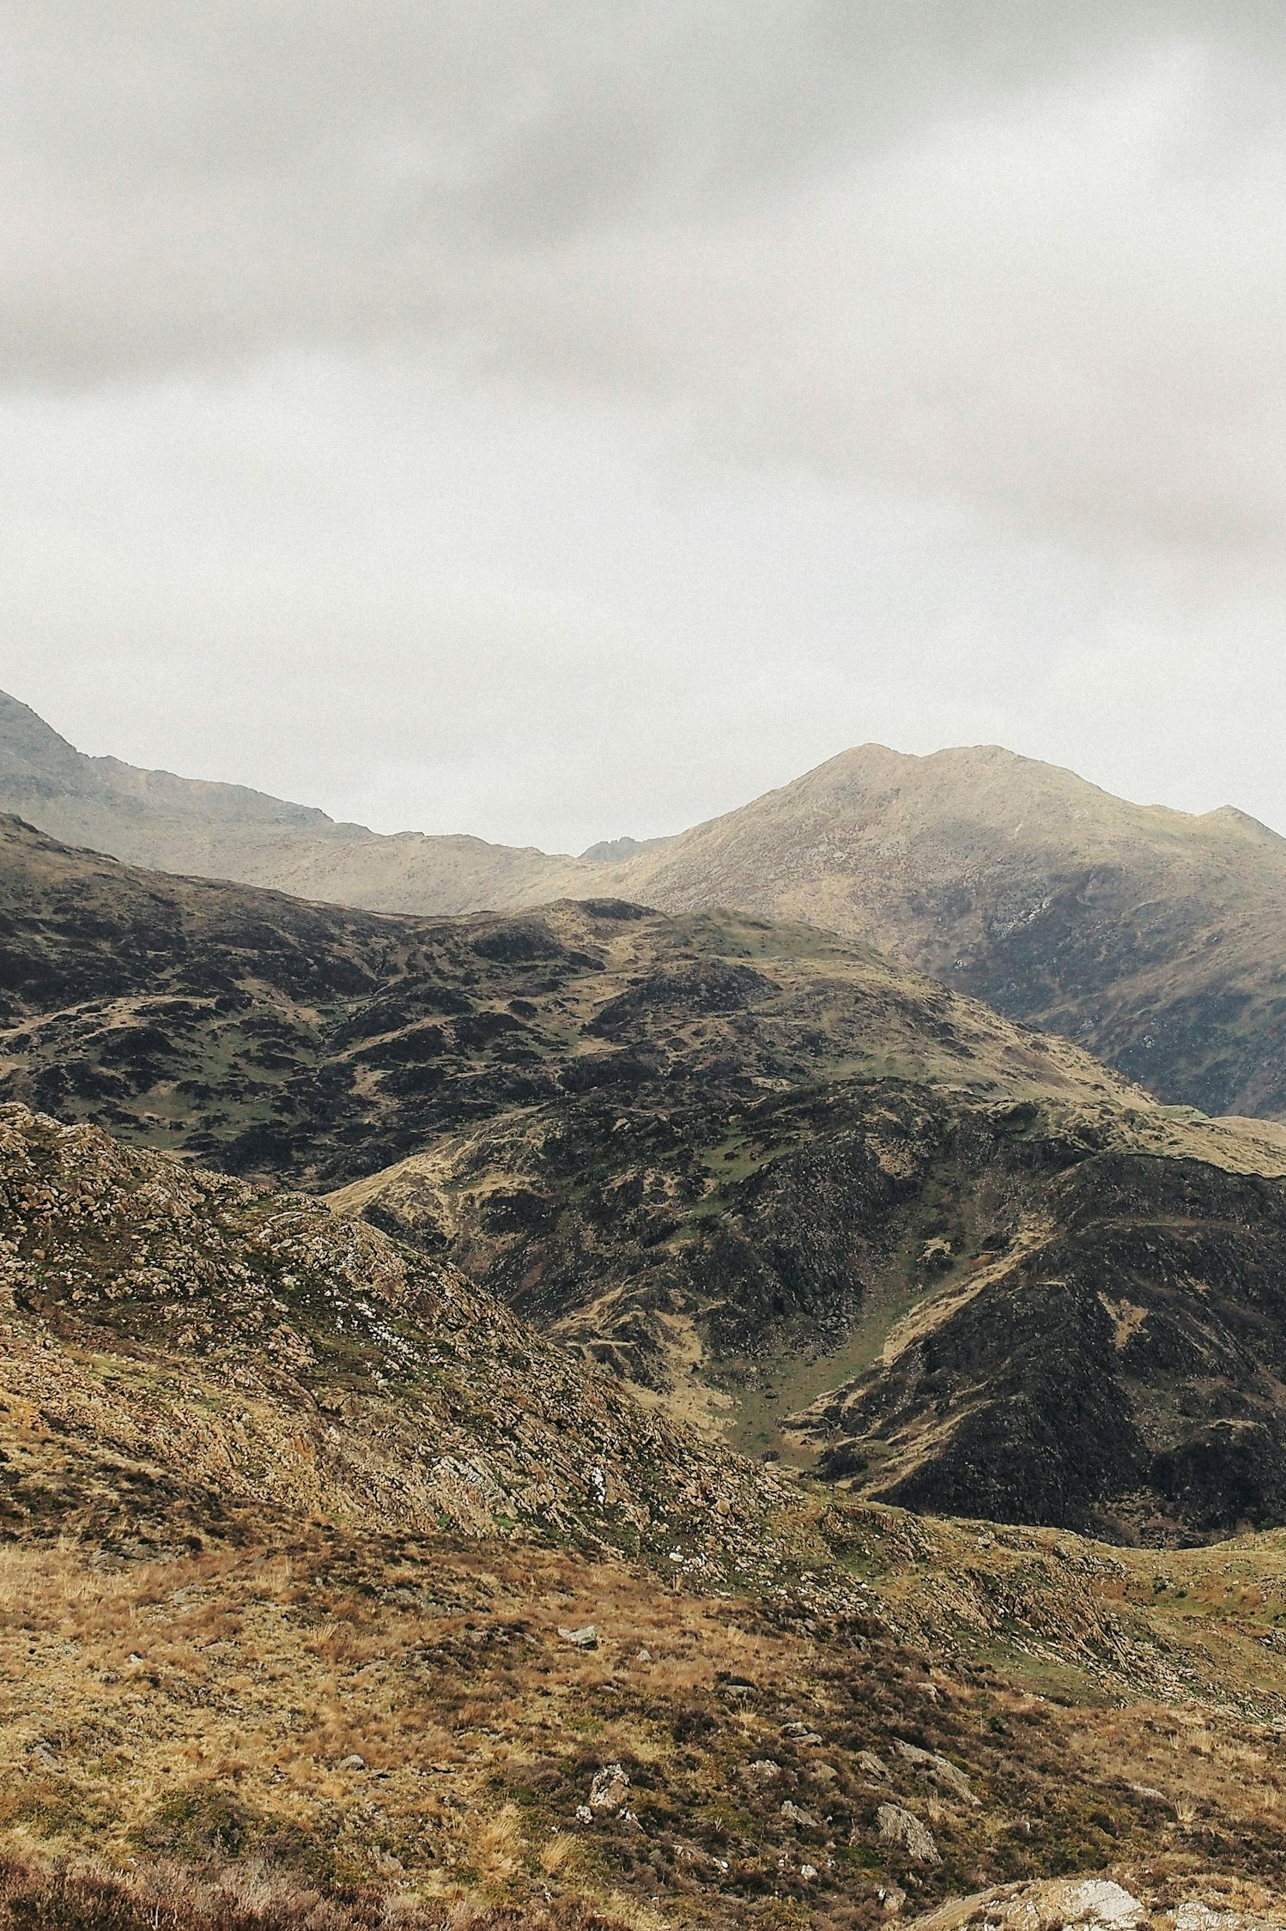
Heard Wales talked about as a place to visit
A larger percentage of the UK domestic holiday market has heard more about Wales as a destination to visit in 2025, compared to 2022 and 2023, though it’s comparable to last year.
% A little/
lot more
17%
13%
26%
25%
H1. Compared to normal, how much have you heard Wales talked about as a place to visit over the last 3 months? Total base size, n=863 (2025).

Slide 34
60% have seen or heard about Wales via at least one information source in the last few months.
Word of mouth is the primary source, closely followed by TV advertising. However, younger independents are less likely to have heard about it through TV ads and more likely through content creators, influencers, and social media.
Seen or heard about holidays in Wales
H2. Which, if any, of the following have you seen or heard about holidays in Wales in the last few months?
Total base size, n=863.

Slide 35

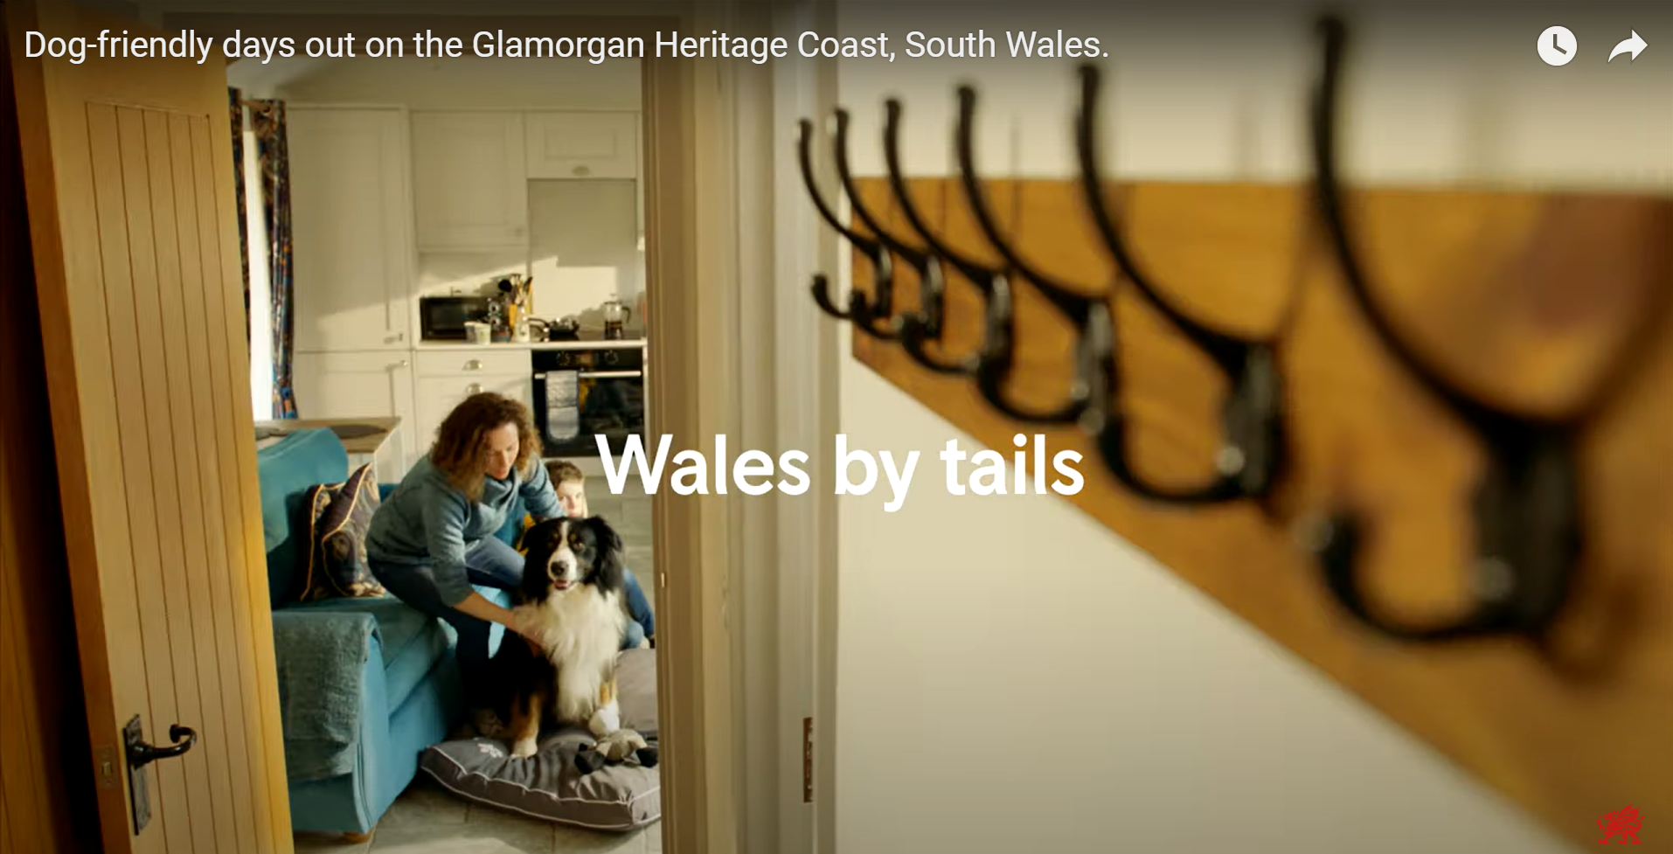
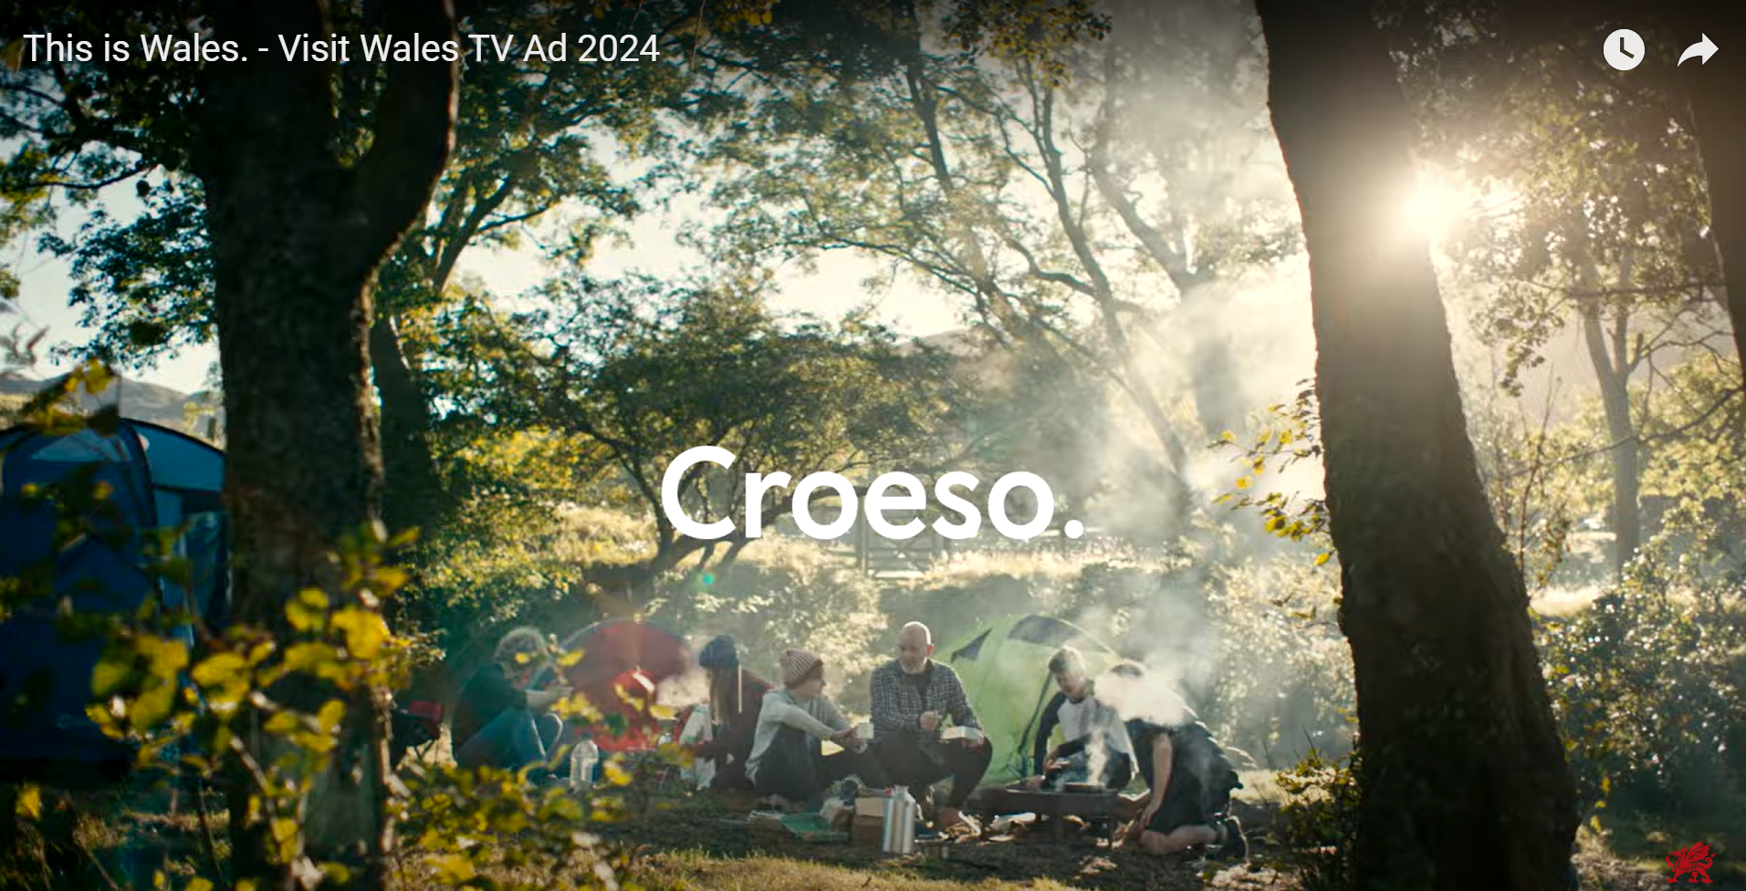
The campaigns had a similar level of recall, with about 30% of respondents stating they remembered seeing each one in the past few months.
Recall campaigns
33% stated they have seen the ‘This is Wales’ campaign
32% stated they have seen the ‘Hwyl’ campaign
27% stated they have seen the ‘Dog’ campaign
H4. Do you recall seeing this film or something very similar in the last few months? Total base size, n=863.
Notes:
Hwyl campaign
English link: Feel the Hwyl. Only in Wales.
Welsh link: Teimla'r hwyl. Gwlad Gwlad.
Dogs campaign:
English link: Dog-friendly days out on the Glamorgan Heritage Coast, South Wales.
This is Wales campaign:
English link: This is Wales. - Visit Wales TV Ad 2024 - YouTube
Welsh link: Gwlad, Gwlad. - Croeso Cymru Tv Ad 2024

Slide 36
Statements campaigns
Perceptions of the ads were positive, with a notable majority agreeing that they paint Wales in a positive light and that they makes Wales look very appealing for a trip.
% Agree
83%
81%
77%
72%
72%
H5. Now thinking of the films we have just shown you as one whole marketing campaign, how much do you agree or disagree with the following statements? Total base size, n=863.

Slide 37
Perceptions campaigns
70% agree that the campaign makes them want to visit areas of Wales they have not been to before and that it makes them much more interested in taking a trip to Wales in general.
% Agree
70%
70%
66%
64%
63%
H7. Now thinking about the impact the campaign has had on you personally, how do these films and adverts impact your perceptions of Wales as a short break or holiday destination?
Total base size, n=863.

Slide 38
Perceptions campaigns, of those aware
For those who were aware of (any) of the campaigns, they reported increases in their perceptions of Wales across all statements.
H7. Now thinking about the impact the campaign has had on you personally, how do these films and adverts impact your perceptions of Wales as a short break or holiday destination?
Total base size, n=369.

Slide 39
Descriptive statements campaigns
The advertisements scored highly for communicating incredible scenery and landscapes in Wales and for having lots of activities and things to do.
Incredible scenery and landscapes
50%
H6. Which, if any, of these descriptive statements about Wales would you say come across clearly from the adverts you have seen? Total base size, n=863.

Slide 40

Visit Wales contact
40% reported engaging with one of the Visit Wales digital marketing channels in the last 12 months, 4% more compared to last year. The Visit Wales website and Instagram were the leading channels.
H8. More generally, which of the following apply to you and Visit Wales in the last 12 months?
Total base size, n=863.

Slide 41
Saw marketing in relation to Welsh tourism?
Of those who are either unlikely to visit or undecided about visiting Wales in 2025, 11% reported having seen marketing or advertising about Welsh tourism. Within this group, most agreed that the advertisement made Wales appear more exciting and raised the likelihood of them visiting in the future.
% Agree
68%
58%
45%
F12a/b. Have you seen any marketing or advertising in relation to Welsh tourism? How much do you agree or disagree with the following statements about the advertising that you saw in relation to Welsh Tourism...Unlikely or undecided about visiting Wales in 2025, n=343 (and have seen advertising for Welsh tourism n=38*). *Caution low base size.

Slide 42

Visit Wales marketing impact
Marketing impact
A greater proportion of the UK domestic holiday market has become more familiar with Wales as a destination for 2025, either ‘a little’ or ‘a lot more,’ compared to 2022 and 2023, although it remains similar to last year.
Word of mouth is the main information source
60% of people have encountered information about Wales recently, with word of mouth and TV ads being the most common sources.
Younger individuals are more likely to learn about Wales through content creators and social media.
Campaigns
About 30% of people recall recent campaigns, with positive feedback on Wales' appeal and scenery.
40% engaged with Visit Wales' digital channels, mainly through the Visit Wales website and Instagram.
Among those unsure about visiting Wales in 2025, 11%* have seen the ads, which many found exciting and potentially influential for future visits.
*Caution low base size.

Slide 43
LUXURY & ACCESSIBILITY FOCUS

Slide 44
Perception of Wales
When people think of Wales, common themes include mountains, valleys, countryside, beautiful scenery, and friendly people. Rugby and rain are also often mentioned.
“When I think of Wales, I think first of all of mountains, hiking trails and epic scenery.”
“Peaceful, beautiful scenery, easy to travel to, relaxing break, beaches, eating out.”
Mountains/valleys
/countryside
“Mountains in the north and the valleys in the south a wide choice of beautiful countryside for those who love nature and like the outdoors.”
“Beautiful scenery, wonderful coast line, windy roads, friendly people, plenty to see.”
“Lots of countryside to see and places to go!”
Beautiful scenery
“Beautiful scenery, good beaches and good choice of hotels with good wholesome food.”
“Friendliness of the people there. They are very accommodating.”
“The friendly atmosphere.”
Friendly people
“Their lifestyle because of how friendly they are.”
G1. When you think of Wales, what aspects come to mind? Total base size, n=863.

Slide 45
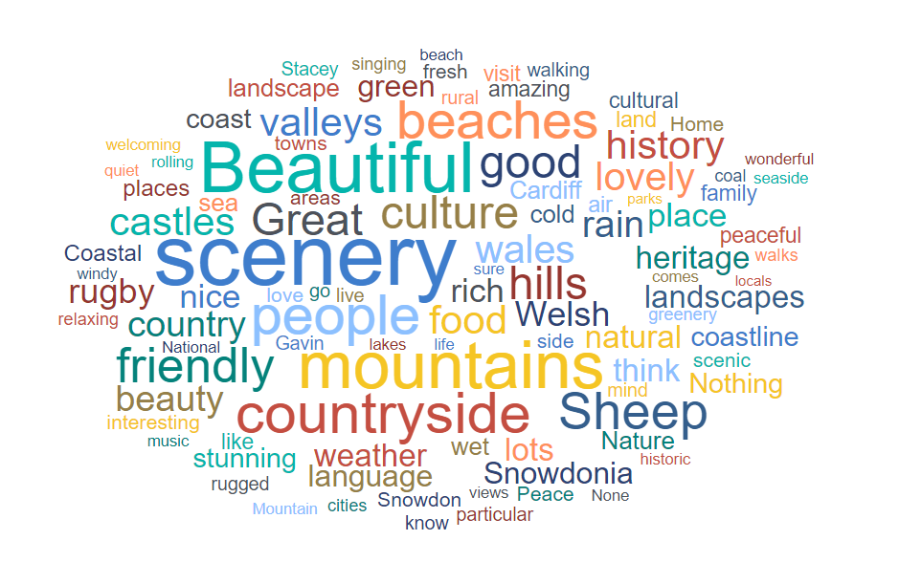
Perception of Wales
G1. When you think of Wales, what aspects come to mind? Total base size, n=863.

Slide 46
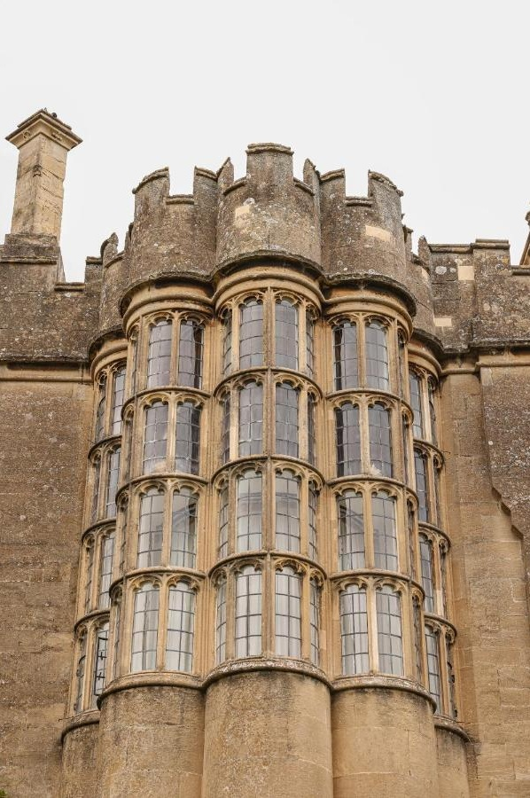
Luxury importance
36% said they consider luxury to be very or extremely important.
Extremely important
36%
Very important
Moderately important
Slightly important
Not important at all
G2. How important is luxury when choosing a travel destination? Total base size, n=863.

Slide 47
Luxury importance, by lifestage
Families generally place more importance on luxury compared to other life stages, while older independents are more likely to think it’s somewhat or not important at all.
% very or
extremely important
36%
32%
51%
29%
23%
Extremely important
Very important
Moderately important
Slightly important
Not important at all
G2. How important is luxury when choosing a travel destination? Total base size, n=863 (younger independents n=121, families n=291, older independents n=252, retirement age n=199)..

Slide 48
47% would consider Wales for a luxury holiday.
63% consider scenic locations/views to be important luxury features when booking accommodation, while 45% consider fine dining options as luxury features.
Moreover, 48% are willing to spend more on luxury holidays.
Luxury
G3. Would you consider Wales for a luxury holiday? Total base size, n=863.
G4. What luxury features are important to you when booking accommodation? Those who think luxury is important, n=602.
G5. How do you feel about spending more money for a luxury experience? Total base size, n=863.

Slide 49
Accessibility importance
Accessible transport and information availability are commonly cited accessibility features, which are areas of relative strength for Wales. Having good mobility access is important to around 15% of the population, with 70% of this group considering it a key factor in their travel choices.
% very/extremely important
G6. What accessibility features are important to you when booking accommodation? Total base size, n=863.
G7. How important is this feature to your decision when booking accommodation? Base size, n=223.

Slide 50
Accessibility accommodation & attractions
Transportation is a key feature when booking, however while it is fairly rated (78%) it falls somewhere in the middle of the ratings.
% good/excellent: Accommodation
% good/excellent: Attractions
G9. How do you rate the accessibility of accommodation when you have visited Wales in the past?
G8. How do you rate the accessibility of attractions when you have visited Wales in the past? Base size, n=107

Slide 51
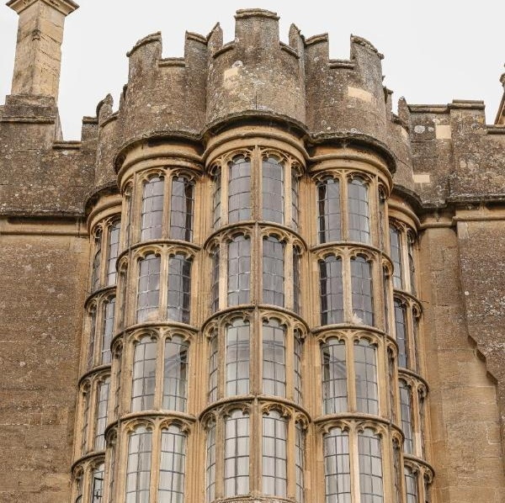

Luxury & accessibility focus
Luxury
When people think of Wales, they often associate it with mountains, valleys, countryside, stunning scenery, and friendly people, with rugby and rain also frequently mentioned.
36% consider luxury very or extremely important, with families valuing it more than other groups, while older independents place less importance on it.
47% would consider Wales for a luxury holiday.
When booking accommodation, 63% consider scenic as luxury features in accommodations, while 45% value fine dining. Additionally, 48% are willing to spend more on luxury holidays.
Accessibility
Accessible transport and information availability are often highlighted as important accessibility features.
Around 15% of the population consider good mobility access to be important, with 70% of them considering it a crucial factor in their travel decisions.
However, there is room for improvement in the accessibility of Wales' attractions, as roughly one-third of this group does not rate them positively.

Slide 52
REASONS FOR NOT VISITING WALES IN 2024

Slide 53

Reasons for not visiting Wales in 2024
The main reasons for not visiting Wales in 2024 is because they took an overseas holiday instead, or have visited Wales before and wanted to explore a different destination.
NON-WALES TRIP TAKERS 2024
E4. What are the reasons that you didn't take a short break or holiday in Wales in 2024?
Non-Wales trip takers 2024, n=517.

Slide 54
Wales visiting intentions by non-trip takers to Wales
Of non-Wales trip takers, 76% did not consider an overnight trip in Wales in 2024. Just over half of those decided to go elsewhere in British Isles or Ireland, with the South Coast of England and West Country being the most popular destinations.
NON-WALES TRIP TAKERS 2024
24% of non-Wales trip takers were considering an overnight trip in Wales in 2024
E1. You indicated that you did not take a short break or holiday in Wales in 2024. Were you considering a trip in Wales in 2024 at any stage?
E2. Did you go somewhere else for a short break or holiday in 2024 or did you not take one at all? Non-Wales trip takers 2024, n=517.
E3. To which of the following areas of the British Isles or Ireland did you go on your short break or holiday in 2024? Went to British Isles or Ireland, n=277.

Slide 55
REASONS FOR NOT PLANNING TO VISIT WALES IN 2025

Slide 56

Reasons for not planning to visit Wales in 2025
Similar to the reasons for not visiting Wales in 2024, the main reasons for not planning to visit in 2025 are opting for an overseas holiday or having visited before, wanted to explore a new destination.
NON-WALES TRIP INTENDERS 2025
F13. What are the reasons that you are not planning to visit Wales for a short break or holiday in 2025?
Non-Wales trip intenders 2025, n=210.

Slide 57

UK and Ireland locations considered for visiting in 2025
Among those who are not planning to visit Wales in 2025, the West Country is the most popular UK and Ireland destination.
NON-WALES TRIP INTENDERS 2025
F14. Where, if anywhere, in the UK and Ireland are you seriously considering visiting for a short break or holiday in 2025? Non-Wales trip intenders 2025, n=210.

Slide 58


Reasons for not visiting Wales in 2024 or planning to visit in 2025
Reason for not visiting
The main reasons for not planning to visit Wales in 2025 are choosing an overseas holiday or wanting to explore a new destination after having visited before.
Top destination
For those not planning to visit Wales in 2025, the West Country (23%) is the most popular destination in the UK and Ireland.

