Slide 1
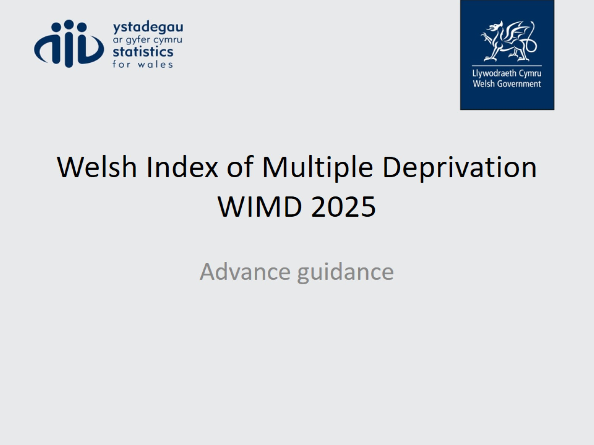
Welsh Index of Multiple Deprivation
WIMD 2025

Slide 2
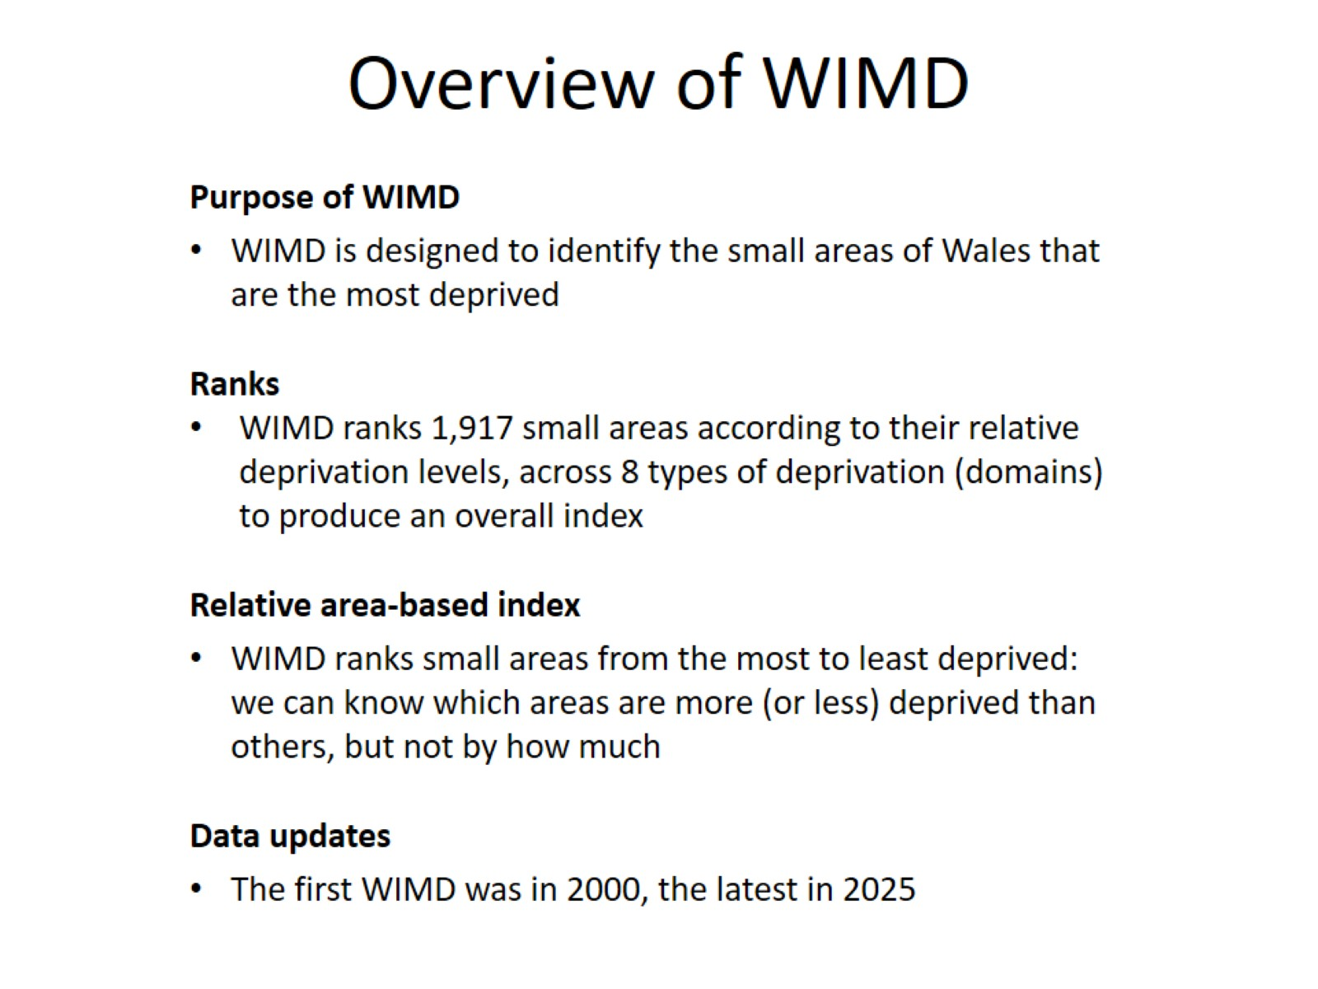
Overview of WIMD

Slide 3
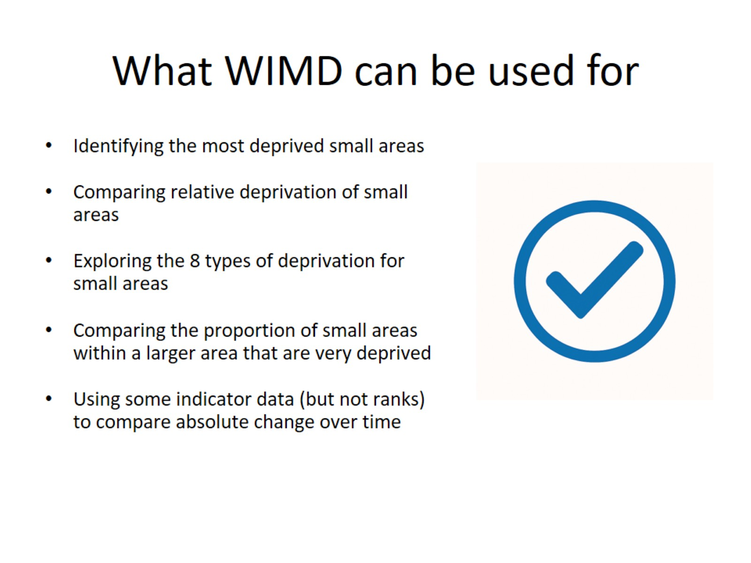
What WIMD can be used for

Slide 4
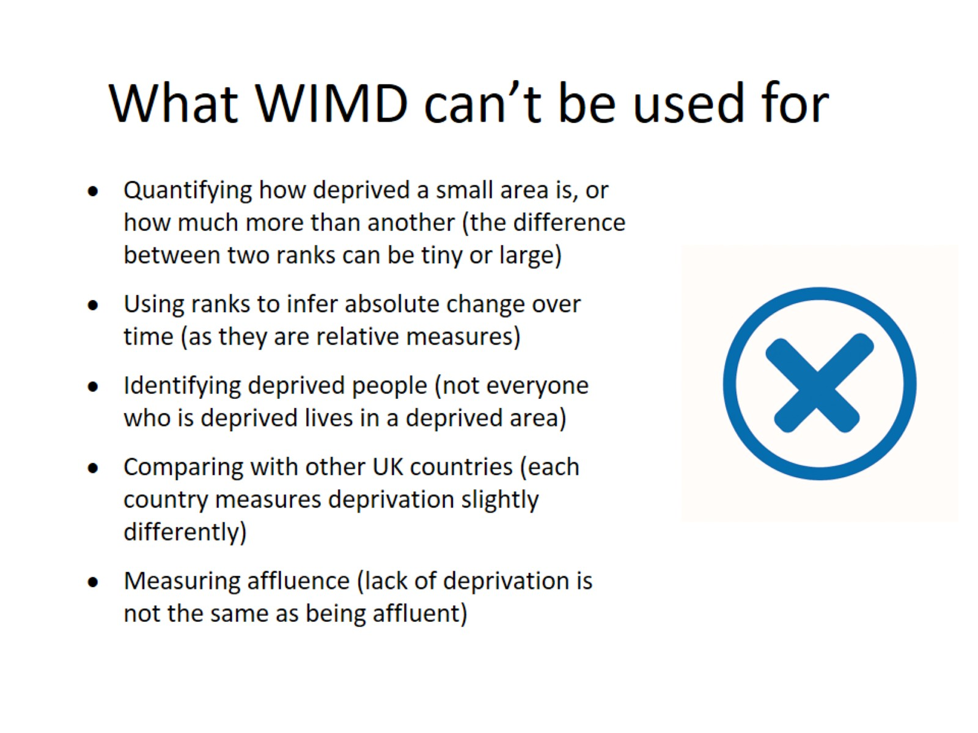
What WIMD can’t be used for

Slide 5
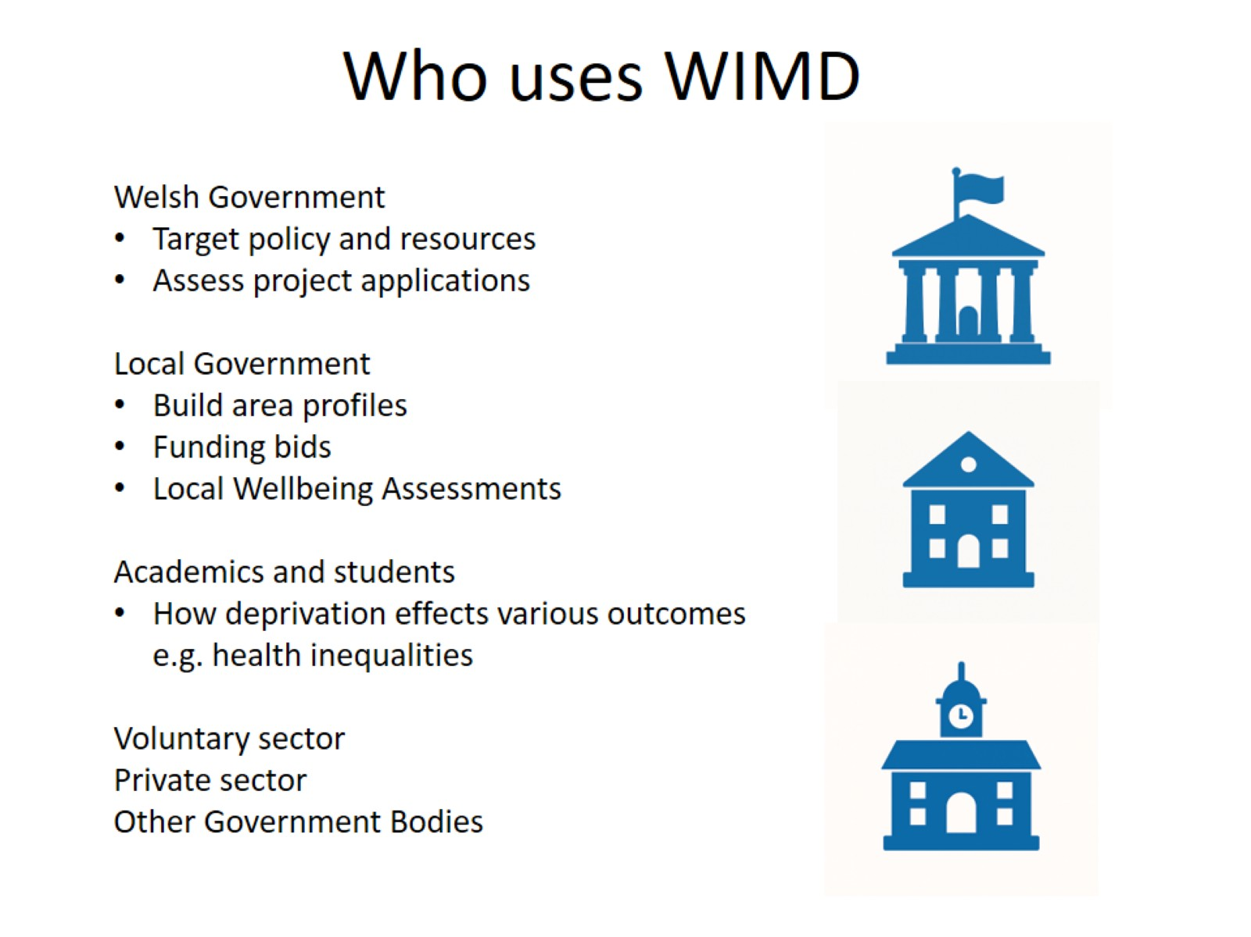
Who uses WIMD

Slide 6
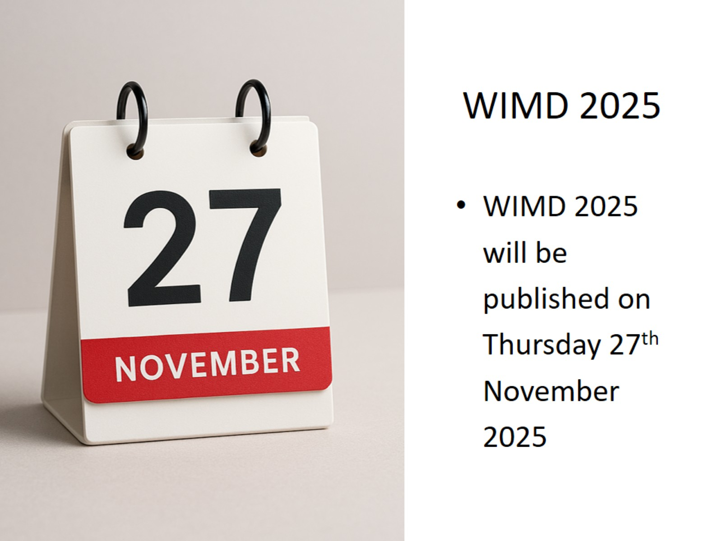
WIMD 2025

Slide 7
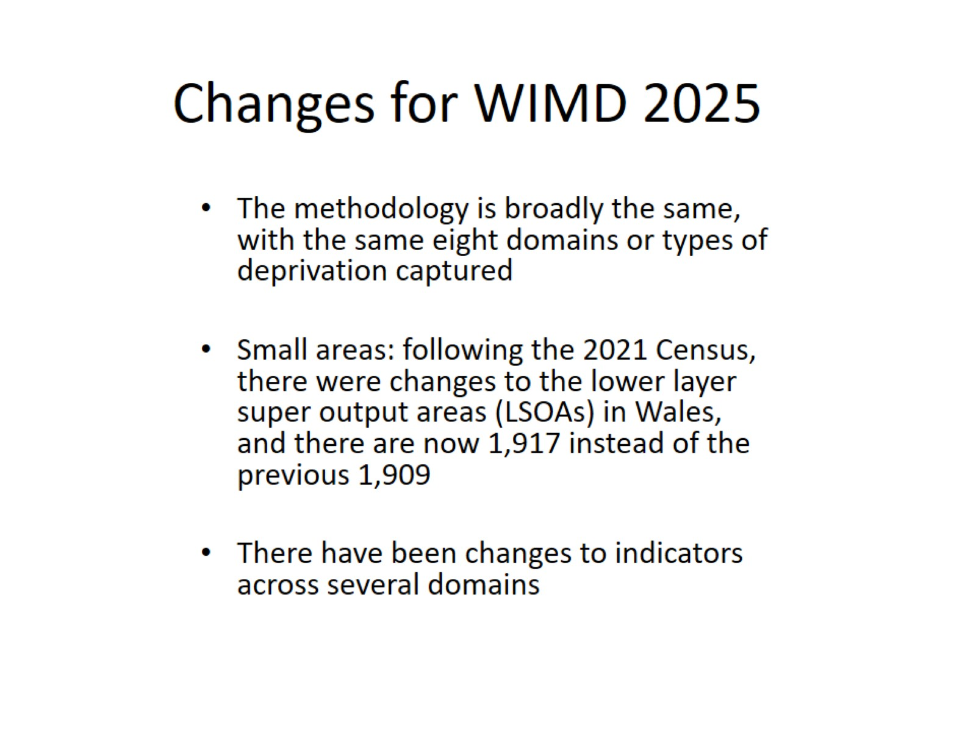
Changes for WIMD 2025

Slide 8
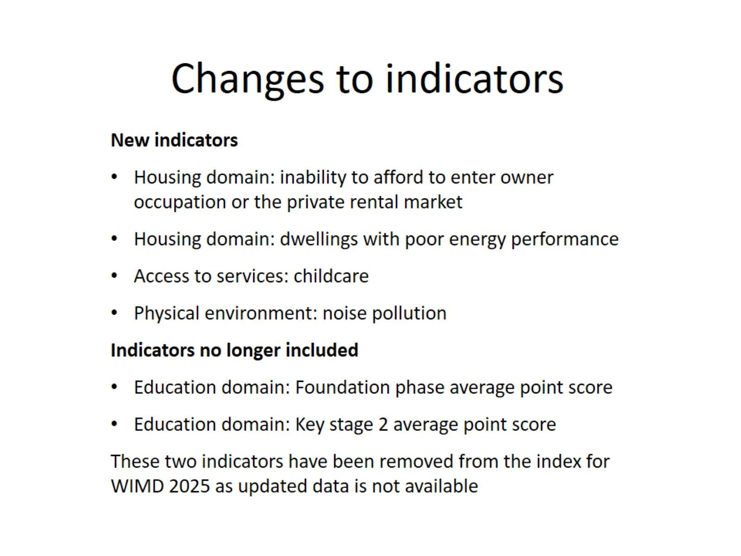
Changes to indicators

Slide 9
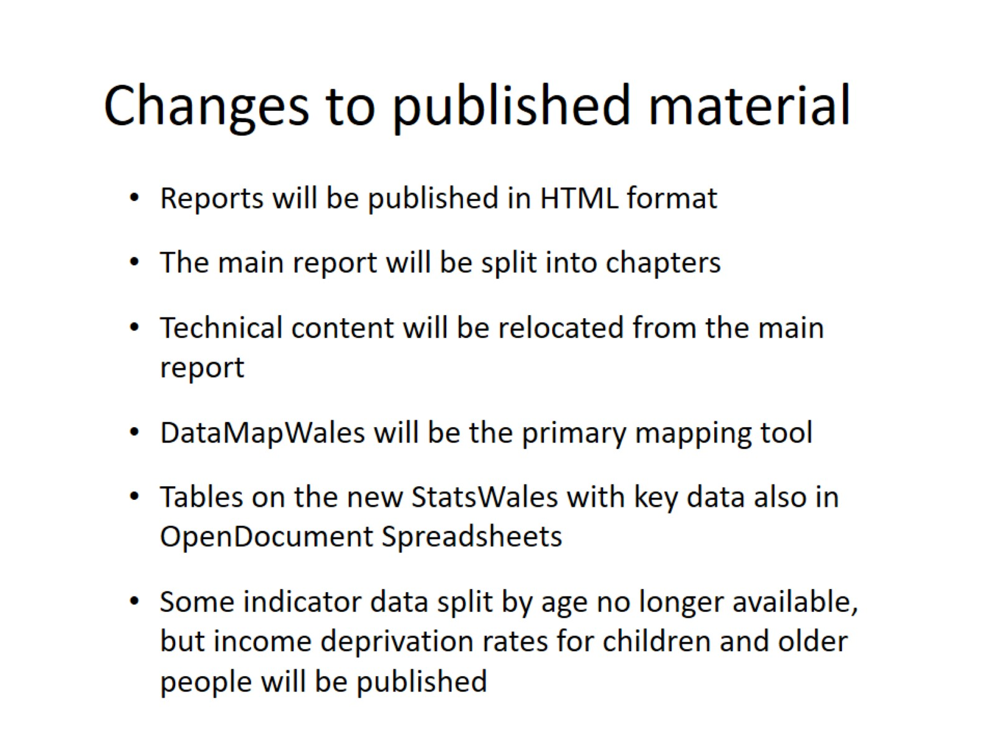
Changes to published material

Slide 10
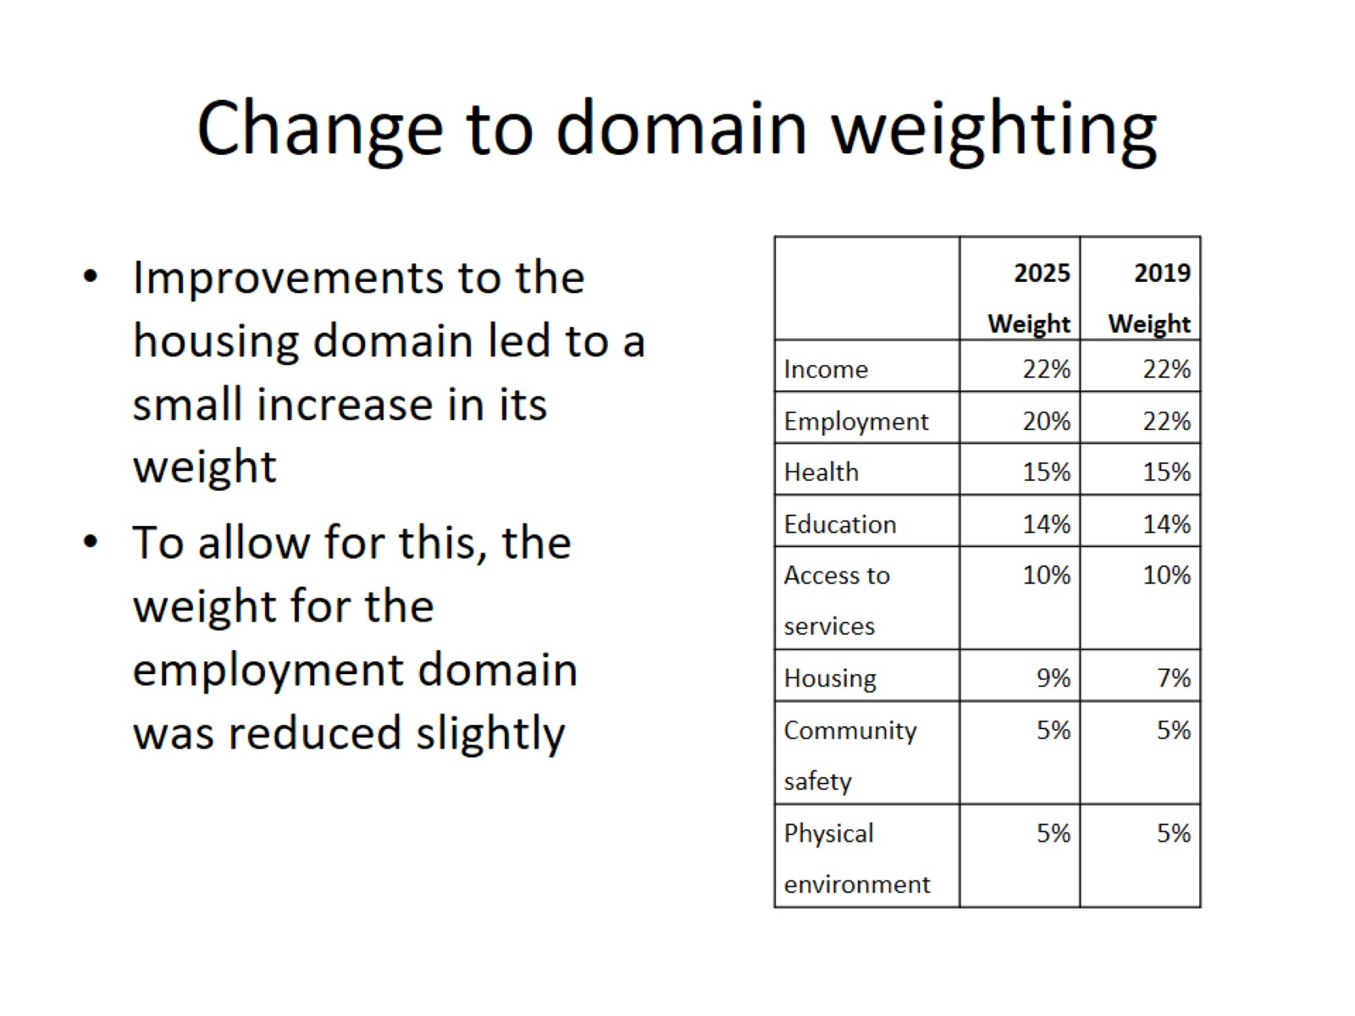
Change to domain weighting

Slide 11
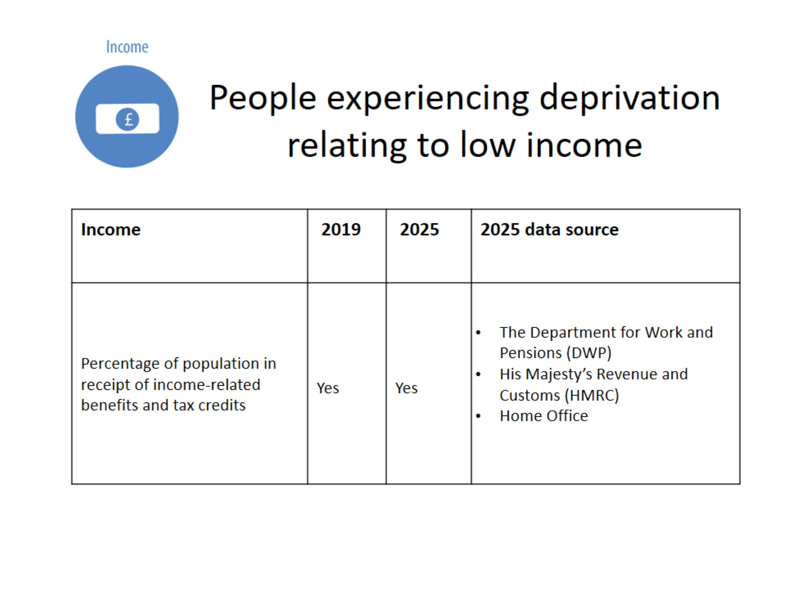
People experiencing deprivation relating to low income

Slide 12
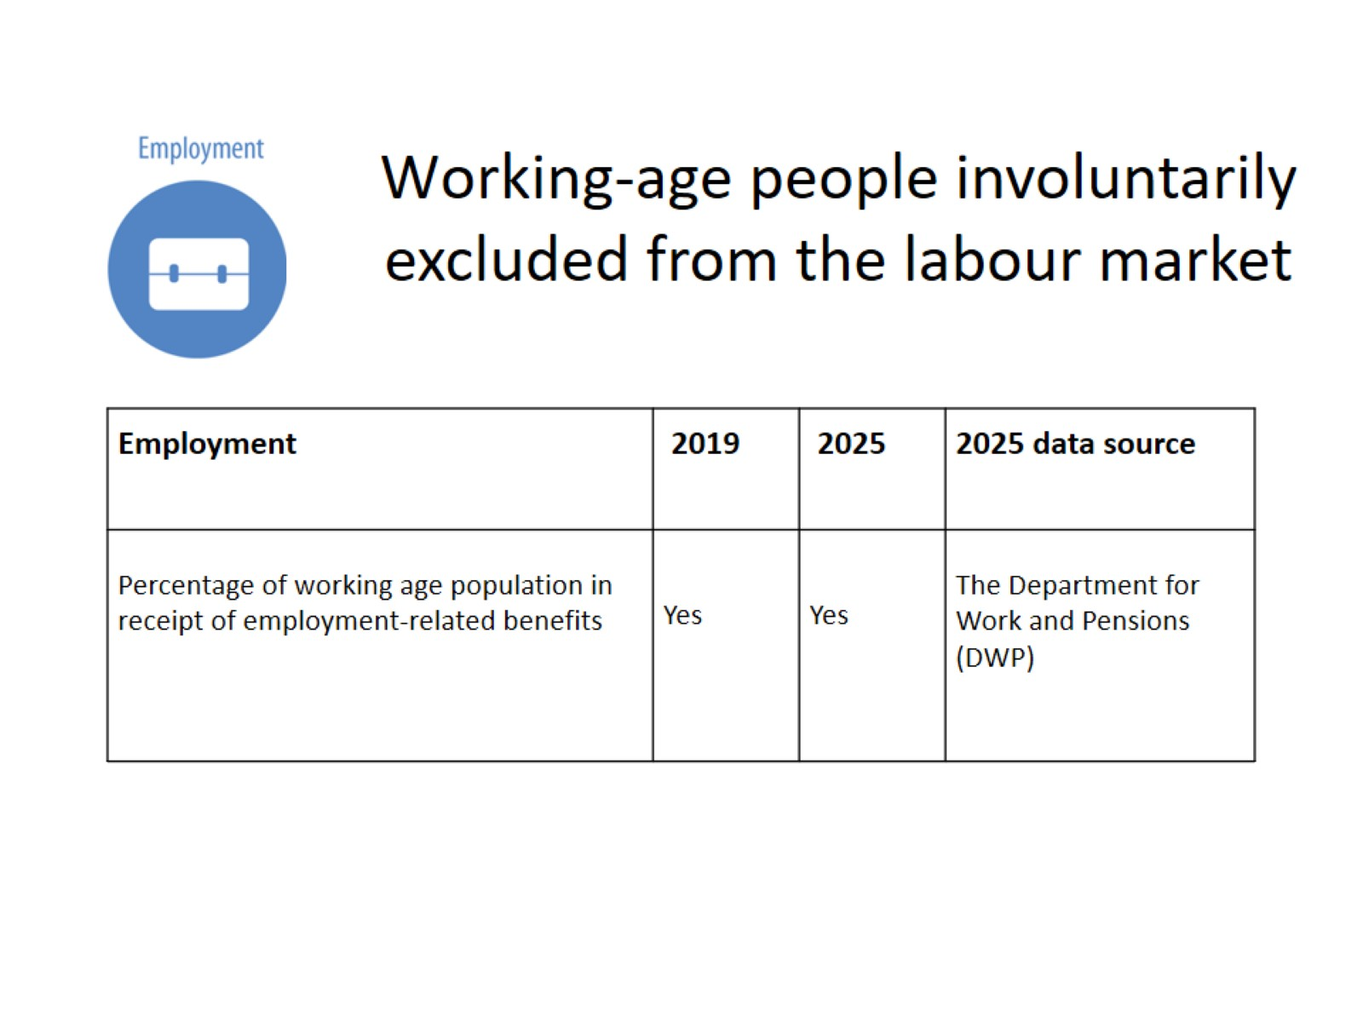
Working-age people involuntarily excluded from the labour market

Slide 13
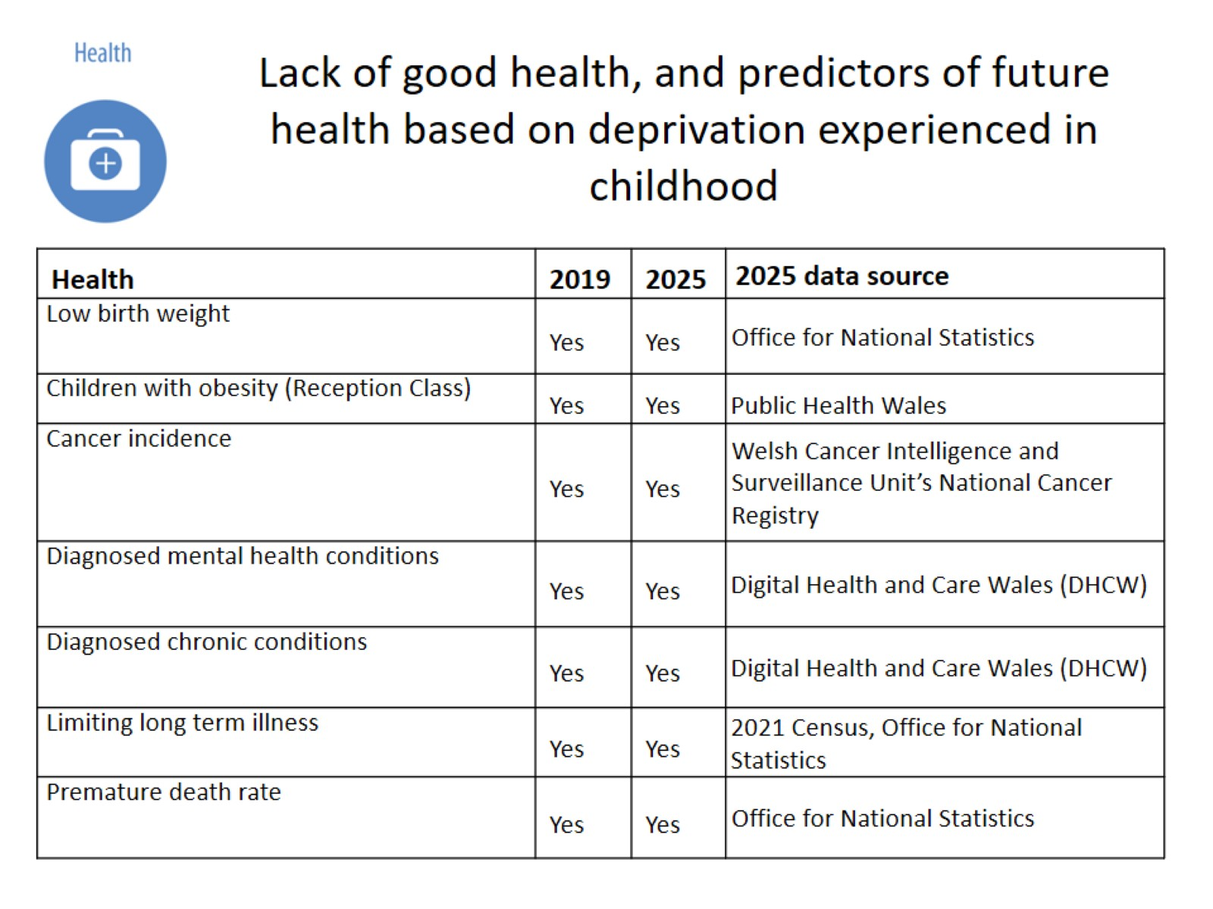
Lack of good health, and predictors of future health based on deprivation experienced in childhood

Slide 14
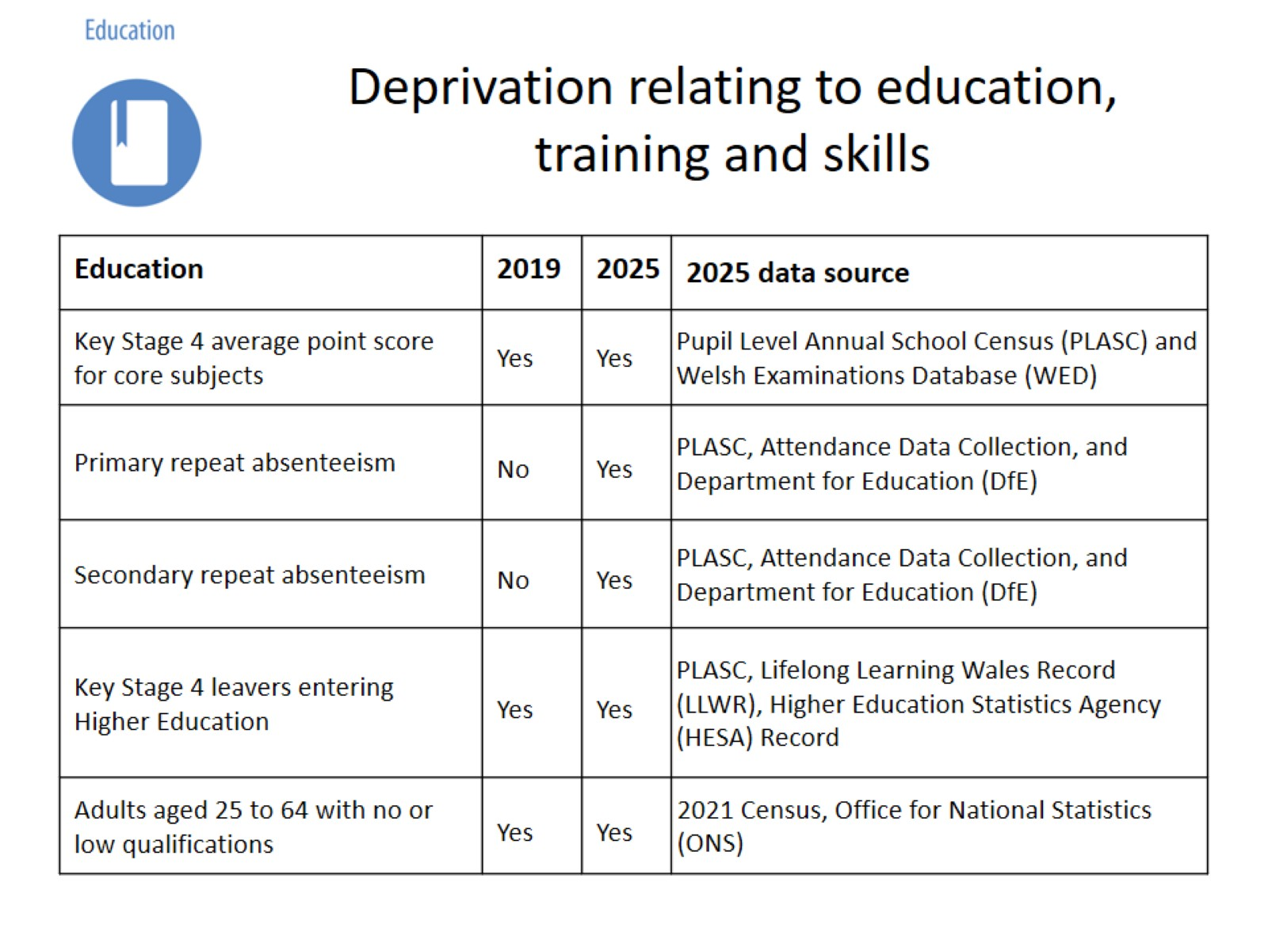
Deprivation relating to education, training and skills

Slide 15
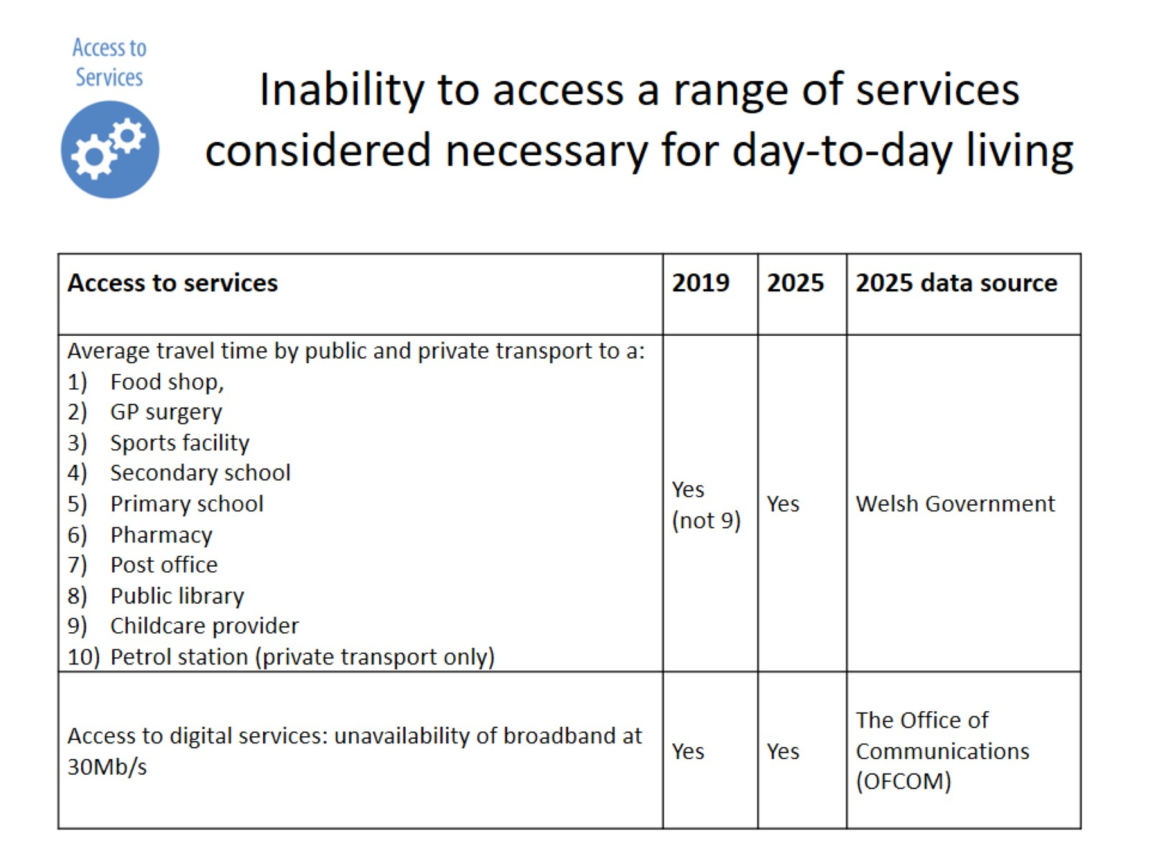
Inability to access a range of services considered necessary for day-to-day living

Slide 16
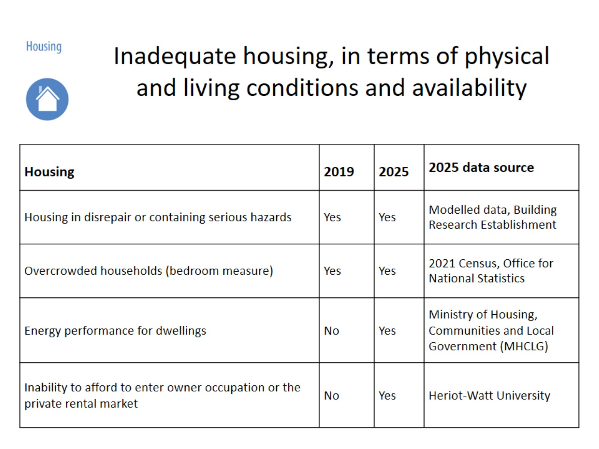
Inadequate housing, in terms of physical and living conditions and availability

Slide 17
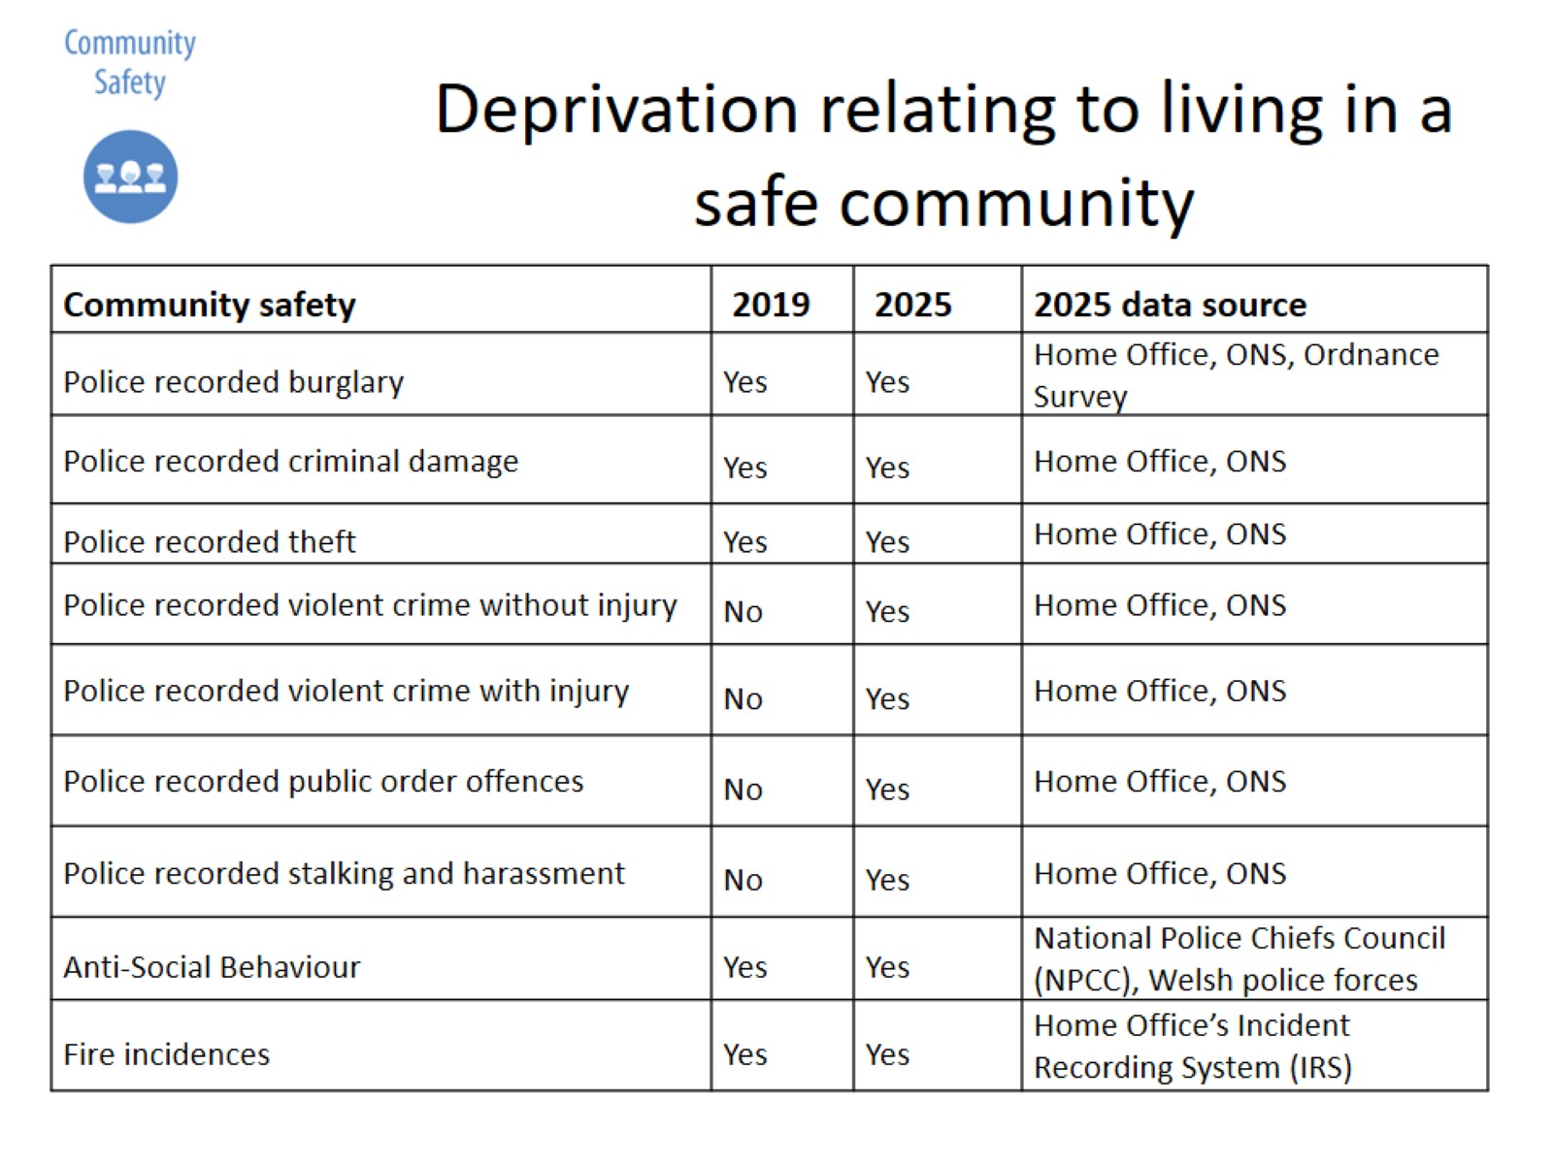
Deprivation relating to living in a safe community

Slide 18
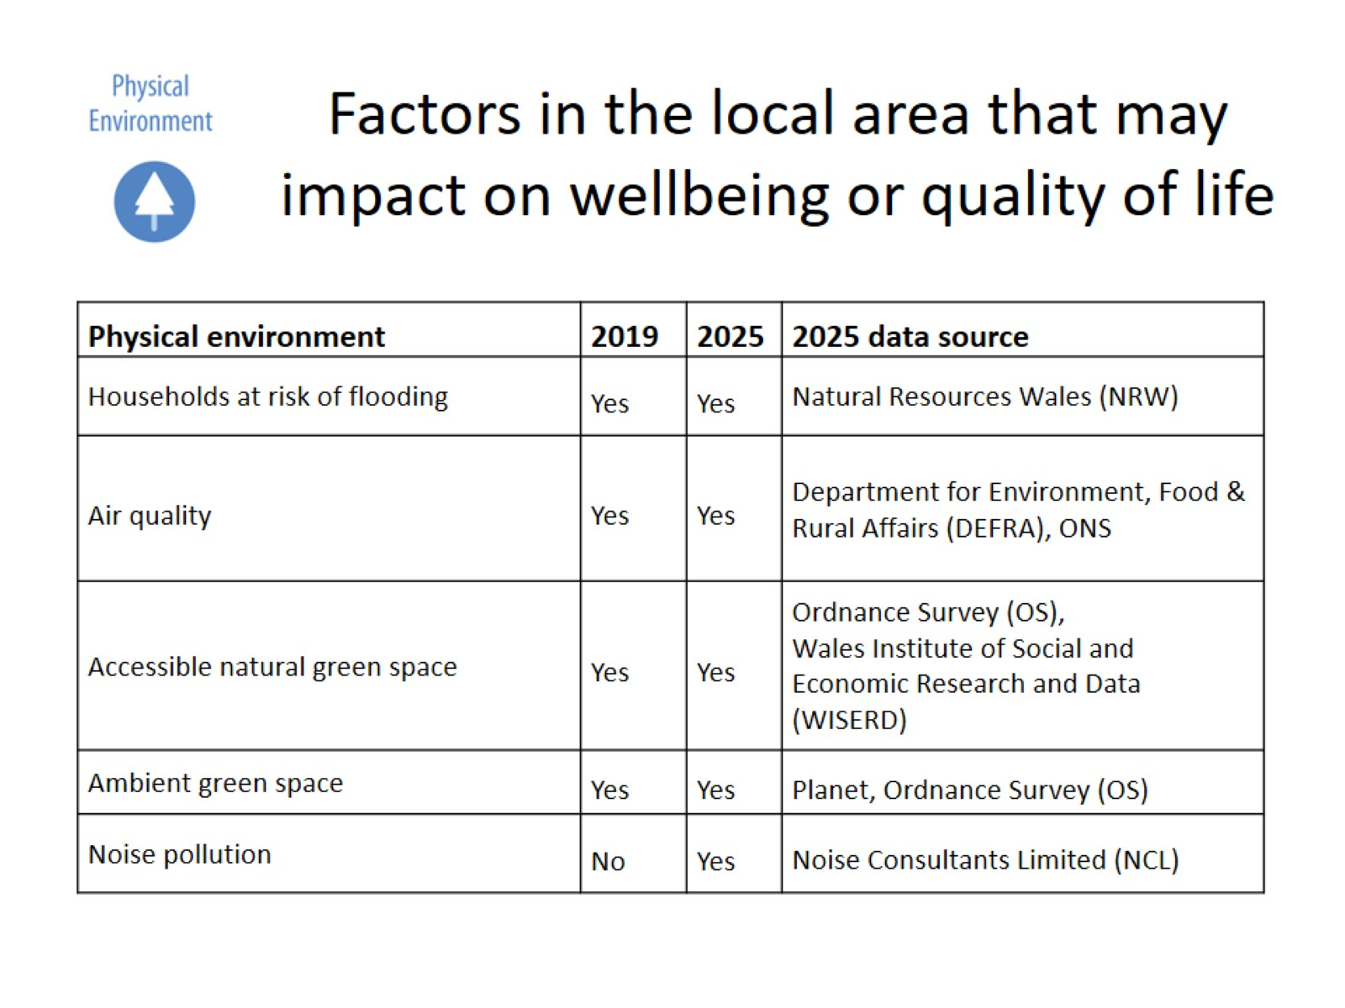
Factors in the local area that may impact on wellbeing or quality of life

Slide 19
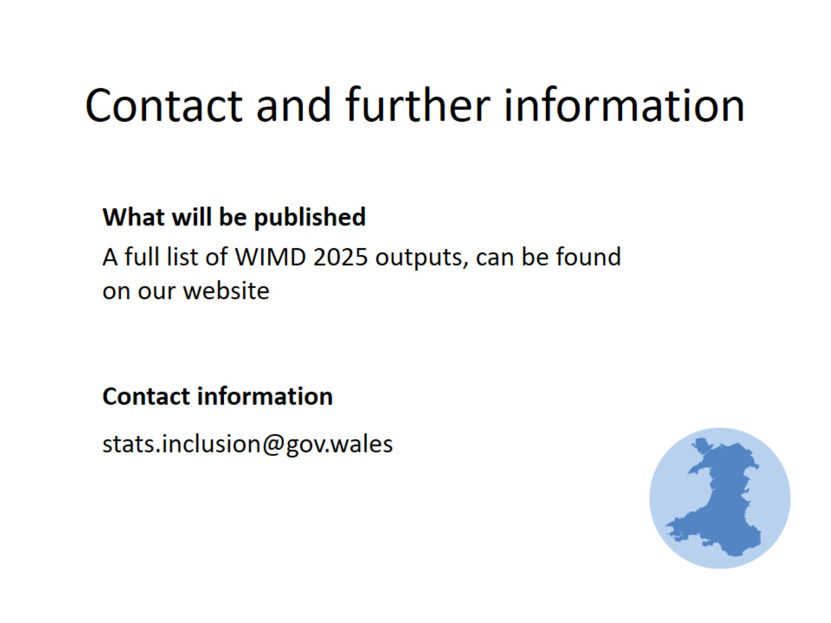
Contact and further information

