Slide 1


Visit Wales consumer market demand COM-B:
UK, USA and Germany (2026)
Social Research Number: 82/2026 Publication date: 01/10/2026
Digital ISBN: 978-1-80853-448-5
© Crown Copyright
Mae’r ddogfen yma hefyd ar gael yn Gymraeg.
This document is also available in Welsh.

Slide 2


Introduction slide 2
Full Research Report: Visit Wales market demand COM-B – UK, USA and Germany report (2026)
Cardiff: Welsh Government, GSR report number 82/2026.
This report can be found on the Statistics and research pages of the Welsh Government website: https://www.gov.wales/statistics-and-research
Views expressed in this report are those of the researcher and not necessarily those of the Welsh Government.
For further information please contact:
Research and Insights Team
Visit Wales,
Economy, Energy and Planning
Cathays Park
Cardiff
CF10 3NQ
Email: tourismresearch@gov.wales

Slide 3
This qualitative research provides depth of understanding, complemented by a wider body of quantitative and sector insight
Alongside this study, Visit Wales produces a range of insight and research, including:
Domestic GB Tourism Statistics - Data on overnight trips and day visits by British residents to destinations throughout Britain.
Visit Wales consumer re-contact survey – Detailed reports drawn from an online survey conducted amongst Visit Wales consumer contacts.
Tourism market demand reports - Each year Visit Wales conducts research amongst its priority markets.
Tourism barometer - The Tourism Barometer provides a ‘snapshot’ of industry performance after important points in the tourism calendar.
Cycling tourism development - This research explores the topic of cycling tourism in Wales, including current capacity and demand, as well as opportunities for growth.
Accessible here:
Domestic tourism statistics
Re-contact survey reports
Market demand survey reports
Tourism barometer
Cycling tourism development report

Slide 4

Contents
01 | Background & methodology
02 | Key findings
03 | The Holiday Decision System
04 | The COM-B Diagnosis of Wales

Slide 5
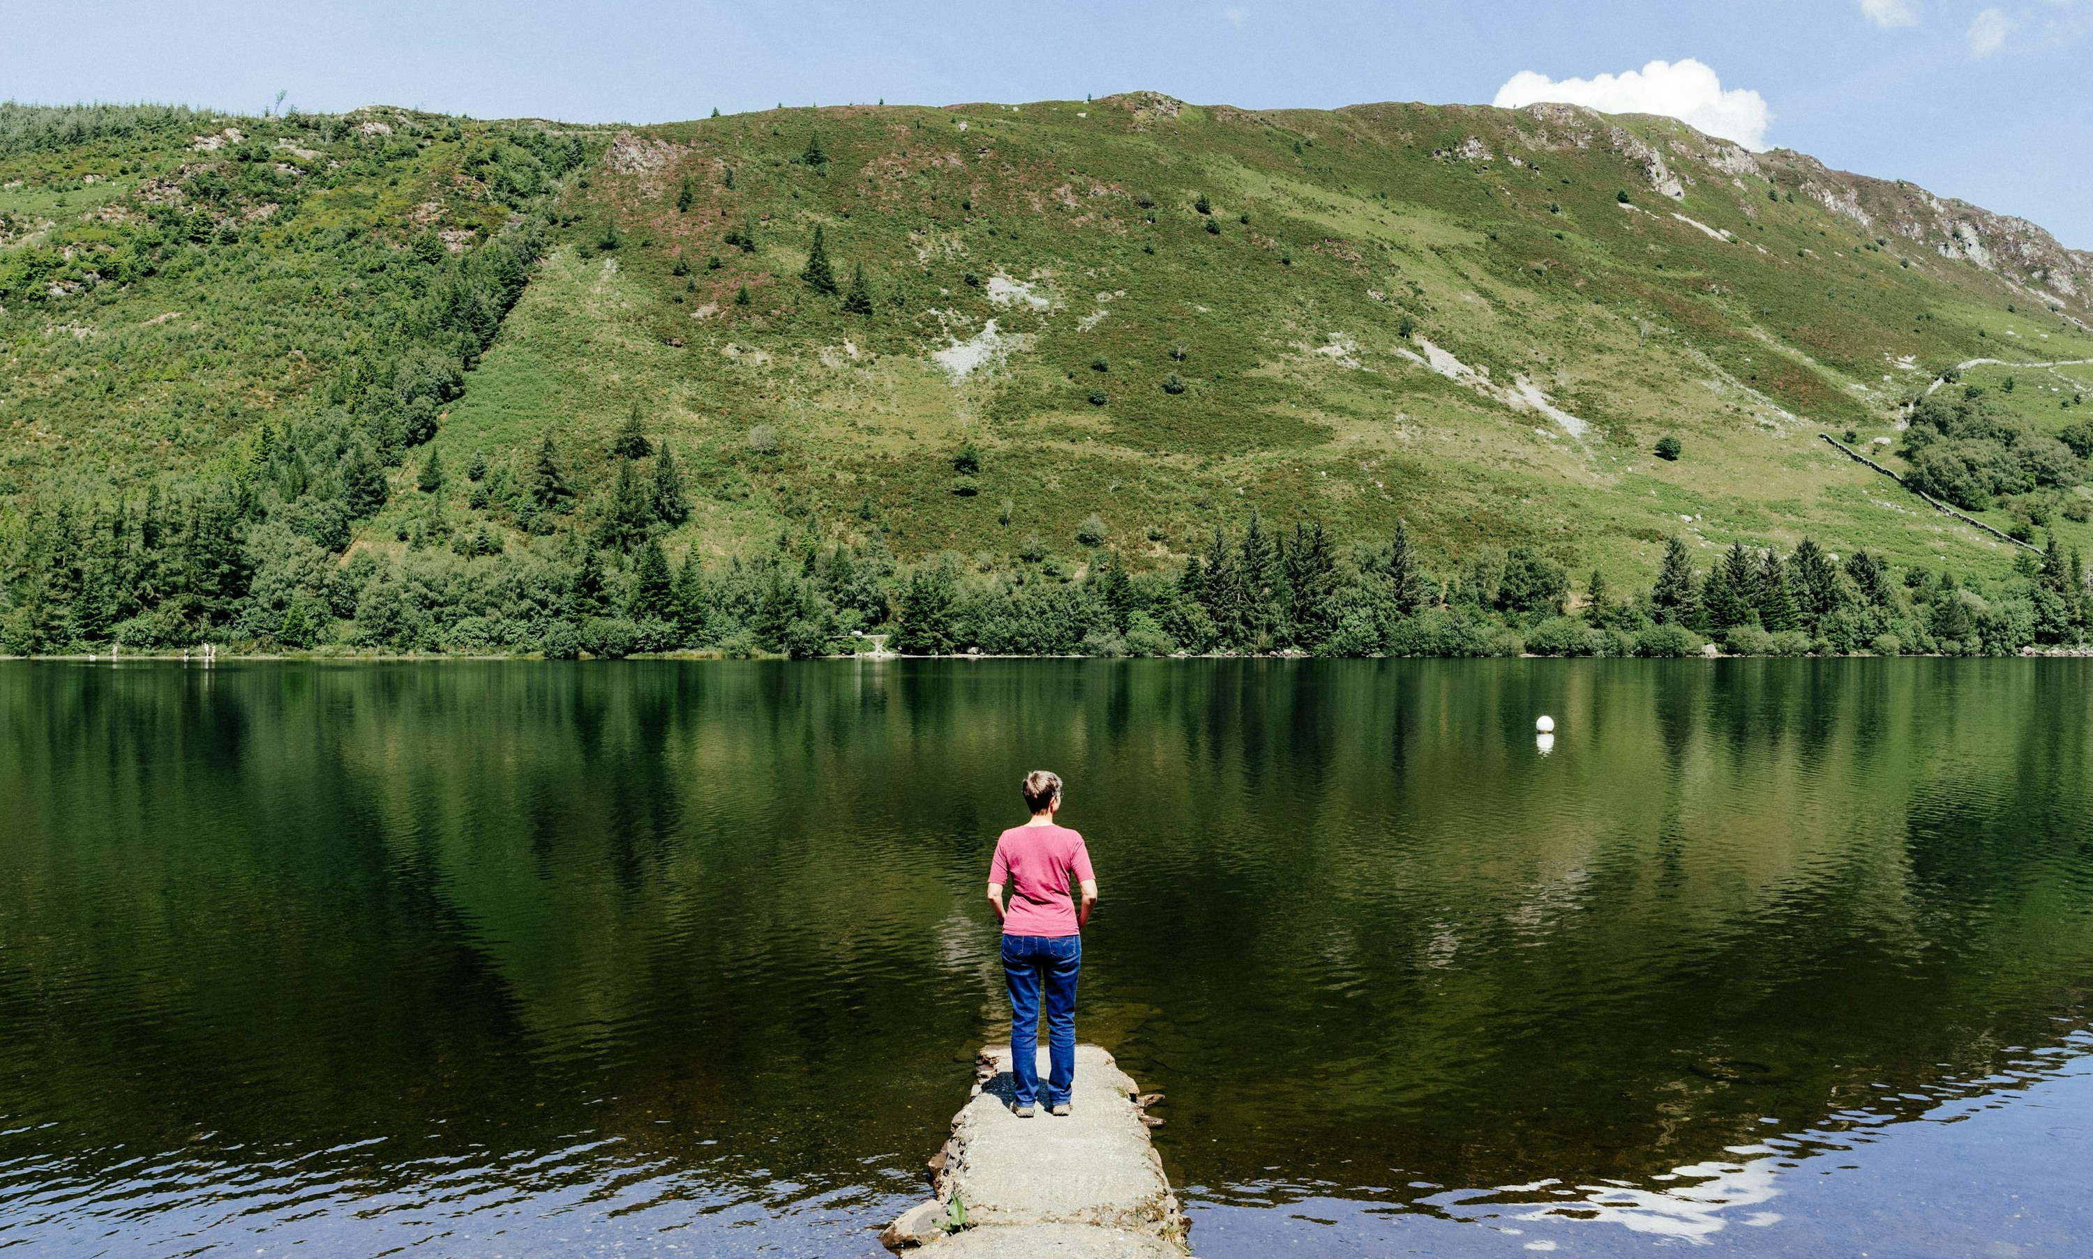


KEY FINDINGS

Slide 6



Three behavioural barriers are limiting conversion:
Key Findings
Capability
Travellers struggle to picture what a trip to Wales actually looks like
Wales must help travellers picture the trip, not just the moments.
Opportunity
Wales is considered within structured travel decisions, but not always prioritised
Wales must feel worth prioritising within existing travel formats.
Motivation
Wales is widely admired, but lacks distinctive signals that drive urgency
Wales must feel unmistakably Welsh –
not just beautiful.

Slide 7
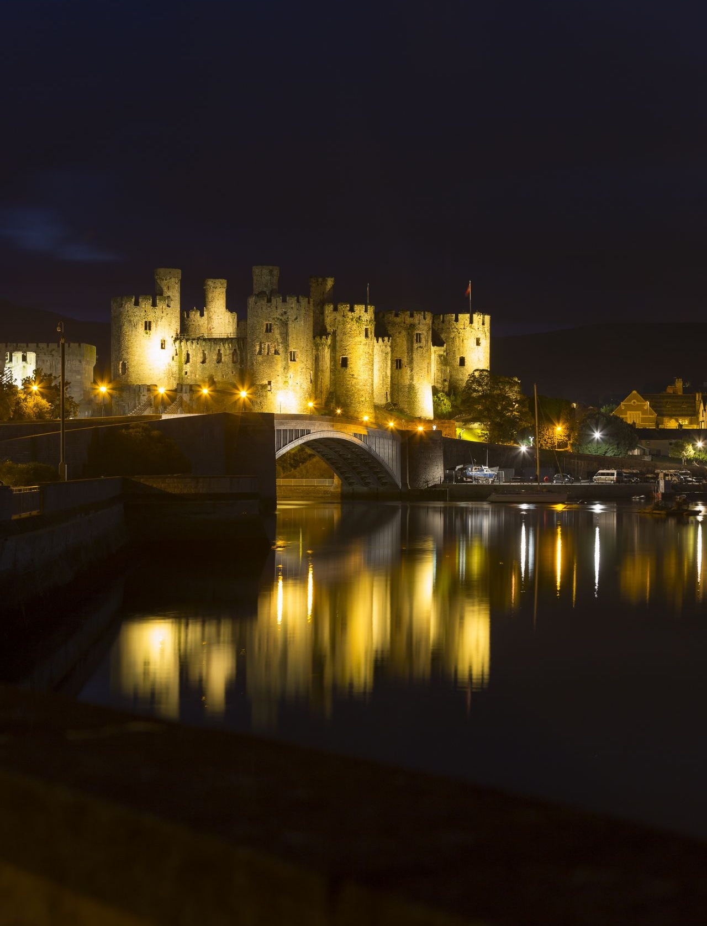
Capability: Helping travellers picture the trip
Key Findings
Wales must help travellers picture the trip, not just the moments
What this means in practice:
Travellers struggle to visualise:
  Where they would stay
  How long to spend
  How experiences connect across days
Wales is strongly associated with scenery and activities, but less with clear, end-to-end trip structures
Implications for content and communication:
Amplify clear routes and itineraries (e.g. 3–5 day trip structures)
Show how places connect (not just individual highlights)
Provide simple “how to do it” guides across regions and themes

Slide 8
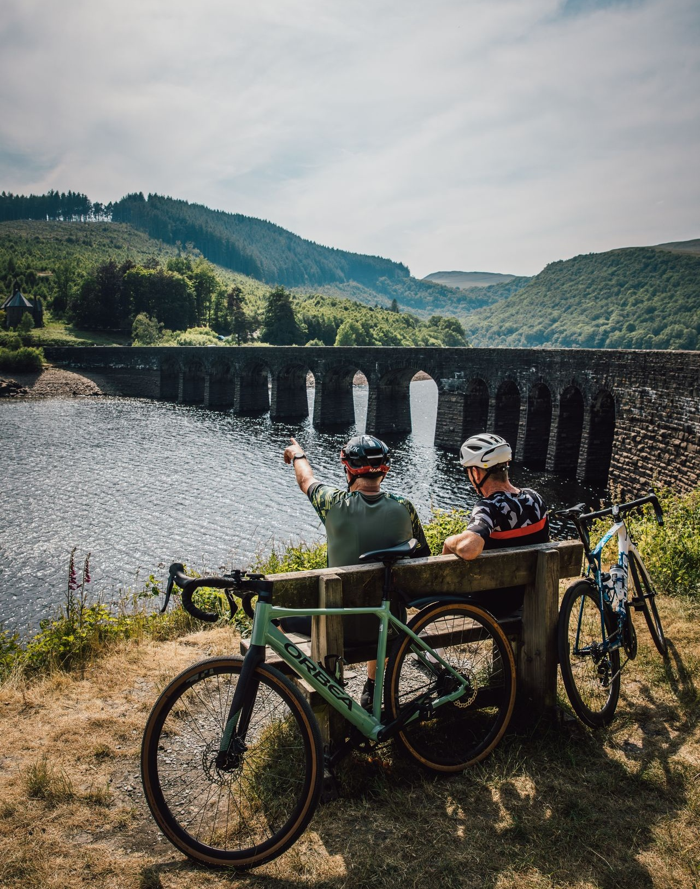
Opportunity: Competing within existing travel formats
Key Findings
Wales must feel worth prioritising within existing travel formats
What this means in practice:
Travellers organise trips around familiar formats:
  City breaks
  Touring holidays
  Multi-destination trips
Wales is often considered within these formats, but not always as the leading choice
Implications for content and communication:
Position Wales clearly within:
  Touring routes
  Multi-stop UK itineraries
Highlight what makes Wales worth including or prioritising
Explore cross-border storytelling (e.g. Wales within a broader UK journey)

Slide 9
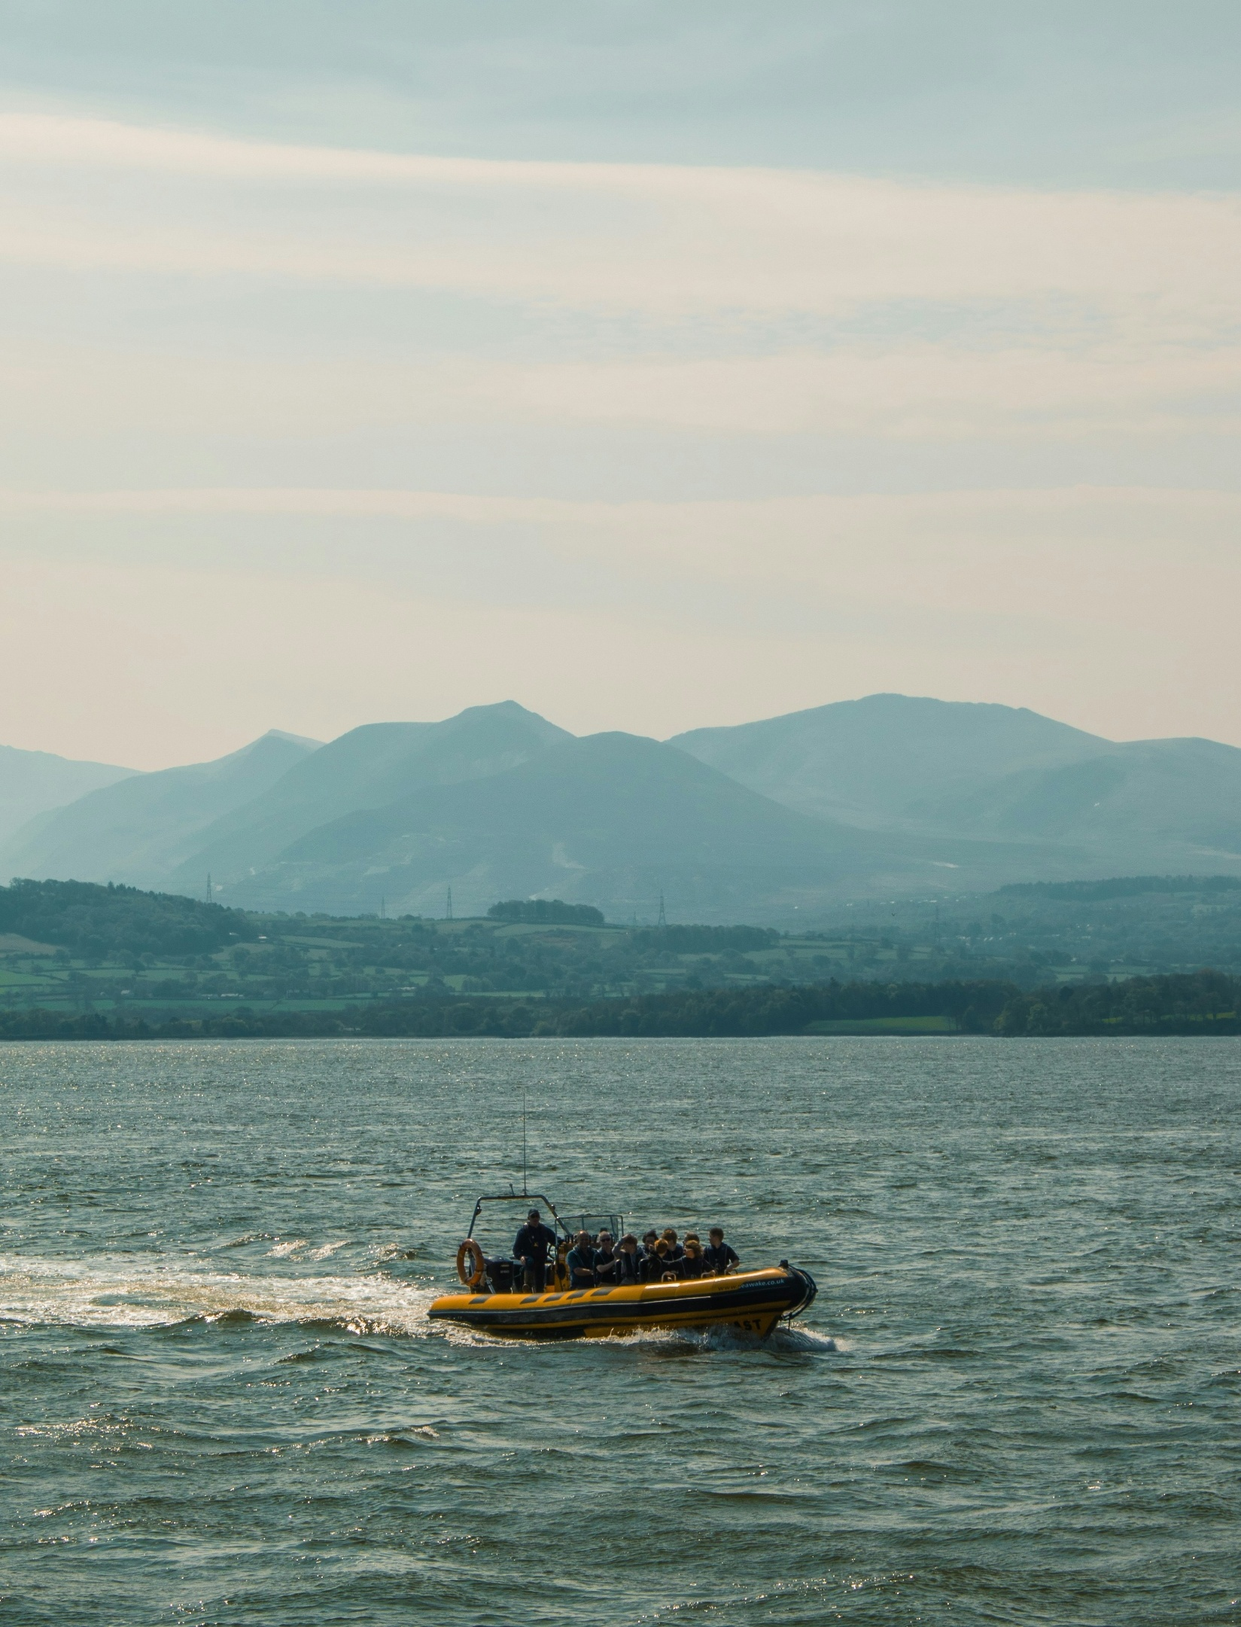
Motivation: Adding distinctiveness alongside beauty
Key Findings
Wales must feel unmistakably Welsh, not just beautiful
What this means in practice:
Wales is consistently described as:
  Beautiful
  Peaceful
  Natural
But these qualities are not unique, and do not always create urgency to visit
Implications for content and communication:
Amplify “only in Wales” experiences
Strengthen cultural distinctiveness (people, language, heritage, atmosphere)
Move beyond landscape to show what makes Wales different, not just appealing

Slide 10
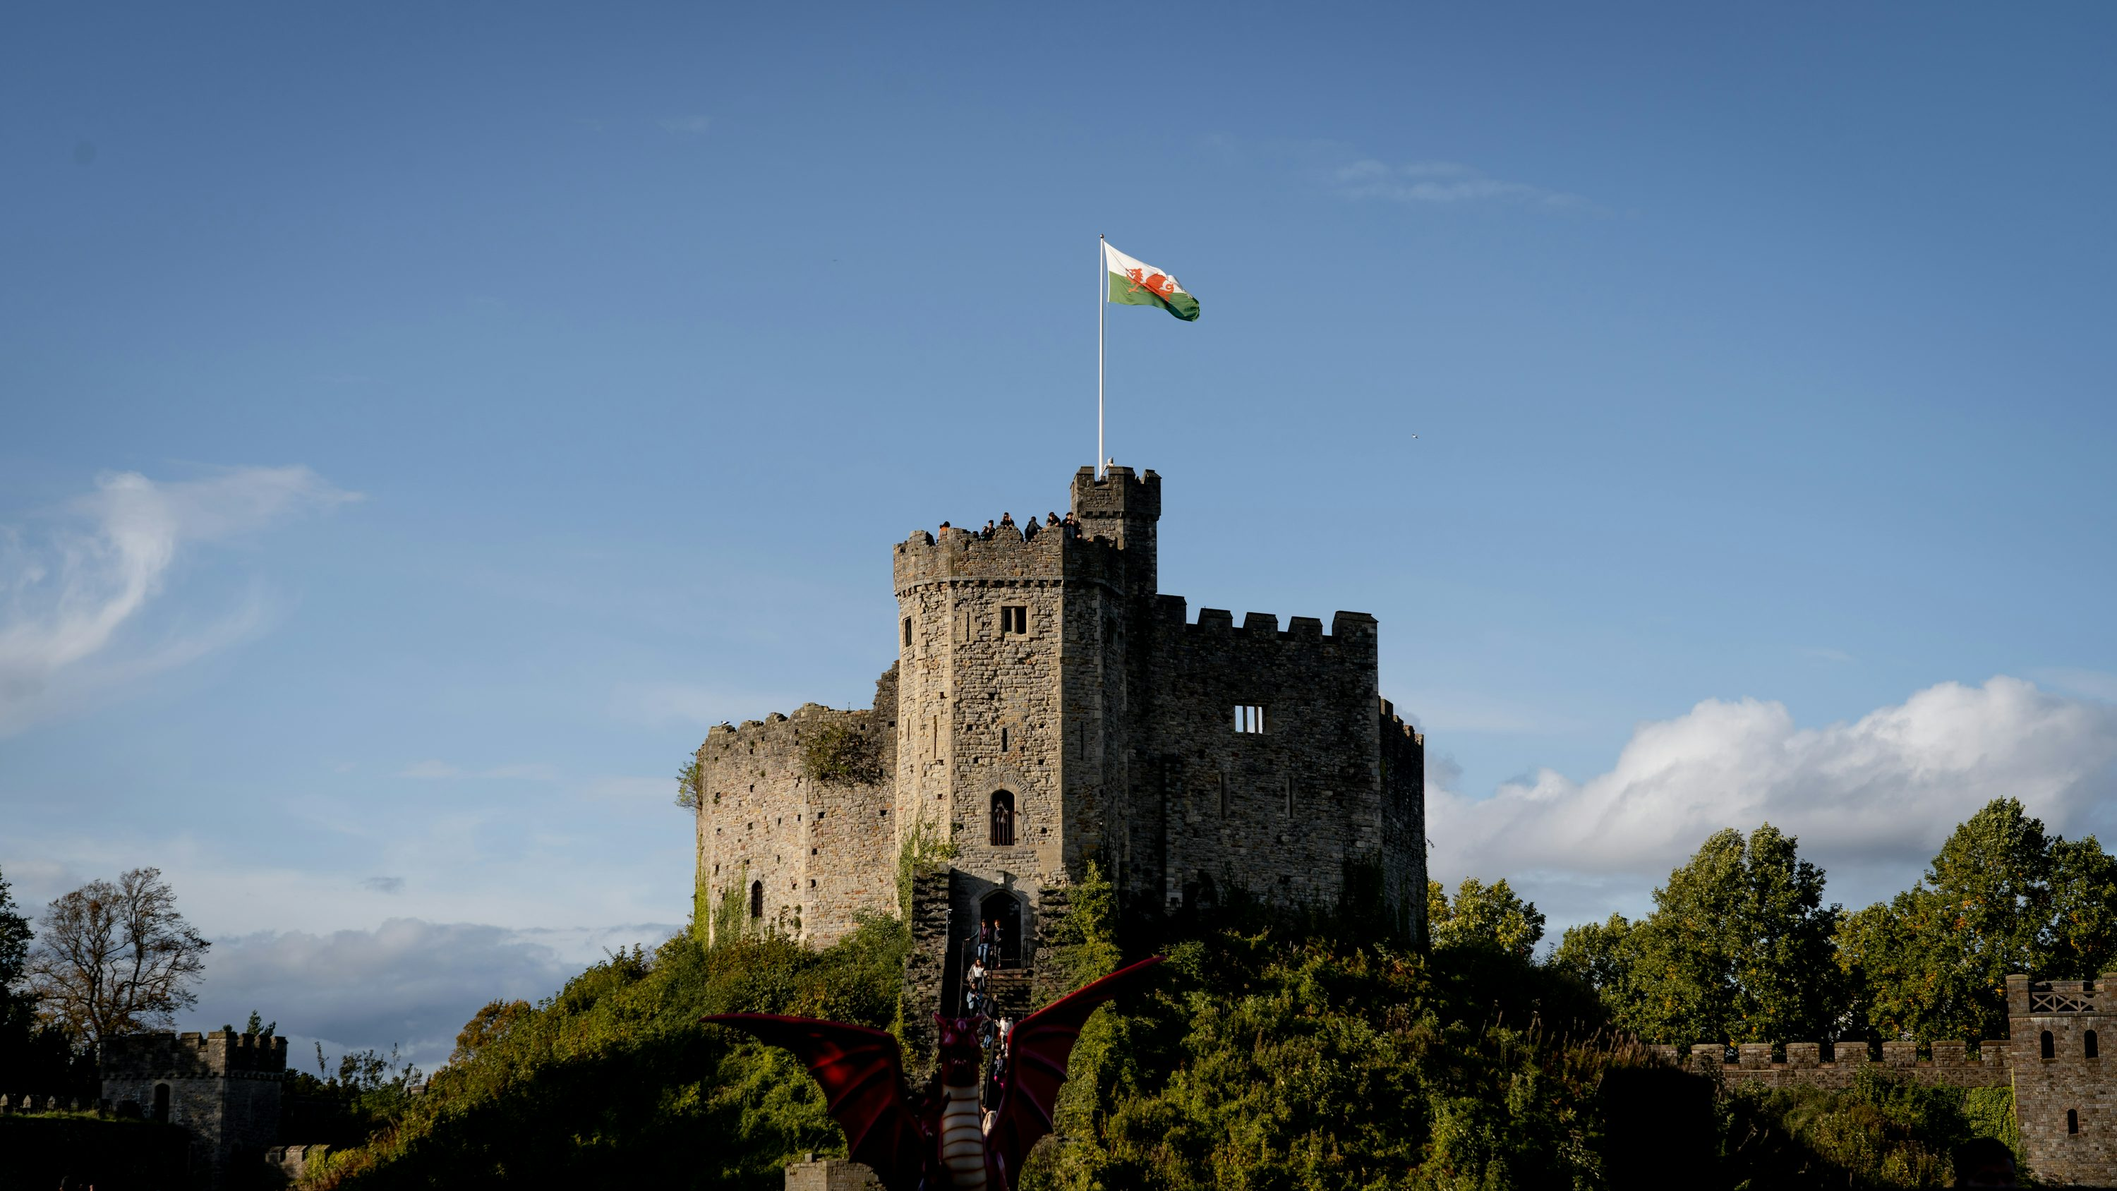
BACKGROUND
& METHODOLOGY

Slide 11
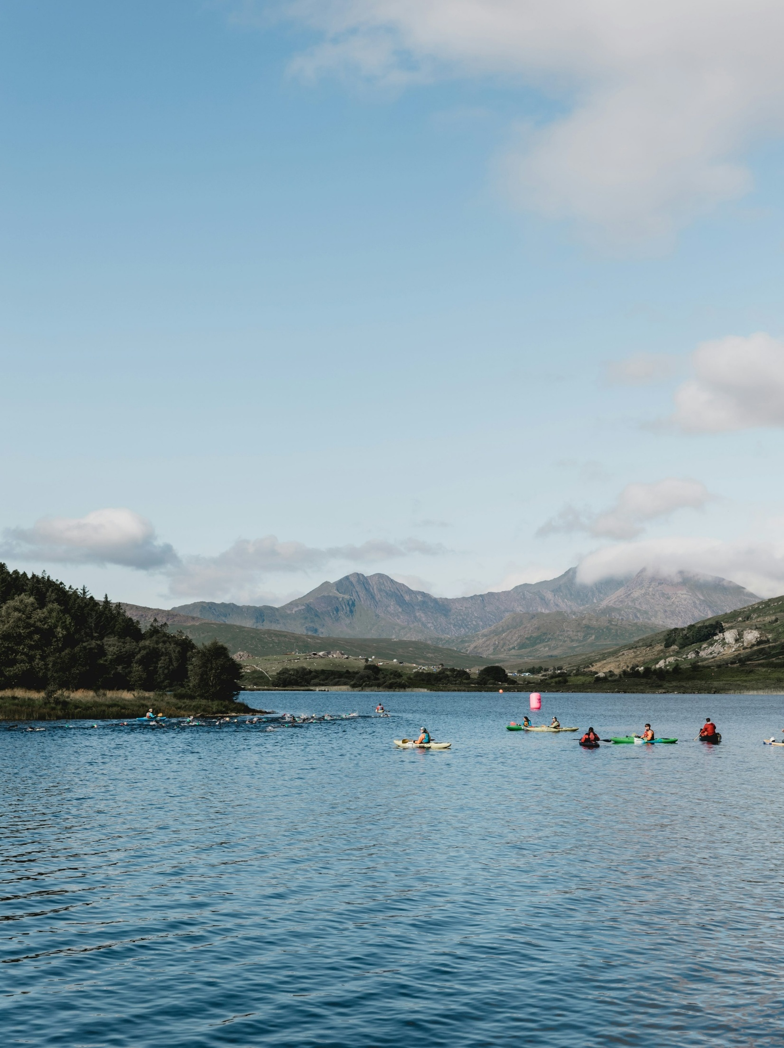
Background
Driving tourism to Wales:
insights from UK, US and German trip-takers
Visit Wales, the Welsh Government's tourism team, is responsible for deploying tourism campaigns in the UK and internationally to position Wales as a leading tourist destination.
The primary research objectives of the survey were to:
  Explore perceptions, motivations, and barriers to visiting Wales among potential visitors.
  Understand the holiday destination decision-making process through the COM-B behavioural change model
  Identify differences across key audience segments.
This detailed report analyses insight from 84 interviews conducted in January and February 2026 amongst UK, US and German trip-takers who would consider Wales as a holiday destination.

Slide 12

Methodology
In January and February 2026, Kubi Kalloo conducted 45-minute online interviews with a total of 84 trip-takers across the UK, USA and Germany that would consider Wales as a potential holiday destination.
Behavioural Framework:
This study was structured using the COM-B behavioural framework, which examines the drivers of behaviour across three dimensions:
Capability – Do people feel they understand how to plan and execute a trip to Wales?
Opportunity – Does Wales feel practically feasible and realistic given cost, access and life stage?
Motivation – Do people feel emotionally compelled to choose Wales over alternatives?
Using COM-B allows us to move beyond surface-level reactions and identify the structural barriers and triggers influencing destination choice.
Audience | UK | USA | Germany
Younger Independents (18–34) | N=7 | N=7 | N=7
Families (35–54) | N=7 | N=7 | N=7
Older Independents (55–64) | N=7 | N=7 | N=7
Retirees (65+) | N=7 | N=7 | N=7
Total sample | N=28 | N=28 | N=28

Slide 13
Methodological context: recruitment, strengths and limitations
A structured, cross-market qualitative sample designed to robustly diagnose behaviour. This study combines depth with breadth across markets and life stages to provide a reliable view of how travel decisions are made
How participants were recruited:
Participants were recruited via specialist research panels across the UK, USA and Germany
All participants were screened to ensure they would actively consider Wales as a potential holiday destination, and that they fit the life stage criteria
Strengths |  | Weaknesses
84 in-depth interviews across 3 markets provides strong qualitative coverage of key audiences Structured sampling enables consistent cross-market and cross-segment comparison Depth of interviews allows exploration of the full decision-making system, not just stated preferences Identifies repeatable behavioural patterns, not just individual opinions |  | Findings are directional and behavioural, rather than statistically representative Designed to explain how decisions are made, not quantify how many people hold each view Best used alongside larger-scale quantitative research to size and validate patterns

Slide 14

THE HOLIDAY DESTINATION SYSTEM
How destinations actually get chosen in 2026

Slide 15

The Holiday Decision System
Holidays are not chosen –
they are constructed through a layered decision journey
Need
Feasibility
Emotion
Shortlist
Book
Travellers do not “pick a place.” They move through a structured decision journey:
Define the type of break
Build a shortlist
Test feasibility
Emotionally validate
Assemble and book the trip
Destinations win or lose at different stages of this journey.
Destinations win or lose at different stages of this process - Wales is competing within it, not being considered in isolation

Slide 16
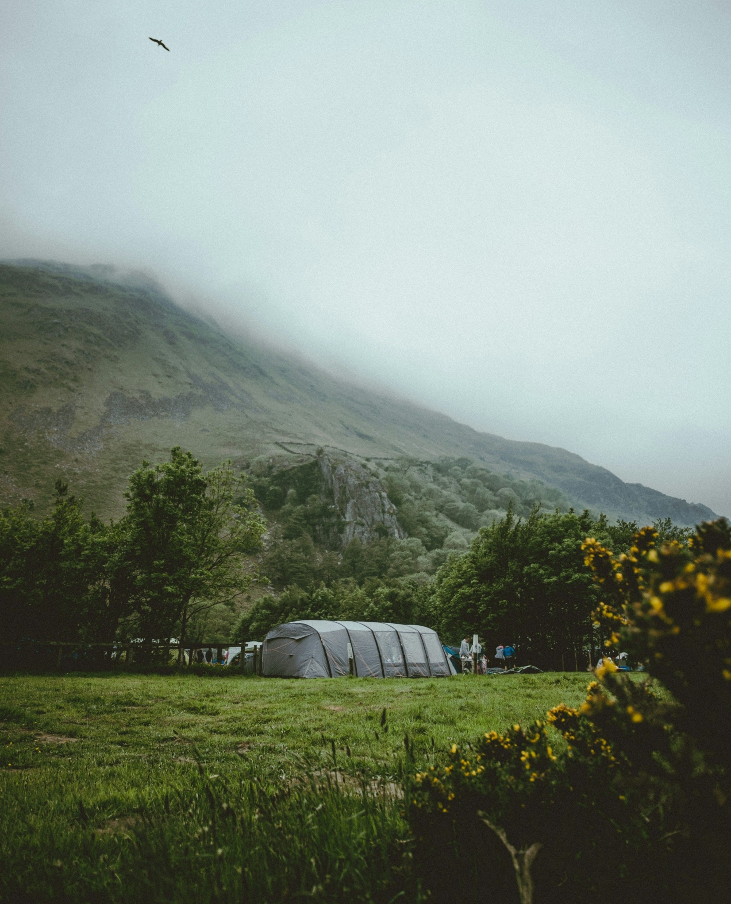
Step 1: Trip type is decided first
“We don’t start with where - we start with what kind of trip we want”
Germany, Family
The Holiday Decision System
Across all three markets, travellers start with:
“We need a reset.”
“We want culture.”
“We want sun.”
“We want something easy.”
“We want family time”
Only then do destinations enter. If a destination doesn’t clearly map to a defined need, it struggles to enter the shortlist.
“It depends what the purpose is - relaxation, culture, something active”
USA, Older Independent

Slide 17

Step 2: Shortlists are built from what comes to mind
The Holiday Decision System
“You just hear about London all the time”
USA, Younger Independent
Destinations enter consideration because they are:
Familiar
Repeatedly seen
Socially referenced
Easy to describe
If a destination requires explanation, it is already at a disadvantage. Mental availability drives shortlist inclusion.
“You see Ireland everywhere on social media”
UK, Younger Independent

Slide 18

Step 3: Planning confidence is the gatekeeper
The Holiday Decision System
“We prefer somewhere that’s already kind of mapped out”
Germany, Family
Once shortlisted, destinations are stress-tested:
Can I picture where I would stay?
Do I understand how to get around?
How long is enough?
Is this straightforward?
Destinations rarely drop out because they are disliked - they drop out because they feel effortful. Small frictions accumulate quickly for all but the most motivated of travellers.
For most, clarity wins over novelty.
“If it feels complicated, I probably wouldn’t bother”
UK, Family

Slide 19
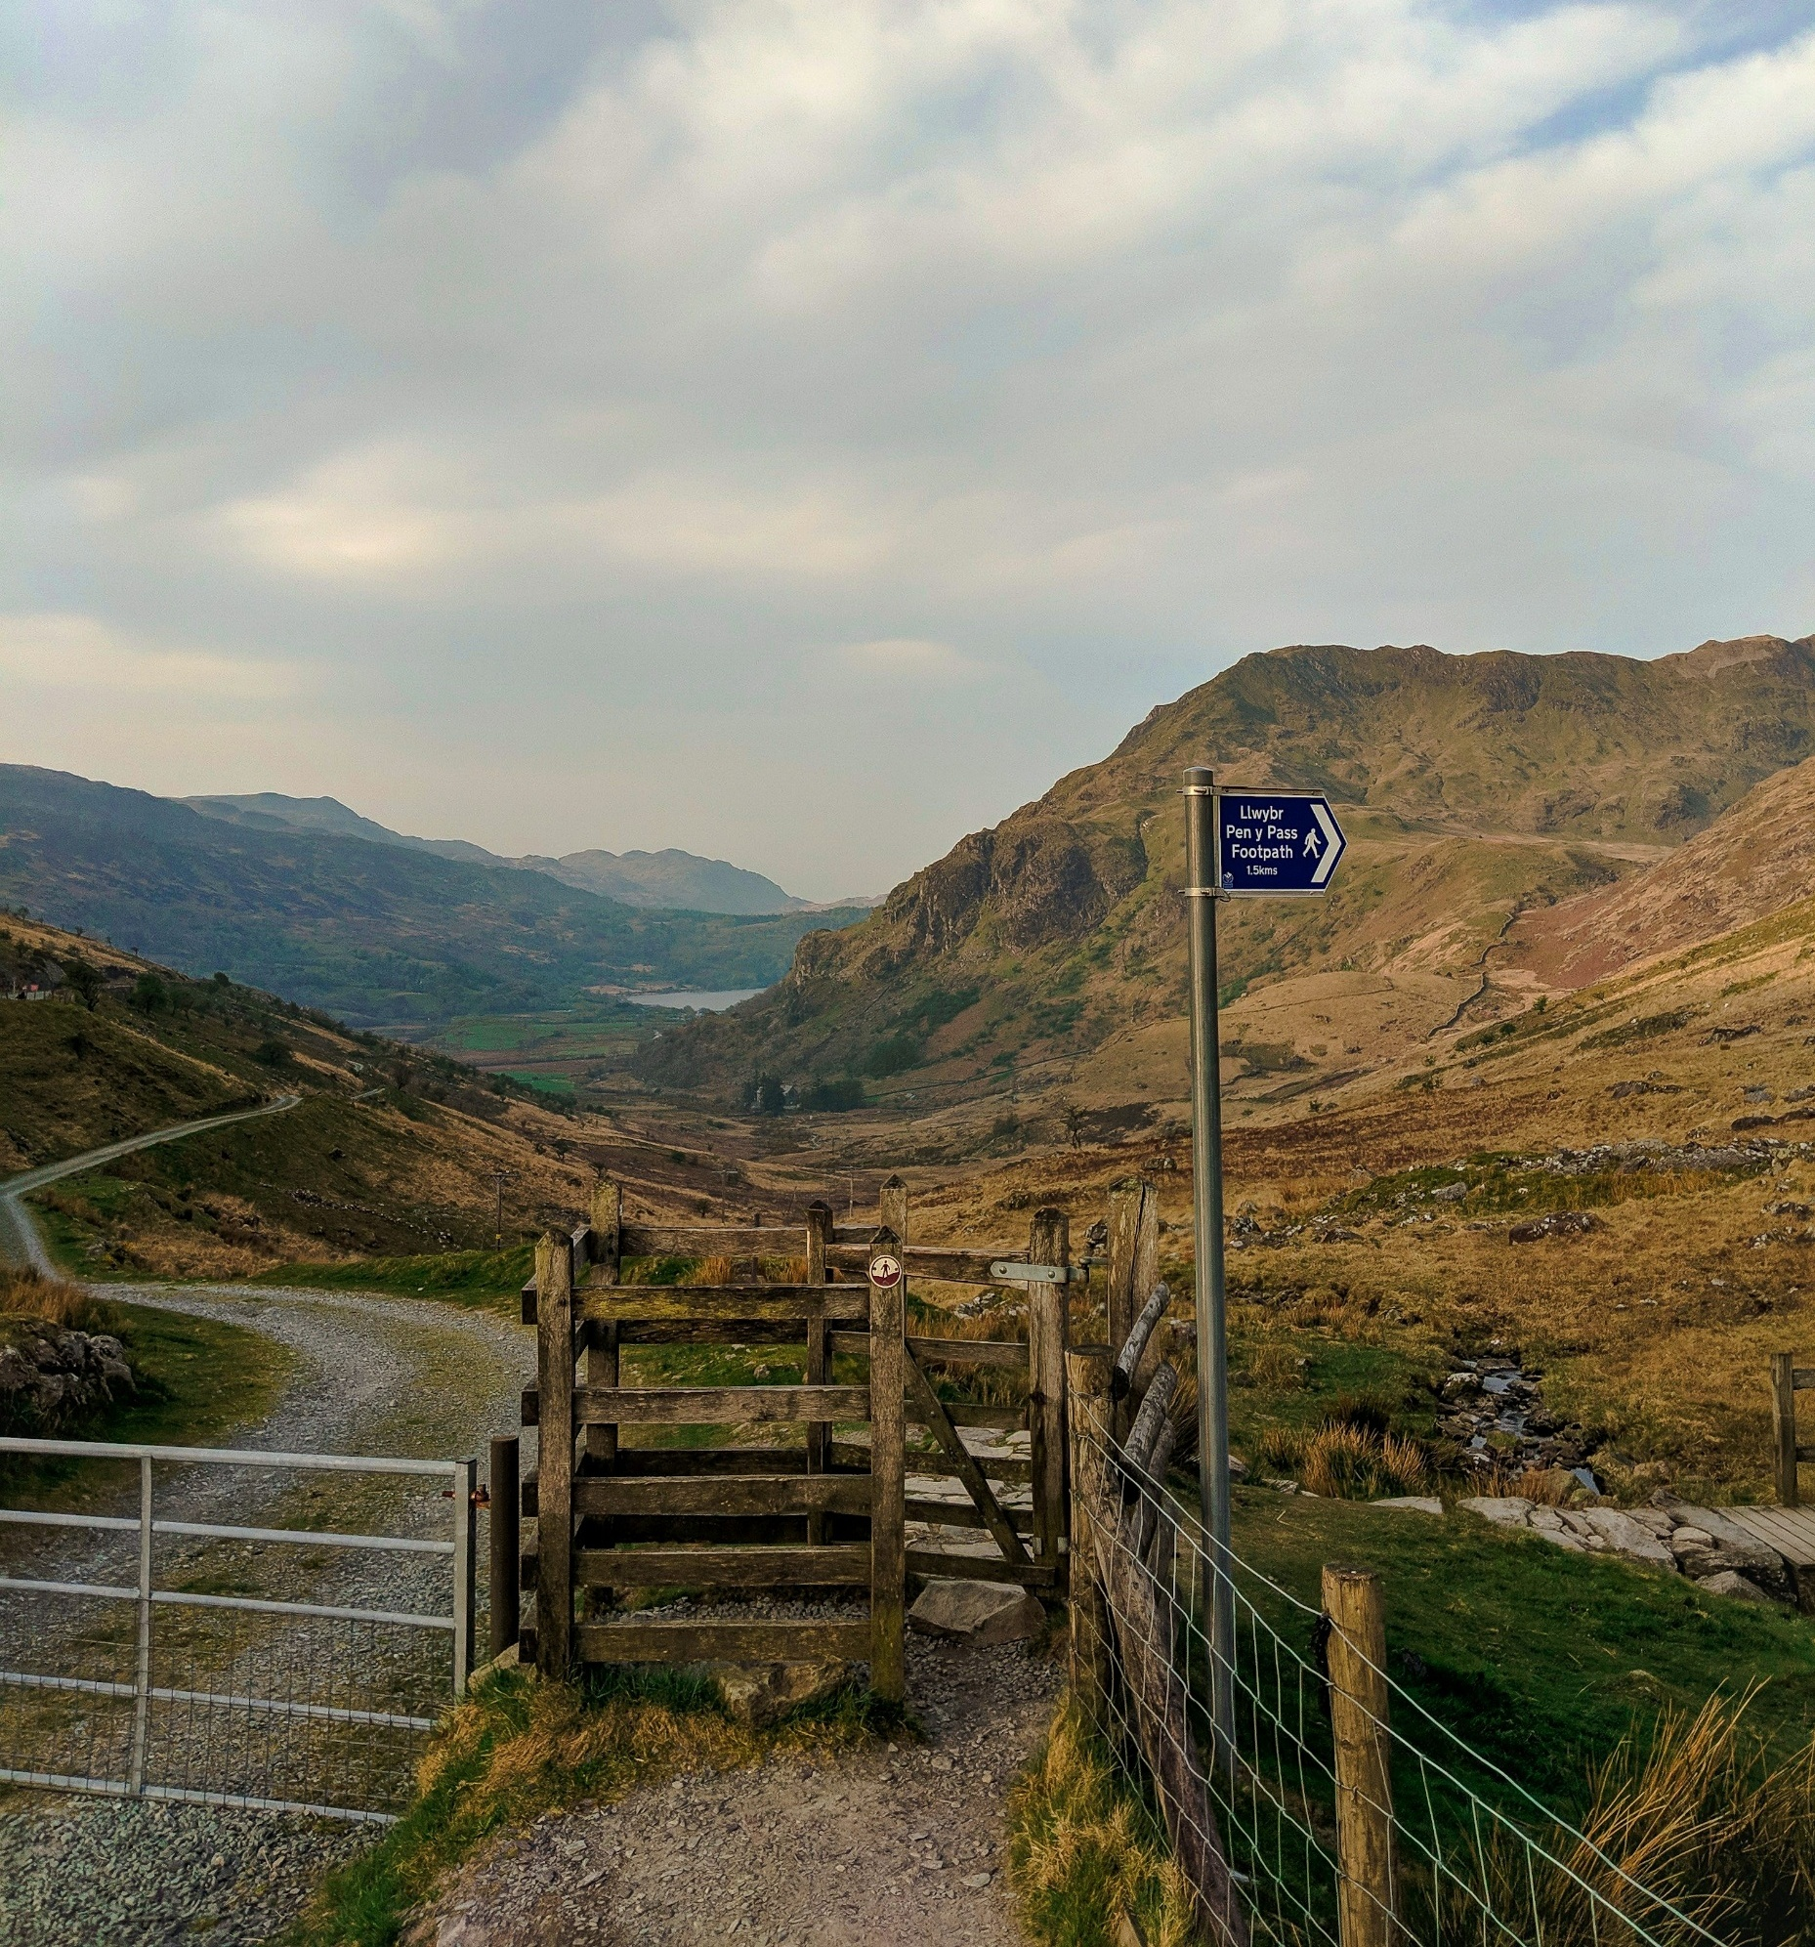
Step 4: Feasibility must precede emotion
“It’s appealing, but I don’t know if it’s practical”
Germany, Retiree
The Holiday Decision System
Emotion matters - but only after practicality. Travellers need to feel:
This fits their practical needs
This justifies the budget
This feels manageable
Inspiration without structure rarely converts.
“I like it - I just don’t know how we’d do it”
UK, Younger Independent

Slide 20
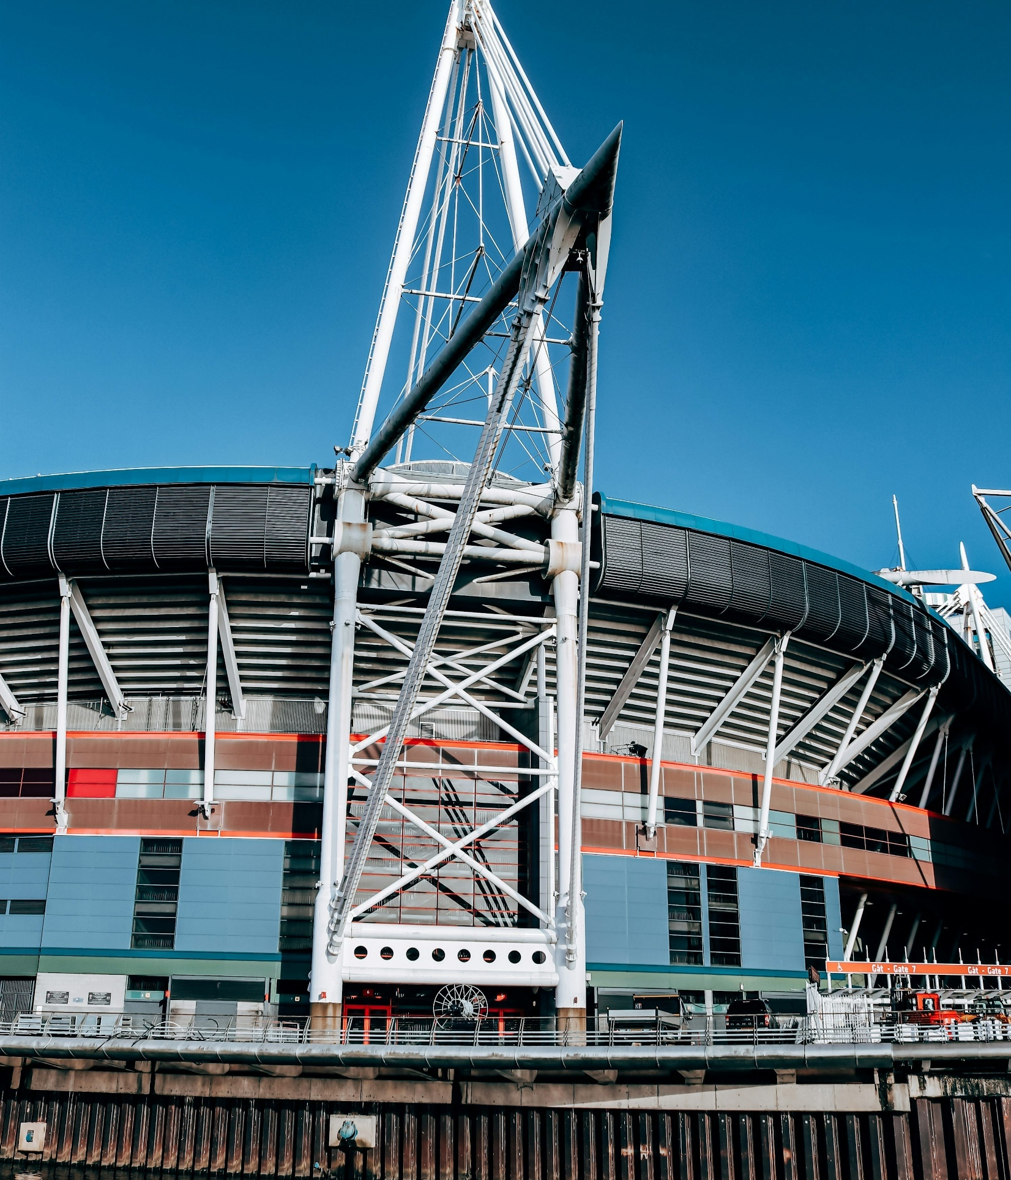
Step 5: Occasion creates urgency
The Holiday Decision System
“If we’re already in the UK, maybe then”
USA, Family
Specifically regarding Wales
Strong destinations are tied to a clear reason to travel - shaping when to go, how long for, and what the trip looks like:
Winter sun
Honeymoon
Cultural city break
Festival trip
Cultural events
Part of a wider trip (e.g. visiting Wales within a trip to the UK)
Occasion creates priority.
Without it, destinations are more likely to remain a “someday” choice.
“
“It would probably be part of something bigger”
Germany, Younger Independent
Specifically regarding Wales

Slide 21
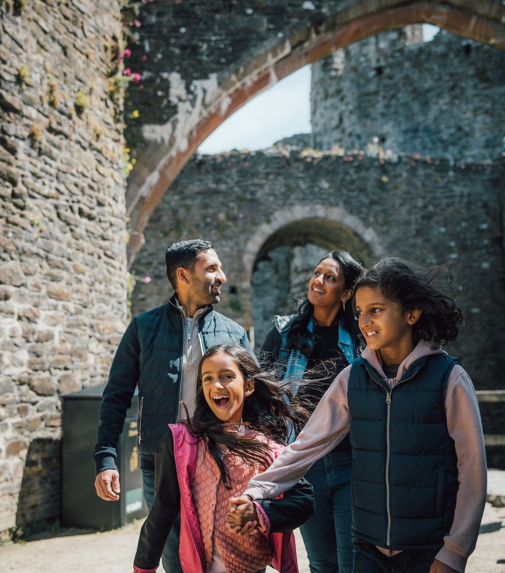
Why this matters for Wales
The Holiday Decision System
Wales is not being evaluated in isolation. It is competing against:
Clear Trips
Iconic Cities
Proven Touring Routes
Familiar Alternatives
To grow consideration, Wales must win inside this system, at multiple stages.
The next section applies the COM-B framework to understand where Wales is strongest, and where it faces friction within this decision journey.

Slide 22

THE COM-B DIAGNOSIS OF WALES CAPABILITY – Can I do Wales?

Slide 23

CAPABILITY: The core question
Capability
The COM-B Diagnosis of Wales – Capability
“Solely based off what I know, I think it’d be a little bit challenging”
Young Adult, USA
Capability is not about awareness alone. It is about planning confidence. It is about whether travellers feel confident that they can:
Structure the trip
Navigate the destination
Allocate the right amount of time
Make it work without excessive effort
Where confidence is low, intention stalls.
“I imagine it to be a little more difficult, because it is not actually mentioned that often”
Retiree, Germany

Slide 24
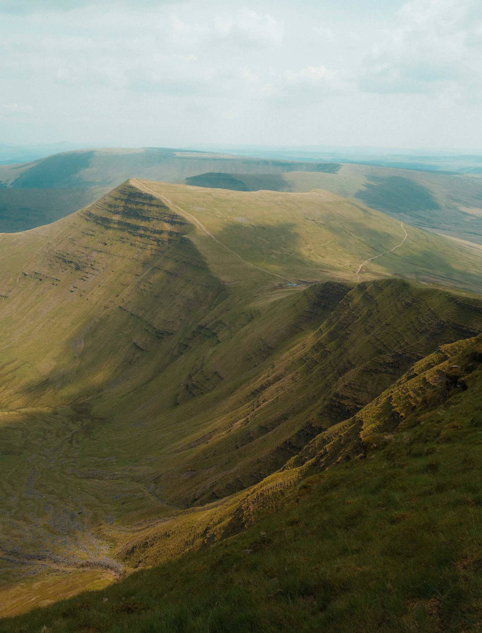
Knowledge is surface-level - Wales is imagery, not itinerary
The COM-B Diagnosis of Wales – Capability
Capability
Even those with limited knowledge of Wales associated it clearly with:
Green landscapes
Hills and open space
Outdoor activity
This reflects a strong sense of atmosphere, but a less developed understanding of where to stay, what to do, or how to structure a trip
It does not translate into a shared, structured trip template like:
Scotland = Highlands + Edinburgh
Ireland = Dublin, Guinness, Wild Atlantic Way
London = iconic city break
Wales is less strongly associated with a clear, repeatable “how to do it” narrative that brings together accommodation, activities and routes
“I always picture the green hilly landscape… hiking, maybe cycling”
Family, Germany
“I just think of like mountains. Lots of green fields… lots of forests and nature”
Younger Independent, UK

Slide 25
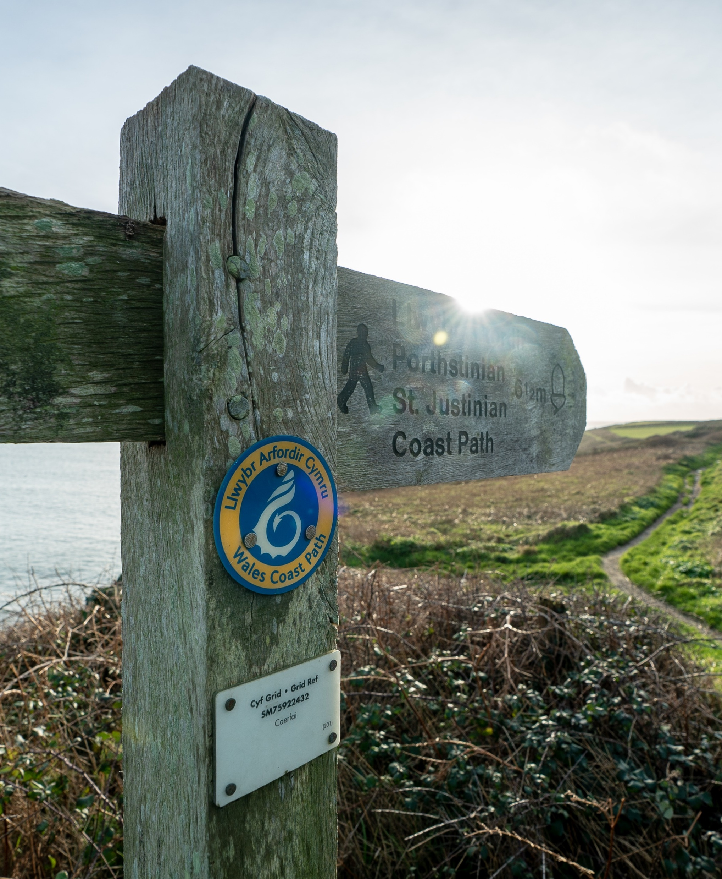
Planning friction emerges at the shortlisting stage
Capability
The COM-B Diagnosis of Wales – Capability
When Wales enters consideration, travellers begin to think through how the trip would work in practice.
Wales often prompts logistical questions:
Where do I base myself?
How long is enough?
Can I see the highlights without overcomplicating it?
Am I “doing it properly”?
The consideration is less about whether to visit, and more about how to make the most of the experience.
This can be a point where Wales is less likely to progress further in the decision journey.

Slide 26

Transport uncertainty magnifies cognitive effort
The COM-B Diagnosis of Wales – Capability
Capability
Transport itself is not the barrier. Uncertainty about transport is.
Questions repeatedly arise:
Do I need a car?
Is public transport viable?
How far apart are experiences?
How easy is access from major hubs?
Where logistics feel ambiguous, travellers default to destinations that feel simpler.
This friction disproportionately impacts:
Younger independents without cars
Long-haul visitors bundling multiple destinations
Retirees seeking ease and reassurance
“It can be very time-consuming to reach certain points with public transportation”
Retiree, Germany
“It is quite expensive to hire a car… that’s such an extra cost”
Younger Independents. UK

Slide 27
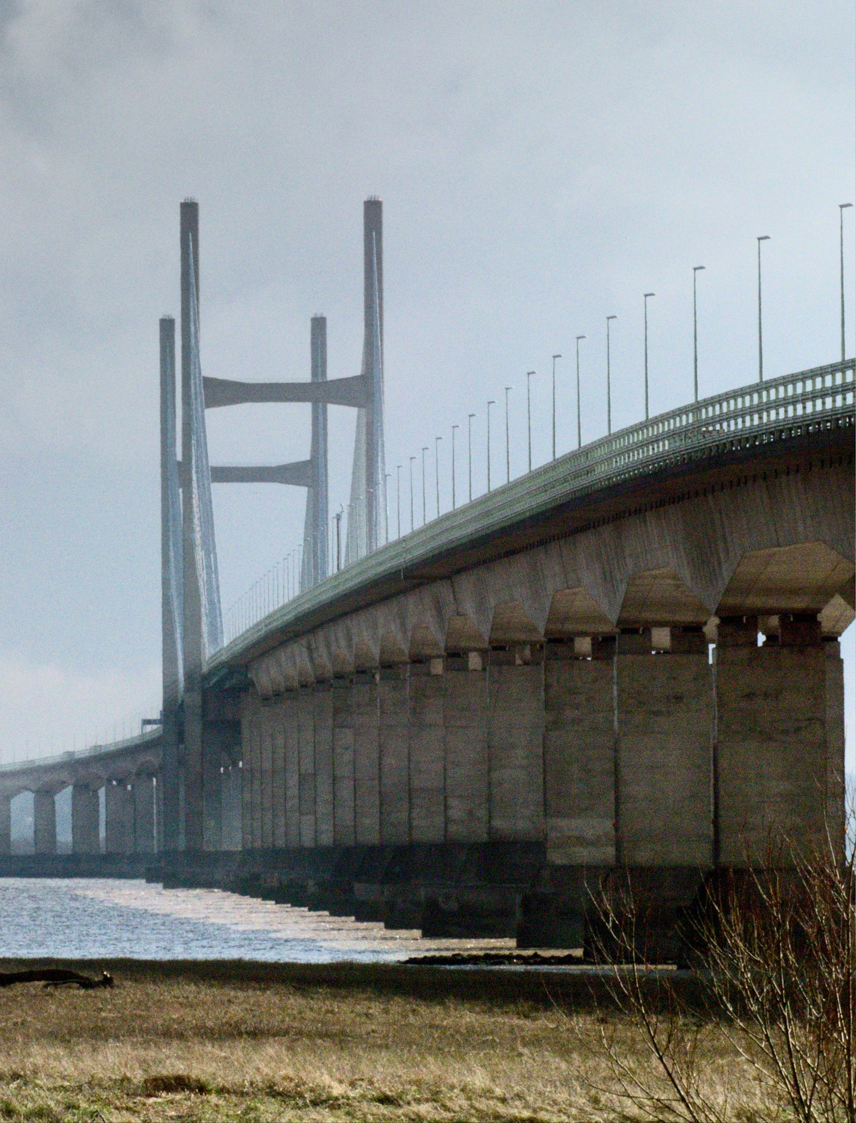
The competitive consequence:
Wales is often considered as part of a wider trip
Capability
The COM-B Diagnosis of Wales – Capability
This is particularly visible in the USA and Germany. When structural clarity is low, Wales becomes:
“Maybe if we’re already in London…”
“Part of a UK trip…”
“An extension rather than the anchor.”
This can influence:
Length of stay
Spend concentration
Standalone trip growth
Wales is often considered, but without a clearly defined trip structure it is more likely to be included as part of a broader itinerary rather than as the primary destination
“If I want to go all the way across the world… I’d probably want at least ten days… and I’d spread that around a few spots”
Older Independent, USA

Slide 28

Capability Diagnosis
The COM-B Diagnosis of Wales – Capability
Performs Strongly
More Limited
Emotional imagery
Perceived natural beauty
Authenticity
Trip template clarity
Structural simplicity
Effortless mental planning
In behavioural terms, travelling to Wales often
requires a greater degree of self-planning.
Destinations that convert more easily come pre-packaged in the traveller’s mind.
The strategic implication:
Reduce Cognitive Effort
Increase trip legibility
Provide ready-made scripts

Slide 29
The COM-B Diagnosis of Wales – Capability
Capability
Planning confidence gaps exist across all segments, but the nature of the gap differs by life stage – be that inspiration gaps to structural planning confidence and need for reassurance
 | Younger Independents | Families | Older | Retirees
Core barrier | Lack of inspiration-led clarity | Lack of practical structure | Lack of relevance clarity | Lack of confidence & reassurance
How it shows up | Can’t picture what makes Wales different or exciting vs alternatives | Can’t picture how to organise a smooth, low-stress trip | Can’t see how Wales fits into existing travel patterns | Uncertainty creates anxiety around logistics and planning
Key friction point | Limited mental imagery beyond “nature” | Questions around: where to stay, how to move, how long | Wales not clearly prioritised vs known destinations | Language, transport, and coordination feel effortful
Planning style | Inspiration into light planning | Structured, efficiency-led planning | Hybrid (habit + exploration) | Preference for guided / supported planning
What unlocks capability | Clear, compelling trip ideas | End-to-end trip structure (itineraries, routes) | Clear role within a broader trip | Reassurance and simplicity (reduced cognitive load)

Slide 30
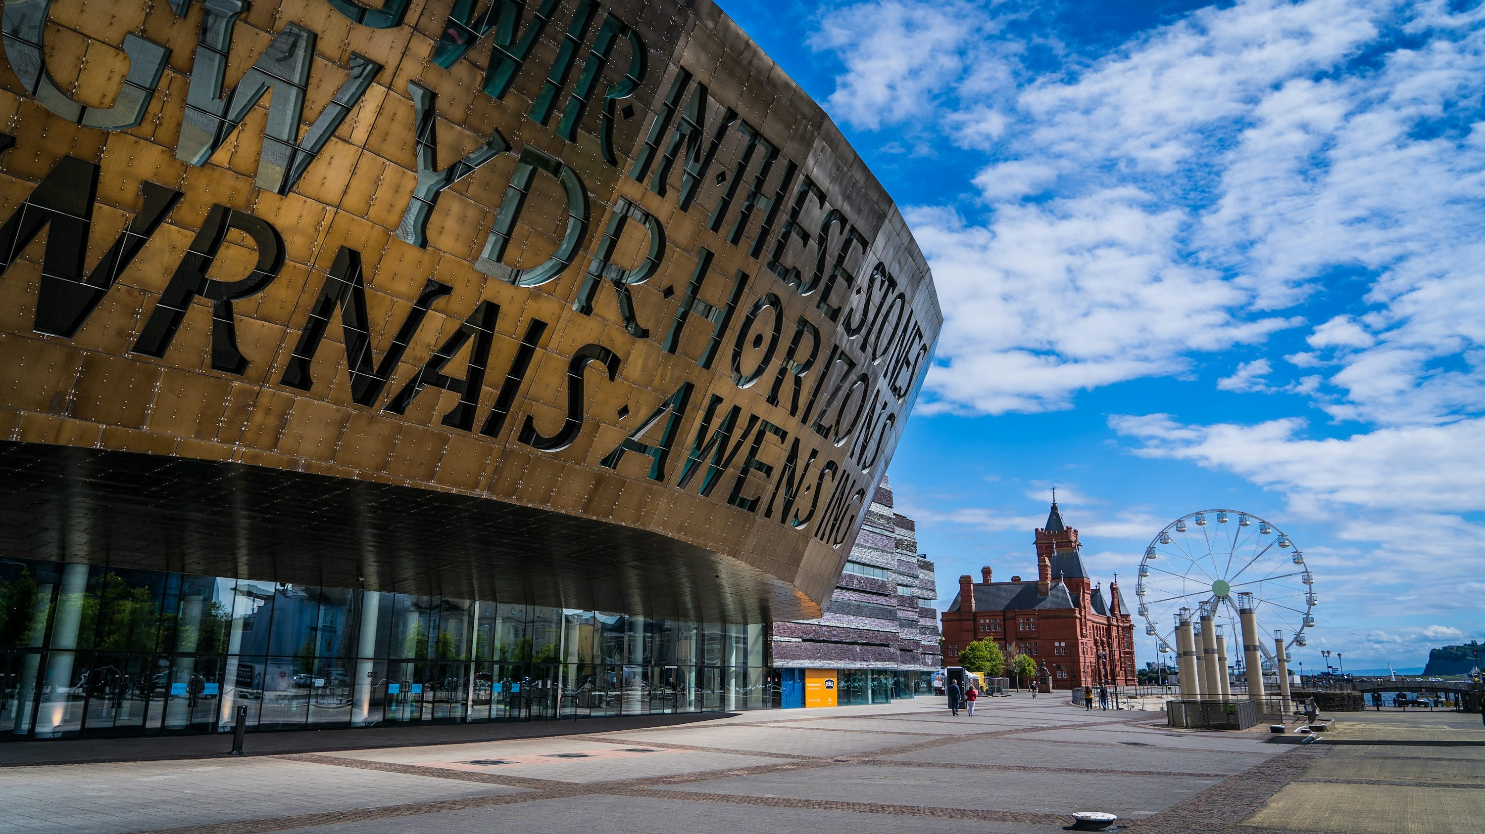
THE COM-B DIAGNOSIS OF WALES OPPORTUNITY – can I make this work?

Slide 31

Opportunity is about whether the trip feels easy to assemble and navigate
Opportunity
The COM-B Diagnosis of Wales – Opportunity
Even when travellers like Wales, they assess whether accommodation, activities and travel feel easy to organise
Across markets, three questions dominate:
Is the effort worthwhile?
Is the value competitive?
Does it fit the time I have available?
When the answer to any of these is uncertain,
Wales is less likely to be prioritised.

Slide 32
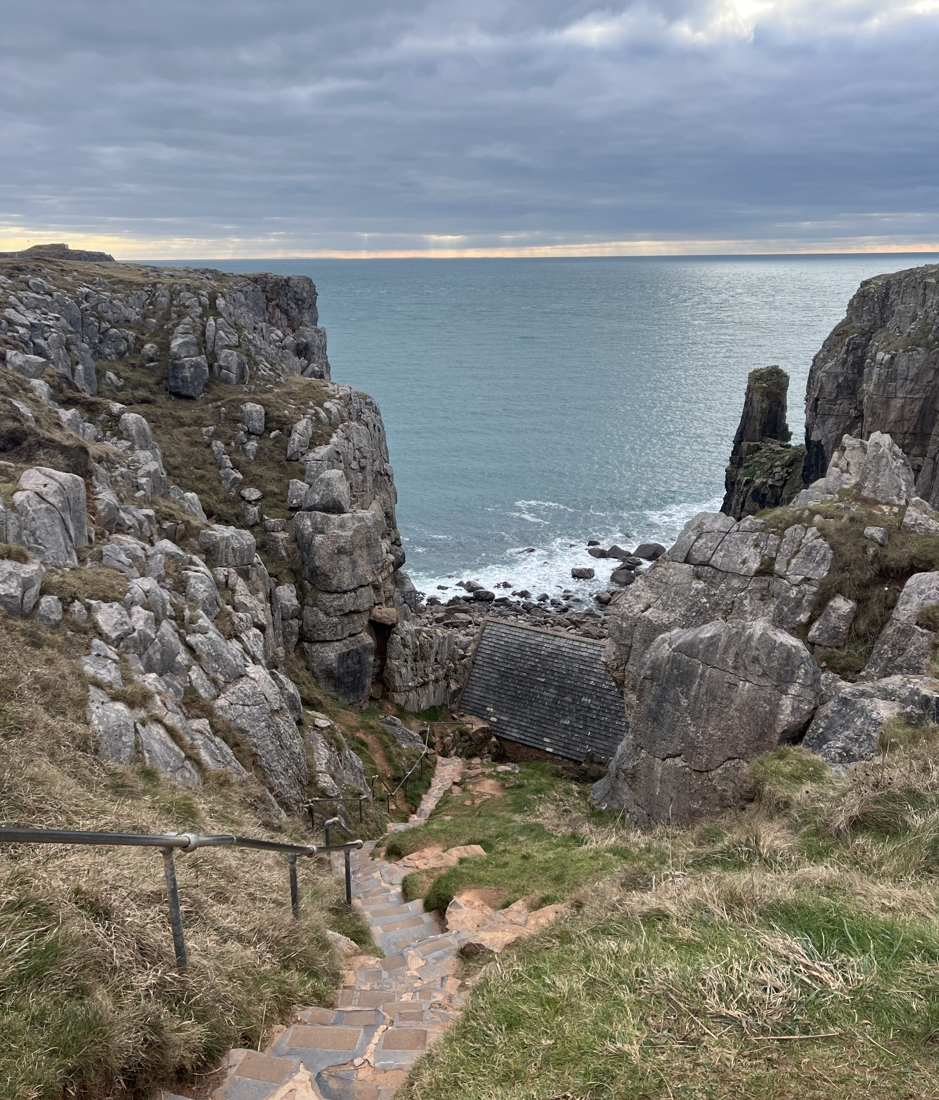
UK travellers evaluate Wales through a value lens
Opportunity
The COM-B Diagnosis of Wales – Opportunity
“Once you’ve paid for accommodation and travel it can be quite expensive”
Younger Independent, UK
For UK travellers, the barrier is not access - it is comparative value.
Domestic trips are frequently compared with:
Low-cost European flights
Package holidays
All-inclusive offers
When accommodation and transport costs accumulate, Wales can feel comparable in price to travelling abroad.
This creates a simple comparison in travellers’ minds:
Why stay domestic if the price difference is small?
“For that price you could probably get a flight somewhere warm”
Older Independent, UK

Slide 33

Long-haul travellers evaluate effort vs reward
Opportunity
The COM-B Diagnosis of Wales – Opportunity
“It would probably be part of something bigger”
Younger Independent, Germany
For US and German travellers, the evaluation shifts:
Is Wales worth the travel effort?
This includes:
Distance travelled
Number of travel stages
Time required to explore
Without a clear sense of trip structure, the perceived effort can feel high relative to alternatives.
“If I’m going all the way across the world… I’d want to see a lot”
Older Independent, USA

Slide 34
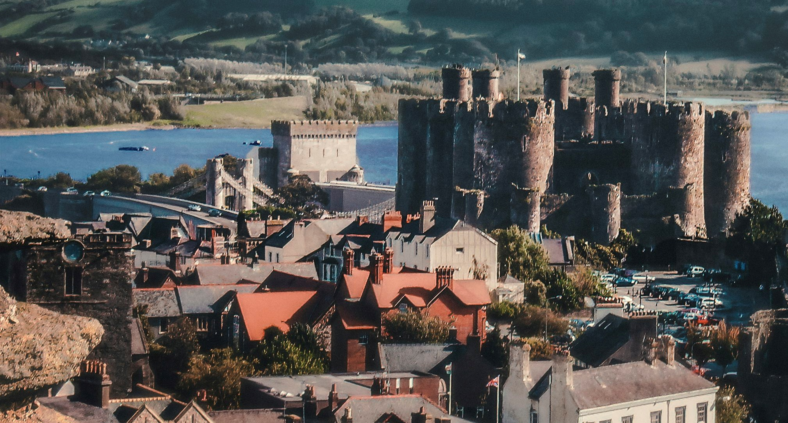
Time thresholds shape destination choice
The COM-B Diagnosis of Wales – Opportunity
Opportunity
Wales is perceived as rural, exploration-led and best experienced through movement.
Travellers tend to organise trips into clear time formats.
Wales sits most naturally within the mid-length exploration trip. This creates an implicit time threshold:
Short trips feel difficult to optimise
Long trips compete with larger European itineraries
Short Break (2-3 days) | Flexible Stay (4-7 days) | Long Exploration (7+days)
City breaks | Regional touring | Multi-country trip
Defined base | Exploration | Major itinerary
Dense experiences | Nature +culture | Iconic destinations

Slide 35
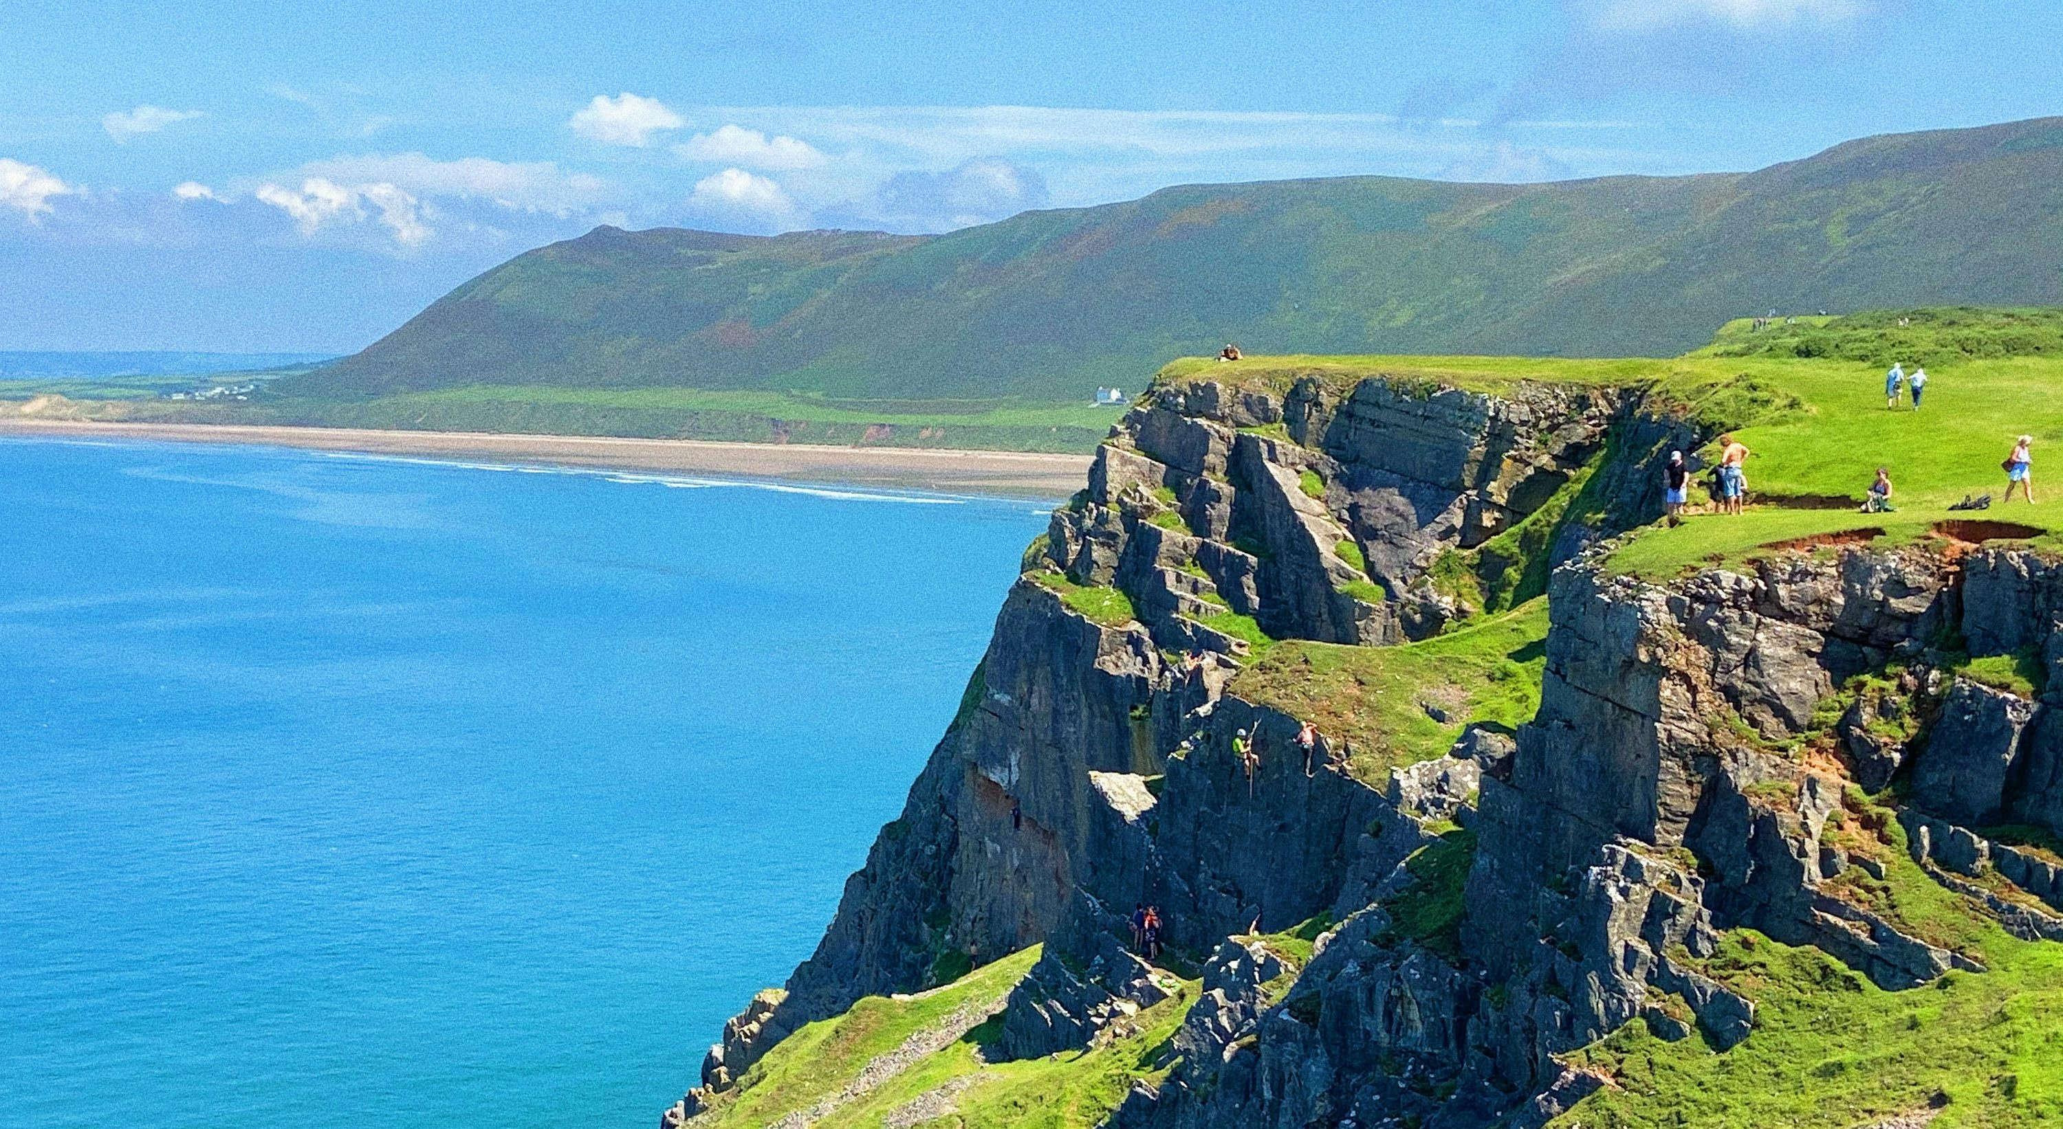
Opportunity diagnosis: feasible, but not frictionless
Opportunity
The COM-B Diagnosis of Wales – Opportunity
Wales is feasible across all markets.
However, feasibility does not always translate into prioritisation.
UK
Domestic trips are often evaluated against overseas alternatives
Value comparisons can weaken the case for staying in the UK
Germany & USA
Travellers assess whether Wales justifies the travel effort
Trip structure and time allocation become critical
Across markets, the result is similar:
As a result, there is an opportunity to make the experience feel more
simple, connected and clearly worth the effort

Slide 36
The COM-B Diagnosis of Wales – Opportunity
Opportunity
Wales is feasible for all segments, but each group applies a different and distinct practical lense feasibility test - from cost and convenience to effort and reassurance
 | Younger Independent | Families | Older | Retirees
Primary filter | Effort vs ease | Effort vs family logistics | Effort vs reward | Ease vs complexity
Key concern | Transport complexity (no car, cost of movement) | Friction across multiple needs (kids, accommodation, time) | Whether Wales justifies time vs other destinations | Need for seamless, low-stress travel
Time sensitivity | Flexible but low tolerance for friction | Highly time-constrained (school holidays, short breaks) | Moderate flexibility, but value optimisation mindset | High flexibility, but low tolerance for effort
Value lens | Experience must feel “worth it” vs alternatives | Strong comparison vs overseas value (esp. UK) | Trade-off between effort and payoff | Willing to pay for ease and organisation
How Wales loses momentum | Feels harder than more accessible options | Feels effortful vs “easy win” holidays | Becomes part of a broader trip, not the focus | Dropped if planning feels too complex
What unlocks opportunity | Frictionless access + clarity on movement | Ease, convenience, and clear logistics | Clear payoff for time invested | Packaged, well-supported travel options

Slide 37

THE COM-B DIAGNOSIS OF WALES MOTIVATION – Do I feel compelled to prioritise Wales?

Slide 38

Motivation is positive - but rarely urgent
The COM-B Diagnosis of Wales – Motivation
Motivation
Across all markets, Wales is described warmly:
Beautiful
Green
Peaceful
Authentic
Historic
There is very little active negativity in how Wales is seen.
However, positive sentiment does not always translate into urgency..
Wales generates interest.
It does not consistently generate prioritisation.

Slide 39

Emotional associations are broad - not distinctive
The COM-B Diagnosis of Wales – Motivation
Motivation
Wales is associated with:
Nature
Castles
Coast
Heritage
However, these are not seen as uniquely owned territories.
Travellers feel they can access similar or overlapping emotional rewards across a range of destinations, including:
Scotland, Ireland and parts of England
Continental Europe
Parts of the US
Without sharper distinctiveness,
motivation can become interchangeable.
“I just think of like mountains… which you could see in many other places”
Younger Independent, UK
“You could get that kind of scenery in other places”
Younger Independent, USA

Slide 40

Wales is less strongly associated with clear travel triggers
The COM-B Diagnosis of Wales – Motivation
Motivation
Competing destinations are linked to specific, recognisable trip types - Wales is less so.
Travellers associate similar destinations with clear travel moments:
Scotland → Highlands touring, iconic landscapes, heritage routes
Ireland → Cultural touring, Wild Atlantic Way, social atmosphere
UK cities → Short breaks, culture, events
These associations help travellers answer two key questions:
When should I go?
Why should I go now?
Wales is rarely linked to a specific travel moment.
Instead, it tends to sit in a broader category of “somewhere nice to visit.”
Without a clear trigger, trips become easier to postpone.

Slide 41
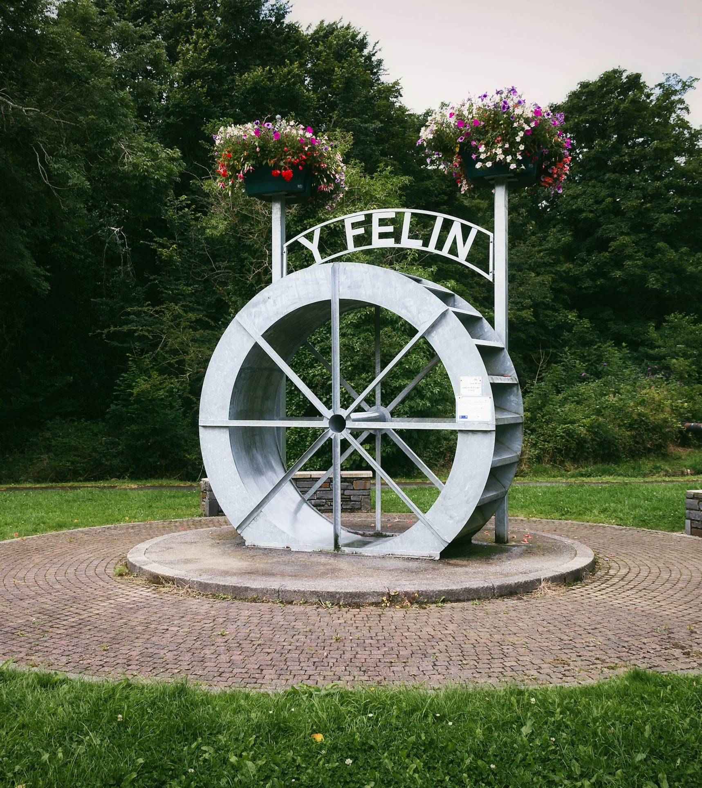
Identity fit is broad rather than highly defined
The COM-B Diagnosis of Wales – Motivation
Motivation
When asked those taking part felt that Wales signals broadly to:
Outdoor lovers
Heritage seekers
Couples
Retirees
Families
This broad appeal is a strength, but can make the positioning feel less clearly defined.
Fewer travellers - particularly outside of older or outdoor-oriented segments - express a strong sense that:
“This feels made for me.”
Motivation is warm –
but not always personally compelling.
“It seems peaceful”
Older Independent, US
“It would be nice”
Younger Independent, UK

Slide 42
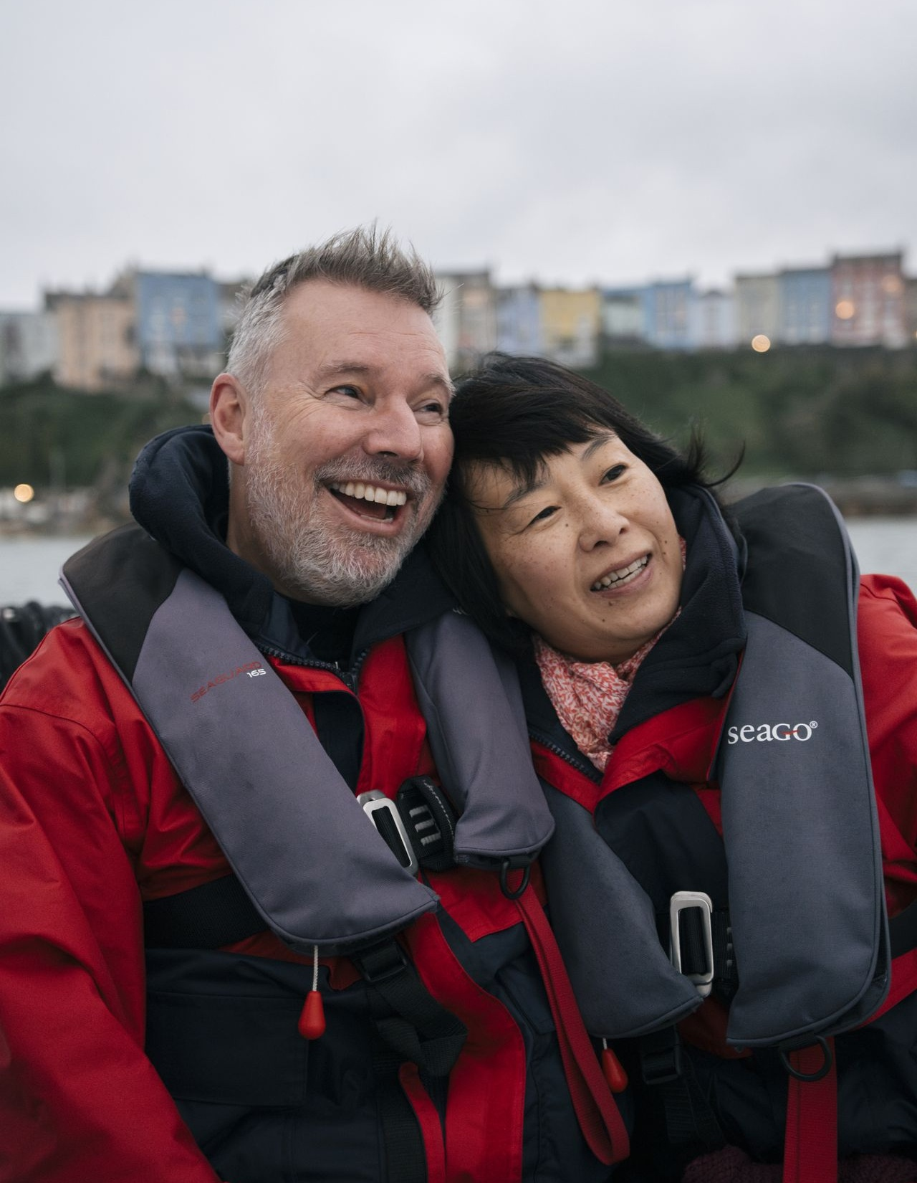
Motivation diagnosis: positive sentiment, limited urgency
Motivation
The COM-B Diagnosis of Wales – Motivation
Wales benefits from broadly positive sentiment.
However, this does not always translate into strong prioritisation.
In behavioural terms:
Admired but not always urgent
Appealing but often deferrable
Pleasant but not consistently top-of-list
Capability and Opportunity create structural friction,
and Motivation is not always strong enough to overcome it.
To strengthen conversion, Wales may need to move from:
That looks lovely to That’s what we’re doing.

Slide 43
The COM-B Diagnosis of Wales – Motivation
Motivation
Motivation is consistently positive across segments but sometimes lacks the specific emotional hooks needed to convert interest into action for different life stages
 | Younger Independents | Families | Older | Retirees
Core motivation | Discovery, novelty, shareable experiences | Quality time, memory-making, ease | Meaningful exploration, authenticity | Relaxation, nature, gentle discovery
Emotional driver | “Something different” | “Something that works for everyone” | “Something enriching” | “Something easy and enjoyable”
Barrier to urgency | Wales lacks a clear cultural or social hook | Wales lacks a clear reason to choose vs easier options | Wales lacks a clear role vs familiar destinations | Wales lacks a compelling reason to prioritise now
Perception of Wales | Nice but interchangeable | Appealing but effortful | Interesting but not essential | Pleasant but not top-of-mind
Trigger sensitivity | Highly responsive to inspiration (social, visual) | Responsive to ease and reassurance | Responsive to narrative (culture, identity) | Responsive to trust and simplicity
What would drive action | Distinctive identity + social proof | Ease + clear family fit | Clear narrative and cultural depth | Comfort, reassurance, and guided experience

Slide 44

THE COM-B DIAGNOSIS OF WALES
Strategic implications for Wales

Slide 45

COM-B synthesis: the behavioural challenge
The COM-B Diagnosis of Wales – Strategic Implication
COM-B | Key Barrier
Capability | Travellers struggle to picture the trip
Opportunity | Effort, value and time must be justified
Motivation | Wales is liked but rarely prioritised
Wales performs well at generating interest,
but uncertainty around planning, effort and distinctiveness means
it is admired, but can lack prioritisation.

Slide 46

How these barriers play out in the holiday decision
The COM-B Diagnosis of Wales – Strategic Implication
Decision Stage |  | Behavioural Friction |  | Result
Inspiration |  | Wales looks beautiful and appealing |  | Wales enters consideration
Planning |  | Travellers struggle to picture and structure the trip |  | Simpler destinations gain advantage
Prioritisation |  | Value, effort and distinctiveness are questioned |  | Wales is postponed rather than rejected
Wales is rarely rejected outright.
Instead, it loses momentum during planning, when travellers shift toward destinations that feel clearer, easier or more iconic.

Slide 47
To win the holiday decision, Wales must shift five key traveller perceptions
The COM-B Diagnosis of Wales – Strategic Implication
COM -B | Insight | Strategic Implication | Required | Example
C | Travellers struggle to picture what a Wales trip looks like. | Planning uncertainty weakens consideration. | Make Wales easy to picture and plan | Example itineraries such as “4 days in North Wales”, defined regional routes or base-and-explore trip structures.
O | Domestic travellers compare UK trips with overseas alternatives. | Wales must justify its value | Make Wales feel like a high-value UK trip | Emphasise distinctive experiences and the richness of a Wales trip compared with short-haul alternatives.
O | Long-haul travellers question whether Wales is worth the travel effort. | Wales must feel worth the journey | Make Wales feel worth the journey | Position Wales clearly within broader UK itineraries or touring routes.
M | Emotional associations with Wales are positive but not often distinctive enough. | Motivation becomes interchangeable | Make Wales feel distinctive | Highlight landscapes, culture and experiences unique to Wales.
M | Wales is rarely linked to specific travel moments. | Trips easily postponed | Make Wales feel like the right trip right now | Seasonal moments, events or themed travel occasions.

Slide 48
Wales must solve different conversion challenges for different audiences
The COM-B Diagnosis of Wales – Strategic Implication
 | Younger Independents | Families | Older | Retirees
What’s holding them back | Wales lacks a distinct, compelling reason to choose it | Wales feels effortful to plan and coordinate | Wales lacks a clear role vs familiar destinations | Wales feels uncertain and complex to organise
What they need to see | A clear, differentiated experience worth travelling for | A simple, well-structured trip that works for everyone | A defined narrative or purpose for visiting | A reassuring, low-effort way to experience Wales
What unlocks action | Strong identity + social proof | Ease, clarity and convenience | Meaningful storytelling + cultural depth | Simplicity, trust and guided options
Wales has a varied and appreciated product.
It needs to prioritise clarifying how the trip is framed, structured and delivered
for each audience

