Slide 1


Visit Wales consumer re-contact survey: Germany report (2026)
Social Research Number: 104/2026 Publication date: 01/10/2026
Digital ISBN: 978-1-80853-446-1
© Crown Copyright
Mae’r ddogfen yma hefyd ar gael yn Gymraeg.
This document is also available in Welsh.

Slide 2


Full Research Report: Visit Wales consumer re-contact survey – Germany report (2026)
Cardiff: Welsh Government, GSR report number 104/2026.
This report can be found on the Statistics and research pages of the Welsh Government website: https://www.gov.wales/statistics-and-research
Views expressed in this report are those of the researcher and not necessarily those of the Welsh Government.
For further information please contact:
Research and Insights Team
Visit Wales,
Economy, Energy and Planning
Cathays Park
Cardiff
CF10 3NQ
Email: tourismresearch@gov.wales

Slide 3
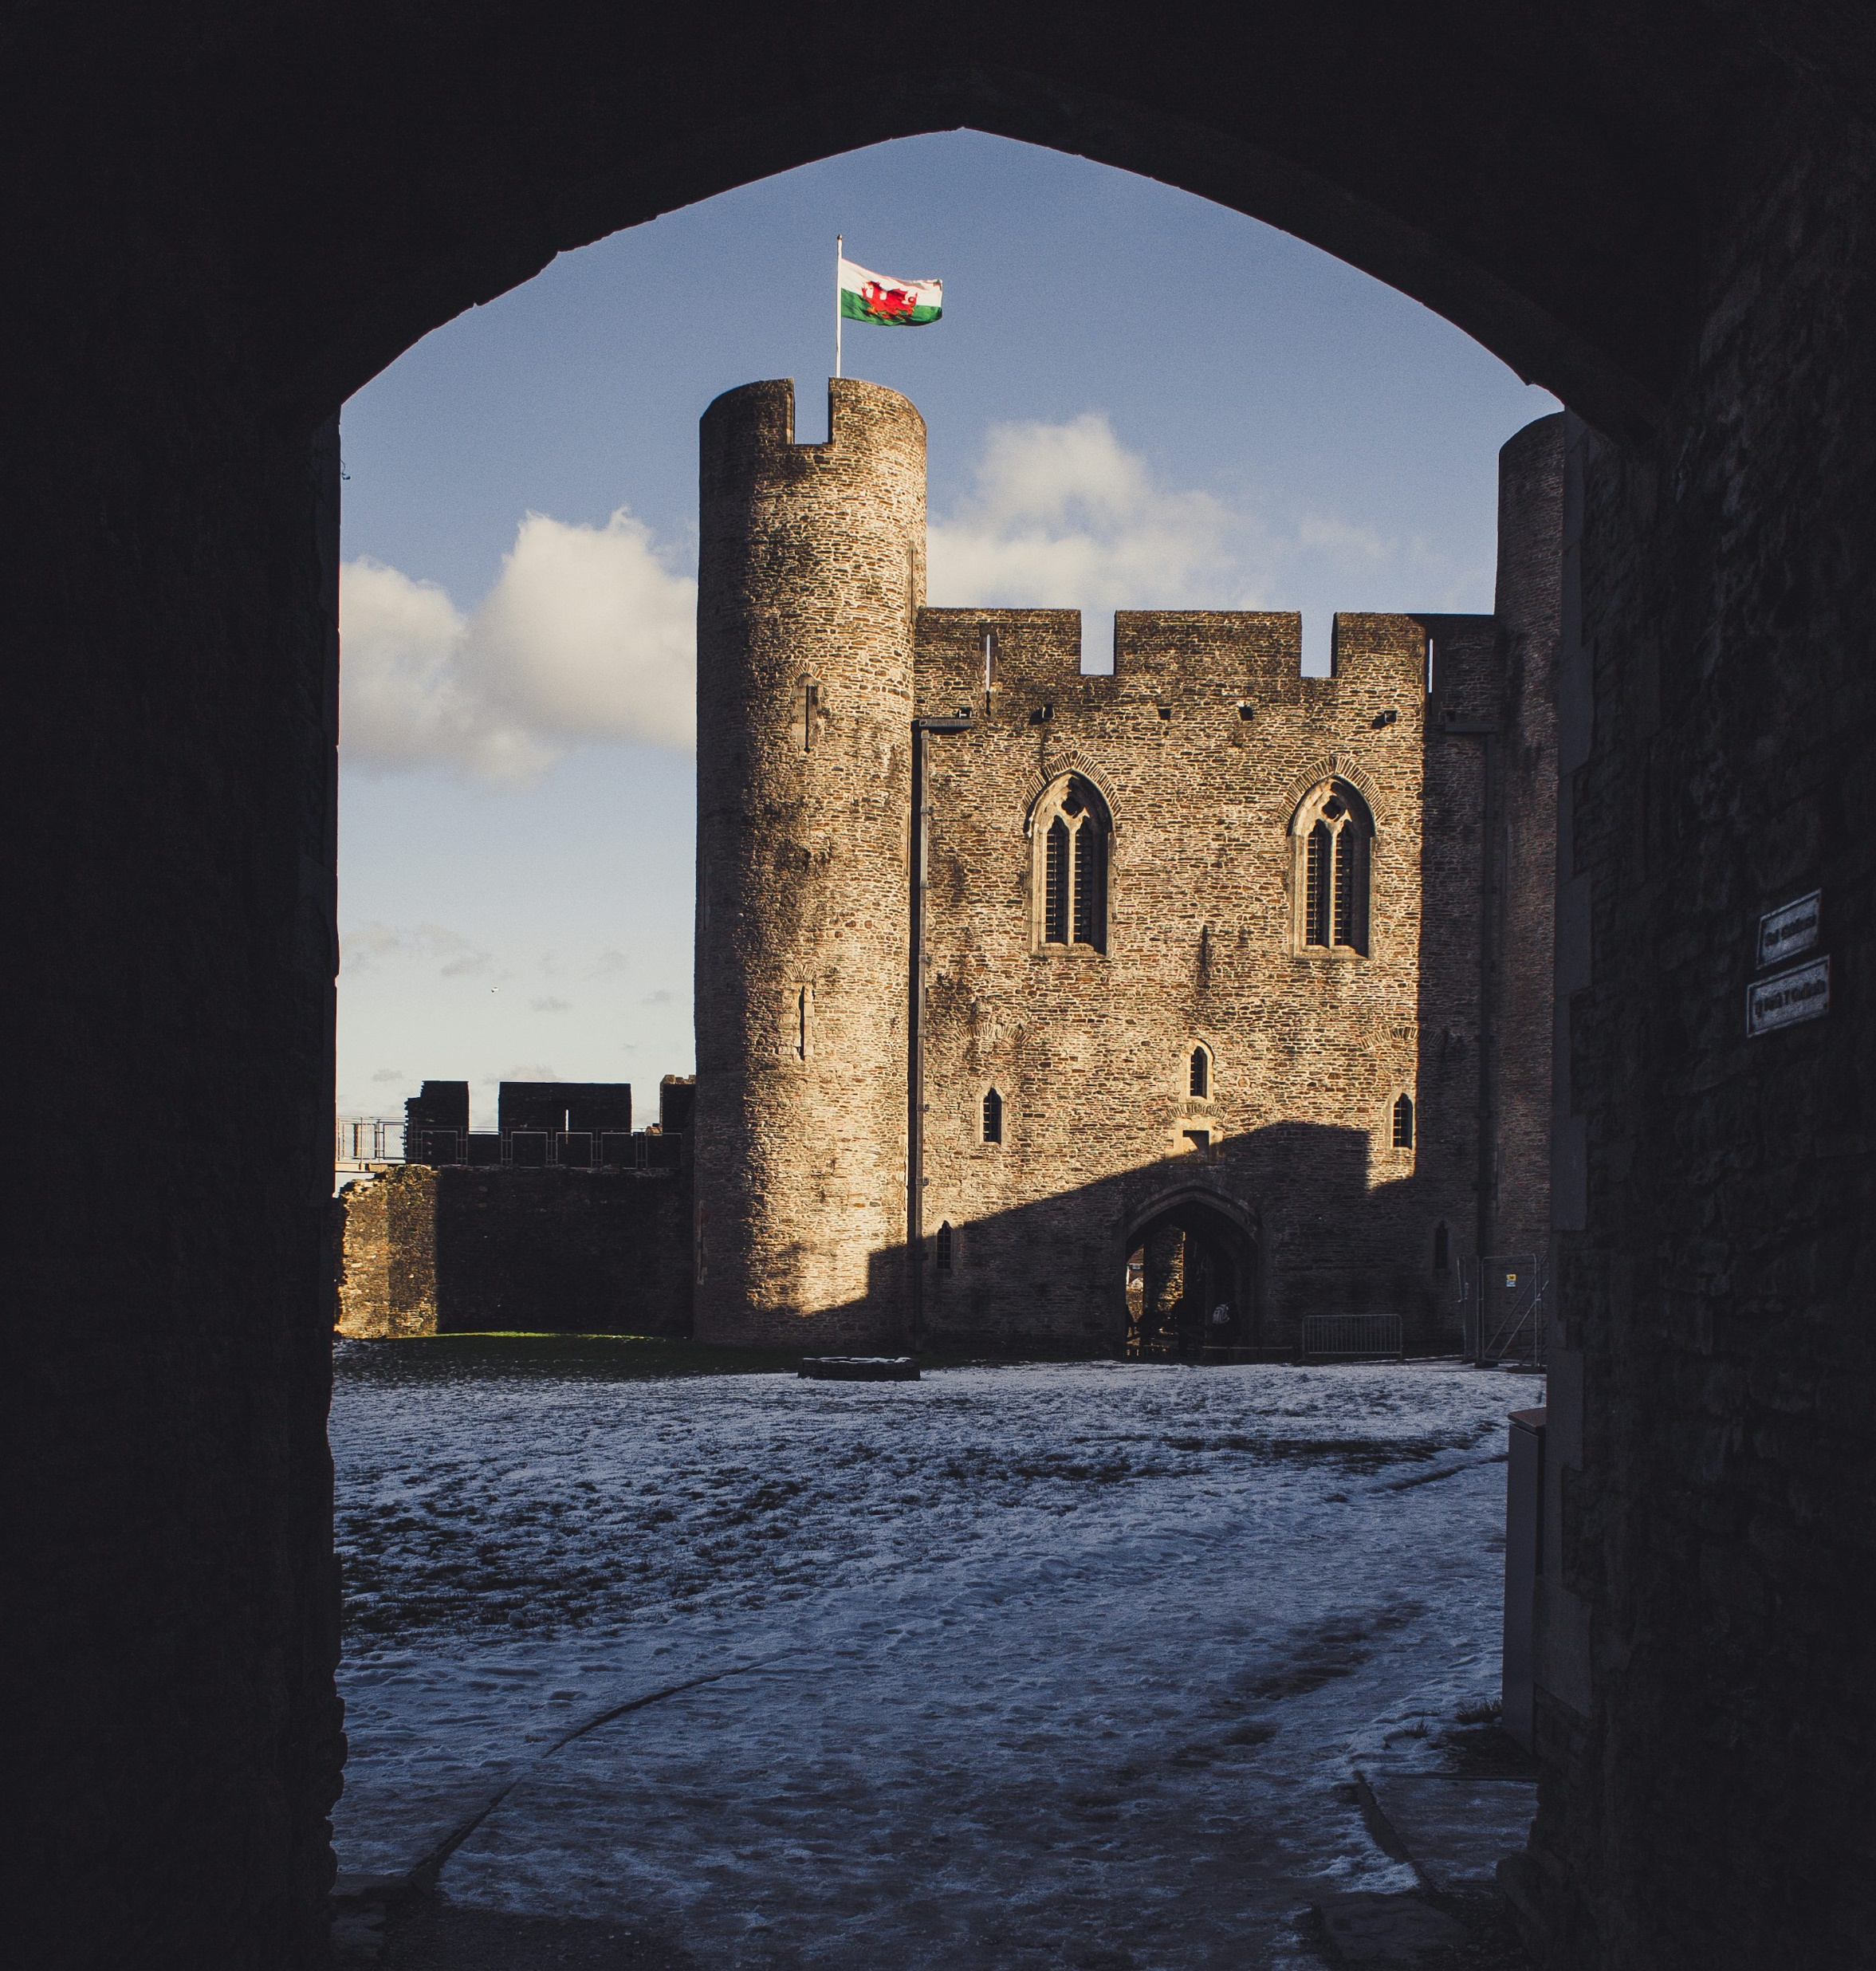
Contents
01 | Background & methodology
02 | Key findings
03 | Profile of Visit Wales enquirers
04 | 2025 trip conversion & relationship with Wales
05 | 2025 trip characteristics
06 | Impact of Visit Wales marketing
07 | Likelihood of visiting Wales in 2026
08 | Reasons for not taking a trip in Wales in 2025

Slide 4



BACKGROUND
& METHODOLOGY

Slide 5

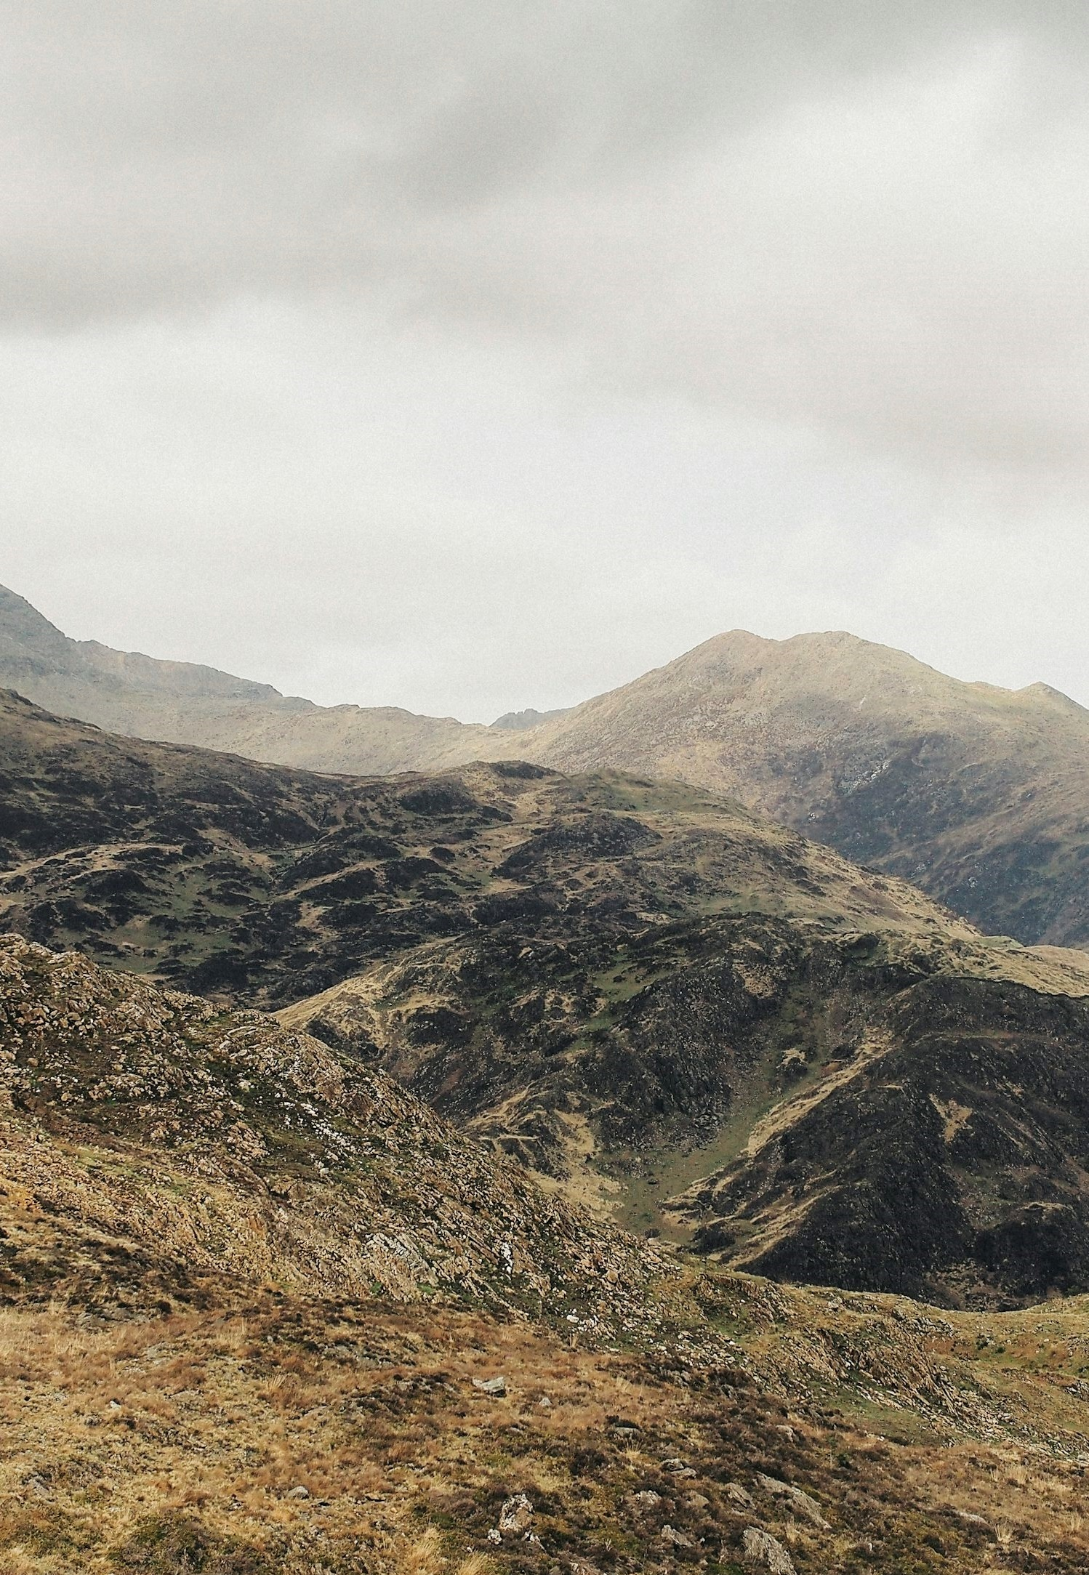
Driving tourism to Wales: insights from German enquirers
Background
Visit Wales, the Welsh Government's tourism team, is responsible for deploying tourism campaigns in the UK and internationally to position Wales as a leading tourist destination.
This detailed report analyses data from an online survey conducted in February and March 2026 amongst Visit Wales’s German consumer contacts (referred to as ‘enquirers’ throughout). These are individuals who have interacted with Visit Wales across various touchpoints over the past 12 months, including the website, consumer database sign ups, and social media followers. A separate report is also available for UK and Ireland enquirers. Alongside this study, Visit Wales produces a range of insight and research, which can be found here.
The primary research objectives of the survey were to:
  Assess trip conversion and relationship with Wales
  Understand the characteristics of trips taken in 2025
  Quantify the impact of the marketing
  Understand plans for trips in 2026
  Assess the reasons for not taking a trip in 2025

Slide 6
Alongside this study, Visit Wales produces a range of insight and research.
Domestic GB Tourism Statistics - Data on overnight trips and day visits by British residents to destinations throughout Britain.
Tourism market demand reports - Each year Visit Wales conducts research amongst its priority markets.
Tourism barometer - The Tourism Barometer provides a ‘snapshot’ of industry performance after important points in the tourism calendar.
Cycling tourism development - This research explores the topic of cycling tourism in Wales, including current capacity and demand, as well as opportunities for growth.
Visit Wales consumer re-contact survey (previous years) – Detailed reports drawn from an online survey conducted amongst Visit Wales consumer contacts over the last few years, including in the UK & Irish market.
Accessible here:
Domestic tourism statistics
Market demand survey reports
Tourism barometer
Cycling tourism development report
Other Re-contact survey reports

Slide 7
Methodology
Out of 9,926 invitations sent to enquirers, 1,041 completed survey responses were received, resulting in a response rate of 11%.
Base sizes and response rates 2026, by enquiry method
In February 2026, Visit Wales contacted enquirers via email, inviting them to complete a 10-to-15-minute online survey. Reminder emails were sent to non-respondents one week after the initial invitation, and a prize draw incentive was offered. The survey opened on 5th February and closed on 2nd March 2026.
Sample and Response Rate
The sample was drawn from various sources, reflecting the different ways enquirers had contacted Visit Wales. The graph on the right shows the sample sources along with the number of completed surveys for each source.
Data consideration
It is important to note that the sample is not representative of the general population of Germany, as participants had existing connections with Wales. As a result, findings are likely to reflect more positive or ‘warmer’ views than would be expected in the wider public. This should be considered when interpreting the results.
/ 59%
/ 36%
/ 5%

Slide 8
Definitions used in this report
This report uses several terms to define the survey respondents.
These include:
Visit Wales enquirers: The total survey population - Visit Wales consumer contacts who responded to this survey.
2025 Wales trip takers: Visit Wales enquirers that stated within the survey that they took a short break or holiday in Wales in 2025.
2025 Wales non trip takers: Visit Wales enquirers that stated within the survey that they did not take a short break or holiday in Wales in 2025.
2026 Wales trip intenders: Visit Wales enquirers that stated within the survey that they intend to take a short break or holiday in Wales in 2026.
Life stages are preferable to ‘age’ as they better describe someone’s life situation. For the purpose of this report, the following is used:
Younger independents: aged 16-34 without children in household.
Families: aged 16-64 with children in household.
Older independents: aged 35-64 with no children in household.
Retirement age: aged 65+.
DEFINITIONS

Slide 9
KEY FINDINGS

Slide 10



KEY FINDINGS
Wales visitation
27% of respondents travelled to Wales in 2025, a small decline from 30% the previous year, but an increase from 24% in 2023.
Among those who visited, 86% rated their experience as excellent.
The main reason for visiting was to connect with nature, cited by 70% of visitors. This was followed closely by a desire to experience culture and heritage (62%).
Trip characteristics
North Wales had the highest share of visits at 53%. Most visitors chose hotels/motels/inns chose as their form of accommodation.
The majority stayed in multiple locations over the course of their trip.
Communication influence
Website content was the most commonly reported point-of-contact for those Visiting Wales.
16% of 2025 trip-takers reported that Visit Wales communications influenced their decision to visit.
Of this group, 52% saw communications about new places, with 43% of those citing it as very/extremely influential on their trip.

Slide 11
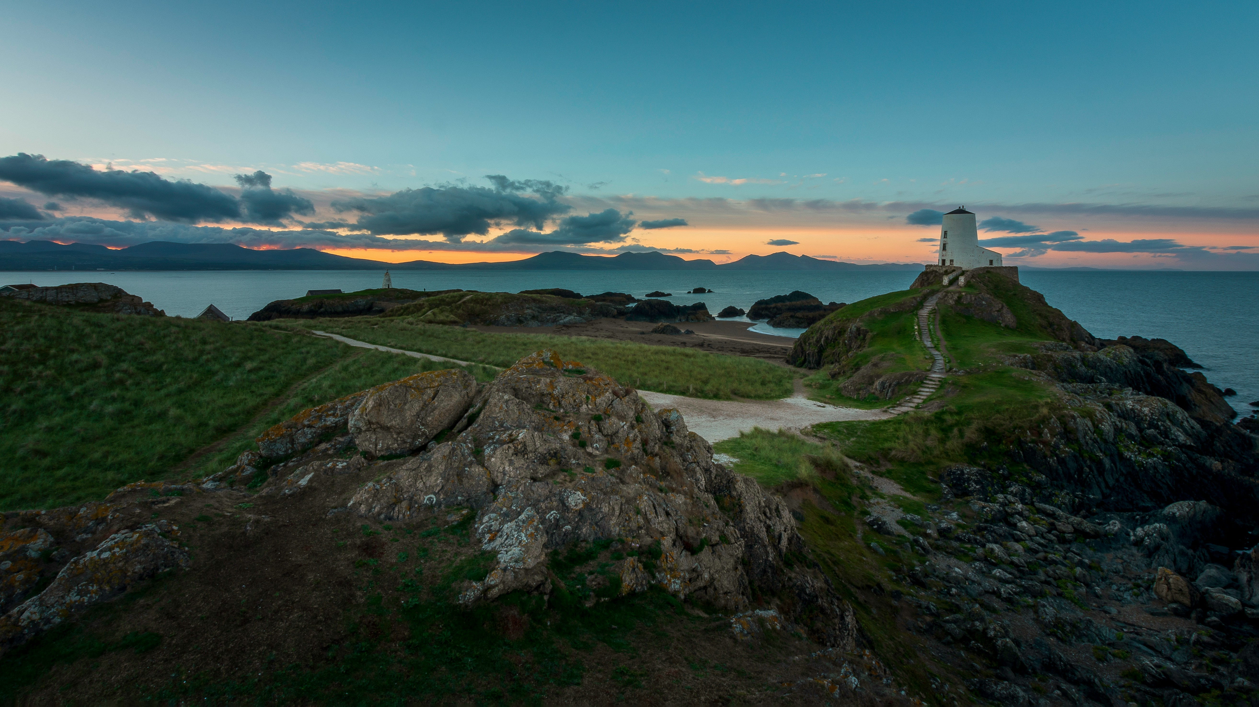
PROFILE OF VISIT WALES ENQUIRERS

Slide 12

The sample population is similar to the previous years.
Gender | 2026
Prefer not to say 1%
Age | All Waves
Female
Male
Lifestage | All Waves
X1. How do you describe your gender? X2. Please type in your age. X2b. Do you have any children aged 15 or under in your household that you are responsible for (parent, legal guardian etc)? Total base size, n=1,041.

Slide 13
The number of people who have ‘never visited Wales but would like to’ is declining. However, those who have visited and might return are on the rise.
Intentions for visiting Wales | All waves
A1. Which of the following statements best applies to you when it comes to visiting Wales? Total base size, n=1,619 (2024), n=1,049 (2025), n=1,041 (2026).

Slide 14
Region of Residence | All waves
North Rhine-Westphalia, Bavaria, and Baden-Württemberg are the most frequently represented sample regions, and this pattern remains consistent across years.
X3a_DE. And where in Germany do you live? Respondents who live in Germany, n=1,570 (2024), n=1,043 (2025), n=1,038 (2026).

Slide 15
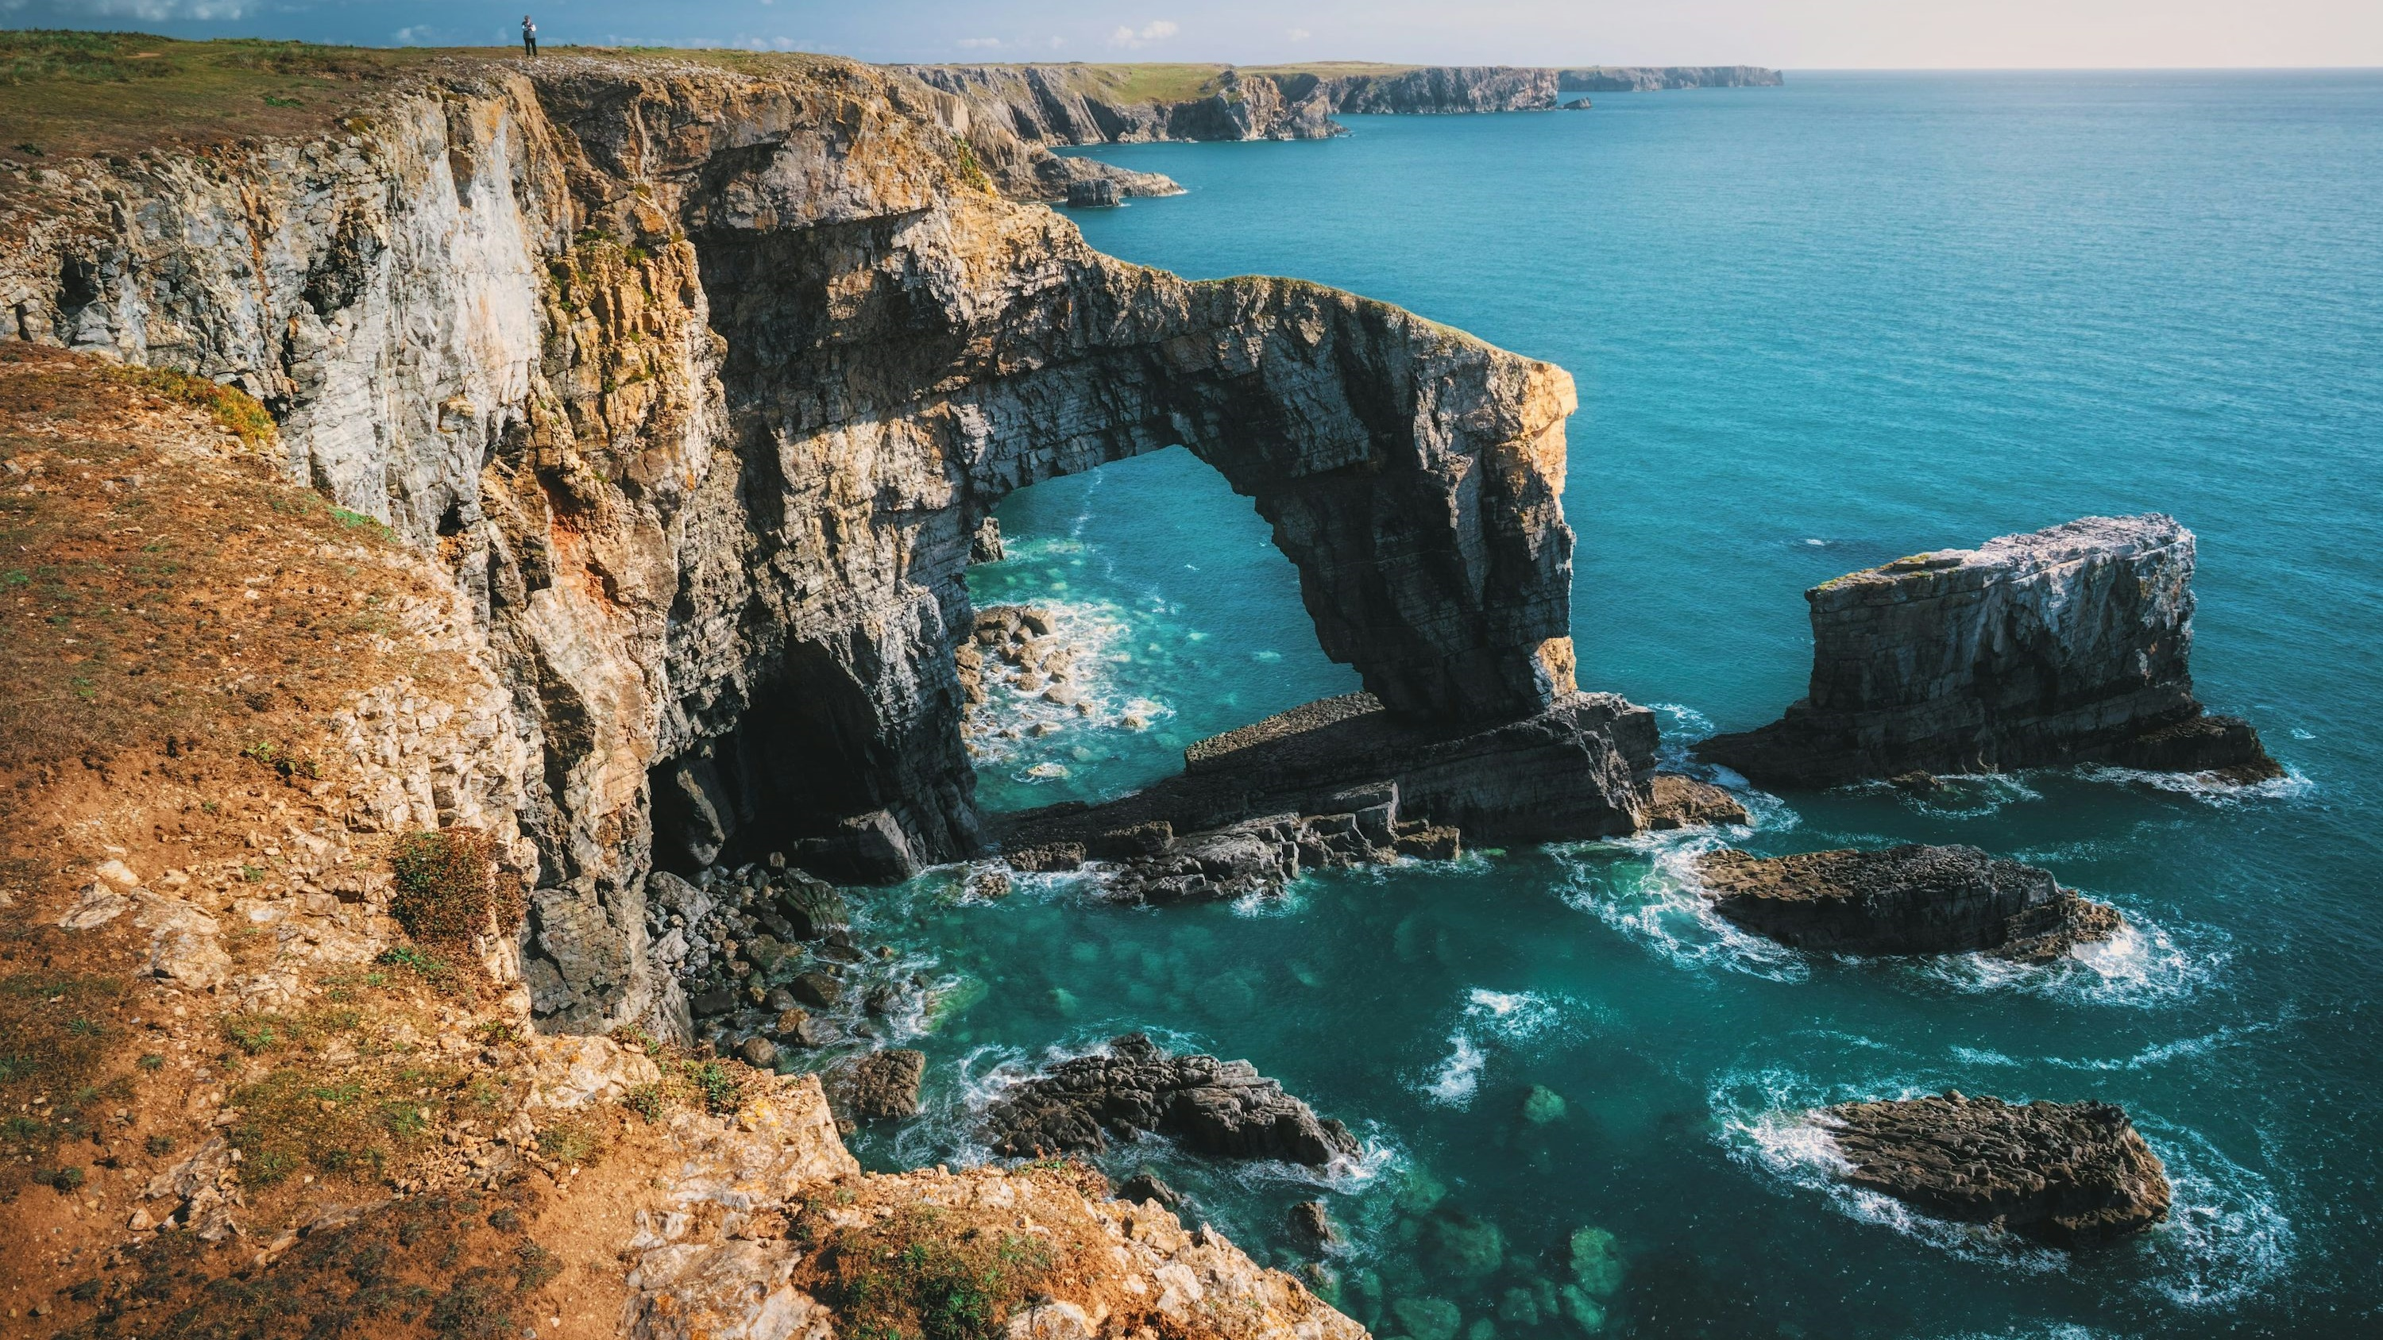
2025 TRIP CONVERSION AND RELATIONSHIP WITH WALES

Slide 16


2025 TRIP CONVERSION AND RELATIONSHIP WITH WALES
Visited Wales in 2025
In 2025, 27% of respondents travelled to Wales, a small decline from 30% the previous year but an increase from 24% in 2023.
How many trips?
On average, those who visited Wales in 2025 took 2.45 short breaks or holidays there.
Additionally, 55% of respondents had travelled to Wales prior to 2020.

Slide 17
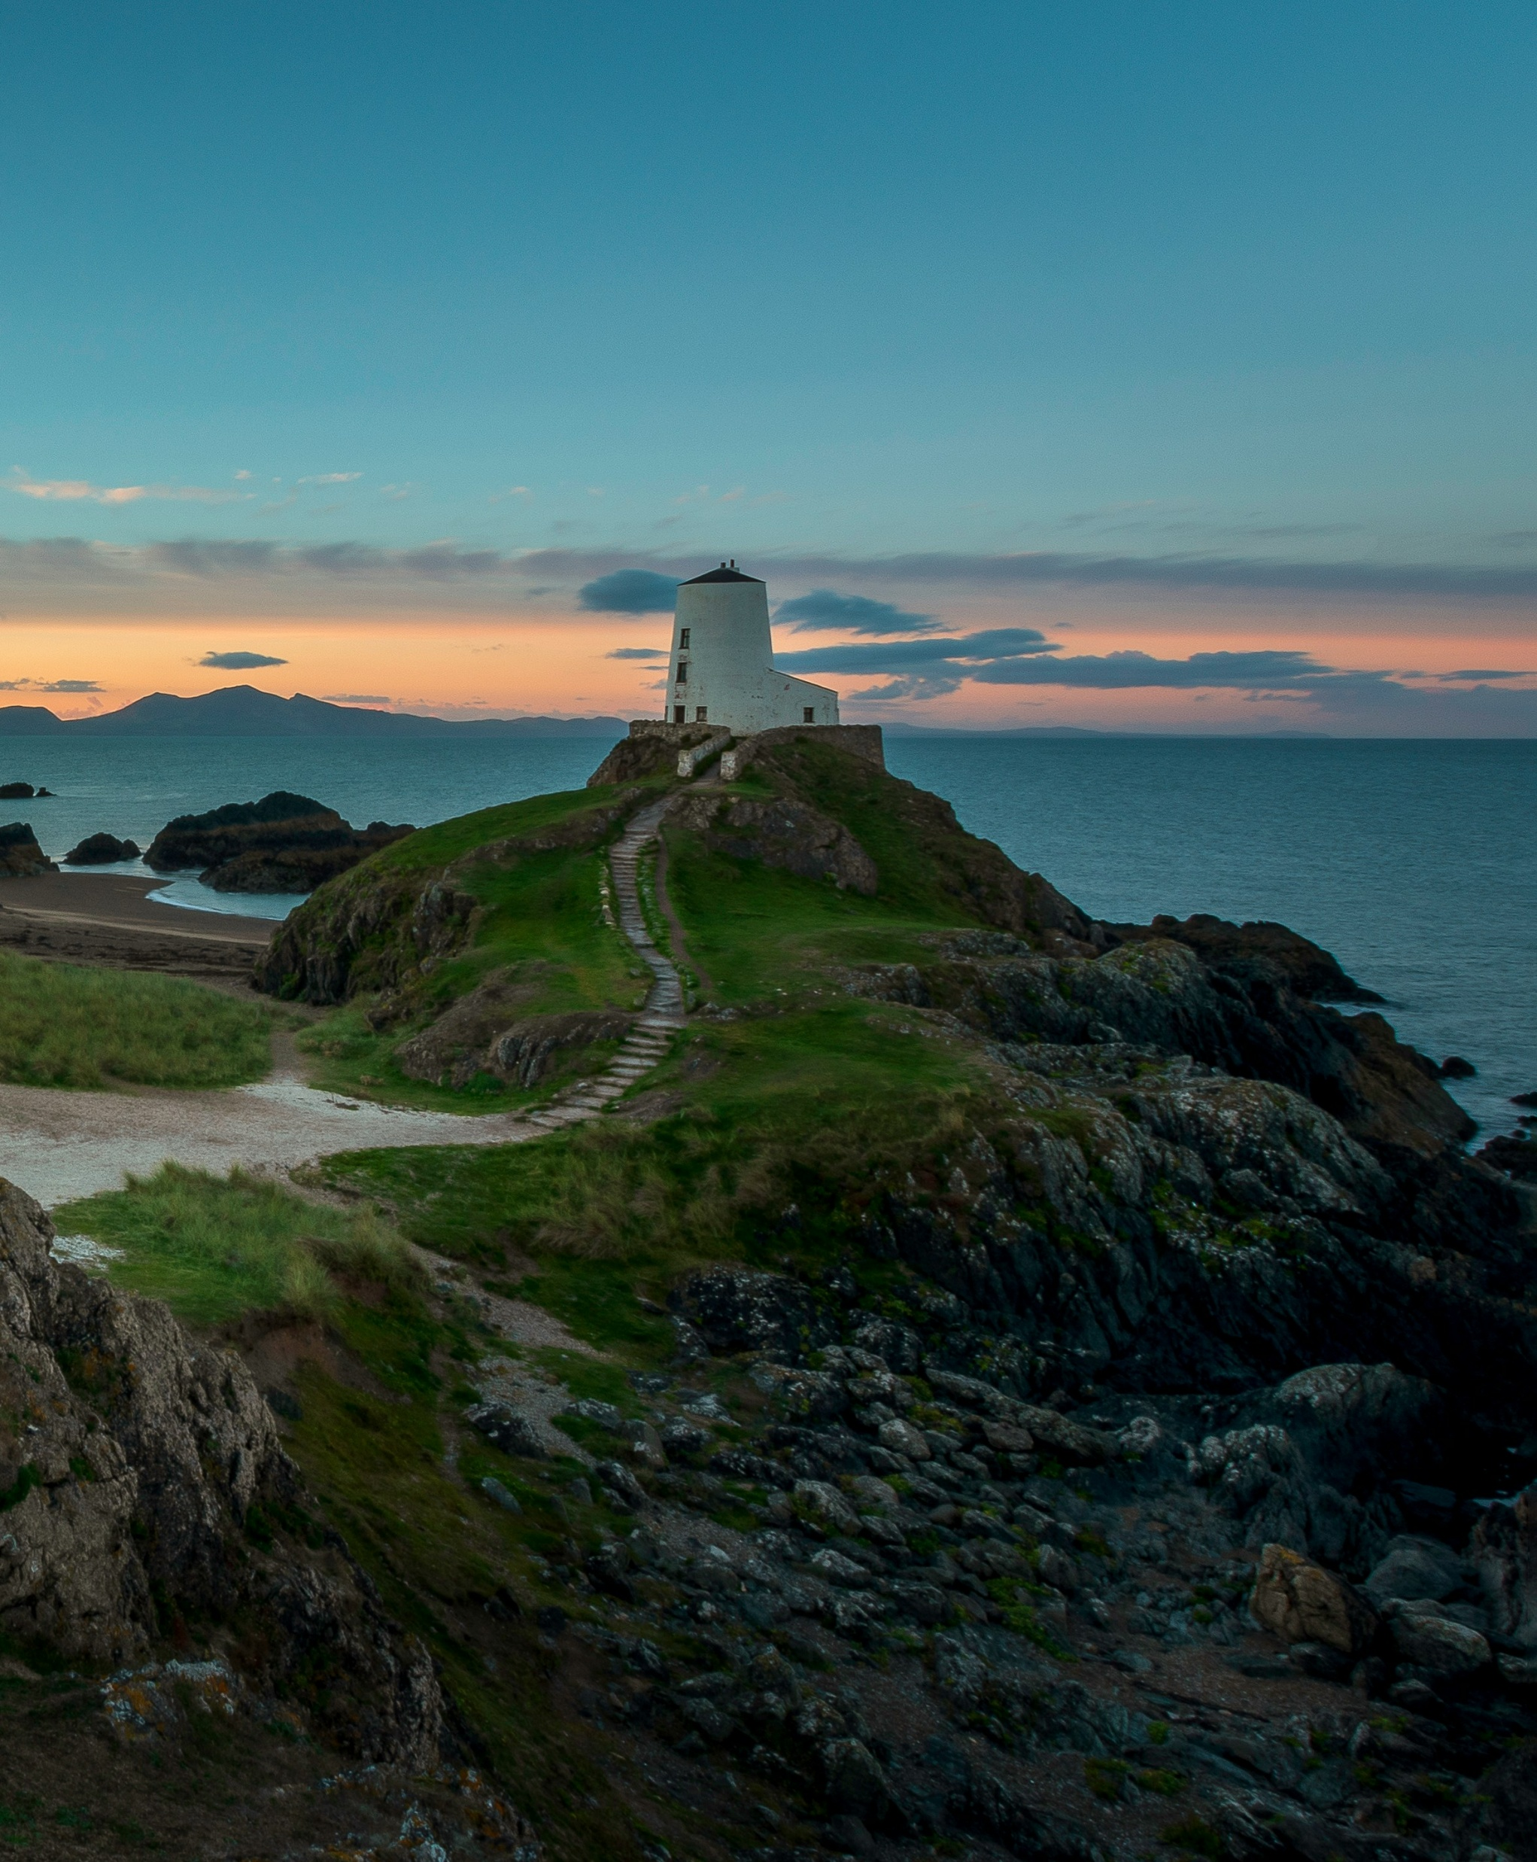
Welsh holiday frequency | All Waves
27% reported having taken a trip to Wales in 2025, a small decline from 30% the previous year but an increase from 24% in 2023.
A2a. Did you take a short break or holiday in Wales in 2025
Total, n=595 (2025).

Slide 18
Welsh holiday frequency | All Waves by life stage
While most groups saw a peak in 2024 followed by a decline, retirees are the only life stage showing consistent year-on-year growth in Welsh holiday frequency.
Caution: Low base size in this group
A2a. Did you take a short break or holiday in Wales in 2025
Total, n=595 (2025), Younger independents n=29*, Families n=71, Older Independents n=337, Retirement age n=152.

Slide 19

Average Number of Holidays in Wales | All Waves
In 2025, trip takers who visited Wales averaged 2.45 short breaks or holidays to Wales.
A3. How many separate short breaks or holidays did you take in Wales in 2025?
Mean Summary. 2025 Wales trip takers, n=595.

Slide 20

Holidays taken prior to 2025 | Total
55% took a trip to Wales before 2020, while 27% took a trip in 2024.
A2b. Have you taken a short break or holiday in Wales prior to 2025?
Took a short break or holiday in Wales, n=595.

Slide 21
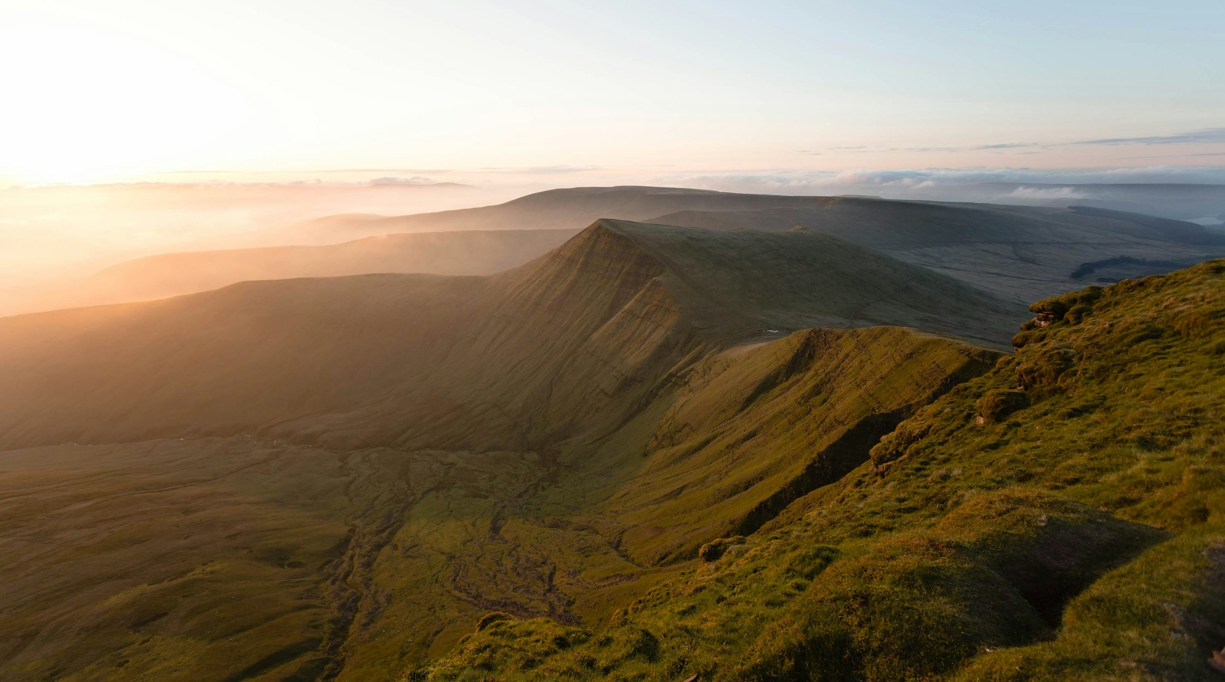
2025 TRIP CHARACTERISTICS

Slide 22

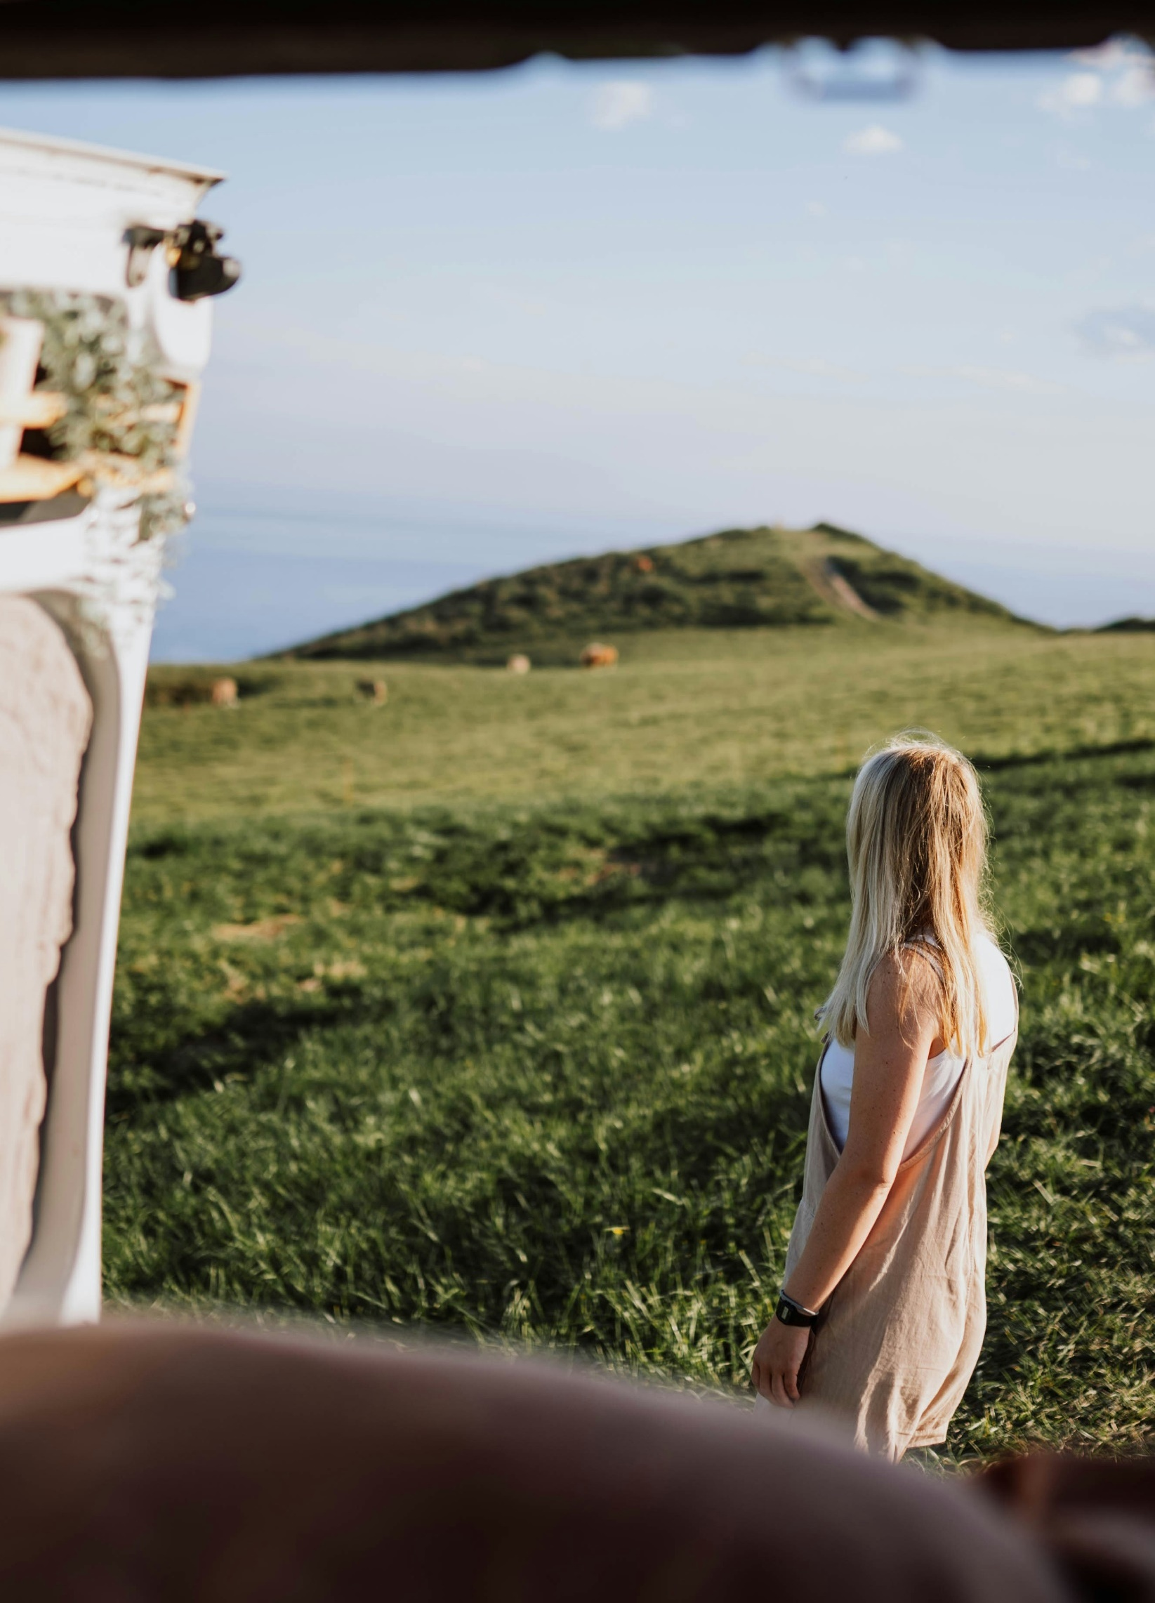
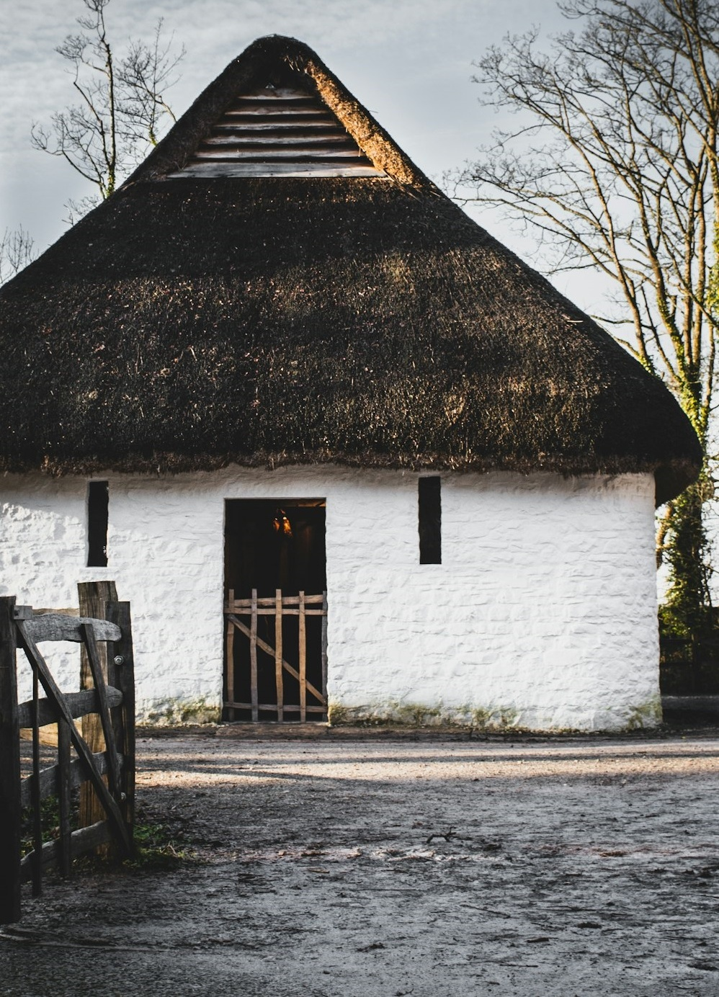
2025 TRIP CHARACTERISTICS
Experience
86% of respondents rated their trip to Wales as excellent, with a further 12% describing it as good.
In line with previous years, the main reason for visiting was to connect with nature, cited by 70% of visitors. This was followed closely by a desire to experience culture and heritage (62%).
Details of trip
North Wales had the highest share of visits at 53%.
The majority stayed in multiple locations over the course of their trip (55%).
Time-of-year for visits has remained stable across waves, with a clear preference for Summer season.
Accommodation
36% of travellers chose hotels/motels/inns, with guest houses and cottages following behind (21%).
34% are finding accommodation through ‘travel websites’. Around 12% used the Visit Wales website to support finding their accommodation.

Slide 23

Experience Rating | All Waves
Ratings of travel experiences in Wales are very high, with 86% agreeing that they are excellent.
3%
A15. Now going back to your trip in Wales in 2025, how would you rate your experience over from 1 to 10 where 1 is very poor and 10 is very good? 2025 Wales trip takers, n=159.

Slide 24

Reasons for choosing Wales as a destination | 2025 Trips
70% chose to visit Wales to ‘connect with nature and be outdoors’, while 62% did so to ‘experience the culture and heritage’.
*
*It may reflect both the destination's popularity and a sampling effect, as respondents are likely already familiar with Wales, influencing their likelihood to return.
A7. Which, if any, of the following were the main factors that made you choose Wales as a destination for this short break/holiday in 2025? 2025 Wales trip takers, n=159.

Slide 25

Top 14 activities done in Wales | 2025 Trips
Walking, hiking, or rambling are the most popular activities in Wales, aligning with the main motivation for visiting, connecting with nature and enjoying the outdoors. This is followed by visiting heritage sites or cultural attractions and trying local food/drink.
A14. Which, if any, of the following did you do on this trip in Wales in 2025?
2025 Wales trip takers, n=159.

Slide 26
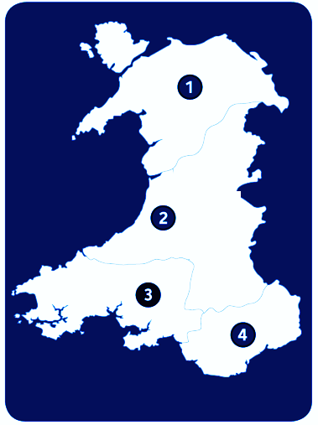
Destination choices | 2025 Trips
North Wales received the highest number of overnight visits (53%) in 2025, followed by the Southeast (48%). The majority of visitors stayed overnight in multiple locations (55%).
Number of locations on trip | 2025 Trips
53%
North Wales (1)
I stayed overnight in several places / toured around
I stayed overnight in several places / toured around
I stayed overnight in several places / toured around
36%
Mid Wales (2)
I stayed overnight in one location
44%
South West Wales (3)
48%
South East Wales (4)
A12. Where in Wales did you stay overnight on this trip in [MONTH]? Please select all that apply.
A13. Which of the below best describes your trip in Wales in 2023? Wales trip takers, n=199 (2023), n=178 (2024), n=159 (2025).

Slide 27

Month of trip | All Waves
The summer months continue to be the most popular time to visit Wales. However, August and September were more popular in 2024.
A4. And in which month(s) of the year did you visit Wales for a short break or holiday in 2025?
Wales trip takers, n=199 (2023), n=178 (2024), n=159 (2025).

Slide 28
Amount of nights | All Waves
Most preferred longer stays, with 52% staying 8 or more nights. The average stay was 9.06 nights.
Immediate party size | All Waves
On average, groups contained 2.8 people in 2025
Average number of children/dogs within party
(2025 Trips)
1.39
1
A5. On this overnight trip in Wales in 2025, how many nights did you stay away for?
A6. Including yourself, how many of the following were there in your immediate party on this overnight trip in Wales in [MONTH]? 2025 Wales trip takers, n=159.

Slide 29
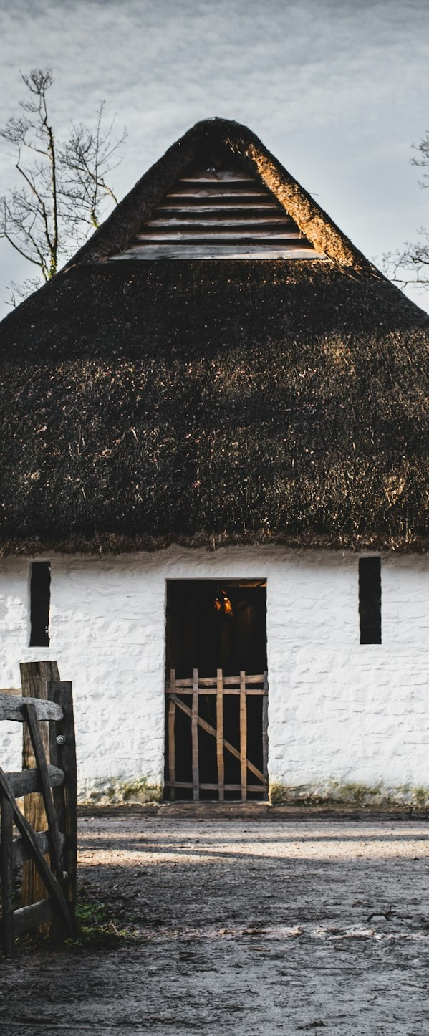
Booking Sources | 2025 Trips
34% of Wales trip takers booked their accommodation via ‘a travel website’ and 32% ‘directly with an accommodation provider’. 12% found information for their accommodation via the Visit Wales website.
12%
found information or contact details for their accommodation on the Visit Wales website, similar to last year’s 12%.
A9. How did you book your accommodation for this trip in Wales? 2025 Wales trip takers, n=159.
A10. Did you find information or contact details for the accommodation you stayed in on the Visit Wales website?
Those who booked accommodation, n=122.

Slide 30

Accommodation type | 2025 Trips
‘Hotels/motels’ was the most popular accommodation type (36%).
A11. What type/s of accommodation did you stay at during your trip in 2025 in Wales?
2025 Wales trip takers, n=159.

Slide 31
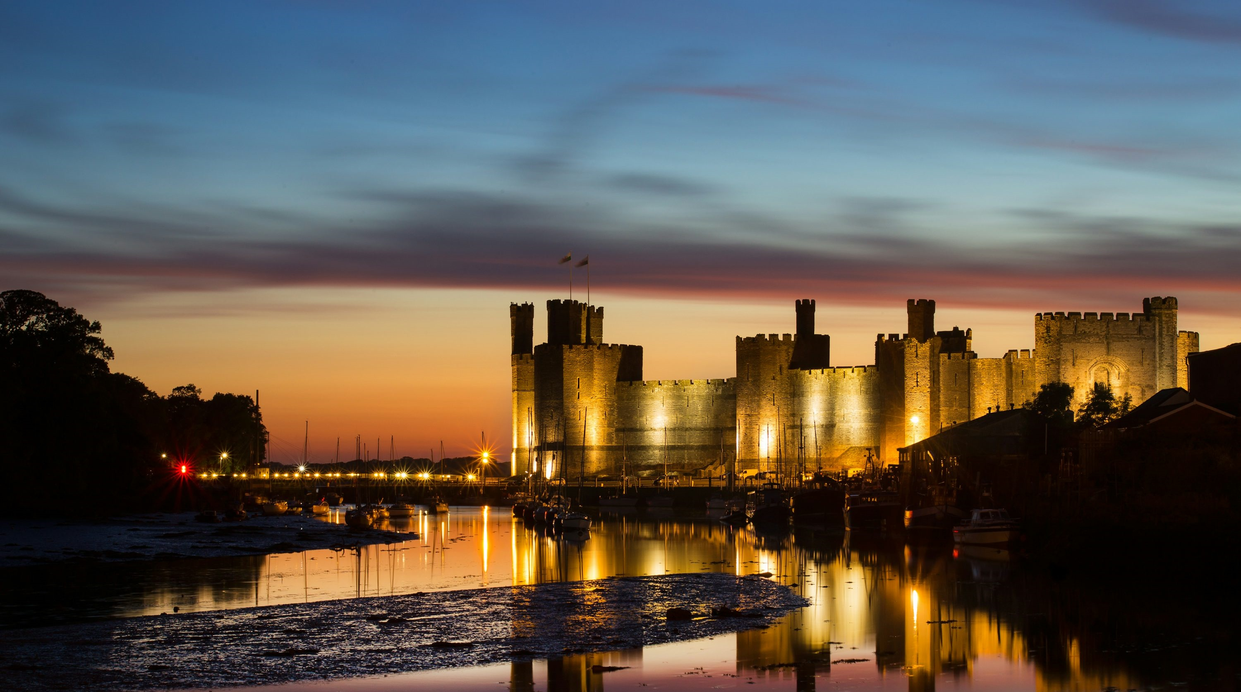
IMPACT OF VISIT WALES MARKETING

Slide 32


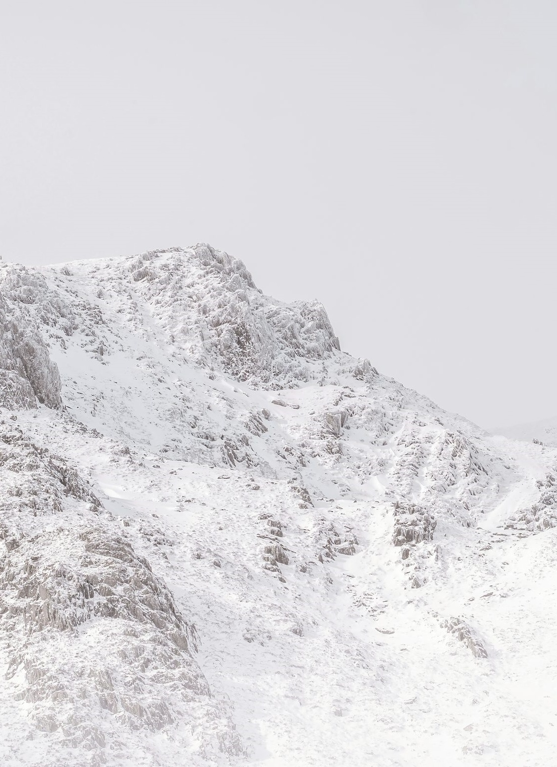
IMPACT OF VISIT WALES MARKETING
Contact Visit Wales
Wales trip takers were most likely to have seen or heard about Wales through promotion or content on a website (40%) or social media (32%), followed by ‘word of mouth’ (30%).
E-Newsletters remain the most common way of receiving Visit Wales content at a total level (76%) of those sampled, though this is likely influenced by the skewed sample.
Visit Wales website
Most visitors accessed the Visit Wales website at home, on a desktop.
Mobile devices are a more popular route to access when at work or during a trip to Wales.
Influence promotion
16% of 2025 trip takers said that Visit Wales communications influenced their decision to visit.
Of this group, 52% saw communications about new places, with 43% of those citing it as very/extremely influential on their trip.

Slide 33

Communication Exposure | 2025 Trips
Wales trip takers were most likely to have seen or heard about Wales through promotion or content on a website or social media, followed by ‘word of mouth’.
A18. Thinking about marketing and communications which, if any, of the following did you see or hear about Wales during 2025? 2025 Wales trip takers, n=159.

Slide 34
Contact with Visit Wales | 2025 Trips
E-newsletters from Visit Wales were the most popular way for potential visitors to be in contact with Visit Wales, , though this is likely influenced by the skewed sample*.
48% also visited the Visit Wales website. Instagram and Facebook lead the way in terms of social media.
*The majority of the re-contact sample comes from the ECRM database, and most of the social media sample was captured via Facebook. As both sources rank within the top three, this may influence the overall distribution of responses.
A19. Thinking about contact you had with Visit Wales in 2025, which of the following apply to you?
Total base size, n=1,041.

Slide 35

Access to Visit Wales Website | 2025 Trips
Most visitors accessed the Visit Wales website from home on a laptop. However, while on a trip, mobile phone usage was more common.
 | At Home | During a trip to Wales | At work
Laptop/ Desktop | 76% | 22% | 55%
Mobile | 65% | 91% | 59%
A20. In the past 12 months, what devices did you use to access the Visit Wales website? Who visited Visit Wales website, n=501, at home n=496, during a trip n=129, and at work n=127.

Slide 36
Visit Wales Influence on Trip Decision | 2025 Trips
16% stated that communications from Visit Wales had a major or strong influence on their decision to visit Wales. Additionally, 33% reported that Visit Wales communications influenced them to visit a part of Wales they had not been to before, aligning with messaging about discovering new places.
Visit Wales Influence on Trip Behaviours | 2025 Trips
16%
A22. On a scale of 1 to 5 where 1 means ‘no influence at ’ and 5 means 'a major influence', what influence, if any, did Visit Wales communications have on your decision to take a short break or holiday in 2025?
A23. In 2025, did Visit Wales communications impact your behaviour in any of the following ways... 2025 Wales trip takers, n=159.

Slide 37
Types of communication seen and perceived level of influence | 2025 Trips
52% saw communications about new places. Of those, 43% found it very or extremely influential.
 | Very/Extremely Influential
 | 43%
 | 45%
 | 44%
 | 28%
Caution*: Low base size in this group
A23a. In 2025, did you see any communication promoting Wales in relation to the following? 2025 Wales trip takers, n=159.
A23b. And how influential were they on your decision to take a trip in Wales in 2025. 2025 Wales trip takers, new places n=83, new activities n=38*, new reasons to visit all year-round n=34*, new events n=18*.*Caution low base size

Slide 38

Trip decision timings | 2025 Trips
67% of trip takers had already decided to take a trip to Wales in 2025 by the end of 2024.
A24. Finally in this section, thinking back to the end of 2024, which of these statements best describes your plans at that time to visit Wales in 2025? 2025 Wales trip takers, n=159.

Slide 39
ARTIFICIAL INTELLIGENCE (AI)
Note that these insights are based on audiences already engaged with Wales or VW touchpoints, and may therefore over represent ‘warm’ users. Less familiar audiences are likely to demonstrate different behaviours, including greater use of AI for initial discovery and orientation

Slide 40

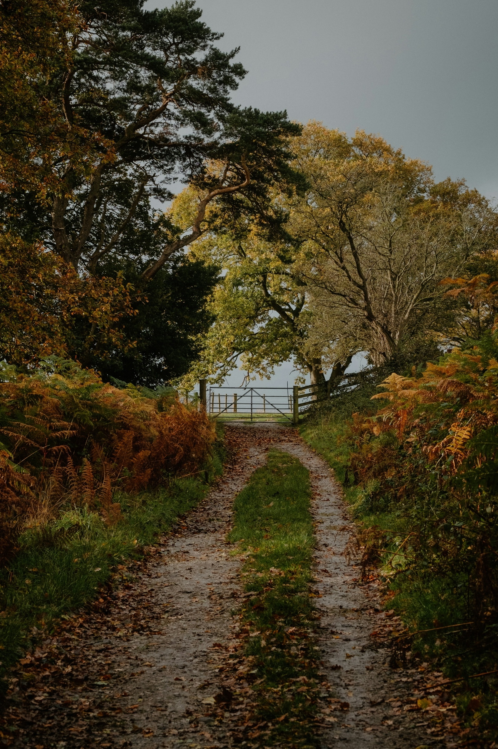
Planning with AI | Wales trip takers
85% of those who travelled to Wales in 2025 reported that they did not use AI tools for their trip planning. Among the minority who did use AI, it was most frequently used for generating ideas and inspiration (8%) or creating specific itineraries (6%).
D1. When planning your most recent short break or holiday within Wales, did you use any AI-powered tools or services? 2025 Wales trip takers, n=159.

Slide 41
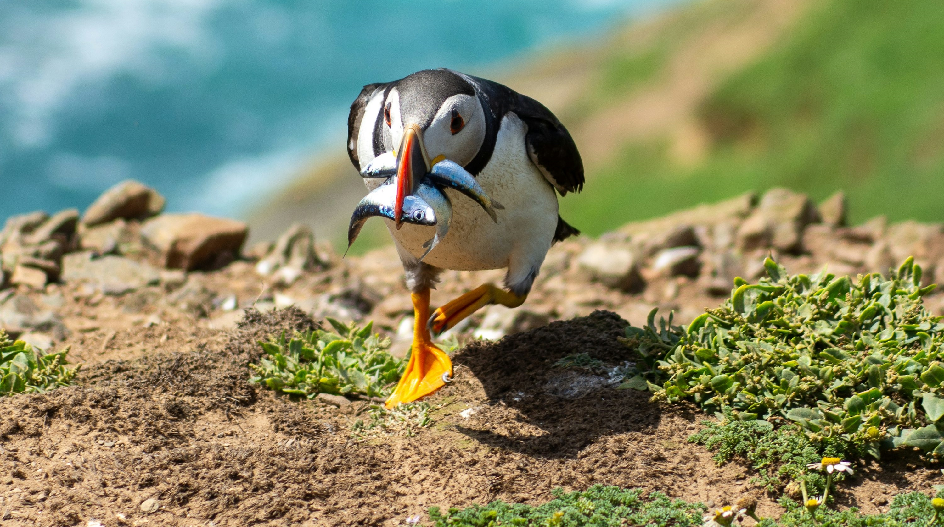
LIKELIHOOD OF VISITING WALES IN 2026

Slide 42
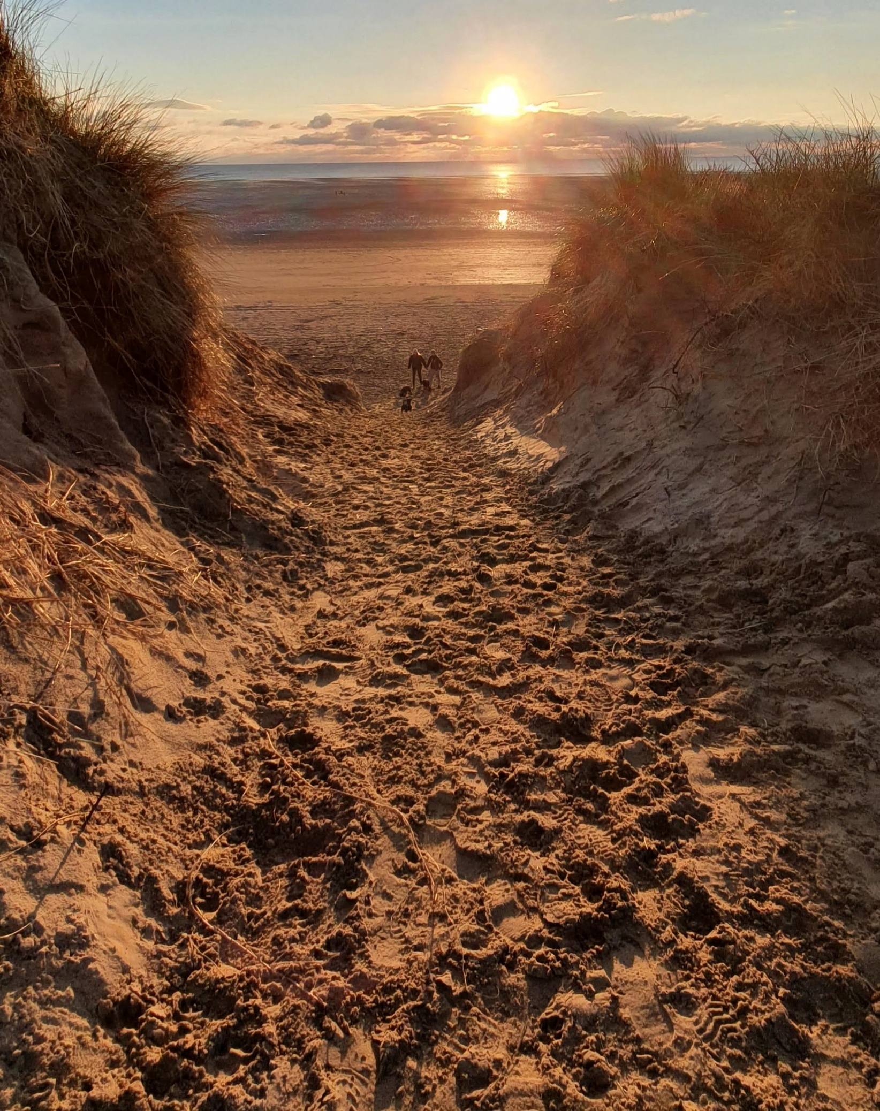


LIKELIHOOD OF VISITING WALES IN 2026
Likelihood of visiting Wales in 2026
17% of those who visited Wales in 2025 have already booked a trip for 2026.
Although younger independent travellers express the greatest interest in visiting again, they are the least likely to have already booked. Families lead in terms of bookings.
Influence Visit Wales on trip decision
Almost half of trip intenders indicate that Visit Wales communications have influenced their decision to take a trip to Wales in 2026.
Next likely to visit Wales
Among those not planning to visit Wales in 2026, half were unsure about when they might take their next trip.
A further 27% indicated that they would visit in 2027.

Slide 43
2026 Trip Intentions | Total
17% of those who visited Wales in 2025 have already booked a trip for 2026, while a further 33% intend to visit. Younger independents show the highest intention to visit Wales, but are the least likely to have booked so far. Families are the most likely to have already made a booking.
B5. Do you intend to visit Wales for a short break or holiday in 2026?
Total, n=1,041 (Wales Trip Takers n=159, Wales non-trip takers n=882, younger independents n=51, families n=141, older independents n=581, retirement age n=255).

Slide 44

Influence of Visit Wales communications | By Source
Almost half of trip intenders indicate that Visit Wales communications have influenced their decision to take a trip to Wales in 2026. Although campaigns appear to have the highest influence, this may be exaggerated due to the small base size for this group.
Caution: Low base size in this group
% significant or major influence (score 4 or 5 out of 5)
B10. On a scale of 1 to 5 where 1 means ‘no influence at ’ and 5 means ‘a major influence’, what influence, if any, has Visit Wales communications had on your decision to take a short break or holiday in Wales in 2026? Likely to visit Wales in 2026 or already booked, n=336 (Website n=129, e-CRM n=195, Campaign n=12).

Slide 45
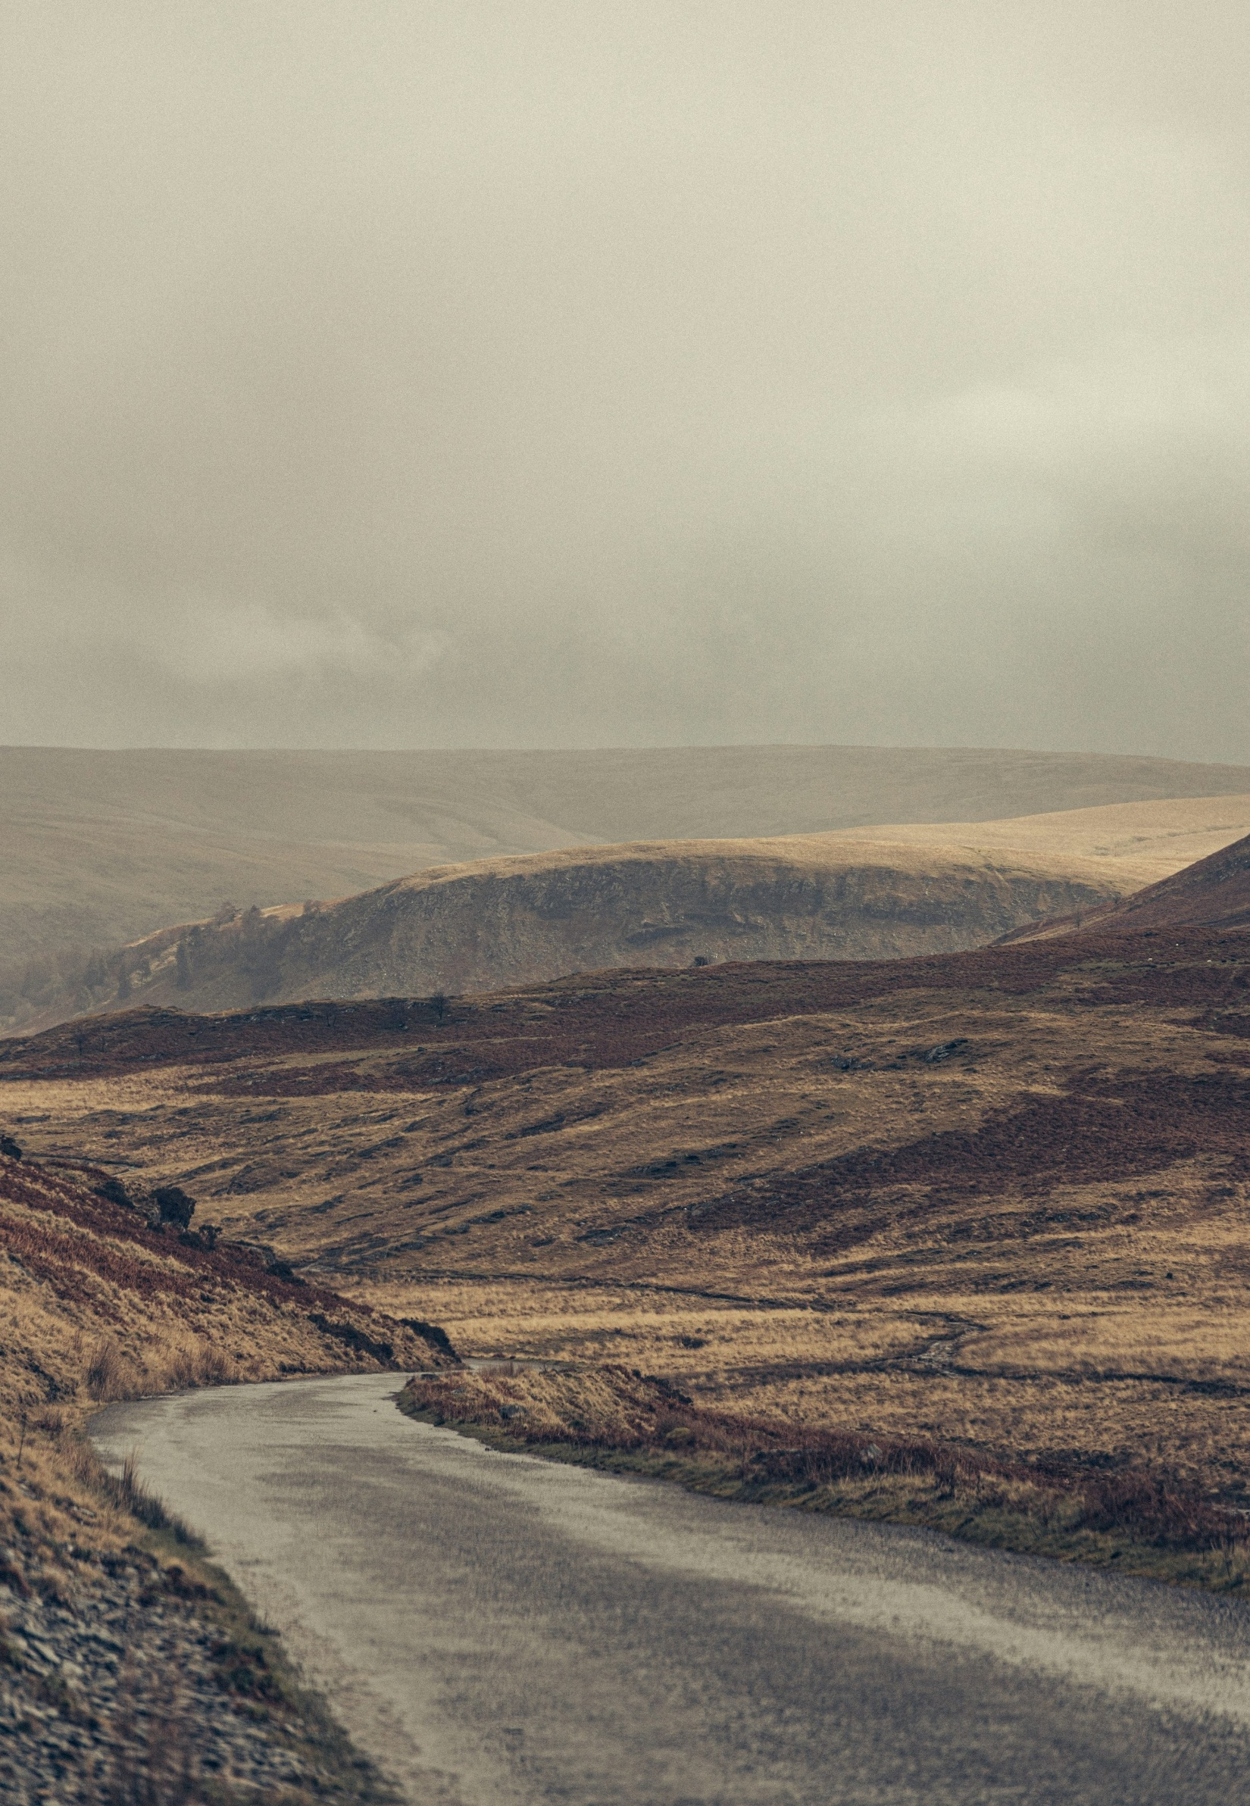
Future likelihood of visiting Wales | Unlikely to visit Wales in 2026
Of those unlikely to visit Wales in 2026, half stated they ‘don’t know’ when they would visit Wales. 27% stated they would visit in 2027.
B6. And when are you next likely to visit Wales for a short break or holiday?
Unlikely to visit Wales in 2026 or not sure, n=705.

Slide 46
REASONS FOR NOT
TAKING A TRIP

Slide 47
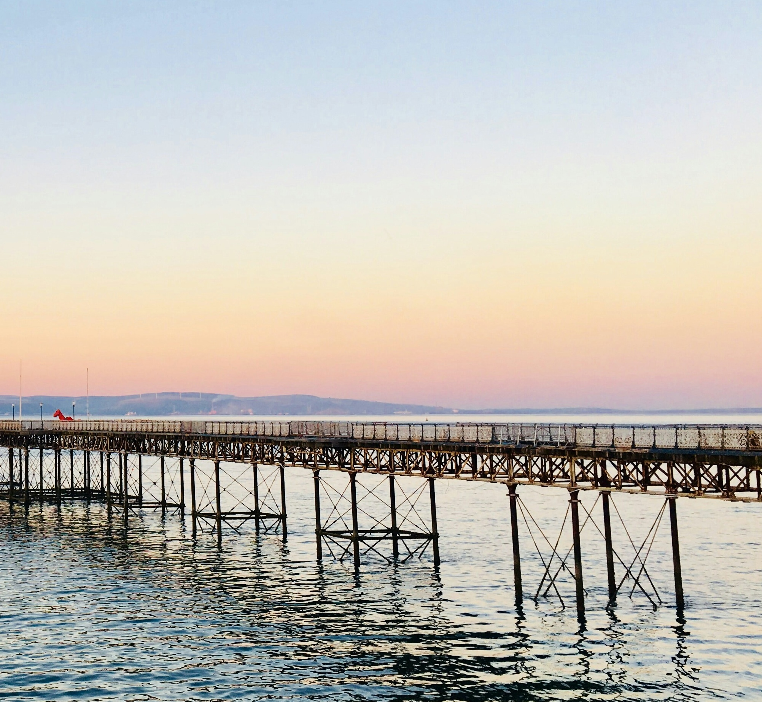
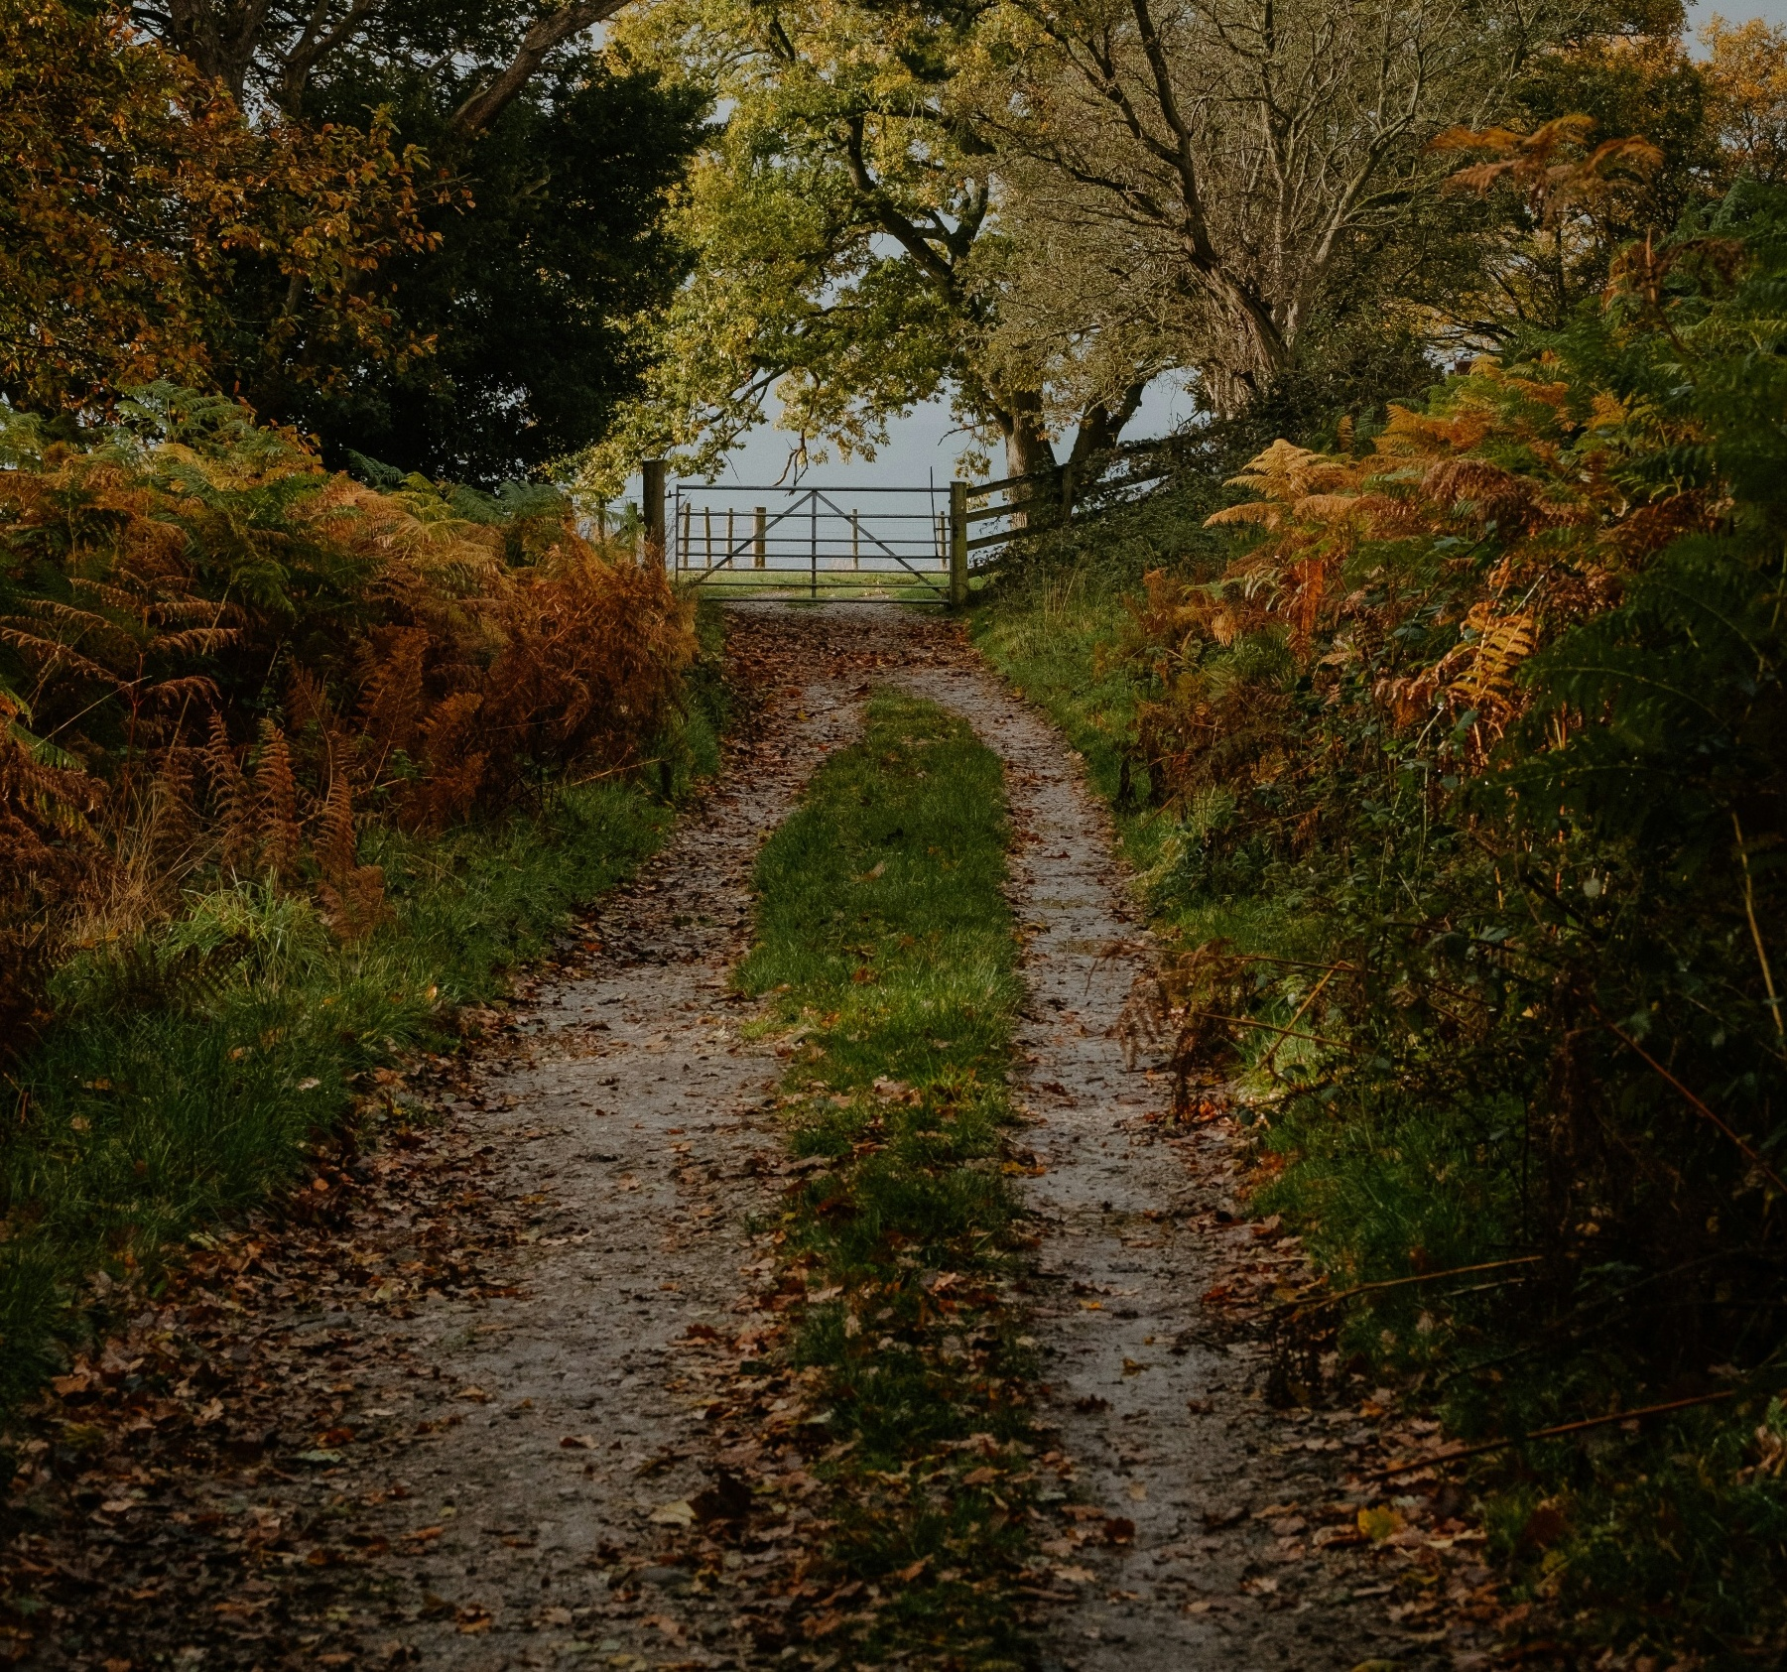
REASONS FOR NOT TAKING A TRIP
Reasons for not visiting
In 2025, the main reasons for not visiting Wales were personal circumstances and travel challenges linked to Brexit.
Of those who did not visit, 58% were considering an overnight trip to Wales.
83% went somewhere else
Of those who did not travel to Wales, 83% chose other destinations, with 50% going abroad, 23% booking a holiday in Germany, and 22% visiting the British Isles or Ireland. The remaining 17% did not take a holiday at all.
Among non-visitors to Wales who travelled within Britain and Ireland (22%), England was the most popular destination, with 76% visiting.

Slide 48
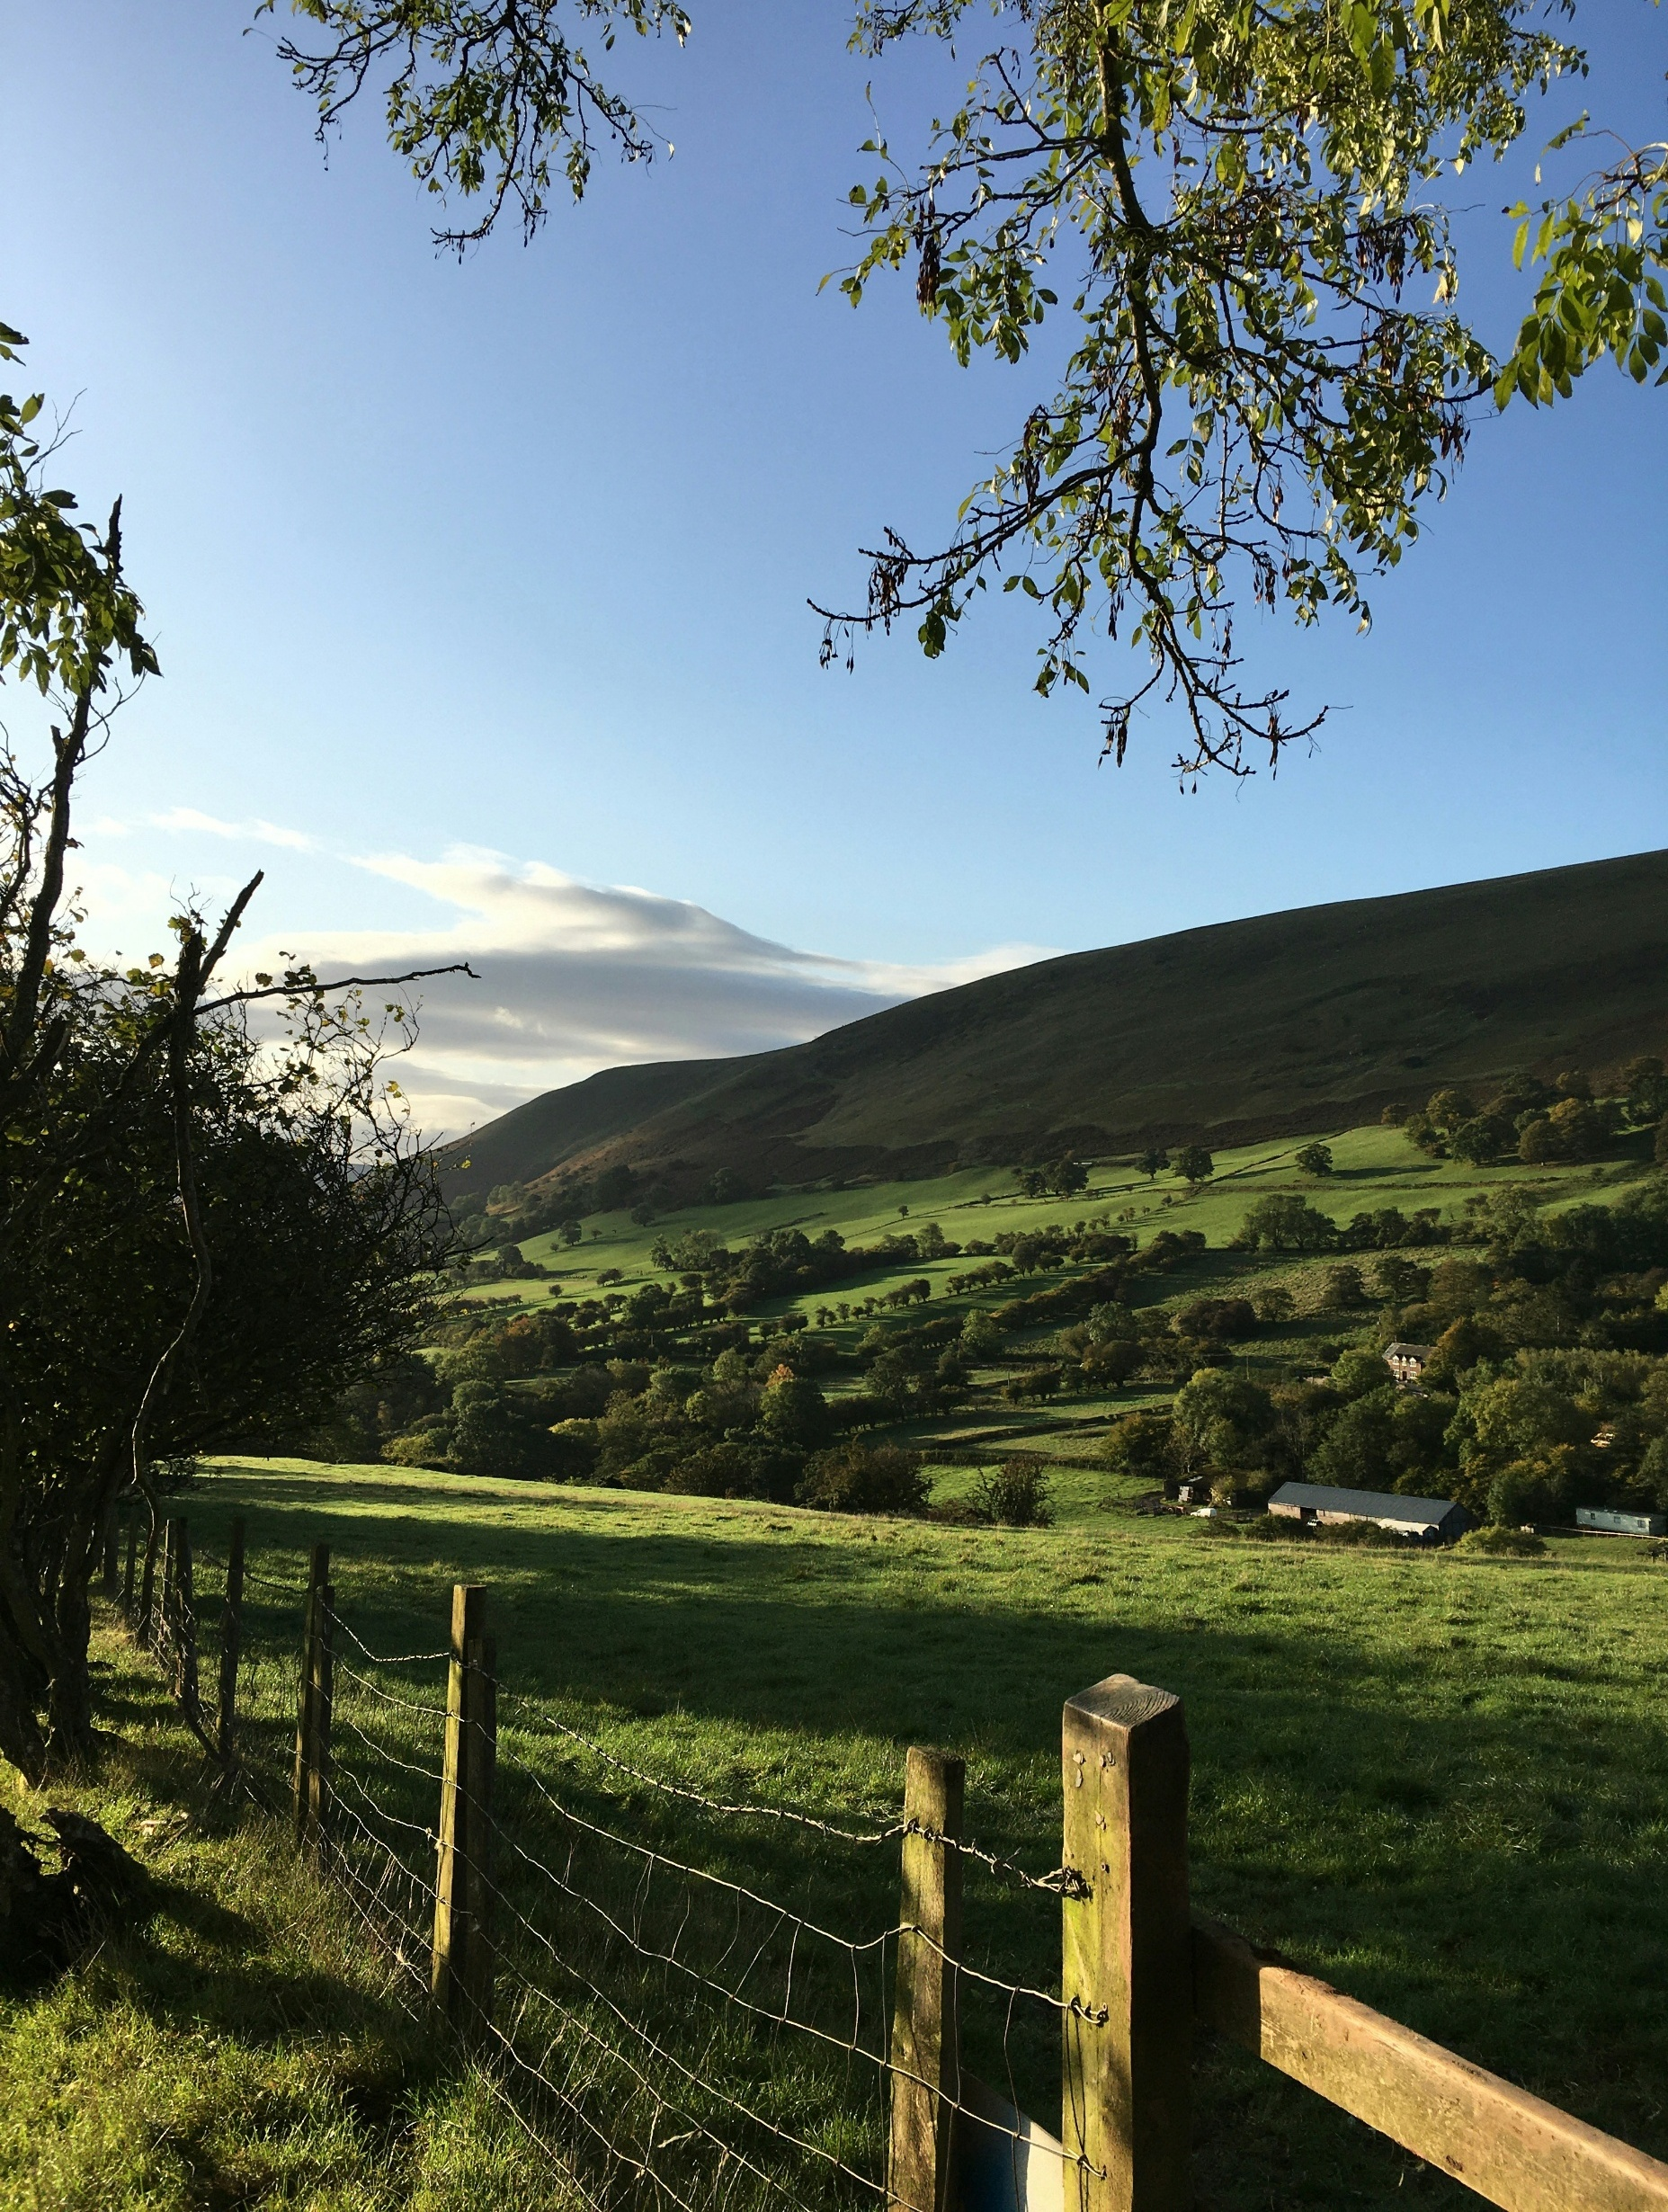
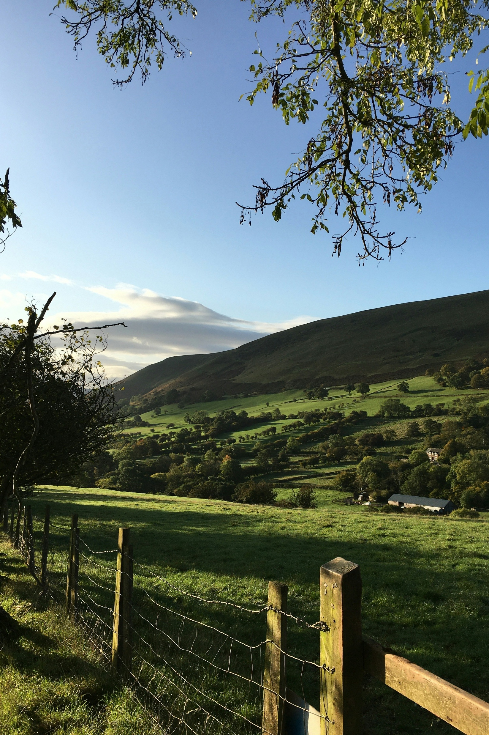
Reasons for not visiting Wales | Wales non-trip takers
The main reasons for not visiting Wales in 2025 were personal circumstances and Brexit related travel challenges.
B4. What are the reasons that you didn’t visit Wales for a holiday in 2025?
2025 Wales non-trip takers, n=882.

Slide 49
Considerers | Wales non-trip takers
58% of non-Wales trip takers in 2025 were considering a short break or holiday in Wales. 83% went somewhere else, while 17% did not take a holiday at all.
58%
Of those that didn’t take a trip to Wales were considering a short break or holiday in Wales in 2025, compared to last year’s 62%
83%
B1. You mentioned that you did not take a short break or holiday in Wales during 2025. Were you considering an overnight trip in Wales in 2025 at any stage?
B2. And did you go somewhere else for a holiday, or did you not take a holiday at all? 2025 Wales non-trip takers, n=882.

Slide 50




Non-visitor alternative trip destinations | Wales non-trip takers
Among travellers who did not visit Wales but travelled elsewhere in Britain and Ireland (22%), England was the most visited destination (67%), although there is a declining trend. Compared with the previous year, a higher proportion travelled to Scotland.
B3. And in which of the following areas of the British Isles and Ireland did you go?
Non-visitors to Wales that went elsewhere in the British Isles or Ireland, n=144 (2023), n=103 (2024), n=198 (2025).

