Slide 1


Visit Wales consumer re-contact survey:
UK and Ireland report (2026)
Social Research Number: 81/2026 Publication date: 01/10/2026
Digital ISBN: 978-1-80853-442-3
© Crown Copyright
Mae’r ddogfen yma hefyd ar gael yn Gymraeg.
This document is also available in Welsh.

Slide 2


Full Research Report: Visit Wales consumer re-contact survey – UK and Ireland report (2026)
Cardiff: Welsh Government, GSR report number 81/2026.
This report can be found on the Statistics and research pages of the Welsh Government website: https://www.gov.wales/statistics-and-research
Views expressed in this report are those of the researcher and not necessarily those of the Welsh Government.
For further information please contact:
Research and Insights Team
Visit Wales,
Economy, Energy and Planning
Cathays Park
Cardiff
CF10 3NQ
Email: tourismresearch@gov.wales

Slide 3
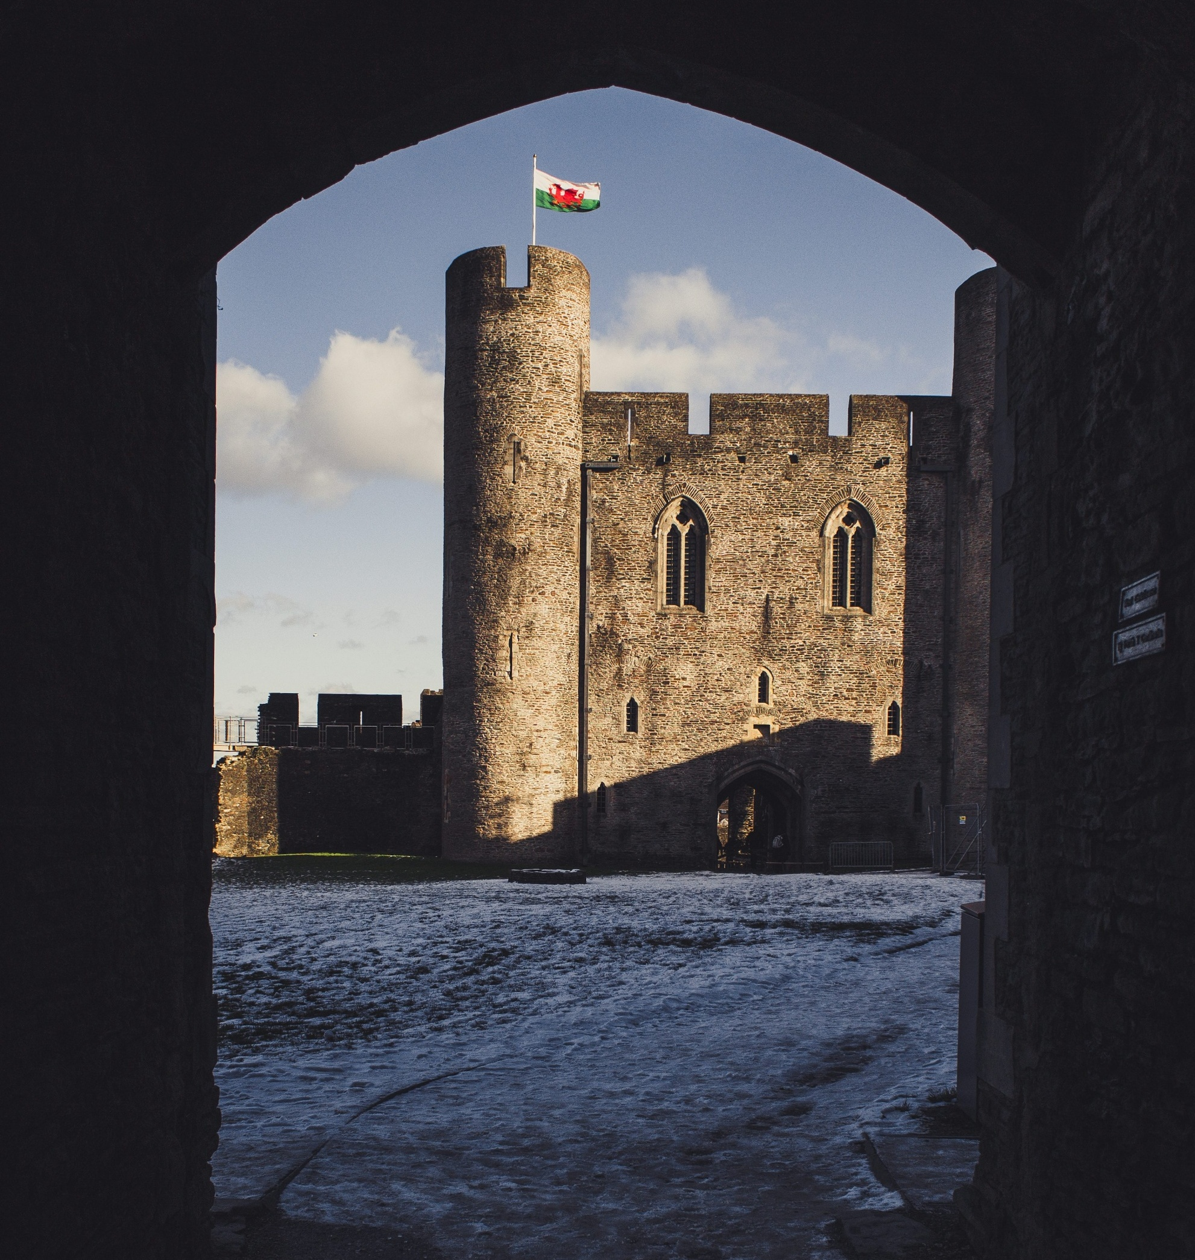
Contents
01 | Background & methodology
02 | Key findings
03 | Profile of Visit Wales enquirers
04 | 2025 trip conversion & relationship with Wales
05 | 2025 trip characteristics
06 | Impact of Visit Wales marketing
07 | Likelihood of visiting Wales in 2026
08 | Reasons for not taking a trip in Wales in 2025

Slide 4



BACKGROUND
& METHODOLOGY

Slide 5


Background
Driving tourism to Wales:
insights from UK & Ireland enquirers
Visit Wales, the Welsh Government's tourism team, is responsible for deploying tourism campaigns in the UK and internationally to position Wales as a leading tourist destination.
This detailed report analyses data from an online survey conducted in February and March 2026 among Visit Wales’s UK and Ireland consumer contacts, referred to as ‘enquirers’ throughout. These are individuals who have interacted with Visit Wales across various touchpoints over the past 12 months, including the website, consumer database sign ups, and social media followers. A separate report is also available for German enquirers.
The primary research objectives of the survey were to:
  Assess trip conversion and relationship with Wales
  Understand the characteristics of trips taken in 2025
  Quantify the impact of the marketing
  Understand plans for trips in 2026
  Assess the reasons for not taking a trip in 2025

Slide 6
Alongside this study, Visit Wales produces a range of insight and research.
Domestic GB Tourism Statistics - Data on overnight trips and day visits by British residents to destinations throughout Britain.
Tourism market demand reports - Each year Visit Wales conducts research amongst its priority markets.
Tourism barometer - The Tourism Barometer provides a ‘snapshot’ of industry performance after important points in the tourism calendar.
Cycling tourism development - This research explores the topic of cycling tourism in Wales, including current capacity and demand, as well as opportunities for growth.
Visit Wales consumer re-contact survey (previous years) – Detailed reports drawn from an online survey conducted amongst Visit Wales consumer contacts over the last few years, including the German market.
Accessible here:
Domestic tourism statistics
Market demand survey reports
Tourism barometer
Cycling tourism development report
Other Re-contact survey reports

Slide 7
Methodology
In February 2026, Visit Wales contacted enquirers via email, inviting them to complete a 10-to-15-minute online survey available in both English and Welsh. Reminder emails were sent to non-respondents one week after the initial invitation, and a prize draw incentive was offered.
The survey opened on 5th February and closed on 2nd March 2026.
Sample and Response Rate
The sample was drawn from various sources, reflecting the different ways enquirers had contacted Visit Wales. The table on the right shows the sample sources along with the number of completed surveys for each source.
Out of 53,294 invitations sent to enquirers, 4,092 completed survey responses were received, resulting in a response rate of 8%.
Data consideration
It is important to note that the sample is not representative of the general populations of the UK or Ireland, as participants had existing connections with Wales. As a result, findings are likely to reflect more positive or ‘warmer’ views than would be expected in the wider public. This should be considered when interpreting the results.
Base sizes and response rates 2026, by enquiry method
/ 51%
/ 30%
/ 10%
/ 9%

Slide 8
DEFINITIONS
Definitions used in this report
This report uses several terms to define the survey respondents.
These include:
Visit Wales enquirers: The total survey population - Visit Wales consumer contacts who responded to this survey.
2025 Wales trip takers: Visit Wales enquirers that stated within the survey that they took a short break or holiday in Wales in 2025.
2025 Wales non trip takers: Visit Wales enquirers that stated within the survey that they did not take a short break or holiday in Wales in 2025.
2026 Wales trip intenders: Visit Wales enquirers that stated within the survey that they intend to take a short break or holiday in Wales in 2026.
Life stages are preferable to ‘age’ as they better describe someone’s life situation. For the purpose of this report, the following is used:
Younger independents: aged 16-34 without children in household.
Families: aged 16-64 with children in household.
Older independents: aged 35-64 with no children in household.
Retirement age: aged 65+.

Slide 9
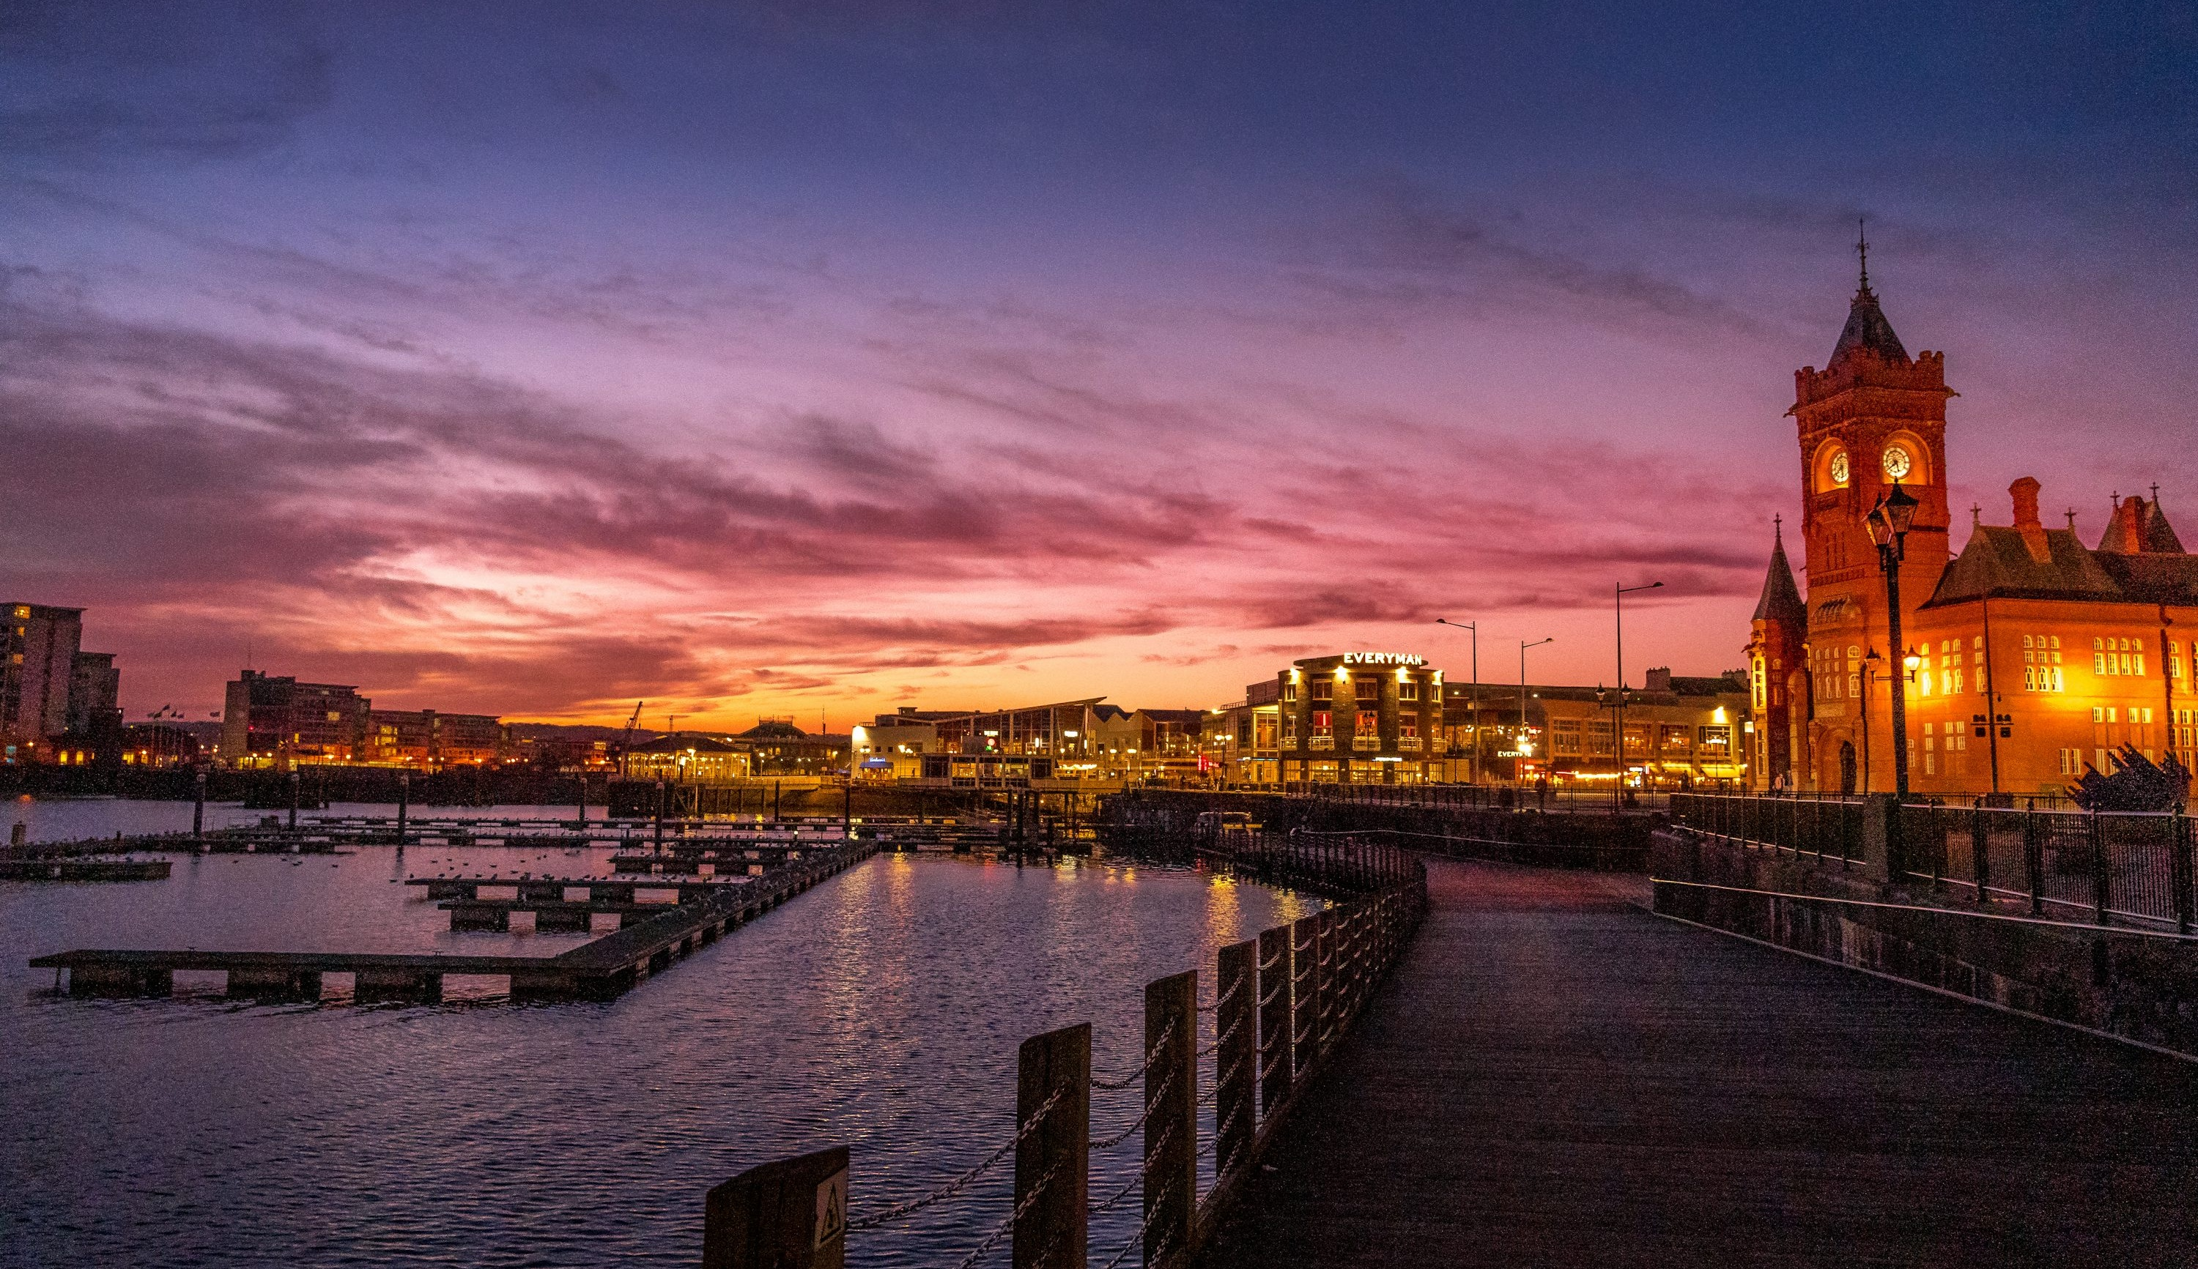
KEY FINDINGS

Slide 10



KEY FINDINGS
Wales visitation
Nearly half of those we surveyed report frequently taking short breaks in Wales, and planning to visit again within the next year.
This is broadly stable in comparison to previous years.
Around 4 in 5 visitors rated their experience as ‘excellent’, which is in line with previous years.
Trip characteristics
North Wales attracts the highest number of visitors, particularly in Gwynedd. Pembrokeshire also receives a comparable volume of visitors.
The most common reason for visiting Wales was having been there already and wanting to go again, followed by connecting with nature.
Communication influence
The most commonly reported impact was encouraging visits outside the summer season, as well as prompting travel to areas they had not previously visited.
21% indicated that Visit Wales communications influenced their decision to visit.
Online advertising and promotional content together are the most common ways 2025 trip-takers learned about Wales, with word of mouth accounting for 31%.

Slide 11
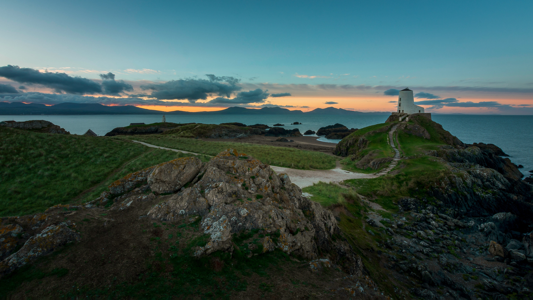
PROFILE OF VISIT WALES ENQUIRERS

Slide 12
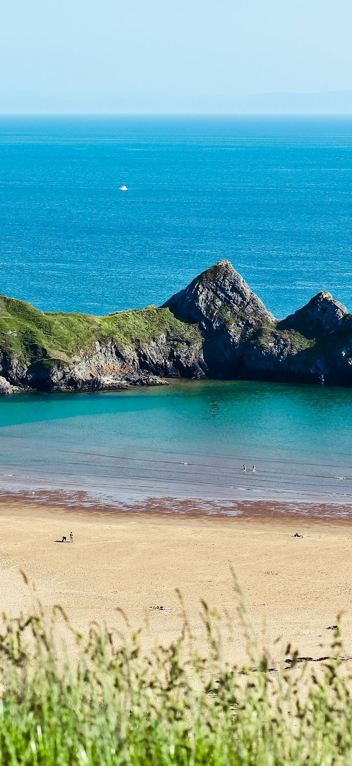
Sample
The sample population is slightly older compared to the previous three years and like in previous years, has a higher proportion of female participants.
Gender | 2026
Age | All Waves
Female
Male
Lifestage | All Waves
X1. How do you describe your gender? X2. Please type in your age. X2b. Do you have any children aged 15 or under in your household that you are responsible for (parent, legal guardian etc)? Total base size, n=4,092.

Slide 13
Intentions for visiting Wales | All waves
Compared to 2025, enquirers from the UK and Ireland in 2026 show little change in their behaviours and intentions for visiting Wales, with nearly half frequently taking short breaks and planning to visit again within the next year.
A1. Which of the following statements best applies to you when it comes to visiting Wales? Total base size, n=6,208 (2024), n=3,827 (2025), n=4,092 (2026)

Slide 14
Intentions for visiting Wales | All waves
Reported visits to Wales are fairly evenly distributed across life stages. While younger independents are the least likely to have visited previously, their intention to visit in the future is just as strong as that of other life stages.
A1. Which of the following statements best applies to you when it comes to visiting Wales?
Total base size, n=4,092 (younger independents n=60, families n=269, older independents n=1,631, retirement age n=2,092).

Slide 15
Place of Residence | All waves
The regional sample composition is generally similar to last year, though there is a clear upward trend in visitors from within Wales, increasing by 8 percentage points since 2024.
X3c. And where in the UK do you live? Respondents who live in UK, n=6,059(2024), n=3,705 (2025), n=3,955 (2026).

Slide 16
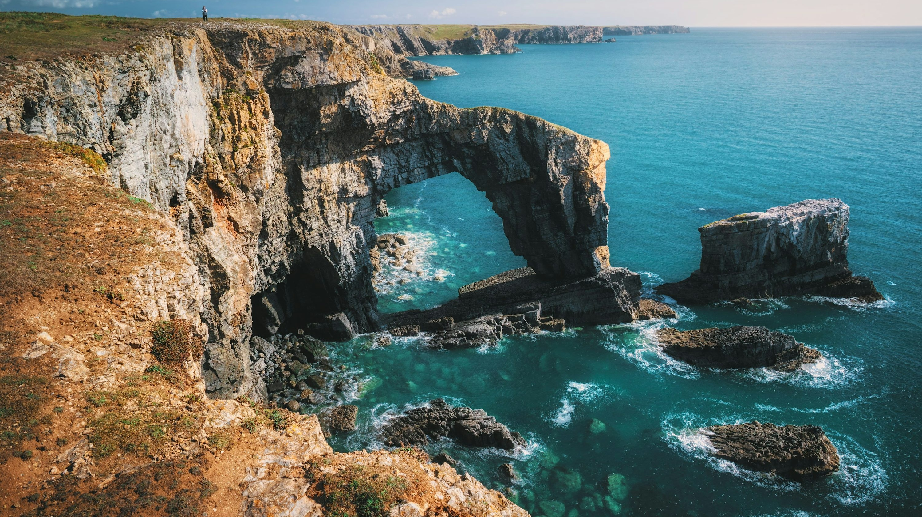
2025 TRIP CONVERSION AND RELATIONSHIP WITH WALES

Slide 17


2025 TRIP CONVERSION AND RELATIONSHIP WITH WALES
Visits to Wales are rising among younger independents, with steady growth seen across recent waves. This result should be interpreted with caution, as it may be influenced by the small sample size within this group.
At a total level, people who visit Wales are more likely to choose short breaks over longer holidays. Prior visitation remains strong – 65% had visited before 2020, closely matching 2024 levels.
61% of respondents visited Wales in 2025.
This is stable in comparison to previous years.

Slide 18
Welsh holiday frequency | By Lifestage
In 2025, 61% of respondents reported visiting Wales, consistent with previous years. By life stage, 71% of younger independents had visited, compared with 60% of those at retirement age. Life stage patterns remained largely stable. An increase in holiday frequency among younger independents was observed, though this may reflect the small sample size for this group.
A2a. Did you take a short break or holiday in Wales in 2025?
Total, n=3,927 (Younger independents n=55, Families n=254, Older Independents n=1,557, Retirement age n=2,012).

Slide 19

Average Number of Holidays in Wales | All Waves
In 2025, trip takers who visited Wales averaged 3.51 short breaks or holidays to Wales, slightly more than last year. They were more likely to take short breaks than holidays of four nights or longer, in line with all previous waves.
A3. How many separate short breaks or holidays did you take in Wales in 2025? - Mean Summary
Wales trip takers, n=3,652 (taken trip in 2023), n=2,202 (taken trip in 2024), n=2,408 (taken trip in 2025).

Slide 20

Holidays taken prior to 2025 | 2026 Wave
Many respondents reported visiting Wales in recent years, with 65% having done so before 2020.
A2b. Have you taken a short break or holiday in Wales prior to 2025?
Took a short break or holiday in Wales, n=3,832.

Slide 21
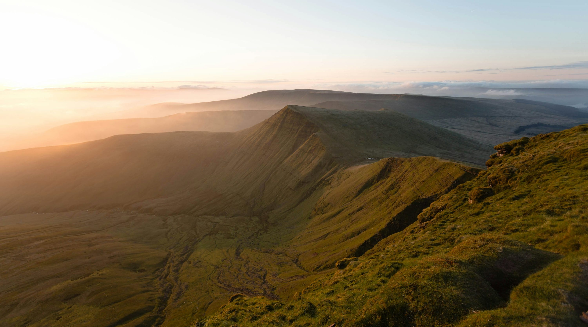
2025 TRIP CHARACTERISTICS

Slide 22

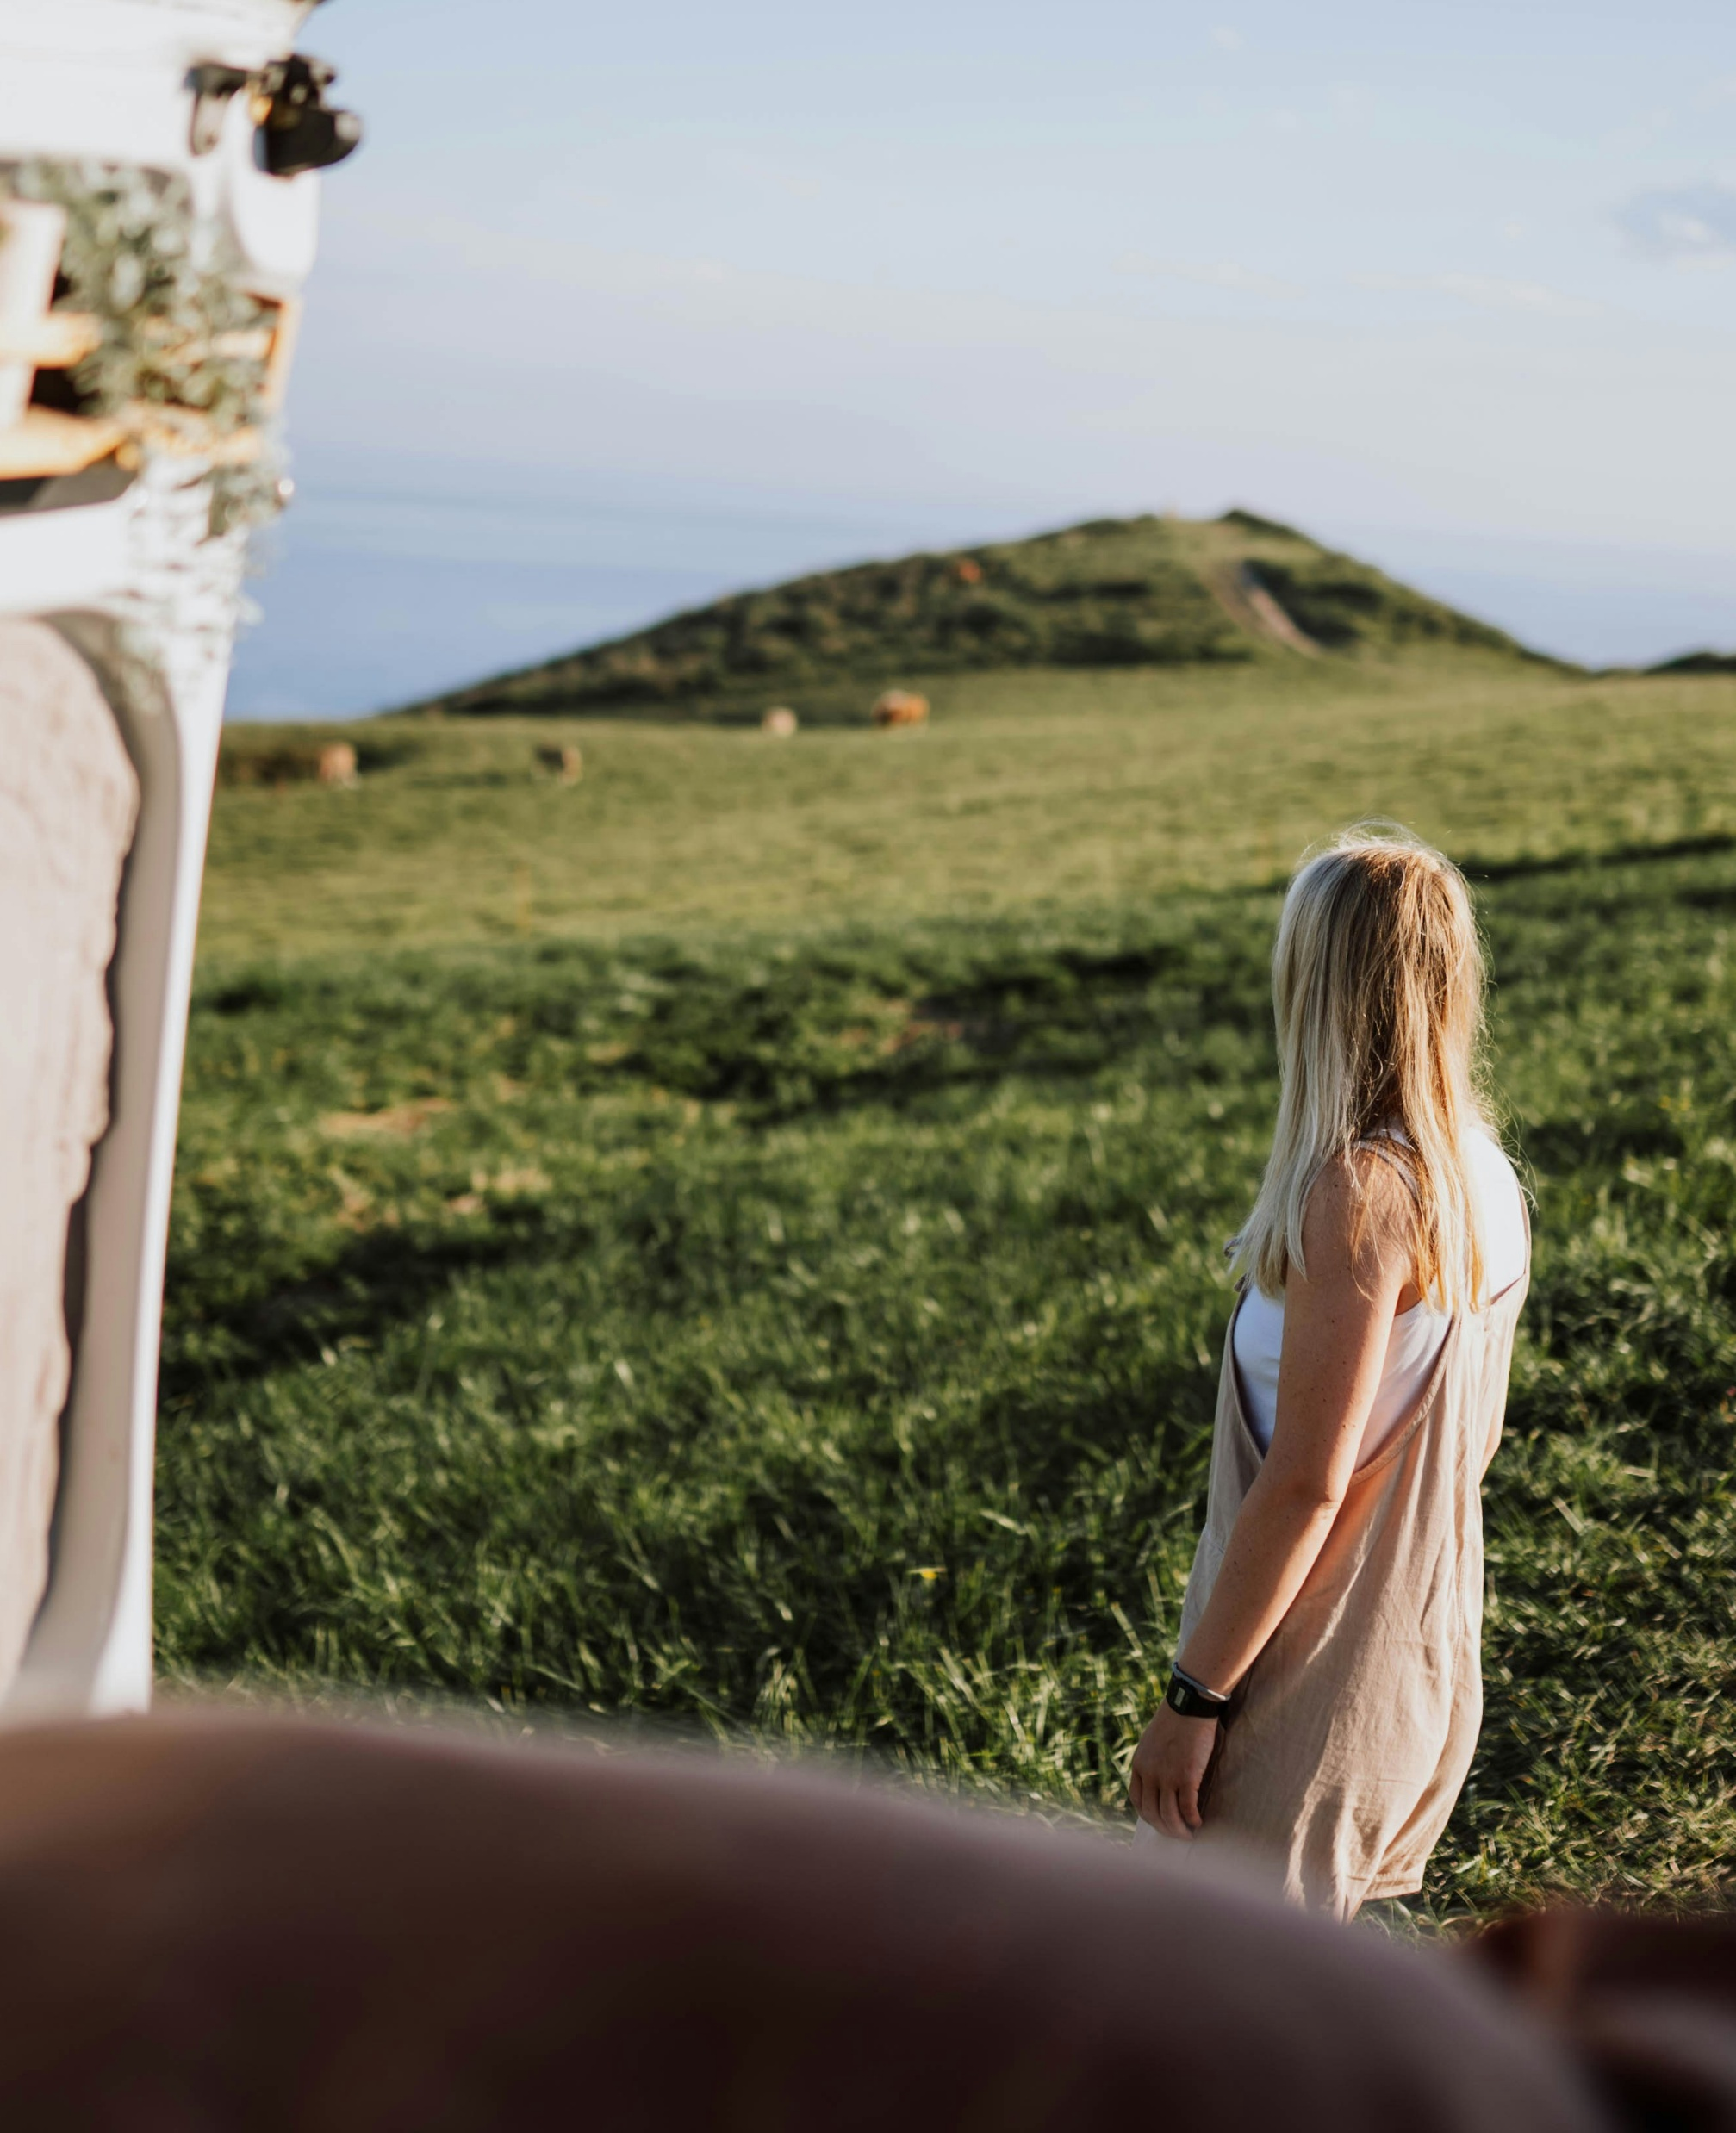
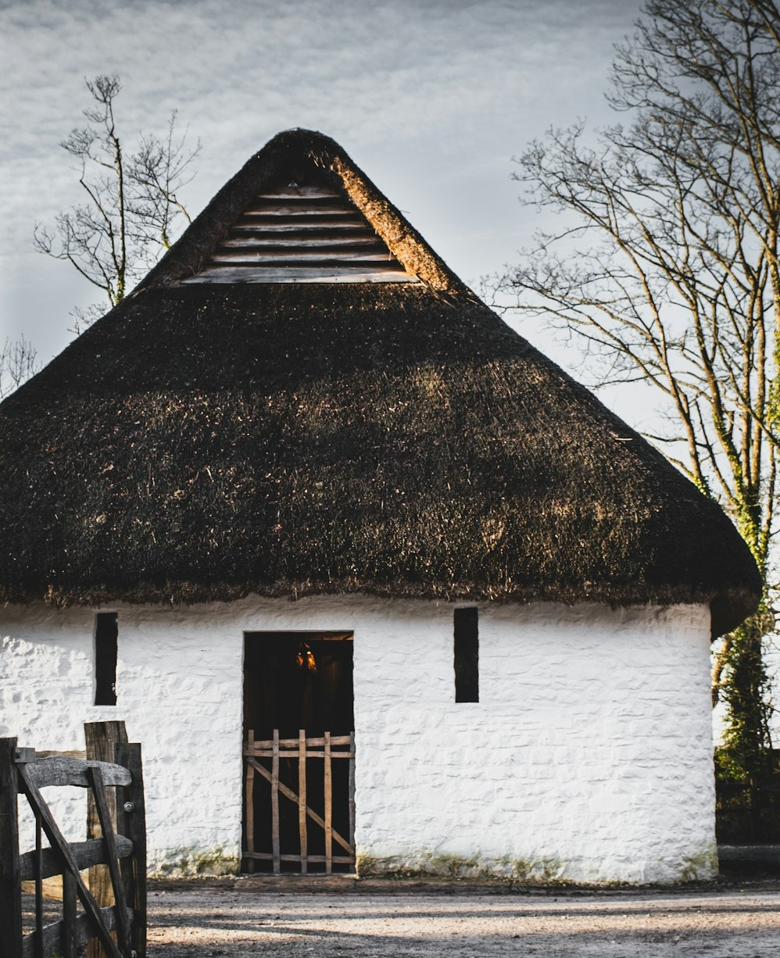
2025 TRIP CHARACTERISTICS
Experience
Around 4 in 5 Wales visitors rated their experience as ‘excellent', similar to all previous years.
53% visited Wales again because they had been before and wanted to return. Connecting with nature remains a key secondary reason.
In 2025, 65% of visitors to Wales did not consider any other destination for their holiday.
Details of trip
North Wales remains the top destination, attracting 47% of all Wales trips, with Gwynedd the most visited area overall.
Most 2025 visitors stayed in one place, typically for 1-3 nights.
September was still the busiest month, while trips in July and December are steadily increasing and June visits are slightly declining.
Accommodation
Hotels and motels remain the top accommodation choice, with rented houses and cottages close behind.
As with previous years, most visitors in 2025 tended to book directly with providers.

Slide 23

Experience Rating | All Waves
Just under 4 in 5 Wales visitors rated their experience as ‘excellent’, which is in line with last year.
A15. Now going back to your trip in Wales in 2025, how would you rate your experience over from 1 to 10 where 1 is very poor and 10 is very good? 2025 Wales trip takers, n=2,408 (younger independents n=39, families n=164, older independents n=976 and retirement age n=1,202).

Slide 24

Reasons for wanting to visit Wales | 2025 Trips
Over half of respondents chose to visit Wales again because they had been before and wanted to return, reflecting both its appeal and a possible sampling bias, as familiarity may encourage repeat visits. Connecting with nature was the second most common reason, consistent with previous years.
A7. Which, if any, of the following were the main factors that made you choose Wales as a destination for this short break/holiday in 2025? 2025 Wales trip takers, n=2,408.

Slide 25
Reasons for choosing Wales as a destination | By Lifestage
Respondents are especially drawn to opportunities to engage with nature, and many also place strong importance on spending time with family and friends. Across all life stages, celebrating special occasions, discovering new parts of Wales, and enjoying great food and drink are among the less common motivations for visiting.
A7. Which, if any, of the following were the main factors that made you choose Wales as a destination for this short break/holiday in 2025?
2025 Wales trip takers, n=2,408 (2,202 (younger independents n=39, families n=164, older independents n=976, retirement age n=1,202).

Slide 26

Top 10 activities done in Wales | 2025 Trips
Walking, hiking and rambling were the most common activities during trips to Wales, alongside trying local cuisine and scenic drives.
A14. Which, if any, of the following did you do on this trip in Wales in 2025?
2025 Wales trip takers, n=2,408.

Slide 27
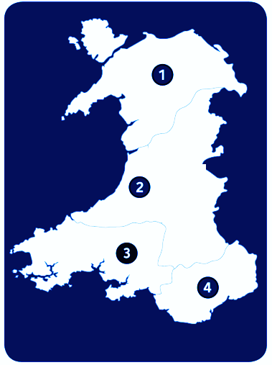
Destination choices | 2025 Trips
North Wales attracts the highest number of visitors, particularly in Gwynedd. Pembrokeshire also receives a comparable volume of visitors.
47%
North Wales (1)
21%
Mid Wales (2)
29%
South West Wales (3)
15%
South East Wales (4)
*Removed destinations containing less than 4%
A12. Where in Wales did you stay overnight on this trip in [MONTH]? Please select that apply. 2025 Wales trip takers, n=2,408.

Slide 28
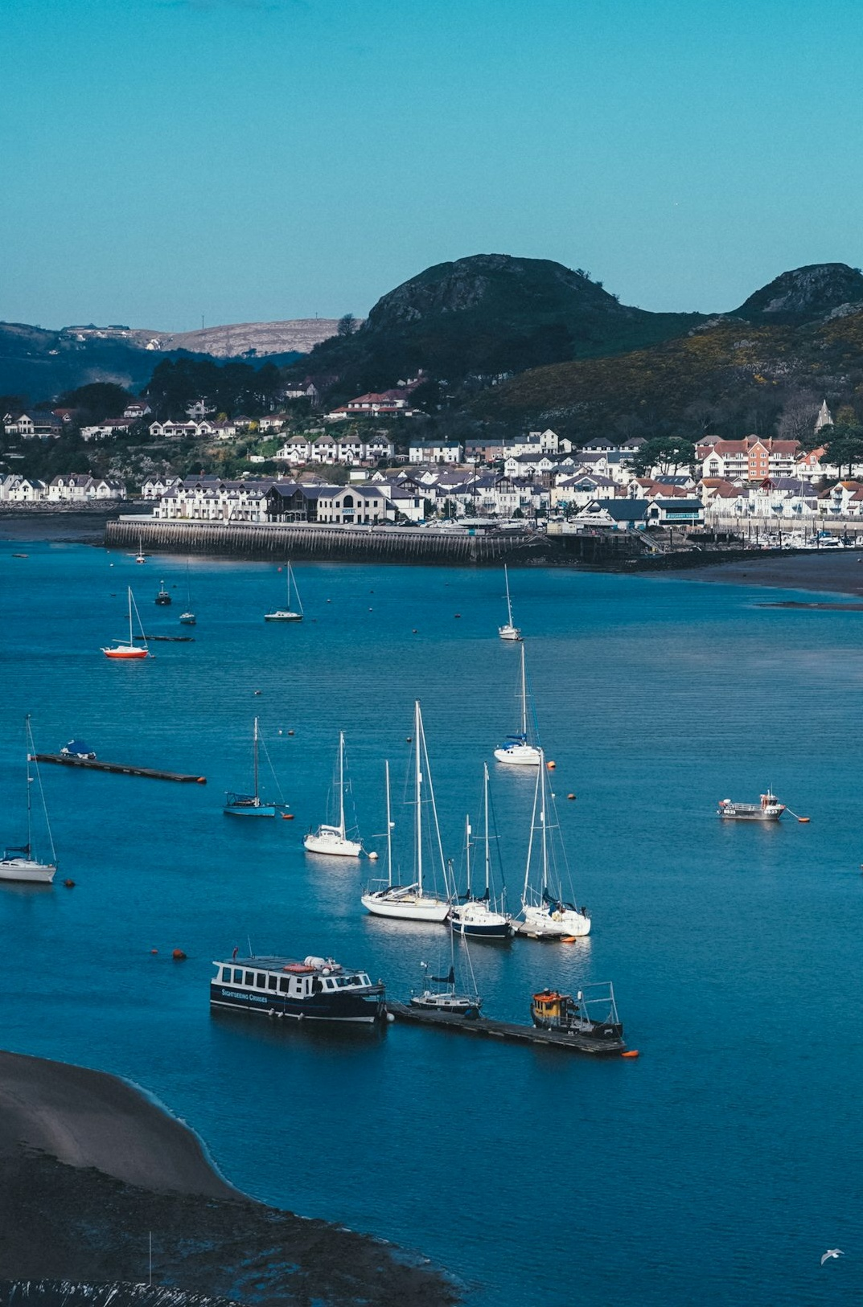
Number of locations on trip | 2025 Trips
Most visitors to Wales stayed in a single location, with patterns broadly consistent across lifestages. However, a higher proportion of enquirers from the social media group reported staying in multiple locations compared to other groups.
A13. Which of the below best describes your trip in Wales in 2025?
2025 Wales trip takers n=2,408 (younger independents n=39, families n=164, older independents n=976, retirement age n=1,202, website n=319, ECRM n=1,143, campaign n=713, social media n=233).

Slide 29
Month of trip | All Waves
September remains the most popular month to visit Wales, with an upward trend for visiting in July and December, and a decline in June trips. Other months stay largely consistent with previous waves.
A4. And in which month(s) of the year did you visit Wales for a short break or holiday in 2025? Wales trip takers, n=3,652 (2023), n=2,202 (2024), n=2,408 (2025).

Slide 30
Amount of nights | All Waves
Of those who took a trip in 2025, the majority stayed for 1-3 days, while only a small proportion stayed for 8 nights or more. This pattern is consistent with previous years. The average trip length was 4.45 nights, with retirement age respondents tending to take longer holidays than other groups.
4.45
Average number of nights
A5. On this overnight trip in Wales in 2025, how many nights did you stay away for? Wales trip takers, n=3,652 (2023), n=2,202 (2024), n=2,408 (2025).

Slide 31

Immediate Party Size | Total
Just under a quarter of 2025 Wales visitors travelled with a dog, which is similar to previous waves. Those travelling with children has marginally decreased since last wave.
On average, groups contained 2.7 people in 2025
A6. Including yourself, how many of the following were there in your immediate party on this overnight trip in Wales in [MONTH]? Wales trip takers, n=3,652 (2023), n=2,202 (2024), n=2,408 (2025).

Slide 32

Booking Sources | 2025 Trips
Similarly to previous years, most respondents booked their accommodation directly through a provider. 15% found information for the accommodation via the Visit Wales website.
15%
found information or contact details for the accommodation they stayed in on the Visit Wales website
A9. How did you book your accommodation for this trip in Wales? A10. Did you find information or contact details for the accommodation you stayed in on the Visit Wales website? 2025 Wales trip takers, n=2,408

Slide 33

Accommodation type | 2025 Trips
Similarly to previous years, ‘Hotels/Motels/Inns’ were the most popular accommodation type for Wales trip-takers in 2025.
A11. What type/s of accommodation did you stay at during your trip in 2025 in Wales? 2025 Wales trip takers, n=2,408

Slide 34
Destination Considerations | 2025 Trips
Most visitors only considered Wales for this trip, and this pattern is consistent across Lifestages.
Caution: Low base size in this group
A8_UKI. Which, if any, of the following other destinations did you consider when you took your overnight trip in Wales in 2025?
2025 Wales trip takers, n=2,408 (younger independents n=39, families n=164, older independents n=976, retirement age n=1,202).

Slide 35
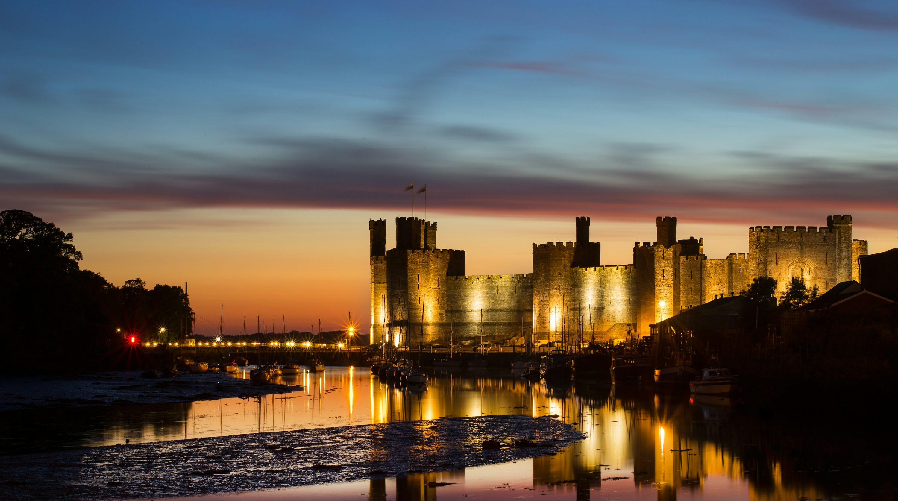
IMPACT OF VISIT WALES MARKETING

Slide 36




IMPACT OF VISIT WALES MARKETING
Contact Visit Wales
Online advertising and promotional content together are the most common ways 2025 trip-takers learned about Wales, with word of mouth accounting for 31%.
Points of contact
E-newsletters were the most common point of contact with Visit Wales overall, though this is likely influenced by the skewed sample.
Of those who visited the Visit Wales website, the majority did so from their home, on their mobile device.
Influence promotion
While around half of respondents reported seeing no campaign materials, 21% indicated that Visit Wales communications influenced their decision to visit.
The largest reported impact was encouraging visits outside the summer season, as well as prompting travel to areas they had not previously visited.

Slide 37
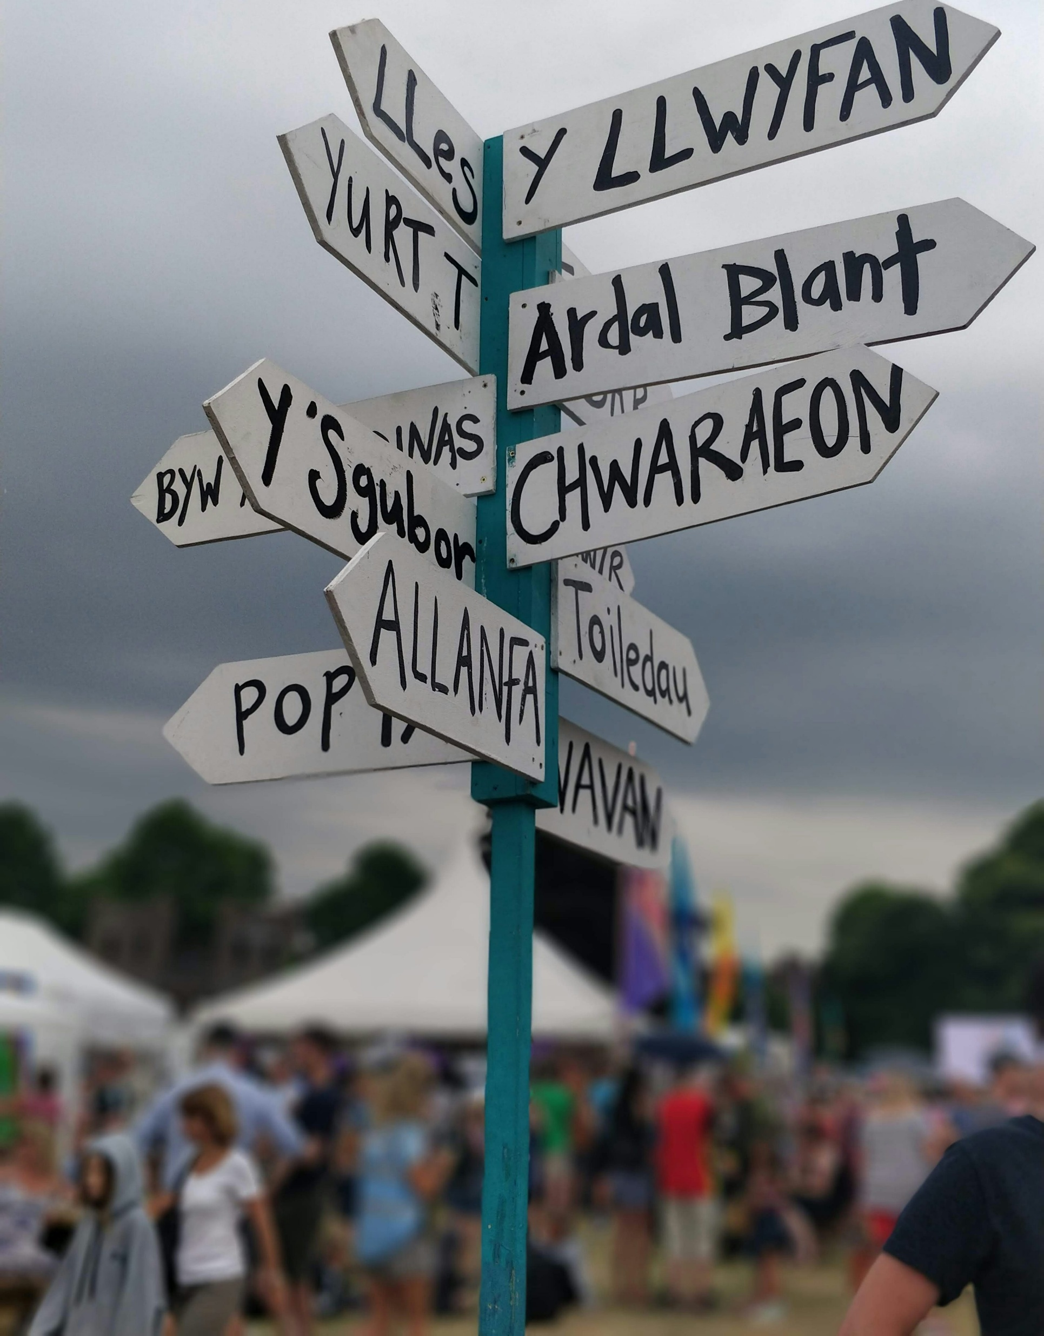
Communication Exposure | 2025 Trips
Wales trip takers were most likely to have seen or heard about Wales through word of mouth, online advertising or social media content.
A18. Thinking about marketing and communications which, if any, of the following did you see or hear about Wales during 2025? 2025 Wales trip takers, n=2,408.

Slide 38
Types of communication seen | 2025 Trips
Younger independents see the most types of marketing, although this group has a relatively low base size, which means results should be interpreted with caution. They also rely more heavily on word of mouth and online advertising and social media influencers than other groups. Retirement age are seeing the least variation in marketing materials and are also seeing the least online advertising.
Caution*: Low base size in this group
A18. Thinking about marketing and communications which, if any, of the following did you see or hear about Wales during 2025?
2025 Wales trip takers, n=2,408 (younger independents n=39, families n=164, older independents n=976, retirement age n=1,202).

Slide 39
Contact with Visit Wales | 2025 Trips
E-newsletters from Visit Wales were the most commonly reported channel through which respondents had engaged with Visit Wales. However, the sample is skewed towards individuals already within the eCRM database, which is likely to over-represent email engagement and under-represent audiences reached through other channels, particularly new or prospective visitors who have not previously signed up.
Similarly to last year, half also visited the Visit Wales website. Facebook still leads the way for social media, however 35% of younger independents engage with Visit Wales via Instagram and 12% with Tiktok.
*The majority of the re-contact sample comes from the ECRM database, and most of the social media sample was captured via Facebook. As both sources rank within the top three, this may influence the overall distribution of responses.
35% among Younger Independents
12% among Younger Independents
A19. Thinking about contact you had with Visit Wales in 2025, which of the following apply to you? Total (n=4,092), Younger Independents (n=60).

Slide 40

Access to Visit Wales Website | 2025 Trips
Most users accessed the Visit Wales website from home. Mobile device usage was higher than desktop/laptop use, especially among those visiting the site whilst already on a trip to Wales.
 | At Home | During a trip to Wales | At work
Laptop/ Desktop | 57% | 18% | 51%
Mobile | 72% | 93% | 64%
A20. In the past 12 months, what devices did you use to access the Visit Wales website? Who visited Visit Wales website, n=1,988, at home n=1,965, during a trip n=936, and at work n=321.

Slide 41
Visit Wales Influence on Trip Decision | 2025 Trips
21% stated that Visit Wales communications influenced their decision to visit Wales. Additionally, 26% reported that Visit Wales communications led them to travel to Wales outside of the peak summer months, and 16% reported that they led them to visit more areas than originally planned.
Visit Wales Influence on Trip Behaviours | 2025 Trips
21%
A22. On a scale of 1 to 5 where 1 means ‘no influence at ’ and 5 means 'a major influence', what influence, if any, did Visit Wales communications have on your decision to take a short break or holiday in 2025? A23. In 2025, did Visit Wales communications impact your behaviour in any of the following ways...
2025 Wales trip takers, n=2,408.

Slide 42
Types of communication seen and perceived level of influence | 2025 Trips
A large proportion saw no campaign related materials, however around a third saw communications about new reasons to visit all year round. Respondents reported New places as the most influential communication type.
 | Very/Extremely Influential
 | 28%
 | 37%
 | 27%
 | 29%
A23a. In 2025, did you see any communication promoting Wales in relation to the following? 2025 Wales trip takers, n=2,408
A23b. And how influential were they on your decision to take a trip in Wales in 2025. 2025 Wales trip takers, new reasons to visit all year-round n=787, new places n=656, new events n=388 & new activities n=347.

Slide 43

Trip decision timings | 2025 Trips
Almost three quarters of trip takers had already decided to take a trip to Wales in 2025 by the end of 2024.
A24. Finally in this section, thinking back to the end of 2024, which of these statements best describes your plans at that time to visit Wales in 2025?
2025 Wales trip takers, n=2,408.

Slide 44
ARTIFICIAL INTELLIGENCE (AI)
Note that these insights are based on audiences already engaged with Wales or VW touchpoints, and may therefore over represent ‘warm’ users. Less familiar audiences are likely to demonstrate different behaviours, including greater use of AI for initial discovery and orientation

Slide 45

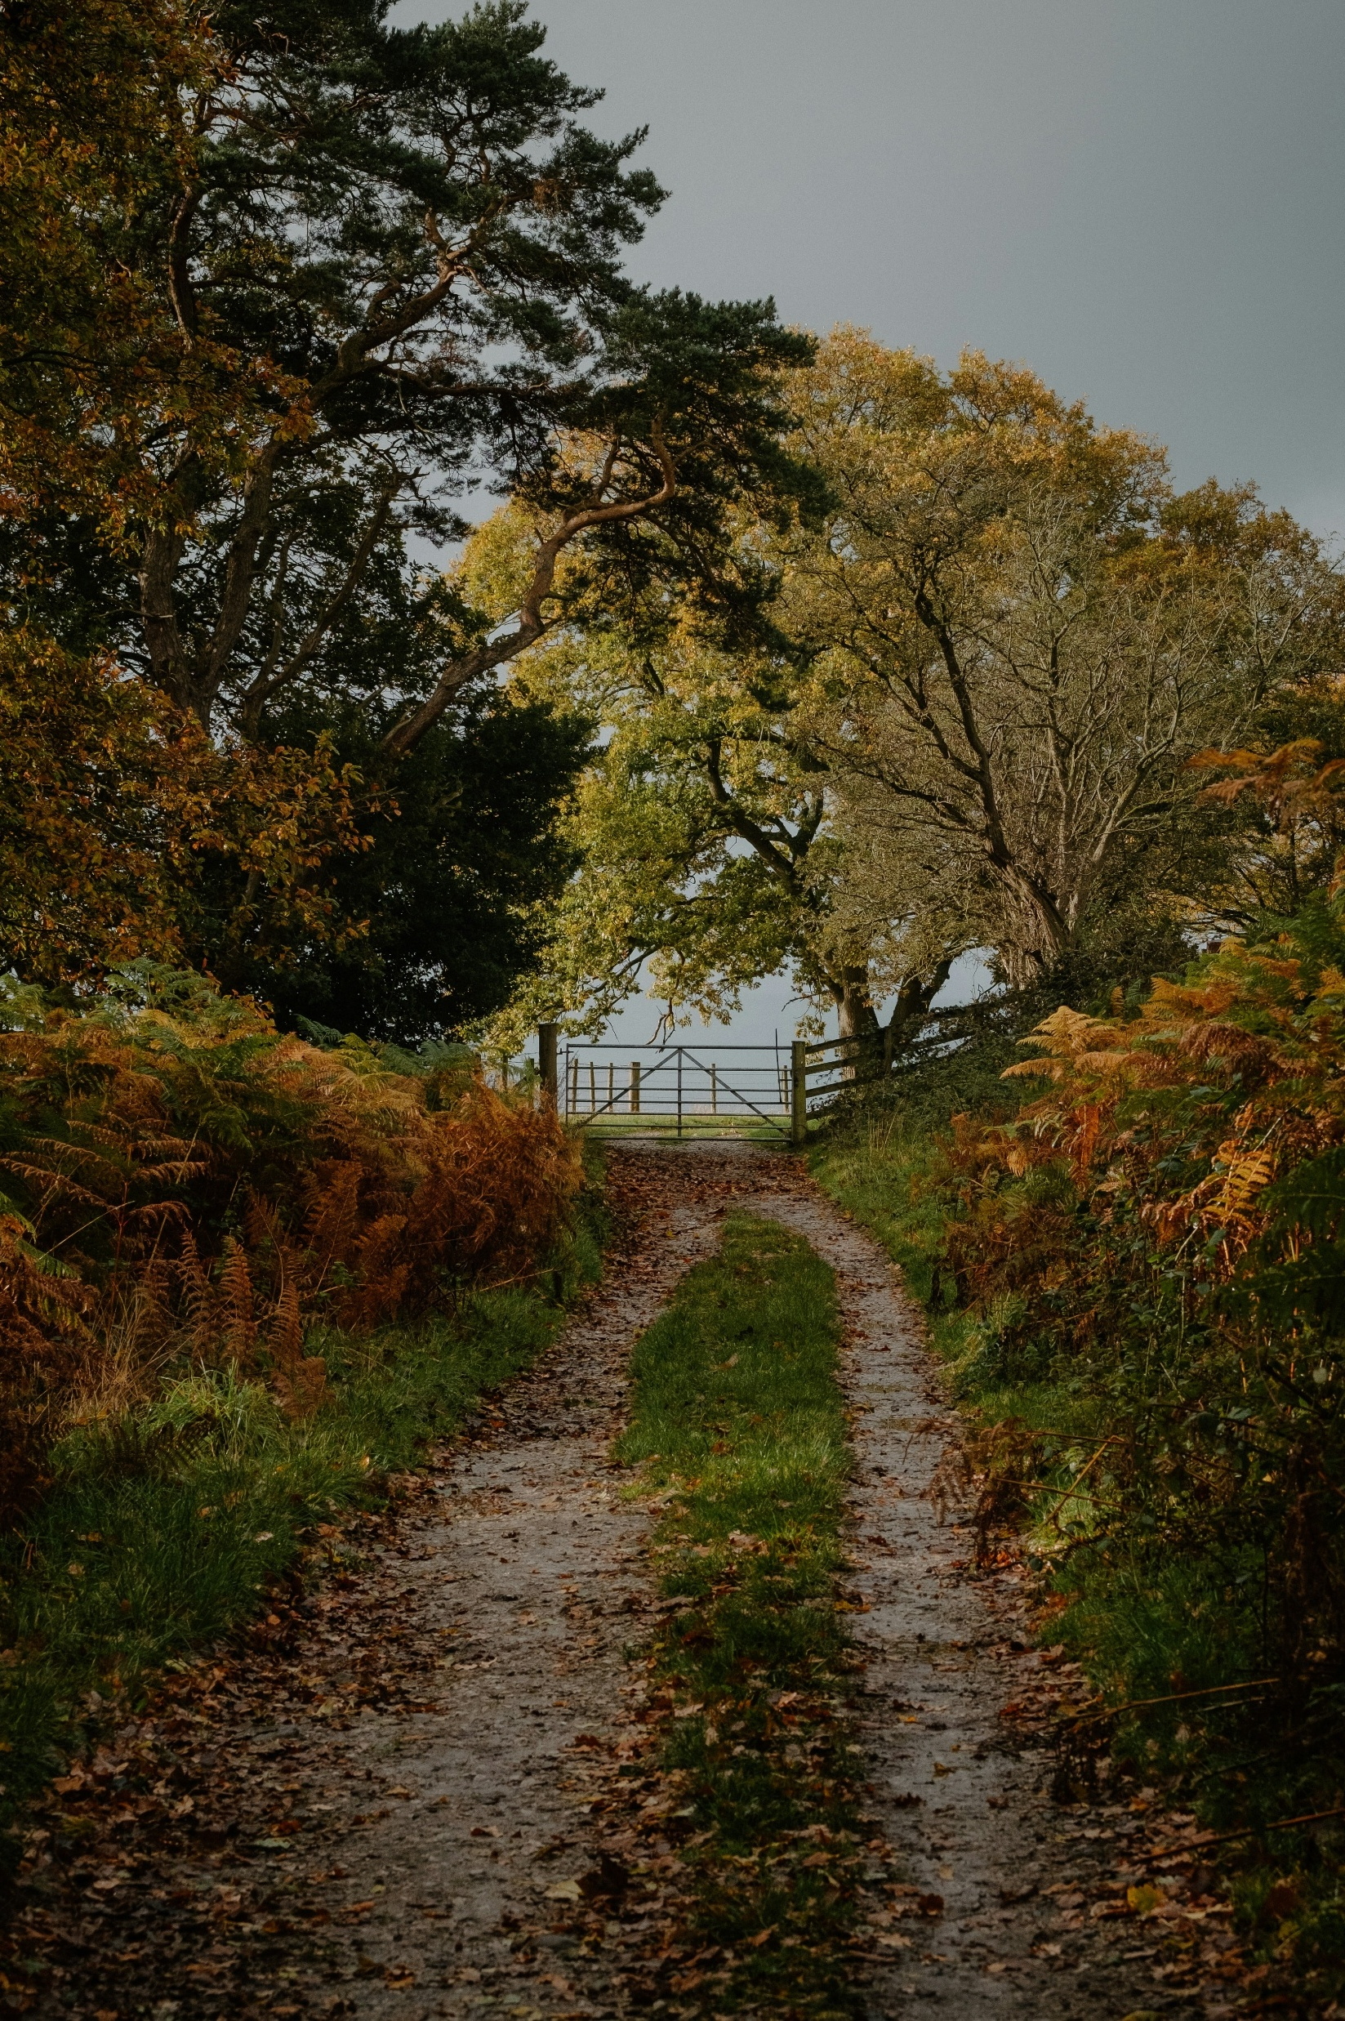
Planning with AI | Wales trip takers
AI was considered especially helpful for quickly condensing large amounts of information into personalised itineraries and for finding lesser known, hidden gem destinations.
91% of respondents reported that they did not use AI to plan their trip to Wales in 2025. Among those who did, 5% used it for ideas and inspiration, 3% used it to create an itinerary, and 3% used it to find accommodation or travel options.
“It helped me put my itinerary together. It confirmed opening times of museums/places of interest.”
“Used to find places of interest in my chosen area plus places to eat and drink.”
“Lists of new useful information about locations.”
“An easy way to make an itinerary.”
“Looking for unusual places to visit.”
“It tells you places to go that you didn’t consider.”
“The ability to tailor answers and insight to my questions without wading through websites“.”
“It compiled information from multiple sources.”
D1. When planning your most recent short break or holiday within Wales, did you use any AI-powered tools or services? 2025 Wales trip takers, n=2,408.
D3. What did you find most useful (or least useful) about using AI when planning your trip to Wales? Used AI to plan trip, n=215.

Slide 46
Booking influence AI | Used AI
Among those who used AI to plan a trip to Wales in 2025, most said it had limited impact on booking decisions, with 48% stating it provided useful information but did not influence booking and 30% saying it made no difference.
In contrast, 19% reported an influence on booking (13% strongly influenced and 6% directly led to a booking), while 3% were unsure or could not remember.
D2. How much did using AI help you get closer to booking a trip to Wales? Used AI to plan trip, n=215.

Slide 47
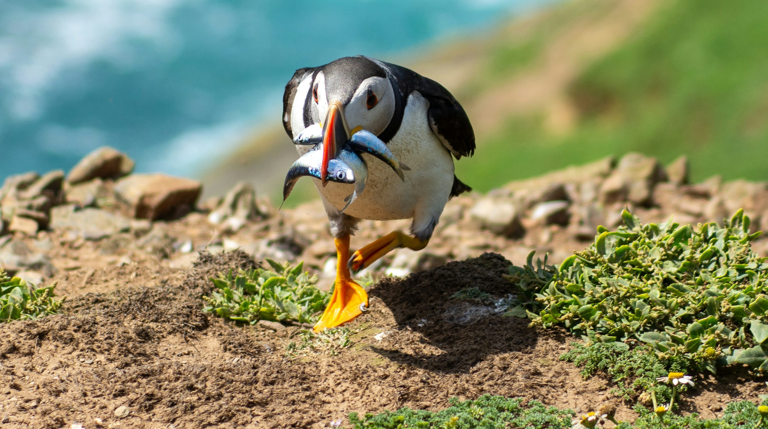
LIKELIHOOD OF VISITING WALES IN 2026

Slide 48



LIKELIHOOD OF VISITING WALES IN 2026
Likelihood visiting Wales in 2026
Intent to return to Wales is strong. 34% of 2025 visitors have already booked for 2026, while a further 53% plan to visit but haven’t booked yet.
Younger independents show the highest likelihood to visit at 80%, with families, older independents and retirement age groups slightly lower at around 74% to 76%. Families are more likely to have already booked, indicating earlier planning rather than lower intent to visit.
Influence of Visit Wales communication
Social Media communications have the most reported influence overall (33%). This is followed by Campaigns (30%).
Current communications are reported to be most influential among Families (30%) and least influential among Younger Independents (21%)
Next likely
25% of those unlikely to visit Wales in 2026, were intending on visiting in 2027.
71% of the same group were unsure of when they would next visit.

Slide 49
2026 Trip Intentions | Total
Around 87% of 2025 visitors intend to return in 2026 or have already booked. Younger independents are the most likely to report that they intend to visit at 80%, while families, older independents and retirement age groups are slightly lower at around 74% to 76%. Families are more likely to have already booked – this may suggest earlier planning, rather than lower intent.
B5. Do you intend to visit Wales for a short break or holiday in 2026? Total, n=4,092 (Wales Trip Takers n=2,408, Wales non-trip takers n=1,684, younger independents n=60, families n=269, older independents n=1,631, retirement age n=2,092).

Slide 50
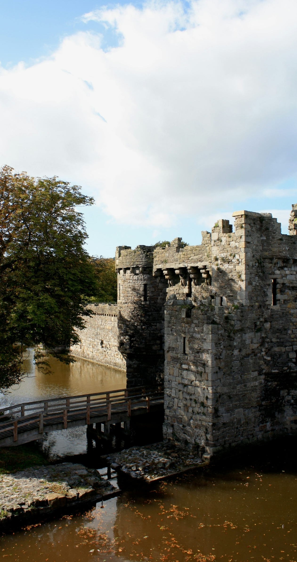
Influence of Visit Wales communications | By Source and Lifestage
Social media communications from Visit Wales are reported to be most influential overall. Families are most likely to report being influenced overall.
Caution*: Low base size in this group
B10. On a scale of 1 to 5 where 1 means ‘no influence at ’ and 5 means ‘a major influence’, what influence, if any, has Visit Wales communications had on your decision to take a short break or holiday in Wales in 2026? Likely to visit Wales in 2026 or already booked, n=3,068 (Website n=330, e-CRM n=1,505, Campaign n=911, Social Media n=322, Younger Independents=48*, Families=202, Older Independents=1,242, Retirement Age=1,551).

Slide 51
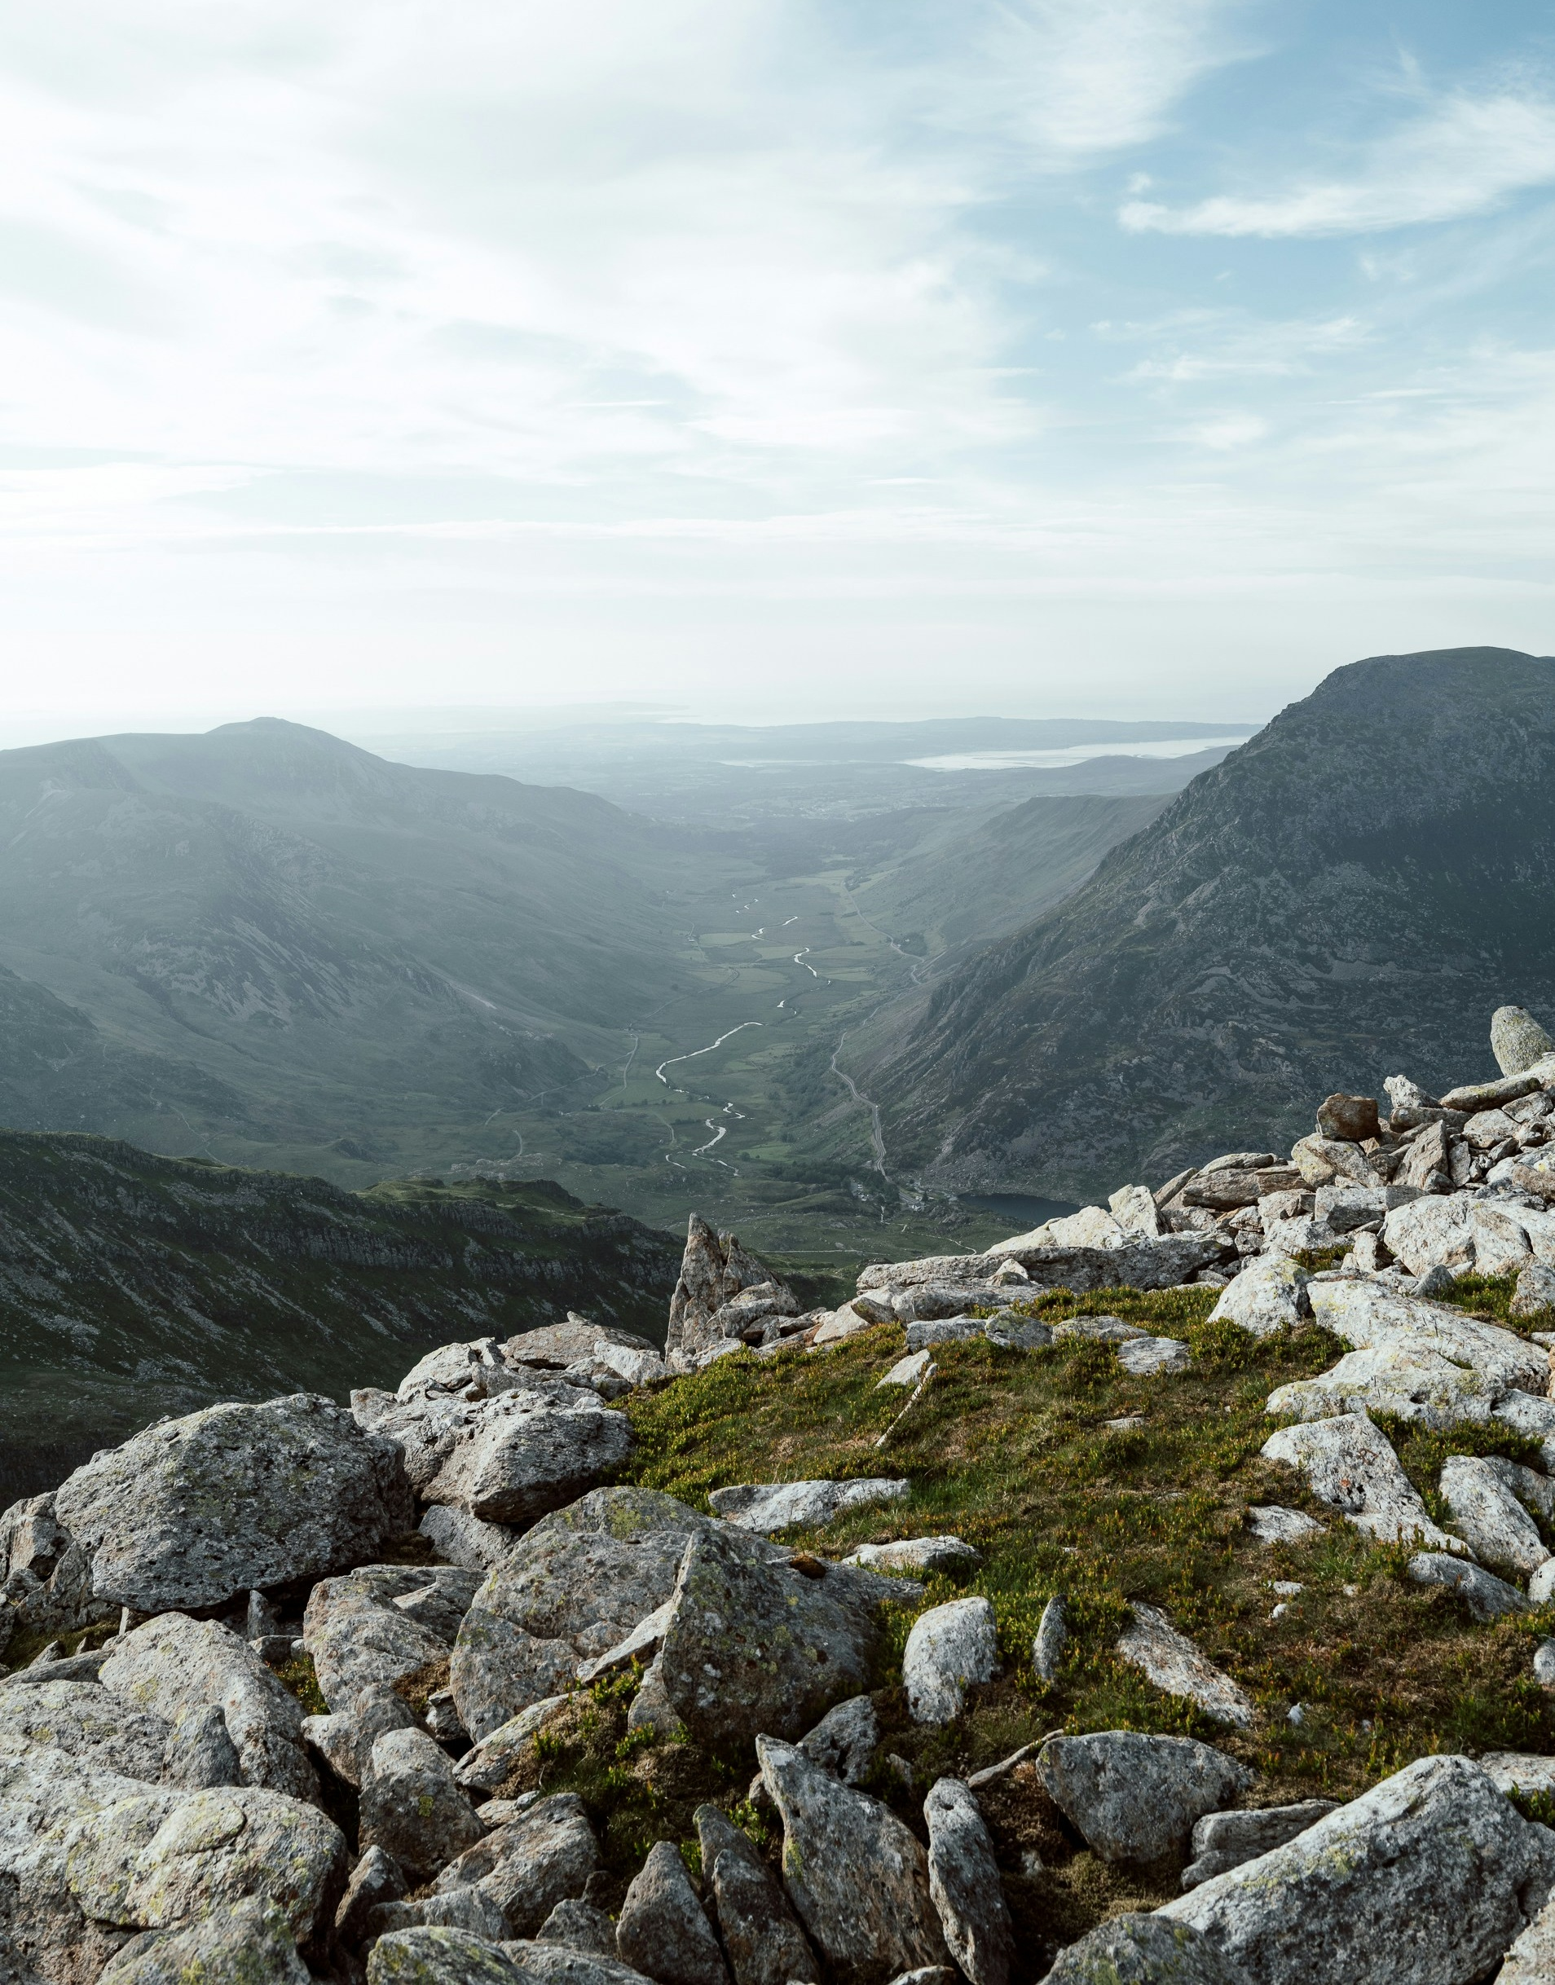
Future likelihood of visiting Wales | Unlikely to visit Wales in 2026
Of those unlikely to visit Wales in 2026 most stated they ‘don’t know’ when they would next visit Wales. A quarter stated they would visit in 2027.
B6. And when are you next likely to visit Wales for a short break or holiday?
Unlikely to visit Wales in 2026 or not sure, n=1,024.

Slide 52

REASONS FOR NOT
TAKING A TRIP

Slide 53

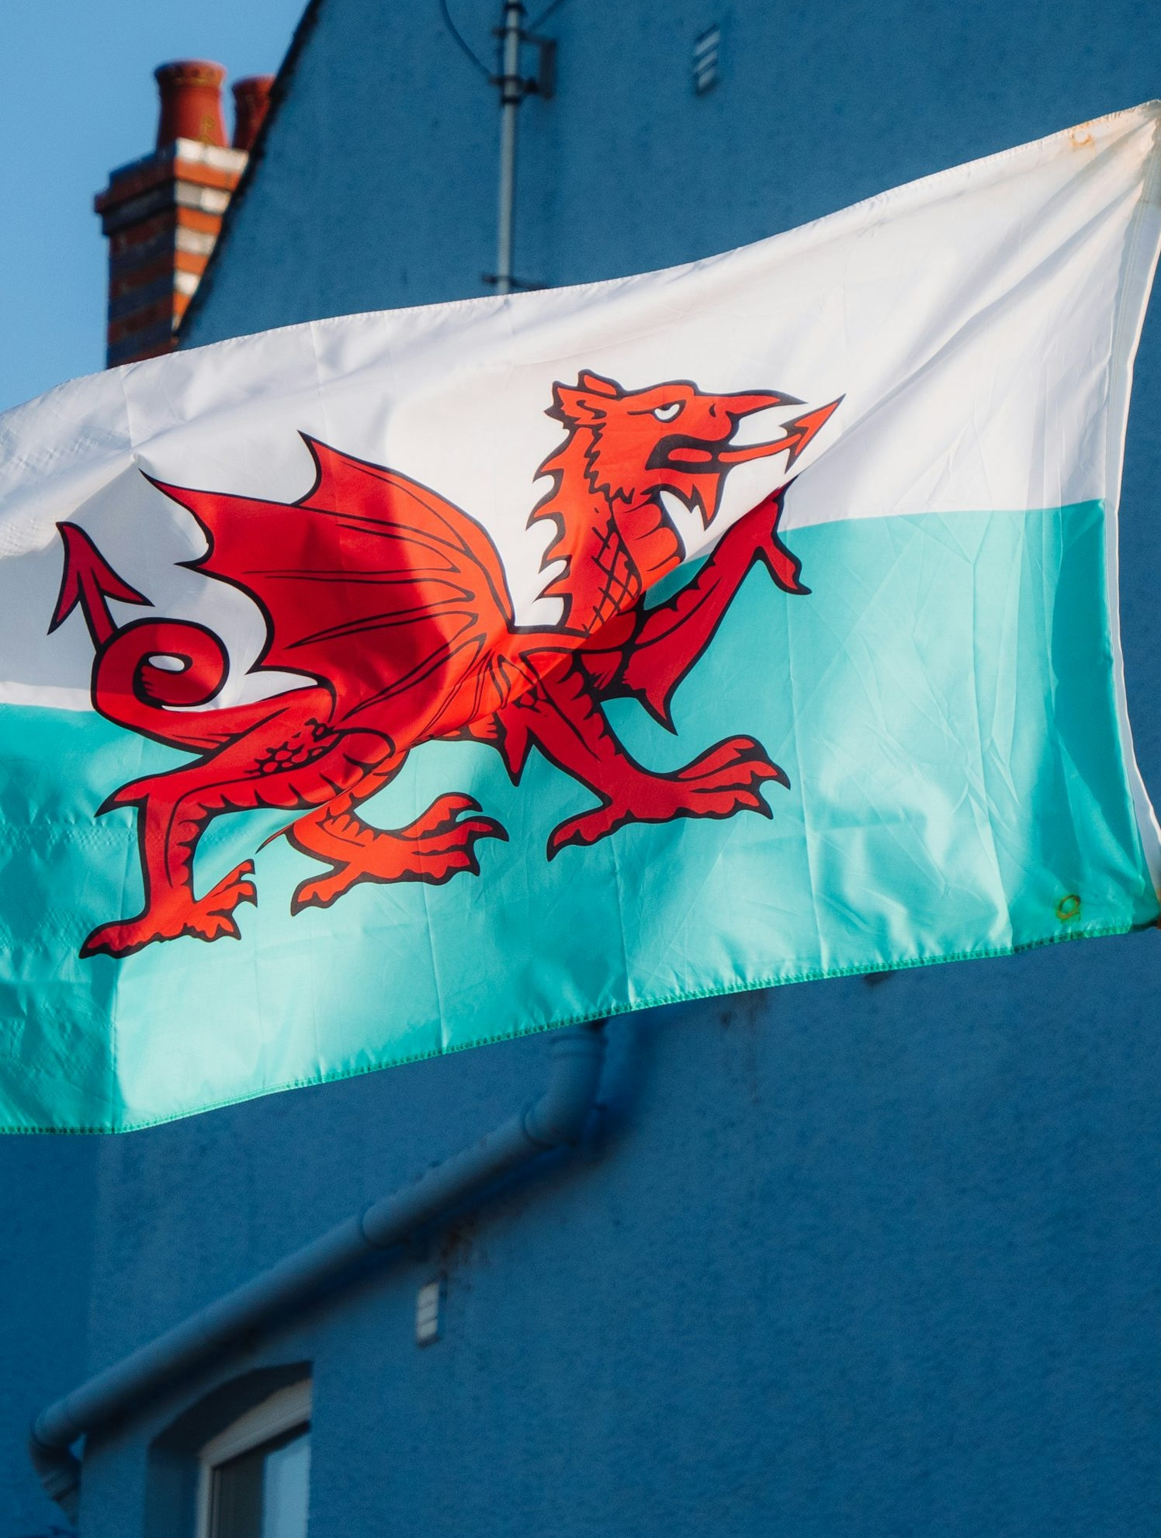

REASONS FOR NOT TAKING A TRIP
Reason for not visiting Wales
Personal circumstances (34%) was reported as the most common reason for not visiting Wales in 2025.
Considering trip to Wales
39% of those who didn’t visit Wales in 2025 did consider an overnight trip.
Of those, most decided to take a trip to another part of Britain or abroad, whilst a third did not take a trip at all.
Destination
Non-Visitors to Wales were most likely to travel to England (78%).
Scotland (19%), Republic of Ireland (3%) and Northern Ireland (3%) were less popular.

Slide 54
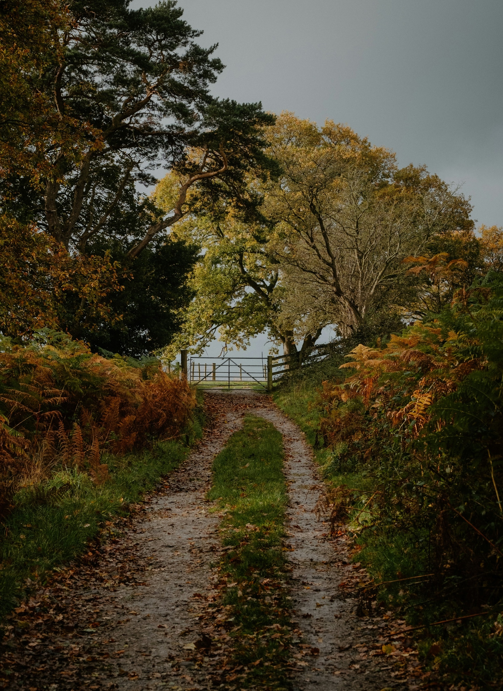
Reasons for not visiting Wales | Wales non-trip takers
In 2025, ‘Personal circumstances’ were the most cited reason for not visiting Wales. 14% took an overseas holiday instead.
B4. What are the reasons that you didn’t visit Wales for a holiday in 2025?
2025 Wales non-trip takers, n=1,684.

Slide 55

Considerers | Wales non-trip takers
39% of those who did not take a trip to Wales in 2025 had considered an overnight trip to Wales in 2025. The largest proportion instead travelled elsewhere in the British Isles or Ireland, whilst just under 3 in 10 opted to go abroad. A further third did not take a trip at all.
Considerers | Wales non-trip takers
39%
of those that didn’t take a trip to Wales were considering an overnight trip in Wales in 2025
B1. You mentioned that you did not take a short break or holiday in Wales during 2025. Were you considering an overnight trip in Wales in 2025 at any stage? B2. And did you go somewhere else for a holiday, or did you not take a holiday at all? 2025 Wales non-trip takers, n=1,684.

Slide 56






Non-visitor alternative trip destinations | Wales non-trip takers
Among non-visitors to Wales who travelled to other parts of Britain and Ireland, England was the most visited destination (78%), with Scotland closest behind (19%).
Note: The prominence of England in these results may reflect the high proportion of respondents residing in England.
B3. And in which of the following areas of the British Isles and Ireland did you go?
Non-visitors to Wales that went elsewhere in the British Isles or Ireland, n=827.

