Slide 1
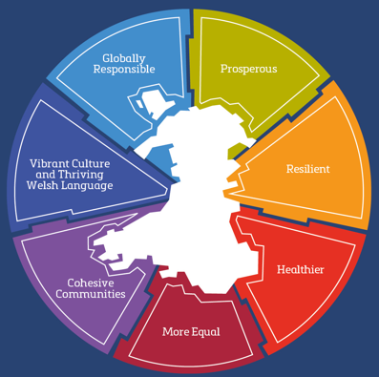
Wellbeing of Wales 2026
Measuring progress towards the national well-being goals
#WellbeingOfWales

Slide 2
These slides summarise some key messages on Wales’ progress towards its 7 wellbeing goals from the
Wellbeing of Wales report for 2026.
For many indicators we would expect change to take a number of years to be seen.
Additionally, not all indicators are updated annually. Some messages will be unchanged from the previous year.
#WellbeingOfWales

Slide 3
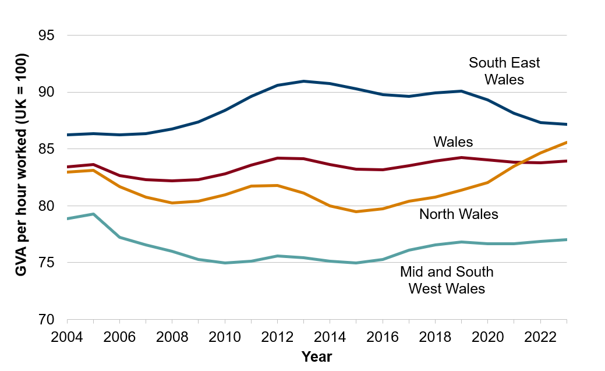

The labour productivity gap measured by gross value added (GVA) per hour worked between Wales and the UK has been relatively stable, with Welsh productivity remaining below the UK average.
Gross value added (GVA) per hour worked, Wales and its regions relative to the UK (UK = 100), 2004 to 2023
National milestone
Note: Chart axis does not start at zero
Source: WG analysis of subregional labour productivity, UK, 2004 to 2023, ONS
#WellbeingOfWales

Slide 4
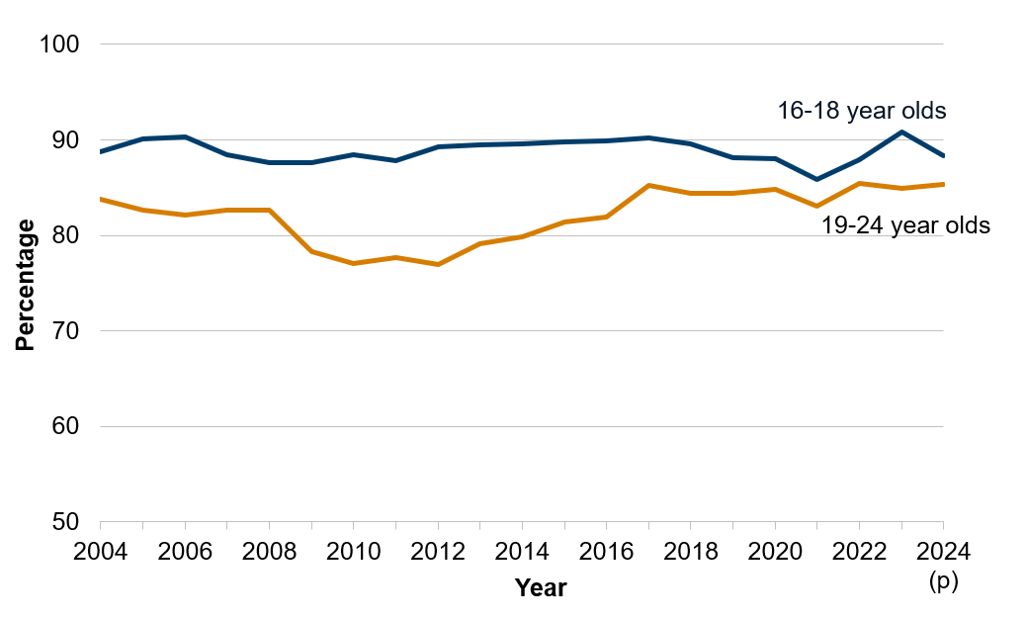
The overall trend in the proportion of 16- to 24-year-olds in Wales who were in education, employment or training has generally increased since 2010 despite some volatility in the data
Percentage of young people in Wales in education, employment or training, 2004 to 2024
Note: Chart axis does not start at zero
National milestone
Source: Annual Population Survey, Office for National Statistics, HESA data
#WellbeingOfWales

Slide 5
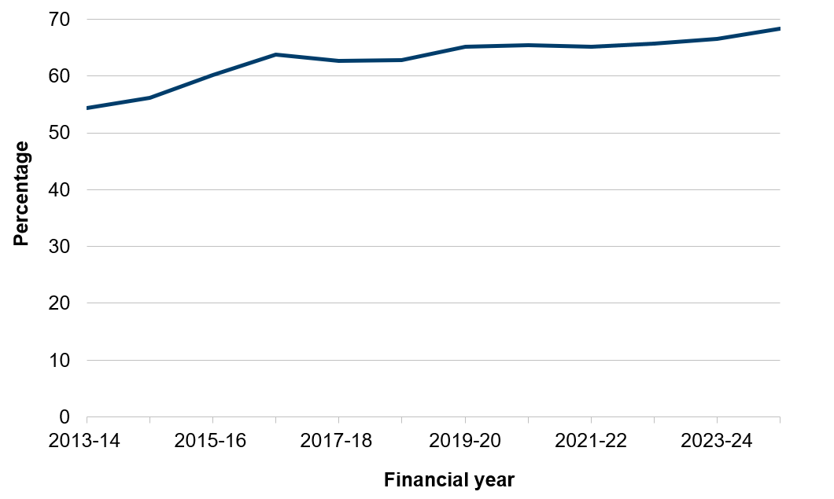
The recycling rate (i.e. the percentage of local authority municipal waste that was reused, recycled or composted) has increased considerably during the last two decades and stands at over two-thirds (68.4%) in 2024 to 2025.
Percentage of waste reused, recycled or composted, financial year 2013 to 2014 to 2024 to 2025
Source: Local Authority Municipal Waste
#WellbeingOfWales

Slide 6
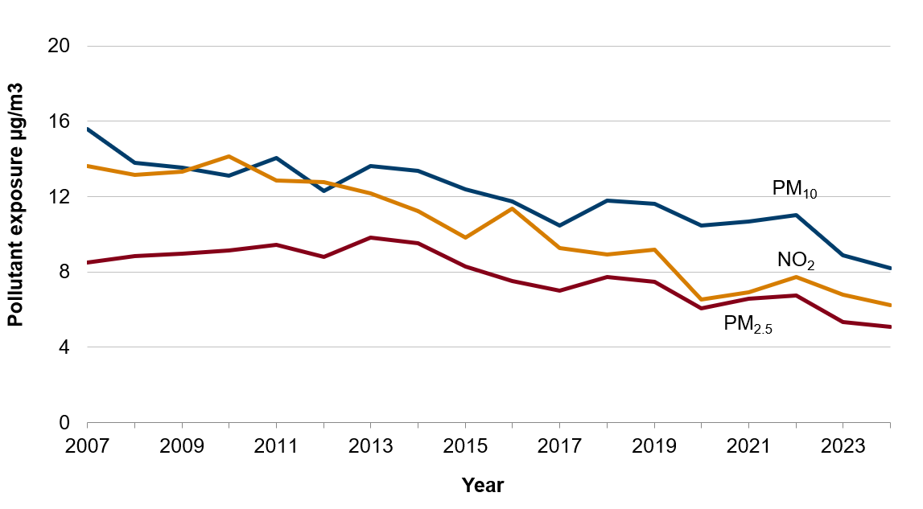
The national indicator on nitrogen dioxide (NO₂) shows that overall, the average concentration levels to which people are exposed has declined over the past decade.
Air quality indicators, 2007 to 2024
Source: Air Quality Emissions Indicators
#WellbeingOfWales

Slide 7
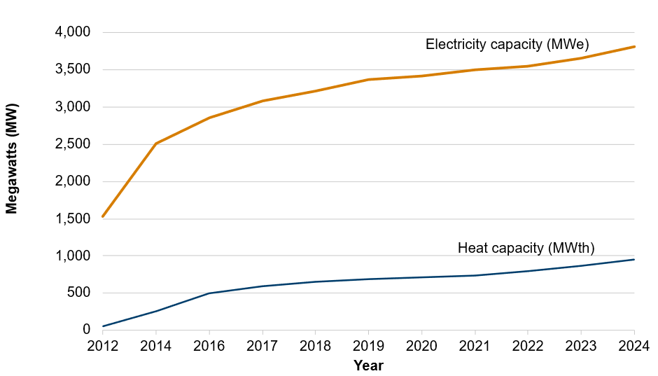
The capacity of renewable energy projects in Wales (electricity and heat) has increased considerably over the last decade, though progress has slowed in recent years.
Renewable energy generation capacity (MW), 2012 to 2024
Source: Energy Generation in Wales report
#WellbeingOfWales

Slide 8
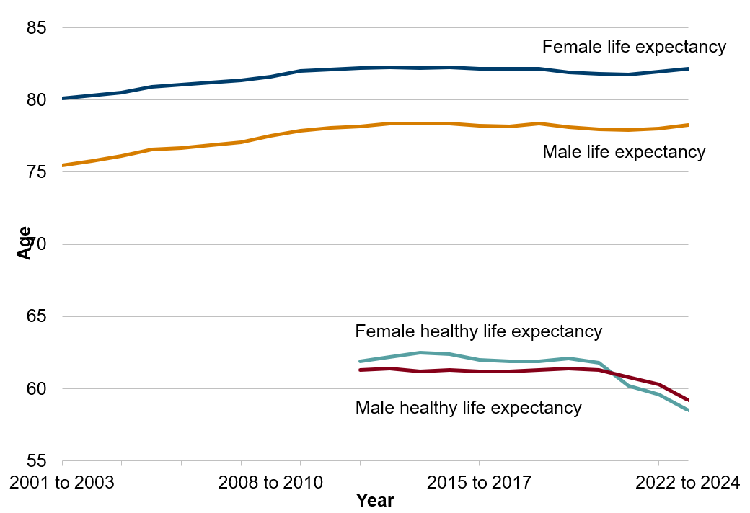
Life expectancy at birth increased in 2022 to 2024, to 82.2 years for females and 78.3 years for males.
Healthy life expectancy at birth decreased to 58.5 years for females and 59.2 years for males, falling for the fourth consecutive period for both women and men.
Life expectancy and healthy life expectancy at birth, by sex, 2001 to 2024
National milestone
Source: Life expectancy and Health state life expectancies, Office for National Statistics
#WellbeingOfWales

Slide 9
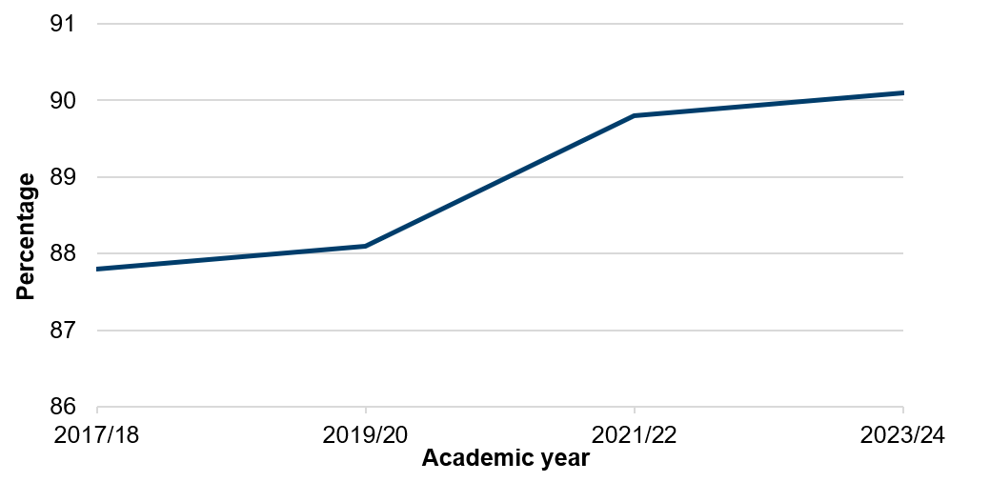
The percentage of young people aged 11 to 16 with 2 or more healthy lifestyle behaviours has improved between 2017/18 and 2023/24.
Percentage of young people aged 11 to 16 with 2 or more healthy lifestyle behaviours, 2017/18 (academic year) to 2023/24
National milestone
Source: School Health Research Network Student Health and Wellbeing Survey
#WellbeingOfWales

Slide 10
Adult mental wellbeing scores and deprivation gaps have remained stable in recent years, though changes in data collection limit long-term trend analysis.
Average Warwick-Edinburgh mental wellbeing scale score for adults, by deprivation, 2016 to 2024
National milestone
Source: National Survey for Wales, Welsh Government
#WellbeingOfWales

Slide 11
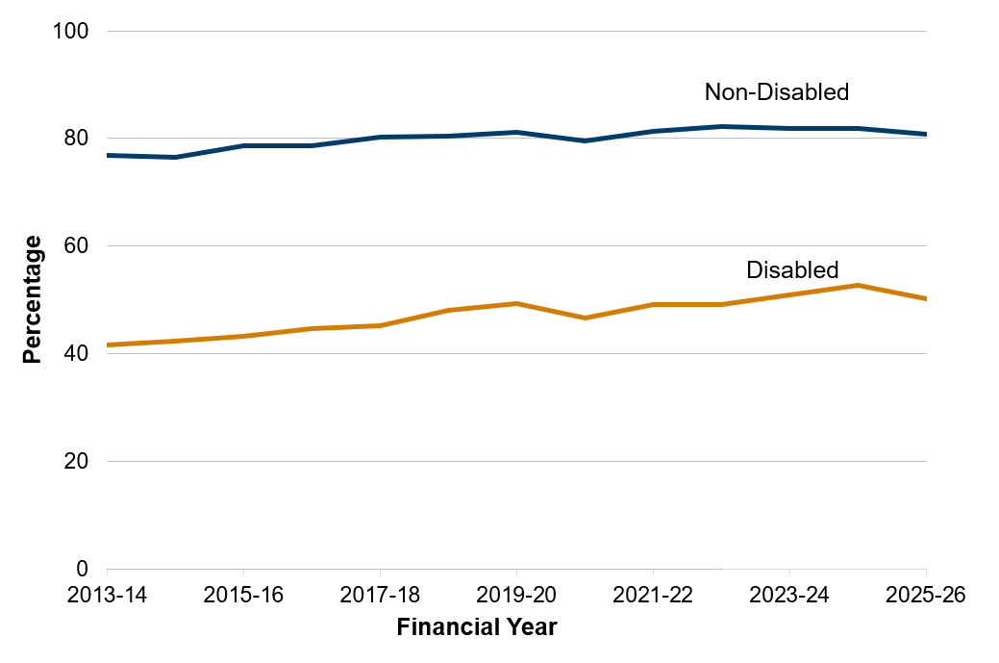
For the year ending 31 March 2026, the employment rate among disabled people aged 16 to 64 in Wales was 50.3% whilst the rate for people who are not disabled was 80.8%. The employment rate gap for disabled people in 2025 to 2026, of 30.5 percentage points, has reduced from 35.4 percentage points in 2015 to 2016.
Employment rate (percentage of population aged 16 to 64) of disabled and non-disabled people in Wales by year, 2013 to 2026 (rates for year ending March)
National milestone
Source: Welsh Government analysis of the Annual Population Survey, Office for National Statistics
#WellbeingOfWales

Slide 12
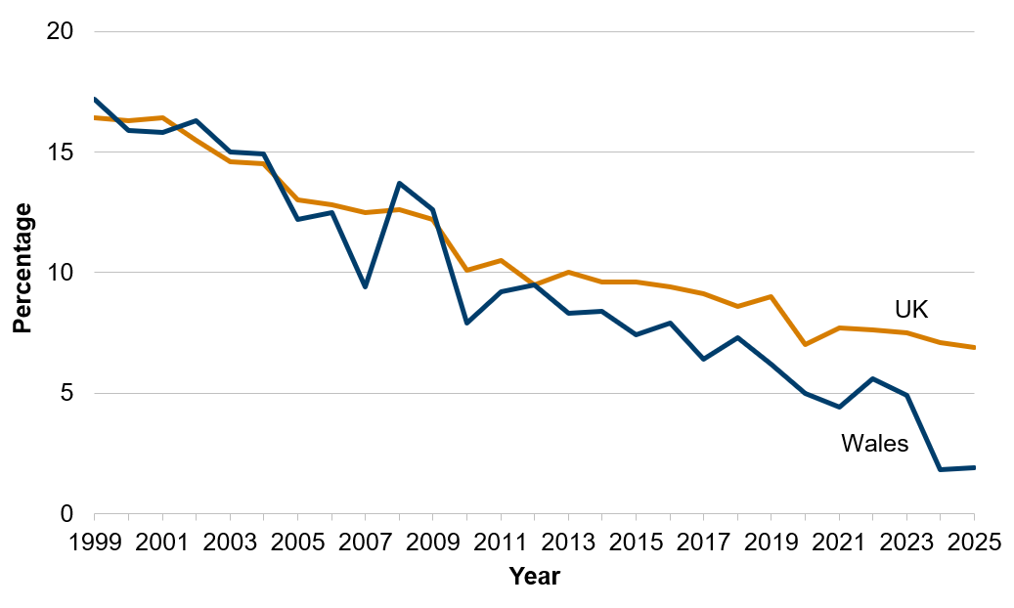
The full-time gender pay gap in Wales has decreased over the last 20 years for both Wales and the UK. Wales has had a narrower gender pay gap than the UK since 2013.
Percentage difference in median hourly full-time earnings between men and women, 1999 to 2025
National milestone
Note: A pay difference greater than zero means men’s earnings are higher than women’s.
Source: Welsh Government Analysis of the Annual Survey of Hours and Earnings, ONS
#WellbeingOfWales

Slide 13
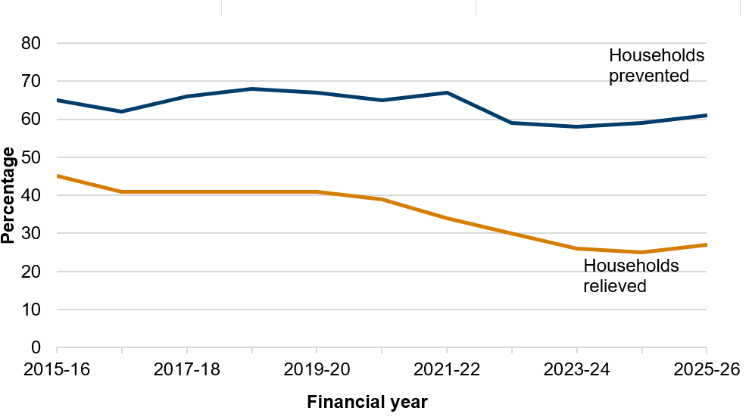
The percentage of households prevented from homelessness has remained fairly stable in recent years following a drop in financial year 2022 to 2023.
The percentage of households relieved from homelessness fell between April 2020 and March 2025 but has increased slightly in the latest year
Percentage of households successfully prevented and relieved from homelessness, 2015 to 2026 (year ending March)
Source: Statutory Homelessness: Key Indicators
#WellbeingOfWales

Slide 14
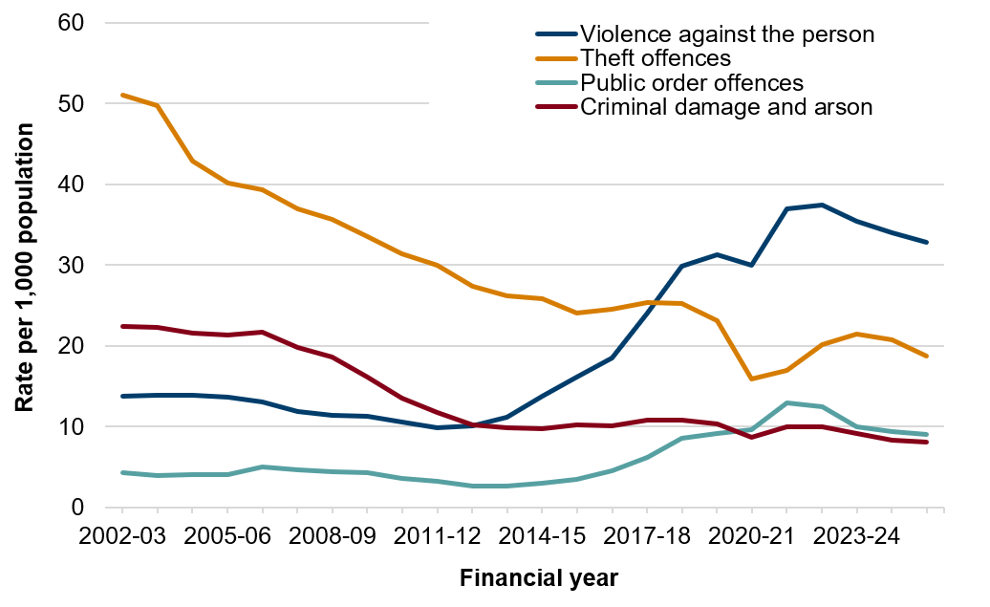
Police recorded crime in Wales (excluding fraud) decreased by 3% in financial year 2025 to 2026 compared with the previous year. Violence against the person decreased by 2%, although the rate per 1,000 of the population remains considerably higher than a decade ago
Police recorded crime per 1,000 population, 2002 to 2026 (year ending March)
Source: Home Office - Police recorded crime
#WellbeingOfWales

Slide 15
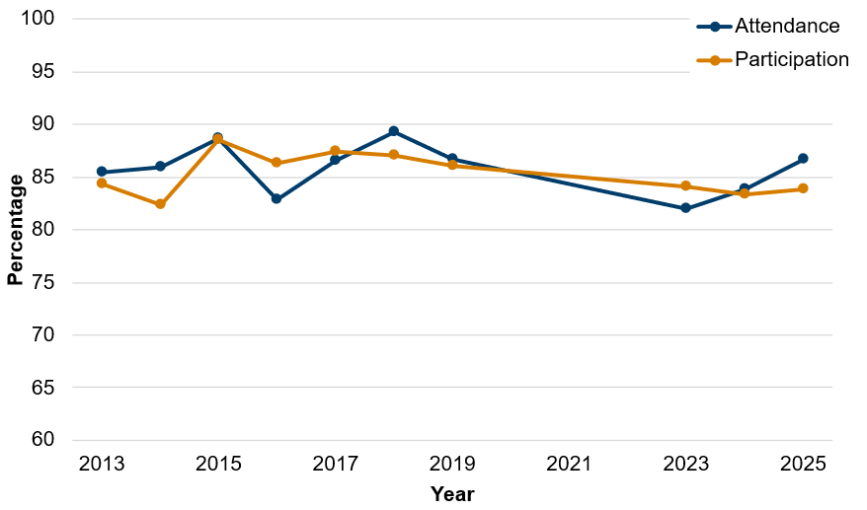
Arts attendance among children increased to 87% in 2025. This is the same level as in 2019, before the COVID-19 pandemic. Children’s participation in the arts has been fairly stable in recent years. In 2025, 84% of children participated in at least one art form.
Children attending or participating in the arts at least once a year, 2013 to 2025
Note: The y-axis does not start at zero
Source: Arts Council of Wales
#WellbeingOfWales

Slide 16
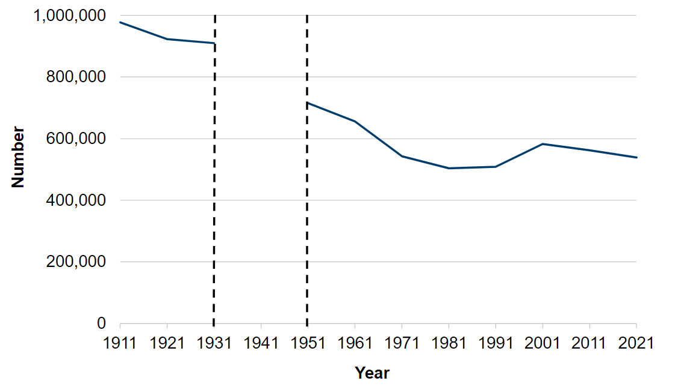

According to Census 2021, 17.8% of people aged three years or older in Wales can speak Welsh, down from 19% in 2011. The decrease in both the number and percentage was mainly driven by a fall among children and young people who were reported as being able to speak Welsh.
People aged three years and older able to speak Welsh, 1911 to 2021
Note: There was no census in 1941.
Source: Census of Population
#WellbeingOfWales

Slide 17
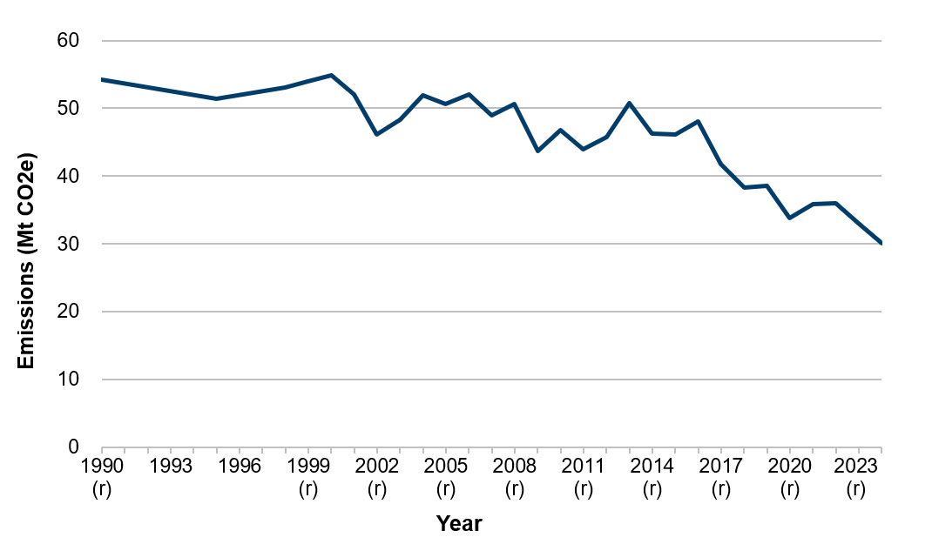
Greenhouse gas emissions have fallen 44% since the base year. The largest source is the industry sector, which produces an estimated 22% of all greenhouse gas emissions in Wales.
Emissions of greenhouse gases, 1990 - 2024
National milestone
[Note 1]: previously published figures for all years up to 2023 have been revised and marked with (r). No data is published for 1991 to 1994, 1996 and 1997.
Source: National Atmospheric Emissions Inventory
#WellbeingOfWales

Slide 18
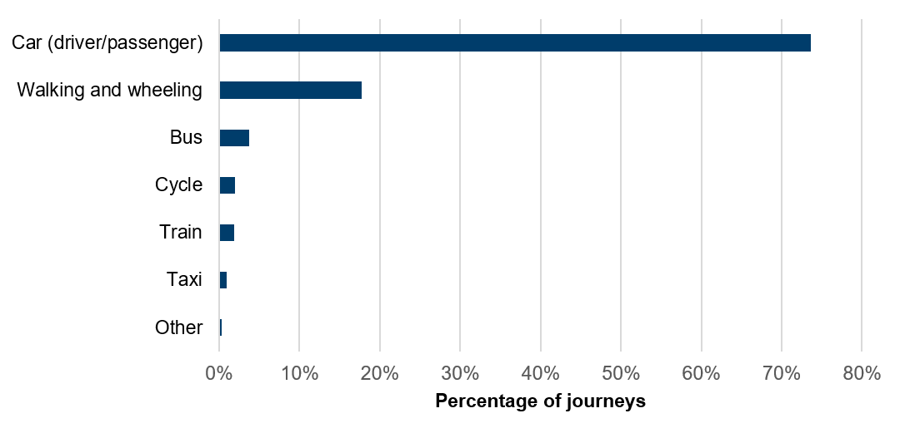
Provisional results from the first six 6 months of the Wales national travel survey (March to August 2025) estimate that 17.7% of journeys were made by walking or wheeling and 2.0% by cycle. Together, active travel modes accounted for 19.6% of journeys in Wales.
Share of journeys per person per year by main mode of travel, 2025
Note: percentages have been calculated excluding respondents who selected “Don’t know” or “Prefer not to say” when answering what mode of travel they used.
Source: Wales national travel survey headline results, Transport for Wales
#WellbeingOfWales

Slide 19

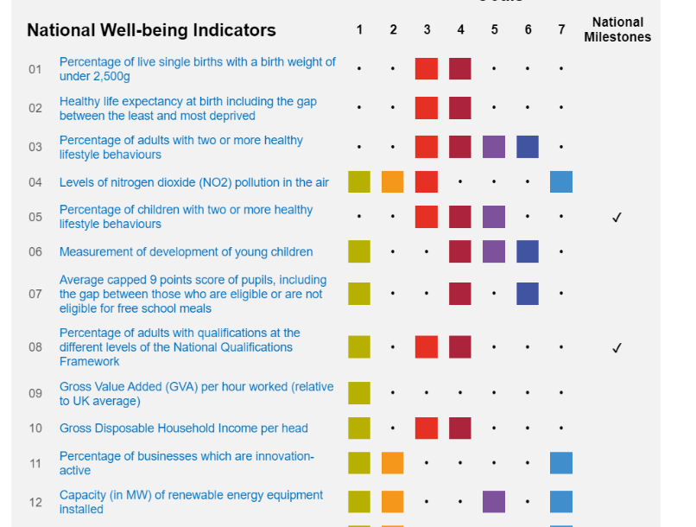
The Well-being of Wales report includes…
Reports on our national progress towards each of the well-being goals
Data for the 50 national indicators
#WellbeingOfWales

Slide 20
Where can you find the Well-being of Wales report?
Well-being of Wales report:
https://gov.wales/wellbeing-wales
National indicators:
https://gov.wales/wellbeing-wales-national-indicators
#WellbeingOfWales

Slide 21
Contact us
@StatisticsWales
stats.info.desk@gov.wales
#WellbeingOfWales

